Slide 1
Consumer Shopping Behaviour Analysis
An end-to-end data analytics case study using Python, PostgreSQL, and Power BI
Python
PostgreSQL
Power BI
DATA ANALYTICS PROJECT REPORT

Slide 2
OVERVIEW
Executive Summary
3,900+
$59.76
3.75/5.0
10
Customer
Records
Avg. Purchase
Amount (USD)
Avg. Review
Rating
Business SQL
Queries
THREE-PHASE ANALYTICAL PIPELINE
01
02
03
Python EDA
PostgreSQL
Power BI Dashboard
Data ingestion, quality auditing, null imputation, feature engineering (age_group, purchase_frequency_days), SQLAlchemy load.
10 structured business queries using aggregations, correlated subqueries, CTEs, window functions, and conditional aggregation.
KPI cards, 5 interactive charts, 4 cross-filter slicers — stakeholder-ready, no SQL/Python required.
KEY FINDINGS
2.1× gender revenue gap — Male $157,890 vs Female $75,191 — unexplained by category mix alone
72% of repeat buyers (>5 purchases) hold no subscription — 2,518 pre-qualified conversion leads
Near-50% discount rates on Hat, Sneakers, and Coat signal margin erosion risk requiring A/B testing
2

Slide 3
NAVIGATION
Presentation Agenda
01
Dataset & Objectives
06
Customer Loyalty & Segmentation
3,900+ records · 6 analytical dimensions · dual objectives
79% loyal base · 72% unsubscribed repeat buyers · segments
02
Python EDA & Data Preparation
07
Power BI Dashboard
Null audit · imputation · feature engineering · SQLAlchemy load
KPI cards · 5 charts · 4 slicers · self-serve analytics
03
PostgreSQL Business Queries
08
Business Recommendations
10 queries · revenue, products, discounts, loyalty, shipping
6 prioritised actions · HIGH / MEDIUM / LOW impact
04
Revenue & Demographics Analysis
09
Conclusion & Deliverables
Gender gap · subscription impact · age group contribution
Technical proficiency · project files · extensibility
05
Product & Discount Insights
Top-rated products · discount concentration · basket analysis
3

Slide 4
01
Dataset & Objectives
19 features · 3,900+ records · 6 analytical dimensions

Slide 5
DATASET
Dataset Overview & Feature Set
FEATURE CATEGORIES
3,900+
Customer Demographics
Total Records
age, gender, location, age_group (engineered)
19
Transaction Details
Feature Columns
purchase_amount, payment_method, discount_applied, shipping_type, season
2
Product Information
Engineered Features
item_purchased, category, color, size, review_rating
1
Loyalty & Behaviour
Null Column (review_rating)
subscription_status, previous_purchases, frequency_of_purchases, purchase_frequency_days (eng.)
Note: promo_code_used dropped — 100% identical to discount_applied (confirmed via Boolean equality check).
5

Slide 6
02
Python EDA & Data Preparation
Ingestion · Cleaning · Feature Engineering · Database Load

Slide 7
PYTHON EDA
Data Cleaning & Feature Engineering
Step 01 | Initial Audit
ENGINEERED FEATURES
df.info(), .describe() confirmed 3,900 × 18 shape. Only review_rating had nulls.
age_group
pd.qcut(df['age'], q=4) — Quantile-based banding ensures equal-frequency groups, making inter-group comparisons statistically balanced.
Step 02 | Null Imputation
Category-median imputation on review_rating — preserves group-level distributions without distorting the overall mean.
Young Adult
Adult
Middle-aged
Senior
Step 03 | Column Standardisation
purchase_frequency_days
All headers lowercased, whitespace stripped, spaces → underscores. purchase_amount_(usd) renamed.
Maps categorical frequency labels to integer day counts, enabling numerical analysis and future predictive modelling.
Weekly → 7d
Bi-Weekly → 14d
Monthly → 30d
Step 04 | Redundant Feature Removal
Quarterly → 90d
Annually → 365d
promo_code_used confirmed 100% duplicate of discount_applied using .all() check. Dropped.
Database Load → df.to_sql('customer', engine, if_exists='replace') via SQLAlchemy · Automated ETL ensures Python & SQL layers are perfectly in sync
7

Slide 8
03
PostgreSQL Business Querying
10 queries · 7 SQL techniques · pgAdmin 4

Slide 9
SQL ANALYSIS
10 Business Queries — Techniques & Coverage
Q1
Revenue by Gender
Q2
Discounters Above Avg Spend
SUM / GROUP BY
Correlated Subquery
Q3
Top 5 Products by Rating
Q4
Avg Spend by Shipping Type
AVG / ORDER BY / LIMIT
ROUND / AVG / WHERE
Q5
Subscription vs. Revenue
Q6
Discount Rate by Product
COUNT / SUM / AVG
CASE WHEN / Cond. Agg.
Q7
Customer Segmentation
Q8
Top Products per Category
CTE + CASE WHEN
CTE + ROW_NUMBER()
Q9
Repeat Buyers & Subscriptions
Q10
Revenue by Age Group
WHERE / GROUP BY / COUNT
SUM / GROUP BY / ORDER BY
Revenue
Discount
Product
Shipping
Loyalty
Demographics
9

Slide 10
FINDINGS · REVENUE
Revenue Analysis
KEY INSIGHT
KEY INSIGHT
2.1× Gender Gap
Young Adults Lead
Male revenue ($157,890) is 2.1× female ($75,191). In clothing/accessories — where female demand typically exceeds male — this 52% revenue shortfall points to acquisition funnel underrepresentation or product-segment misalignment.
Young Adults generated $62,143 — the highest of four age bands. Notably all four groups fall within a $6,380 range, confirming broad cross-generational product appeal. Young Adult lead is notable given price-sensitivity of this cohort.
10

Slide 11
FINDINGS · LOYALTY
Subscription Impact Analysis
2,847
Non-Subscribers
73% of customer base
$0.38
Spend Difference
Subscribers vs Non-subscribers per transaction
2,518
Repeat Non-Subscribers
72% of >5-purchase customers hold no subscription
Q9 Finding: Among customers with >5 purchases, 72% (2,518) hold no subscription — the highest-priority conversion audience in the entire dataset.
STRATEGIC IMPLICATION
Subscription does not drive higher per-visit spend ($0.38 difference). Its value is retention & frequency. Target the 2,518 pre-qualified repeat buyers with exclusive benefits (free shipping, early access, loyalty points).
11

Slide 12
FINDINGS · PRODUCT & DISCOUNT
Product Performance & Discount Analysis
Quality Leaders Are Accessories & Footwear
839 Discount Users Spent Above Average
Basket Expansion Opportunity
Top 5 rated items (Gloves 3.86, Sandals 3.84, Boots 3.82, Hat 3.80, Skirt 3.78) — narrow range signals consistently high satisfaction. Prioritise in homepage hero & email campaigns.
Q2: 839 customers applied a discount and still spent ≥ $59.76 (dataset average). Discounts function as conversion accelerators, not margin eroders — but near-50% rates on 5 SKUs need A/B testing.
Q8: Jewelry (171 orders) leads Accessories; Blouse & Pants (171 each) lead Clothing. Bundling high-volume accessories with top clothing items is an untested basket-expansion lever.
12

Slide 13
FINDINGS · SEGMENTATION
Customer Loyalty & Segmentation
LOYAL
RETURNING
NEW
79%
18%
2%
3,116
701
83
customers · > 10 purchases
customers · 2–10 purchases
customers · 1 purchase only
Q4 — Shipping Behaviour Insight
ACQUISITION RISK
Express shipping customers spend $2.02 more on average ($60.48 vs $58.46 Standard). This self-selection effect — willingness to pay for speed correlates with higher basket values — supports a checkout-stage upsell nudge offering Express shipping above a minimum basket threshold (e.g., 'Upgrade to Express for orders over $75').
Only 83 customers (2%) are classified as New. While a 79% Loyal base is commercially strong, extreme dependence on existing customers without new acquisition inflow creates long-term growth risk.
A new customer acquisition strategy is as critical as loyalty retention — the current base will naturally attrite without replenishment.
13

Slide 14
04
Power BI Dashboard
Dashboard · KPI Cards · 5 Charts · 4 Cross-Filter Slicers · Self-Serve Analytics

Slide 15
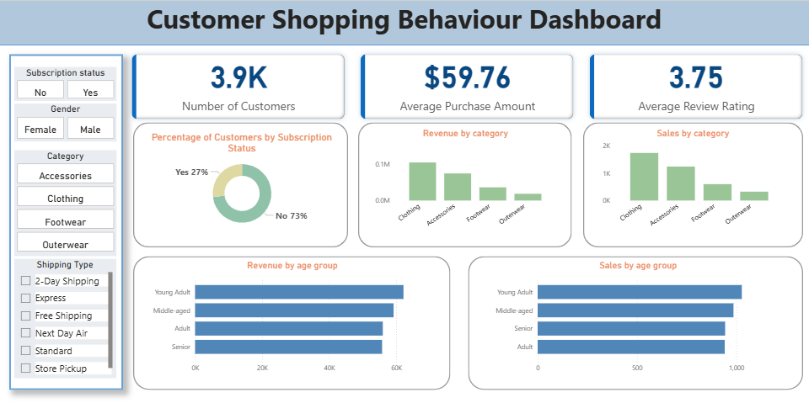
POWER BI
Interactive Dashboard Architecture
Sales Volume by Category
Horizontal Bar
15

Slide 16
POWER BI
Interactive Dashboard Architecture
KPI SUMMARY CARDS
3.9K
$59.76
3.75
Number of Customers
Avg. Purchase Amount
Avg. Review Rating (/ 5.0)
CHART COMPONENTS
Subscription Status Split
Doughnut Chart
Revenue by Age Group
Horizontal Bar
73% non-subscriber vs 27% subscriber — loyalty penetration gap
Young Adults lead ($62K); all groups within $6.4K range
Revenue by Category
Vertical Bar
Sales Volume by Age Group
Horizontal Bar
Clothing leads; Outerwear trails — guides category investment
Young Adults lead order count; Senior slightly below Adult
Sales Volume by Category
Vertical Bar
Validates demand concentration; consistent with revenue ranking
INTERACTIVE SLICERS
Subscription Status (Yes/No)
Gender (Female/Male)
Category (4 options)
Shipping Type (6 options)
16

Slide 17
05
Business Recommendations
6 Prioritised Actions Directly Traceable to Query Outputs

Slide 18
RECOMMENDATIONS
6 Data-Backed Business Recommendations
HIGH
#1 Loyalty → Subscription
MED
#4 Young Adult Retention
Finding: 72% of >5-purchase customers (2,518) are non-subscribers
Finding: Young Adults are the top revenue-generating segment at $62,143
Launch targeted subscription conversion campaign with exclusive benefits: free shipping thresholds, early sale access, loyalty points.
Strengthen retention via mobile-first UX, early access to sale events, and personalised re-engagement journeys.
HIGH
#2 Discount Optimisation
LOW
#5 Express Shipping Upsell
Finding: Hat (50%), Sneakers & Coat (49%) carry near-50% discount rates
Finding: Express buyers spend $2.02 more on average than Standard buyers
A/B test reduced discount depths on top-frequency items. Monitor conversion rate at 20%, 30%, and current levels.
Add checkout-stage upsell nudge tied to minimum basket value (e.g., 'Upgrade to Express for orders over $75').
MED
#3 Female Acquisition
LOW
#6 Top-Rated Amplification
Finding: Female revenue ($75,191) is 52% lower than male ($157,890)
Finding: Gloves (3.86), Sandals (3.84), Boots (3.82) lead on review rating
Invest in gender-targeted digital campaigns, female-skewed influencer partnerships, and personalised recommendation engines.
Feature in homepage hero sections, email headers, and as anchor items in cross-category product bundles.
18

Slide 19
06
Conclusion & Project Deliverables
End-to-End Analytical Pipeline · Reproducible · Extensible

Slide 20
CONCLUSION
Conclusion & Project Deliverables
THREE MOST COMMERCIALLY SIGNIFICANT FINDINGS
1
2
3
72% Repeat Buyers Are Non-Subscribers
2.1× Unexplained Gender Revenue Gap
Near-50% Discount Rates on 5 Major SKUs
2,518 pre-qualified, high-intent customers have demonstrated loyalty without any subscription incentive — the highest-ROI conversion target in the dataset.
Male ($157,890) vs Female ($75,191) in a product mix where female demand typically dominates — signals acquisition funnel or personalisation failure.
Hat, Sneakers, Coat, Sweater, and Pants each show 47–50% discount rates. Full-price purchasing is no longer the norm — margin erosion risk is immediate.
TECHNICAL PROFICIENCY DEMONSTRATED
Python
PostgreSQL
Power BI
Pandas · SQLAlchemy · pd.qcut · group-median imputation
Aggregation · Correlated Subqueries · CTEs · Window Functions · Conditional Aggregation
KPI Cards · Multi-chart Dashboards · Cross-filter Slicers
PROJECT DELIVERABLES
.ipynb Python Notebook — EDA, cleaning, feature engineering, SQLAlchemy load
.sql PostgreSQL Script — 10 annotated business queries with full output comments
.pbix Power BI Dashboard — Interactive KPIs, 5 charts, 4 cross-filter slicers
.docx Project Report — Full methodology, findings, recommendations, and tables
20

Slide 21
Thank You
Consumer Shopping Behaviour Analysis

