Slide 1
PSCS46 - Diagnosis of Acute Diseases Using AI ( RogiDoot )
PIP2001 Capstone Project
Review-1
Batch Number: CBC-08
Roll Number | Student Name
20211CBC0045 | Sukarna Jana
20221LBC0002 | Maneesh G
20211CBC0051 | Yash Kumar Singh
20211CBC0028 | Sha Aiyan Mehdi
20211CBC0024 | Penukonda Bharath Kumar
Under the Supervision of,
Ms. SUMA N G
Assistant Professor
School of Computer Science and Engineering
Presidency University
Name of the Program: Bachelor of Technology
Name of the HoD: Dr. S. Pravinth Raja
Name of the Program Project Coordinator: Ms. SUMA N G
Name of the School Project Coordinators: Dr. Abdul Khadar A

Slide 2
Introduction
Overview:
Organization: Max Healthcare
Objective: Addressing the shortage of doctors in smaller towns and villages through innovative technology.
Solution: Development of the RogiDoot App, an AI-powered telemedicine platform integrated with IoT devices.
Key Features:
AI-driven health diagnostics for common acute diseases.
Integration with IoT devices for real-time health monitoring.
Multi-language support catering to diverse Indian populations.
Significance:
Enhancing healthcare accessibility and efficiency in underserved areas.
Empowering users with personalized health data and insights.

Slide 3
Literature Review
AI in Infectious Disease:
Cheng et al. (2023) discuss the potential applications of AI, using ChatGPT as a model for diagnosing infectious diseases, highlighting its scalability in rural healthcare settings.
Systematic Review on AI Diagnostics:
Kumar et al. (2023) provide a comprehensive review of AI's role in disease diagnosis, identifying frameworks that can guide future telemedicine innovations, particularly in underserved areas.
Wearable Health Devices:
Pawar et al. (2024) present the development of an ESP32-based health monitoring device, demonstrating its efficacy in real-time patient data collection, which is essential for the RogiDoot App.
Open-Source Health Monitoring:
Ashraf et al. (2023) outline the design and implementation of an IoT-based health monitoring system, emphasizing the importance of accessibility and affordability in health tech solutions.

Slide 4
Literature Review
IoT Applications in Patient Monitoring:
Purwitosari et al. (2023) focus on IoT-enabled systems for patient monitoring, showcasing various metrics (SpO2, BPM, body temperature) crucial for comprehensive health assessments.
Mobile Health Applications:
Alruwaili et al. (2023) explore the integration of IoT in mobile applications, emphasizing user-friendly interfaces and secure data management, relevant to the RogiDoot App's design.
AI and Language Models:
Gupta et al. (2024) investigate the use of large language models in diagnosing common illnesses, supporting the rationale for incorporating AI into the RogiDoot App for enhanced accuracy.
Conclusion:
The literature indicates a growing trend toward AI and IoT integration in healthcare, providing a strong foundation for the development of the RogiDoot App to address healthcare accessibility challenges in India.

Slide 5
Existing method Drawback
1. Traditional Healthcare Delivery:
Drawback: Limited access in rural areas due to a shortage of doctors, leading to delayed diagnoses and treatment.
2. Telemedicine Solutions:
Drawback: Many telemedicine platforms struggle with scalability and user engagement, often requiring high-speed internet and technical literacy, which may not be available in smaller towns.
3. Static Health Monitoring Devices:
Drawback: Devices that provide limited metrics (e.g., only blood pressure or heart rate) do not offer a comprehensive view of a patient’s health status, missing critical insights.
4. Generic Health Apps:
Drawback: Many existing health apps lack personalization and do not consider the user's cultural context or language preferences, reducing their effectiveness.
5. Inconsistent Data Integration:
Drawback: Poor integration between various health monitoring devices and applications can lead to fragmented health data, complicating accurate diagnosis and treatment.
6. High Cost of Healthcare Technologies:
Drawback: Many advanced healthcare technologies are prohibitively expensive for users in rural areas, limiting their accessibility.

Slide 6
Proposed Method
1. Integrated AI Diagnostics:
Custom Large Language Model (LLM): Utilizes AI to analyze user input and provide accurate diagnoses for common acute diseases, enhancing accessibility to medical advice.
2. IoT Health Monitoring:
ESP32 Microcontroller: Collects real-time health data (heart rate, oxygen levels, body temperature, etc.) using integrated sensors, ensuring comprehensive monitoring of user health.
3. User-Friendly Mobile Application:
Flutter Framework: Creates an intuitive interface for seamless interaction, available in multiple Indian languages to cater to diverse populations.
4. Multi-Step User Interaction:
Step-by-Step Process:
Language Selection: Initial setup to enhance user experience.
User Login: Secure authentication for data management.
Member Management: Allows users to add family members for comprehensive health tracking.
Emergency Services: Quickly identifies nearby hospitals and ambulance services using GPS.
Health Assessments: Conducts MCQ-based evaluations for preliminary diagnosis.
Data Integration: Connects to nearby RogiDoot devices via Bluetooth for enhanced data accuracy.

Slide 7
Proposed Method
5. Dynamic Report Generation:
Comprehensive Health Reports: Combines AI diagnostics with IoT data to generate detailed health reports for user convenience and consultation with healthcare providers.
6. Data Security Measures:
End-to-End Encryption: Ensures the secure transmission of sensitive health data between devices and the mobile application.
Conclusion:
The RogiDoot App addresses existing healthcare challenges by combining AI diagnostics, real-time health monitoring, and user-friendly technology, making healthcare more accessible and efficient for underserved populations.

Slide 8
Objectives
Enhance Accessibility: Provide healthcare support to rural and underserved areas through the RogiDoot App.
AI Diagnostics: Utilize a custom Large Language Model for accurate preliminary diagnoses of common diseases.
Real-Time Monitoring: Integrate IoT devices for continuous tracking of key health metrics.
Emergency Support: Quickly identify nearby hospitals and ambulance services in emergencies.
Multi-Language Support: Ensure usability with multiple Indian languages.
User Engagement: Create an intuitive interface to encourage active health management.
Data Security: Implement end-to-end encryption to protect user data.
Comprehensive Reports: Generate detailed health reports for user and provider consultations.

Slide 9
Methodology/Modules
1. User Interface Module:
Flutter Framework: Develops a responsive and intuitive mobile application interface for seamless user interaction.
2. Authentication Module:
Firebase Authentication: Ensures secure user login and management of personal and family health data.
3. Health Monitoring Module:
IoT Integration: Utilizes ESP32 microcontroller and sensors to collect real-time health data (heart rate, oxygen levels, temperature).
4. AI Diagnostics Module:
Custom LLM: Analyzes user input and generates preliminary diagnoses for common acute illnesses based on predefined questions.
5. Emergency Services Module:
GPS Functionality: Identifies nearby hospitals and ambulance services during emergencies for quick access.
6. Data Management Module:
Firebase Firestore: Stores user data, health reports, and app settings securely in a cloud-based NoSQL database.
7. Reporting Module:
Dynamic Report Generation: Combines AI diagnostics and IoT data to create detailed health reports for users.
8. Security Module:
End-to-End Encryption: Protects sensitive health data during transmission between devices and the mobile application.

Slide 10
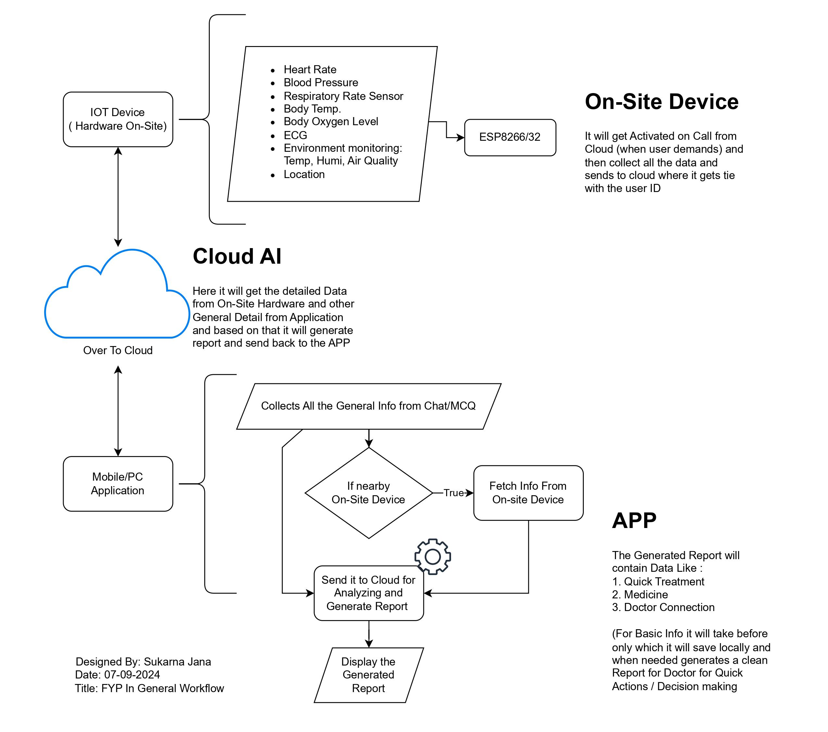
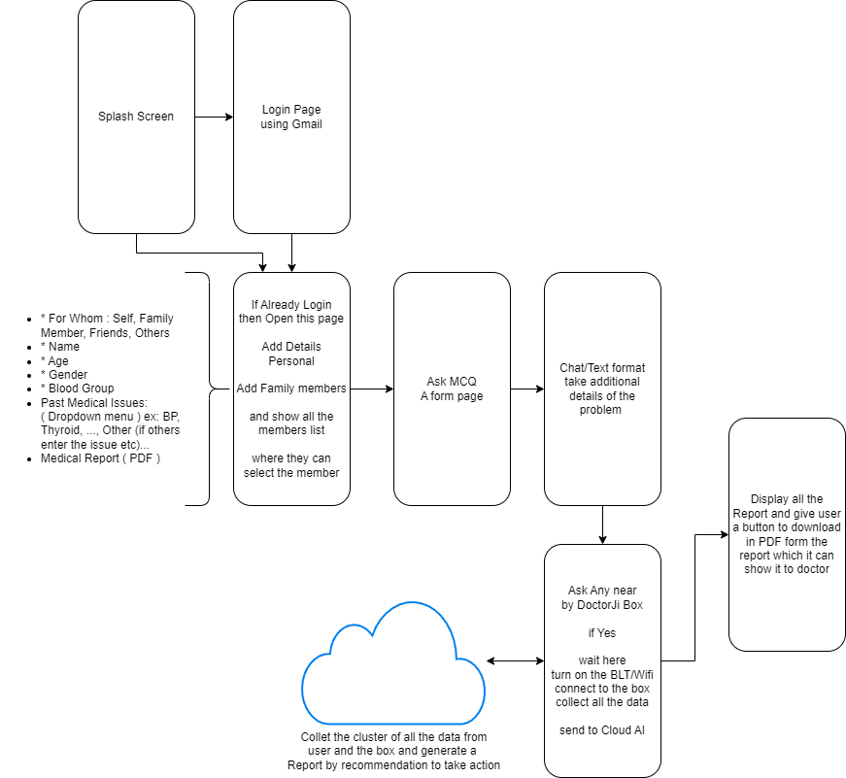
Architecture
DEMO in Figma for UI
Planned Approach

Slide 11
Hardware/software components
Hardware Components:
ESP32 Microcontroller:
Central unit for collecting and processing health data from connected sensors.
Health Sensors:
Heart Rate Sensor: Monitors heart rate.
Oxygen Level Sensor (SpO2): Measures blood oxygen saturation.
Body Temperature Sensor: Tracks body temperature.
Environmental Sensors: Monitors ambient temperature and humidity.
Mobile Device:
User’s smartphone running the RogiDoot App for data display and interaction.

Slide 12
Hardware/software components
Software Components:
Mobile Application:
Flutter: Framework for building the user interface, providing a smooth and responsive experience.
Backend Server:
FastAPI: Handles server-side logic, API requests, and data processing.
Database:
Firebase Firestore: Cloud-based NoSQL database for securely storing user data and health reports.
Authentication:
Firebase Authentication: Manages user login and authentication securely.
AI Model:
Custom Large Language Model (LLM): Analyzes user inputs for diagnosis and health assessments.
Cloud Infrastructure:
Custom setup with powerful CPUs and sufficient RAM to support AI processing and data management.

Slide 13
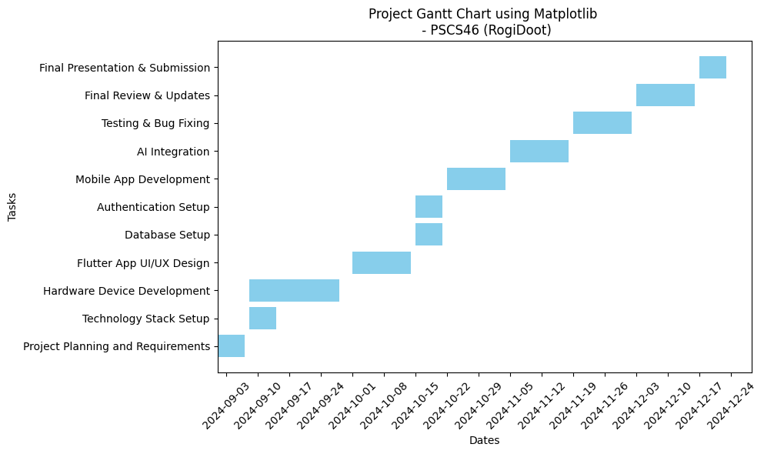
Timeline of Project

Slide 14
Timeline of Project
Task | Duration | Start Date | End Date
Project Planning and Requirements | 1 week | 1st Sep 2024 | 7th Sep 2024
Technology Stack Setup | 1 week | 8th Sep 2024 | 14th Sep 2024
Hardware Device Development (IoT Integration) | 3 weeks | 8th Sep 2024 | 28th Sep 2024
Flutter App UI/UX Design | 2 weeks | 1st Oct 2024 | 14th Oct 2024
Database Setup (Firebase Firestore) | 1 week | 15th Oct 2024 | 21st Oct 2024
Authentication Setup (Firebase) | 1 week | 15th Oct 2024 | 21st Oct 2024
Mobile App Development (Flutter) | 2 weeks | 22nd Oct 2024 | 4th Nov 2024
AI Integration (LLM & Gemini API) | 2 weeks | 5th Nov 2024 | 18th Nov 2024
Testing & Bug Fixing (Hardware + App) | 2 weeks | 19th Nov 2024 | 2nd Dec 2024
Final Review & Updates (Predicted) | 2 weeks | 3rd Dec 2024 | 16th Dec 2024
Final Presentation & Submission (Predicted) | 1 week | 17th Dec 2024 | 23rd Dec 2024

Slide 15
Expected Outcomes
Enhanced Access: Improved healthcare availability for rural users.
Accurate Diagnostics: Reliable AI-driven disease assessments.
Real-Time Monitoring: Continuous tracking of vital health metrics.
Increased Engagement: High user satisfaction through a user-friendly interface.
Efficient Emergencies: Quick access to nearby healthcare facilities.
Detailed Reports: Comprehensive health reports for consultations.
Data Security: Secure management of sensitive health information.
Scalable Model: Prototype adaptable for broader healthcare challenges.

Slide 16
Conclusion
The RogiDoot App leverages AI and IoT to address healthcare challenges in rural India.
By providing accurate diagnostics and real-time health monitoring, it enhances accessibility and efficiency in healthcare delivery.
The user-friendly interface and multi-language support ensure inclusivity, while robust security measures protect user data.
This innovative solution not only empowers individuals to manage their health but also sets the foundation for scalable healthcare advancements in underserved areas.

Slide 17
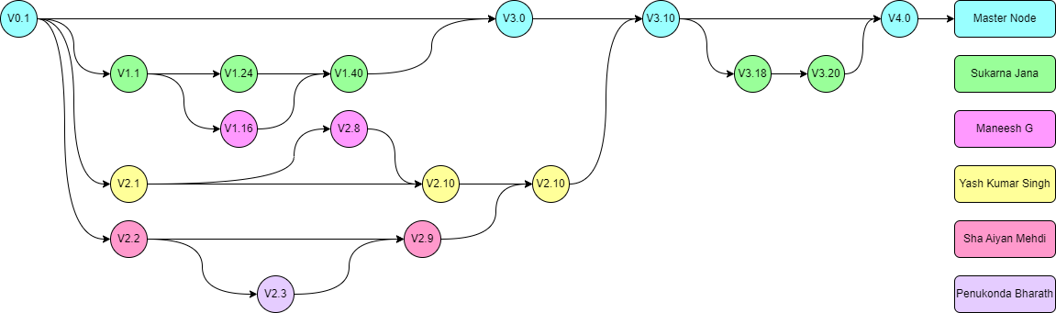
Github Link
Project Repo: https://github.com/Sukarnascience/RogiDoot-VirtualCare

Slide 18
References
Cheng, K., Li, Z., He, Y., Guo, Q., Lu, Y., Gu, S., & Wu, H. (2023). Potential use of artificial intelligence in infectious disease: Take ChatGPT as an example. Annals of Biomedical Engineering, 51(6), 1130-1135. https://doi.org/10.1007/s10439-023-03217-1
Kumar, Y., Koul, A., Singla, R., & Ijaz, M. F. (2023). Artificial intelligence in disease diagnosis: A systematic literature review, synthesizing framework and future research agenda. Journal of Ambient Intelligence and Humanized Computing, 14(7), 8459-8486. https://doi.org/10.1007/s12652-023-04694-5
Pawar, M., Rusia, S., Tijare, S., Gadpalliwar, A., Ashtekar, M., & Pichkate, R. (2024, April). Development of health monitoring wearable device using ESP32. In 2024 International Conference on Inventive Computation Technologies (ICICT) (pp. 2007-2012). IEEE. https://doi.org/10.1109/ICICT56478.2024.1010101
Ashraf, S., Khattak, S. P., & Iqbal, M. T. (2023). Design and implementation of an open-source and Internet-of-Things-based health monitoring system. Journal of Low Power Electronics and Applications, 13(4), 57. https://doi.org/10.3390/jlpea13040057
Purwitosari, D., Irianto, B. G., Triwiyanto, T., & Huynh, P. H. (2023). Design and development of SpO2, BPM, and body temperature for monitoring patient conditions in IoT-based special isolation rooms. Jurnal Teknokes, 16(2). https://doi.org/10.1234/jurnalteknokes.v16i2.1234
Alruwaili, M., Siddiqi, M. H., Farid, K., Azad, M., Alanazi, S. A., Khan, A., & Khan, A. (2023). A health monitoring system using IoT-based Android mobile application. Computers, Systems & Signals, 47(2), 2293-2311. https://doi.org/10.1007/s11276-023-00390-2
Alhur, A. (2024). Redefining healthcare with artificial intelligence (AI): The contributions of ChatGPT, Gemini, and Co-pilot. Cureus, 16(4). https://doi.org/10.7759/cureus.12345
Gupta, G. K., Singh, A., Manikandan, S. V., & Ehtesham, A. (2024). Digital diagnostics: The potential of large language models in recognizing symptoms of common illnesses. arXiv preprint arXiv:2405.06712. https://doi.org/10.48550/arXiv.2405.06712
Vats, A., Azim, S., & Chauhan, A. S. (2023, December). Chat messenger app using Flutter. In 2023 5th International Conference on Advances in Computing, Communication Control and Networking (ICAC3N) (pp. 1531-1535). IEEE. https://doi.org/10.1109/ICAC3N56400.2023.000234
Mariappan, A. (2023). Preliminary identification and therapeutic support of depression in mental health using conversational AI (Doctoral dissertation). [Institution URL if available].
Berida, O. T., Oguntimilehin, A., Badeji-Ajisafe, B., Tope-Oke, A. M., Babalola, G. O., Akinduyite, C. O., ... & Sanya, O. A. (2024, April). SMat-Bot: An interactive chatbot for facilitating students’ comprehension of mathematics. In 2024 International Conference on Science, Engineering and Business for Driving Sustainable Development Goals (SEB4SDG) (pp. 1-8). IEEE. https://doi.org/10.1109/SEB4SDG56478.2024.1010102
Alwin, E. (2024). Using ChatGPT to create mobile apps: Analysis of using ChatGPT as a programming tool for developing smaller mobile applications. [Publisher URL if available].

Slide 19
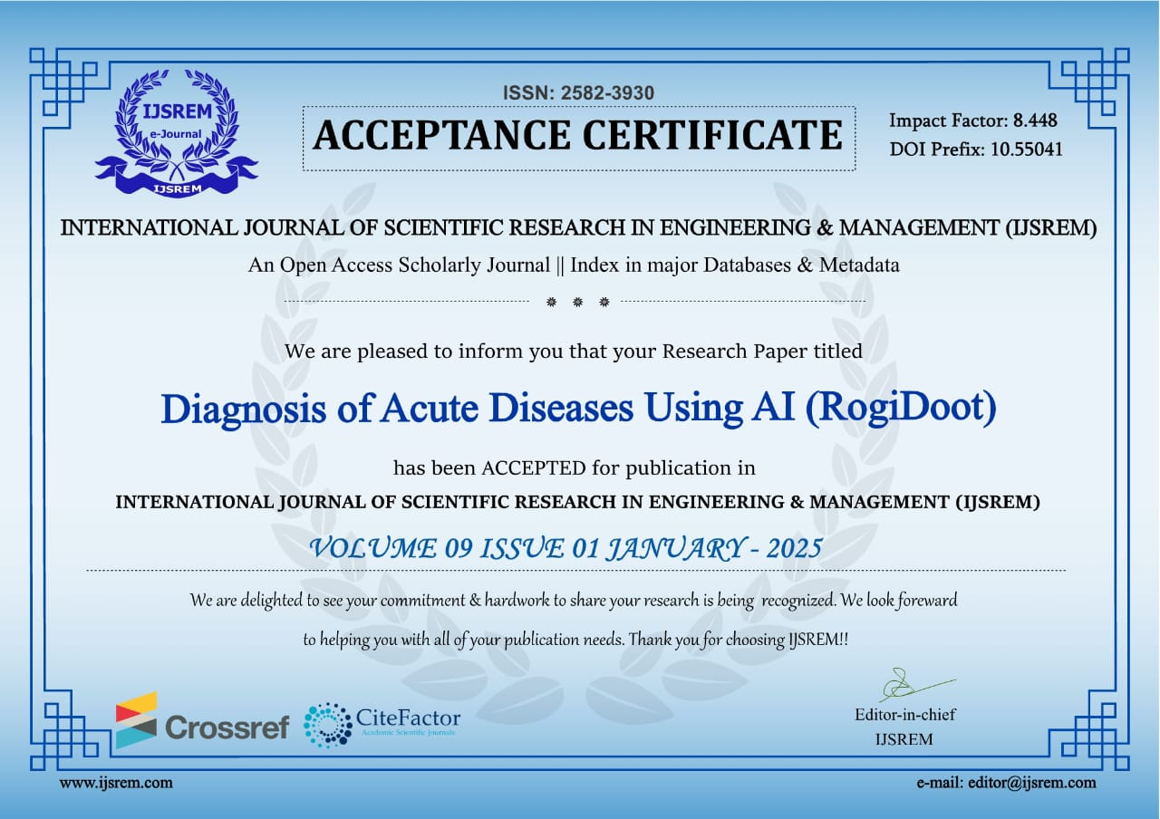
Publication Details

Slide 20
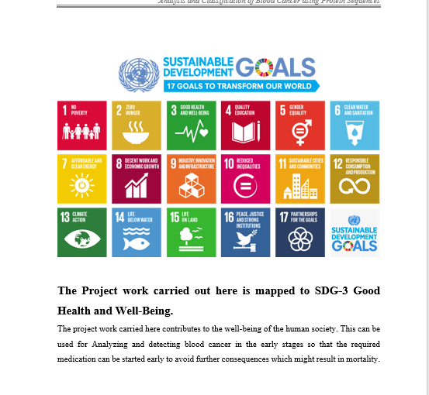
Project work mapping with SDG
1. SDG 3: Good Health and Well-Being
Impact: Enhances healthcare access and quality in rural areas.
2. SDG 9: Industry, Innovation, and Infrastructure
Impact: Promotes innovation through AI and IoT in health monitoring.
3. SDG 10: Reduced Inequalities
Impact: Ensures equitable healthcare access via multi-language support.
4. SDG 11: Sustainable Cities and Communities
Impact: Improves community resilience with quick emergency response.
5. SDG 17: Partnerships for the Goals
Impact: Encourages collaboration with healthcare and tech partners.

Slide 21
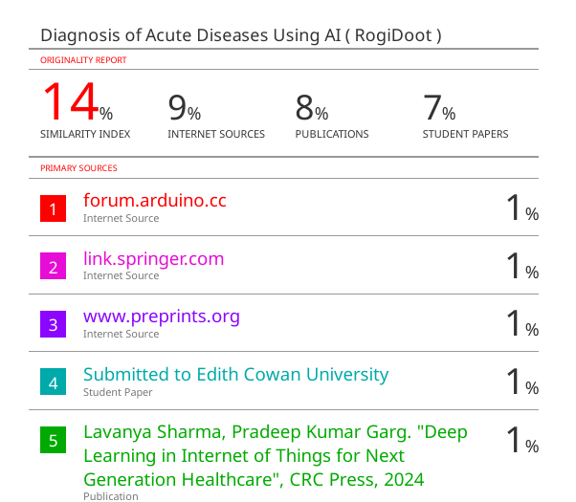
Plagiarism Report

Slide 22
Thank You

