Slide 1
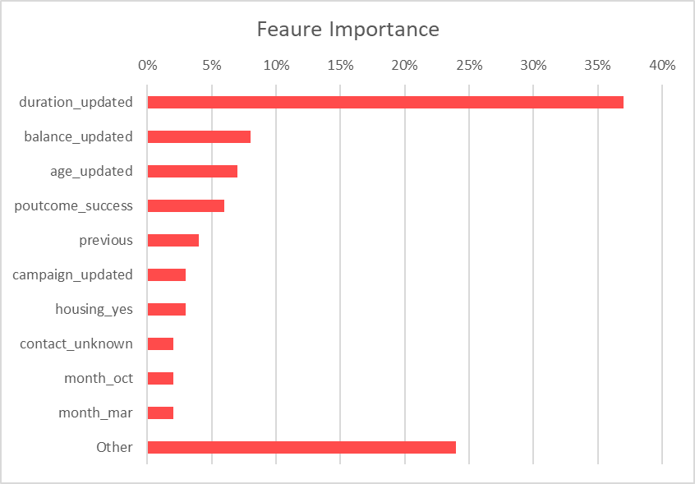

Slide 2
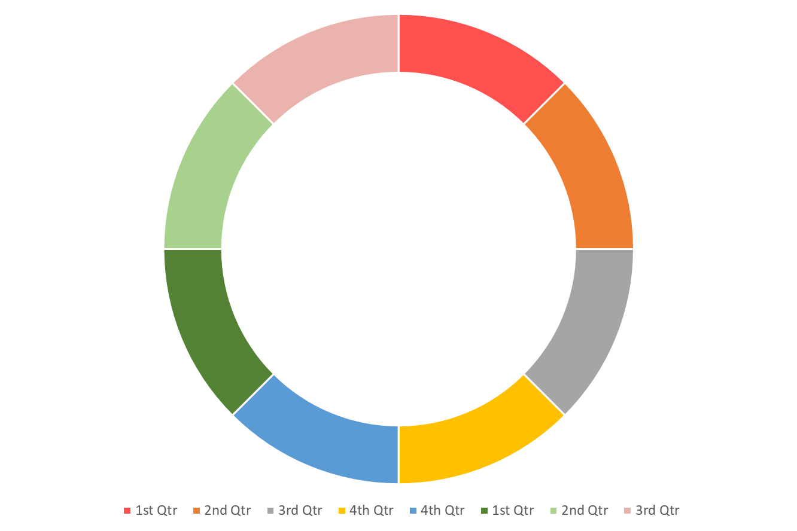

Slide 4
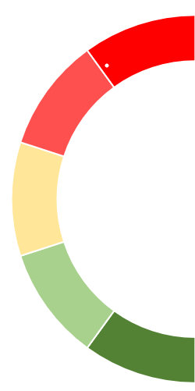

Slide 5
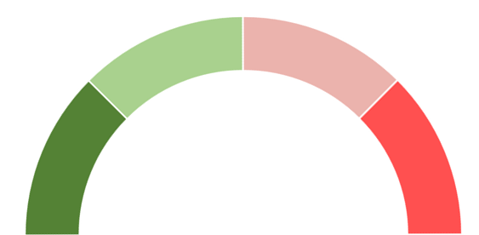


Mild
Moderate
Mild
Moderate
None
Severe
None
Severe
Mild
Moderate
Mild
Moderate
None
Severe
None
Severe

