Slide 1

NHS – Diagnostic analysis using python
Sukeshni Srinivas

Slide 2
GOAL
Reducing or eliminating missed appointments for the beneficial in financial as well as socially

Slide 3
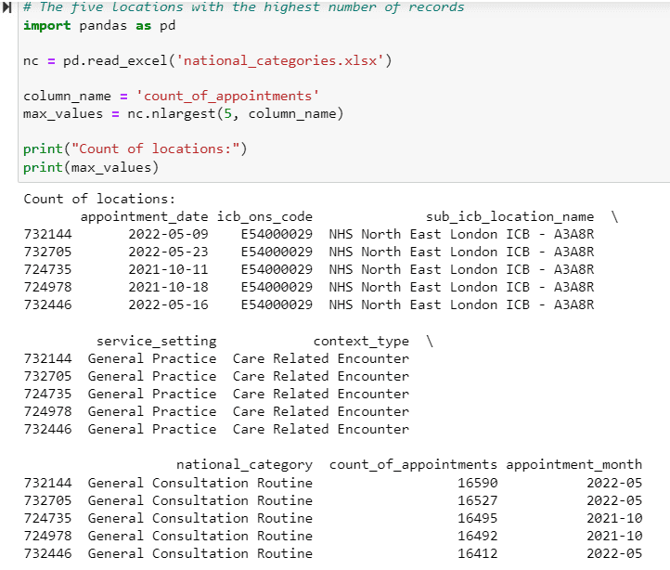
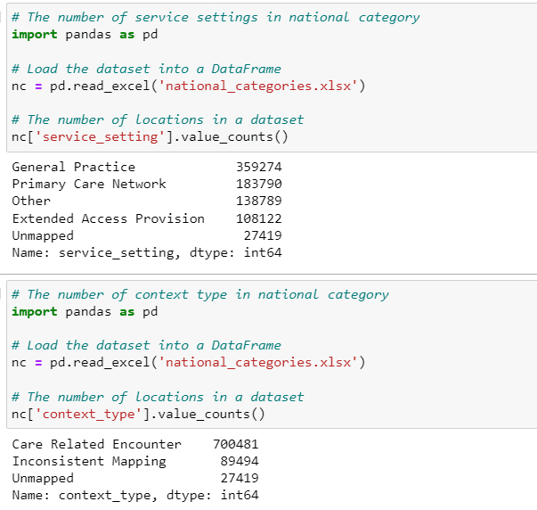
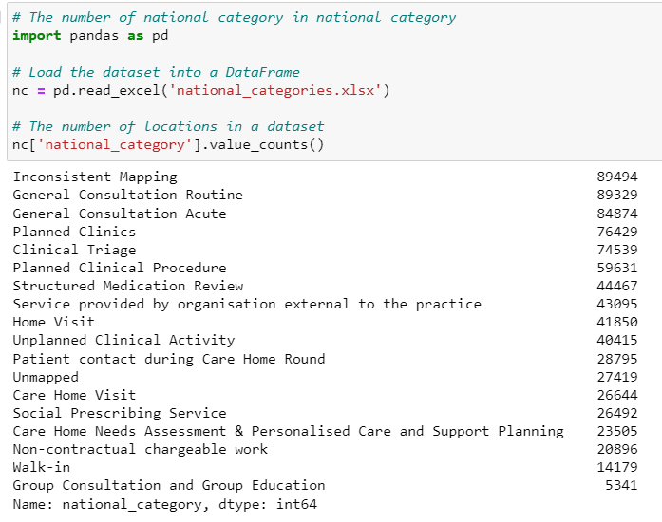
DATA ASSESSMENT

Slide 4
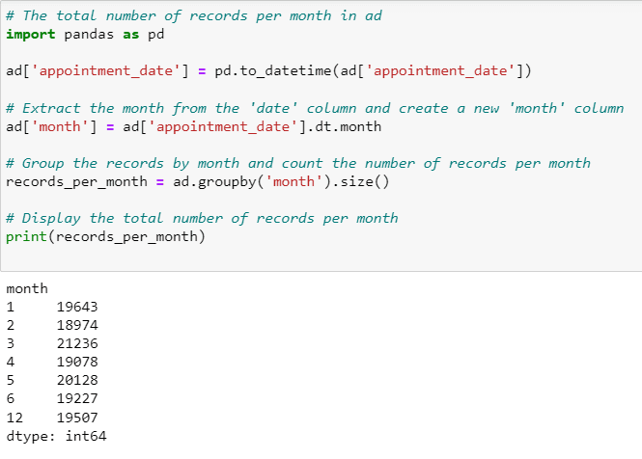
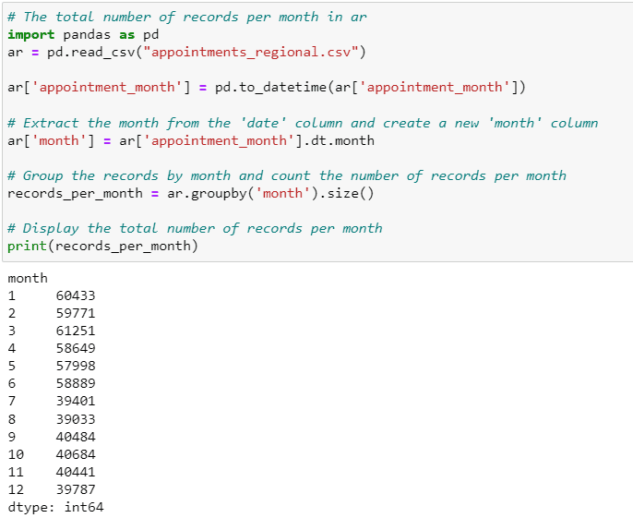
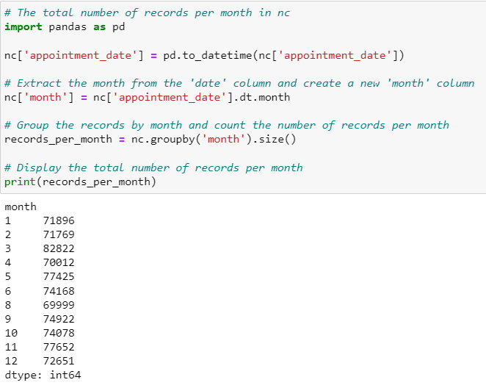
DATA OVERVIEW

Slide 5
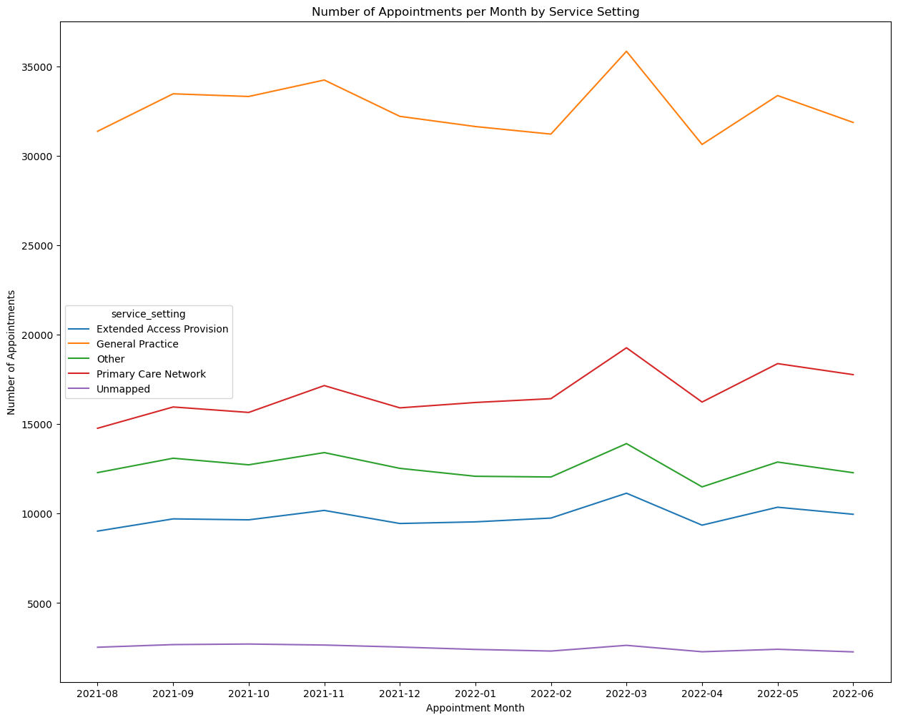
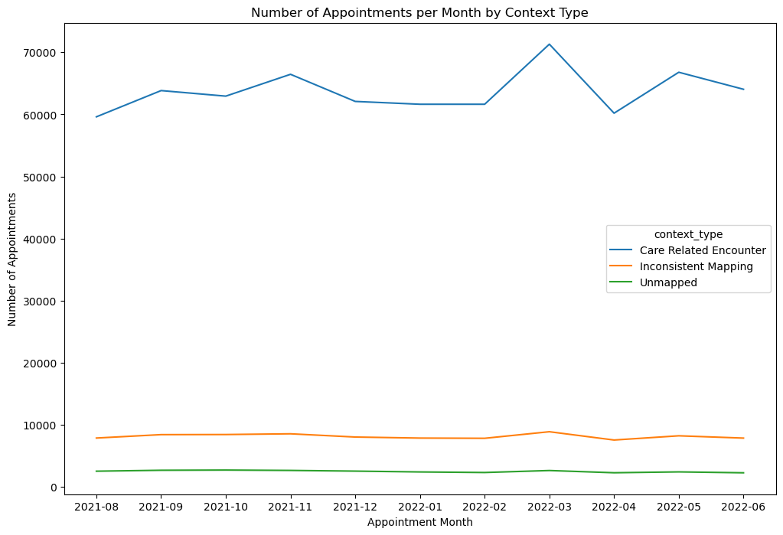
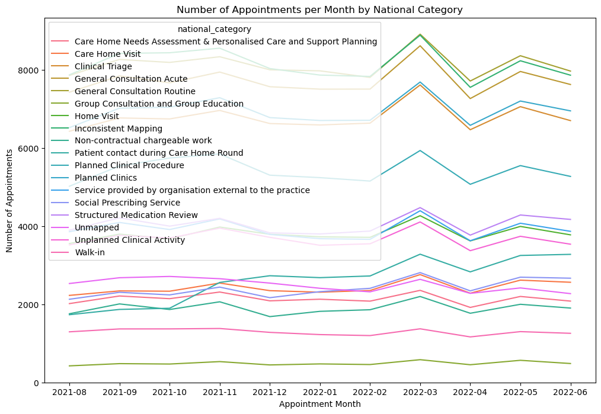
Number of appointments per month

Slide 6
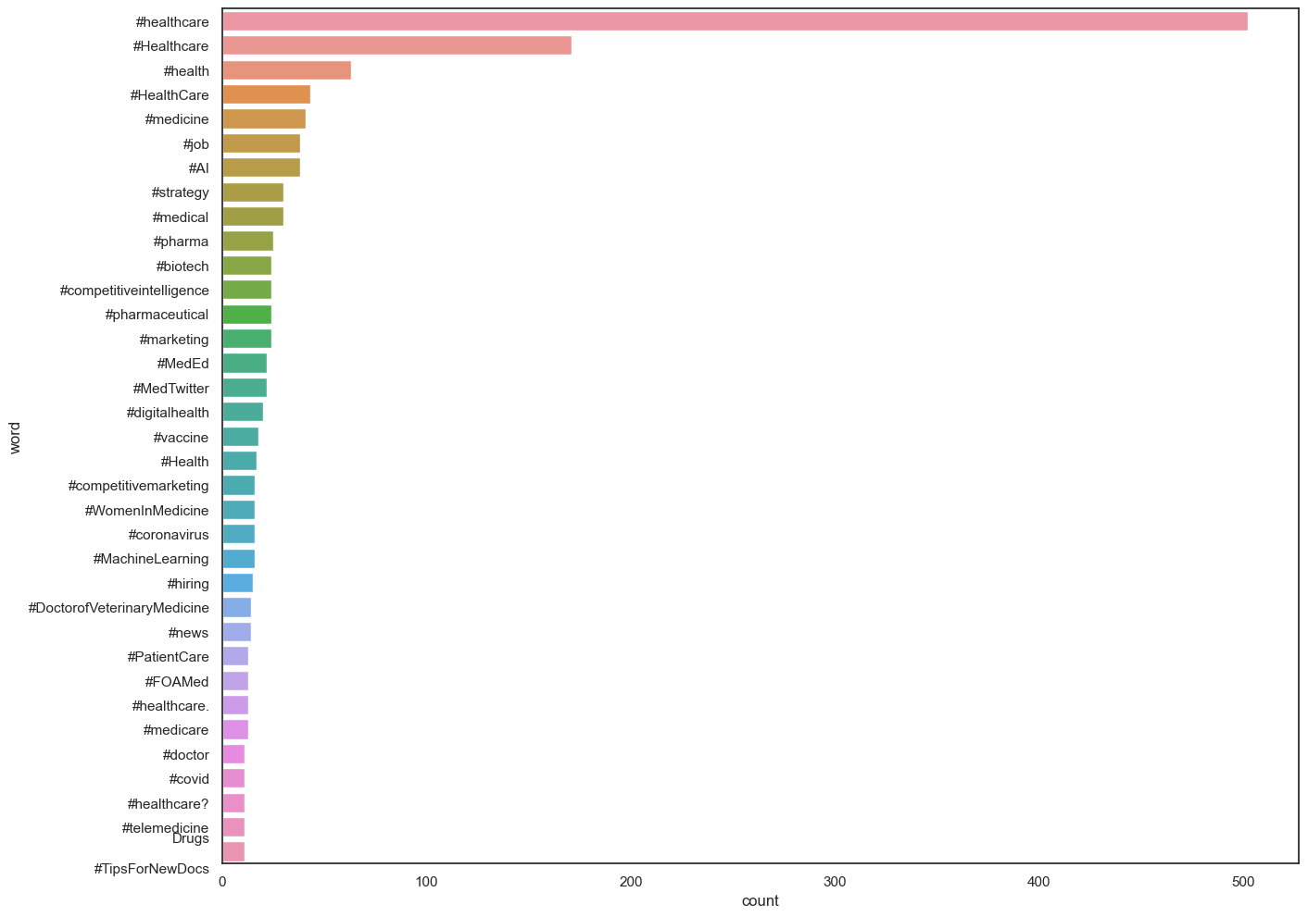
Popular hashtags

Slide 7
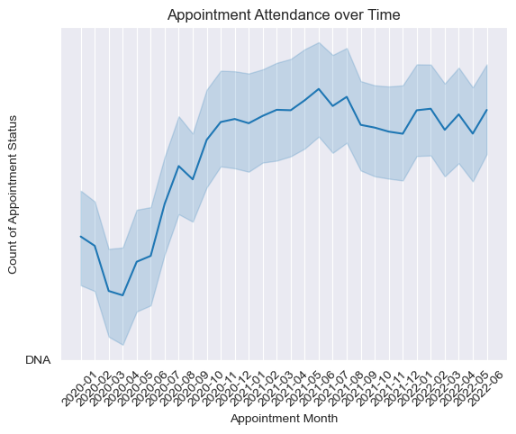
Appointment attendance over time-series

Slide 8
CONclusion
There has been only 62% of adequate staff and capacity in the networks.
The actual utilisation of resources are limited.

