Slide 1
EE245 Project 1 Design: Give Your Project a Descriptive Title
Partner 1, Partner 2
Electrical Engineering and Computer Science
South Dakota State University
Brookings, SD, USA
Mar. XYZ, 2023

Slide 2
Required Slide Sections
top-level design
modules
inputs, outputs as variables
finite state machine design
state transition diagram
next-state logic (K-maps and equations)
output logic (K-maps and equations)
DE10-Lite I/O

Slide 3

Example Top-Level Design
you need to modify this so it represents your own design (make larger)
your inputs/outputs should be consistent throughout your report
e.g., replace “encoded input” with variables ($E_{1:0}$), replace number of state bits S to a number
this is a good place to describe everything about the overall design
S
current state
S
D Q
4:2 enc
next
item
2
next
state
output
00
S
.
-
L
01
encoded
state
bit
logic
.
H
10
input
logic
state
.
.
J
11
memory
.
(D
.
-
FFs)
state digits
CLK
a
b
debounced clock
1:0
7
-
seg
.
decoders
.
debouncer
.
g
b
RES
output digits
1:0
debounced reset
a
b
3:2
7
-
seg
.
decoders
.
debouncer
.
g
b
3:2

Slide 4
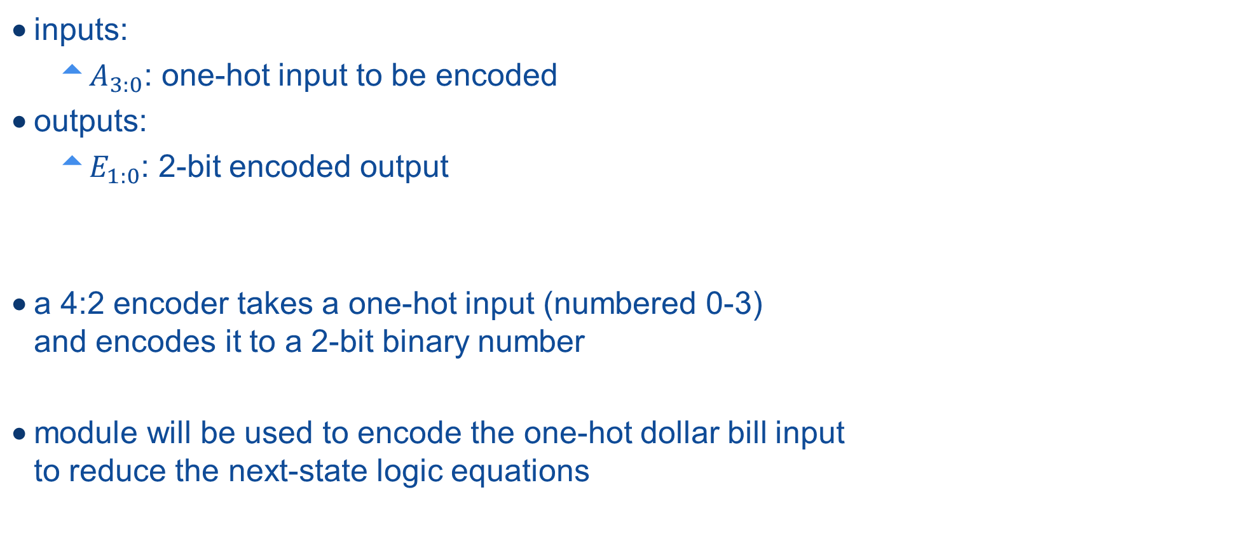


Example Module Description: 4:2 Encoder
inputs:
$A_{3:0}$: one-hot input to be encoded
outputs:
$E_{1:0}$: 2-bit encoded output
a 4:2 encoder takes a one-hot input (numbered 0-3) and encodes it to a 2-bit binary number
module will be used to encode the one-hot dollar bill input to reduce the next-state logic equations
$$A_{0}$$
$$A_{1}$$
$$A_{2}$$
$$A_{3}$$
$$E_{1:0}$$

Slide 5
Required Slide Sections
top-level design
modules
inputs, outputs as variables
finite state machine design
state transition diagram
next-state logic (K-maps and equations)
output logic (K-maps and equations)
DE10-Lite I/O

Slide 6
State Transition Diagram
clearly label states, outputs, and transitions (remove this bullet)

Slide 7











Example Next State Logic Equation: $S_{2}^{∗}$
$$S_{2}=0$$
$$S_{2}=1$$
$$S_{2}^{∗}=S_{2}^{′}S_{0}^{′}E_{1}^{′}+S_{2}^{′}S_{1}^{′}S_{0}^{′}+S_{1}^{′}E_{1}^{′}$$
all of these variables should have been defined before in your top-level design section
you must properly use subscripts and superscripts
you must not use $∗$ for an AND operation, rather $⋅$ or it is implied without an operator
$$E_{1}E_{0}$$
$$E_{1}E_{0}$$
$$S_{1}S_{0}$$
$$00 01 11 10$$
$$S_{1}S_{0}$$
$$00 01 11 10$$
$$00$$
$$01$$
$$11$$
$$10$$
1 | 1 | 1 | 1
1 | 1 | 0 | 0
0 | 0 | 0 | 0
1 | 1 | 0 | 0
1 | 1 | 0 | 0
1 | 1 | 0 | 0
0 | 0 | 0 | 0
0 | 0 | 0 | 0
$$00$$
$$01$$
$$11$$
$$10$$

Slide 8
Required Slide Sections
top-level design
modules
inputs, outputs as variables
finite state machine design
state transition diagram
next-state logic (K-maps and equations)
output logic (K-maps and equations)
DE10-Lite
RTL view
inputs and outputs

Slide 9
DE-10 Lite Inputs and Outputs
map your top-level design to DE-10 board
create your own table of inputs to outputs using your variable names

