Slide 1
The AI Technical Debt Inspector
Automated Code Quality & Refactoring System
Group No. 11
Sabhya Shanti (7ACE44) • Sukhada Bhalerao (7ACE63)
Gauri Narlawar (7ACE16) • Tanvi Bhole (7ACE70)
Guide: Prof. Minakshi Getkar

Slide 2
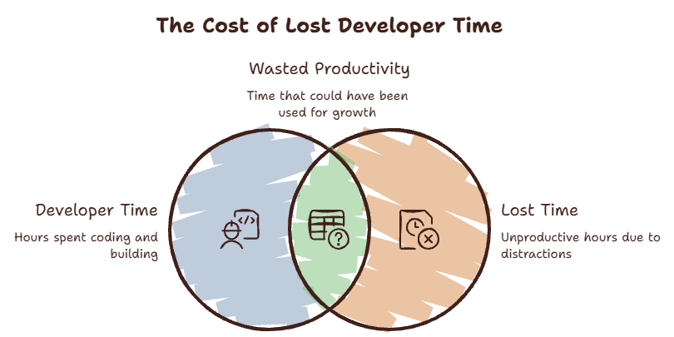
Introduction and Problem Statement
Definition –
The implied future cost(in terms of time) of choosing quick, short-term coding fixes over clean, long-term architecture is called the “Technical Debt”.
The Reality –
Tight deadlines force developers into copy-pasting logic, skipping error handling, and building monolithic "God classes."
Problem Statement –
Large codebases become unmaintainable, consuming nearly 25% of active developer time.
The AI ​​Paradox-
AI code-generation tools accelerate output but increase duplication—showing an 8x rise in repeated code across 211 million analyzed lines.

Slide 3
Objectives of the Project
Continuous Review: Build an automated AI system that acts as an inline senior developer to analyze and clean repositories.
Active Remediation: Shift software maintenance from passive detection to active code comprehension and autonomous repair.
CI/CD Integration: Automatically generate step-by-step refactoring plans and ready-to-merge Pull Requests.
Developer Efficiency: Dramatically reduce manual effort spent on code reviews and legacy refactoring..

Slide 4
Literature Survey / Existing Systems
Rule-Based Limits: Traditional tools (SonarQube, ESLint) rely on rigid regex pattern-matching that only flags surface issues.
Lack of Context: Existing systems do not understand application intent, logic flow, or system architecture.
Manual Overhead: Linters identify errors but still force developers to manually rewrite and test complex logic.
Alert Fatigue: High false-positive rates cause developers to ignore critical quality warnings

Slide 5
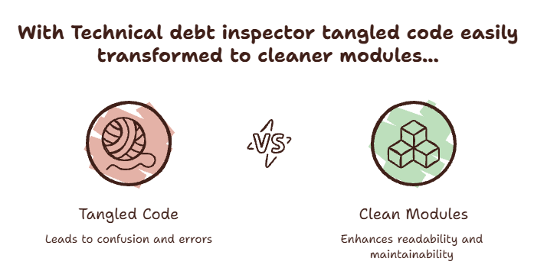
Proposed Methodology / System Architecture
Multi-Agent AI Model:
Uses specialized AI agents working together to break down and solve complex refactoring tasks..
Repository Scanner:
Parses full codebases and maps Abstract Syntax Trees (ASTs) to chart system dependencies.
Static Analysis Agent:
Evaluates code modules to pinpoint semantic duplications and complex control flows.
Security Agent:
Detects hardcoded credentials, injection vulnerabilities, and missing authorization checks.
Refactoring Planner:
Combines insights from all agents to safely rewrite code without disrupting original functionality.

Slide 6
Tools and Technologies Used
Frontend: React.js for interactive dashboards, health metrics, and visual dependency charts.
Backend: Node.js & Express.js for handling RESTful APIs and real-time GitHub webhooks.
AI Orchestration: Python + LangChain with Large Language Models (Gemini/OpenAI) for agent orchestration.
Database: PostgreSQL with pgvectorto store code embeddings for semantic similarity detection.

Slide 7
Implementation and Working
Comprehension Engine: Translates complex code segments into plain explanations to confirm functional intent before modifying code.
Step 1 - Trigger: Code commits to Git launch automated backend webhooks.
Step 2 - Ingestion: Code is chunked, converted into vector embeddings, and indexed..
Step 3 - Analysis: Multi-agent AI compares chunks against vector databases to identify structural flaws.
Step 4 - Action: System generates an optimized Pull Request with clean, modular code.

Slide 8
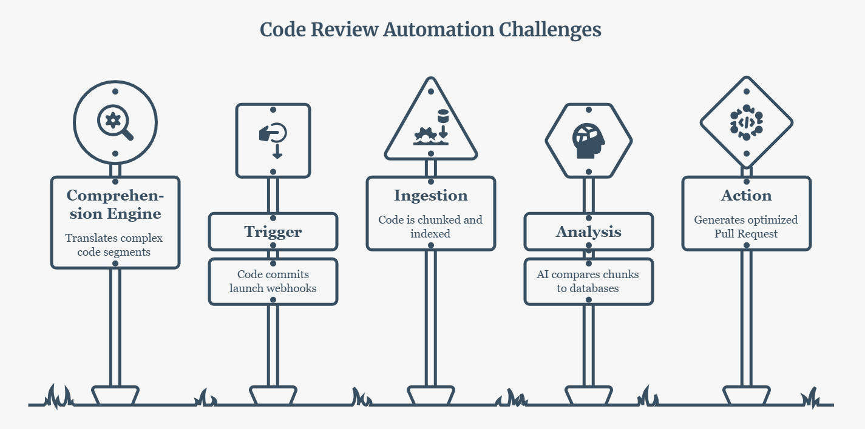

Slide 9
Results and Discussion
Code Transformation: Reconstructs tightly coupled, complex functions into clean, isolated modules.
Quality Metrics: Lowers cyclomatic complexity while increasing overall maintainability and code readability..
Automated Discovery: Discovers dead code paths, anti-patterns, and database bottlenecks without manual checks.
Developer Impact: Streamlines PR approvals and drastically lowers hours spent on technical debt.

Slide 10
Conclusion
Automation: Automates repetitive, manual software maintenance workflows..
Architectural Awareness: Moves beyond simple syntax linting to deep, context-aware repository comprehension.

Slide 11
Future Scope
IDE Extensions: Develop real-time plugins (eg, VS Code extensions) for instant feedback while typing.
Test Generation: Expand the Refactoring Planner agent to auto-generate comprehensive unit test suites.
Enterprise Automation: Embed continuous, background debt remediation into large-scale pipelines.
Feature Focus: Reclaim engineering hours so teams focus fully on building new feature value.
Self-Healing Systems: Shifts the industry paradigm from passive issue reporting to active, self-healing code bases.

Slide 12
References
1) https://www.sciencedirect.com/science/article/abs/pii/S0164121226003018
2) https://www.sciencedirect.com/science/article/abs/pii/S0164121226002712
3) https://github.blog/engineering/
4 ) https://www.oreilly.com/live-events/reading-and-maintaining-code-with-generative-ai

Slide 13
Thank You!

