Slide 1
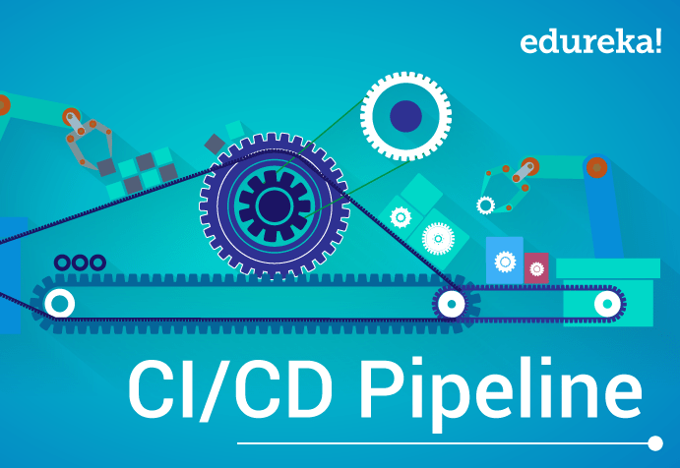
CICD Session-2 By Praveen Singampalli 18/06/2022

Slide 2
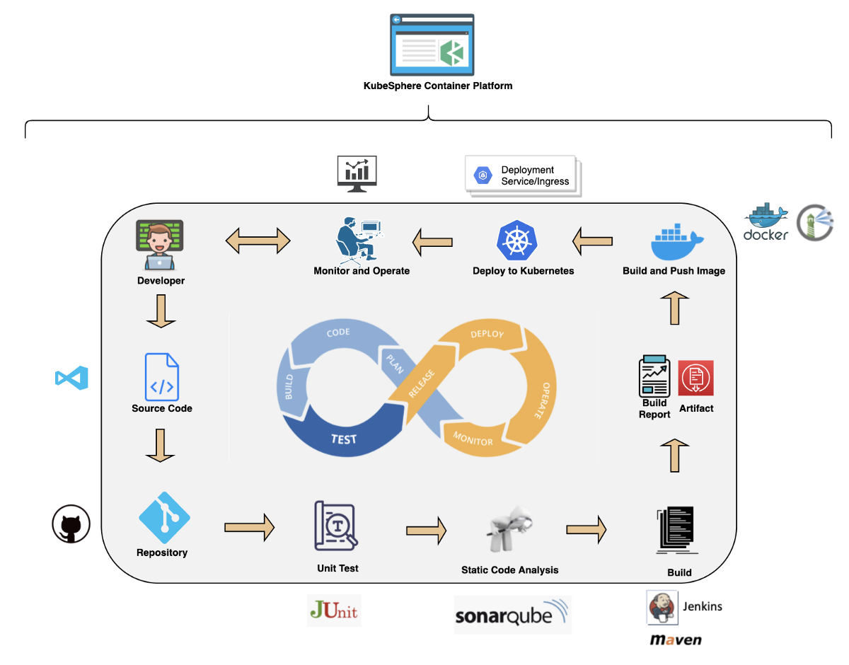



Please note whatever tools we will discuss today all are connected to Jenkins

Slide 3
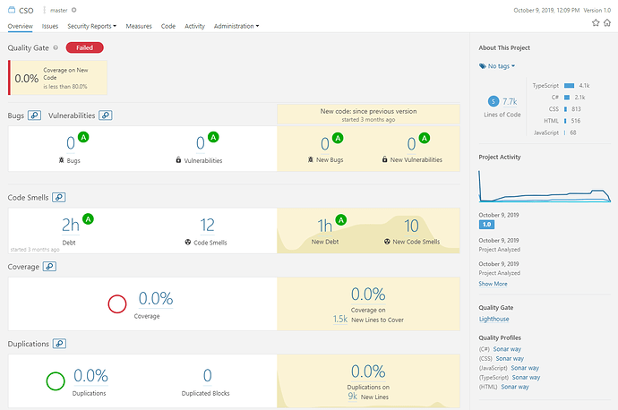
SonarQube
SonarQube is an open-source platform developed by Sonar Source for continuous inspection of code quality to perform automatic reviews with static analysis of code to detect bugs, code smells, and security vulnerabilities on 20+ programming languages.

Slide 4
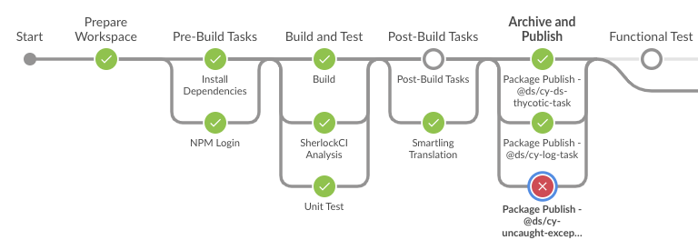
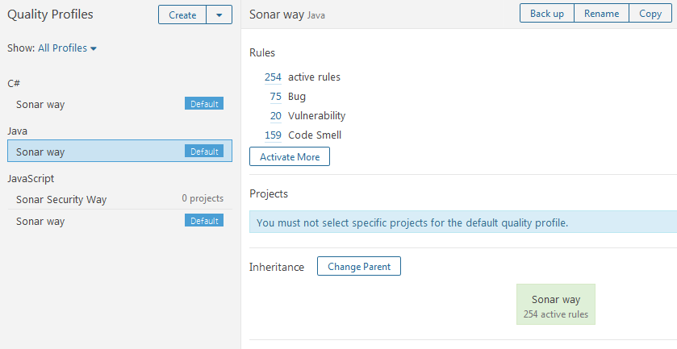
Quality profiles & Quality Gates
Quality Profiles are a core component of SonarQube where you define sets of Rules that, when violated, raise issues on your codebase
SonarQube executes rules on source code to generate issues. There are four types of rules:
Code Smell (Maintainability domain)
Bug (Reliability domain)
Vulnerability (Security domain)
Security Hotspot (Security domain)
Quality Gates can be defined as a set of threshold measures set on your project. Few conditions that can be in included are listed below.
Code Coverage > certain value
Number of Blocker issues >certain value
Security Rating / Unit Test Pass Rate etc..

Slide 5
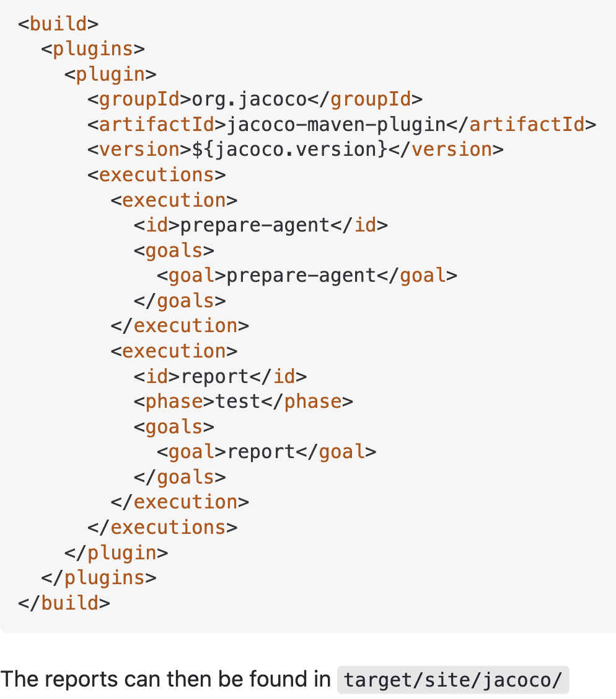
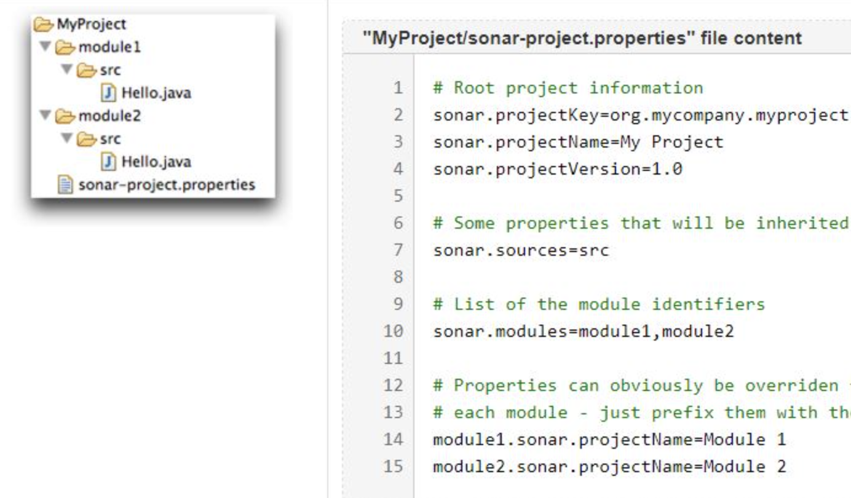
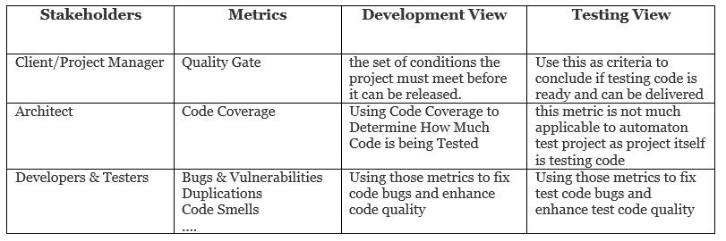
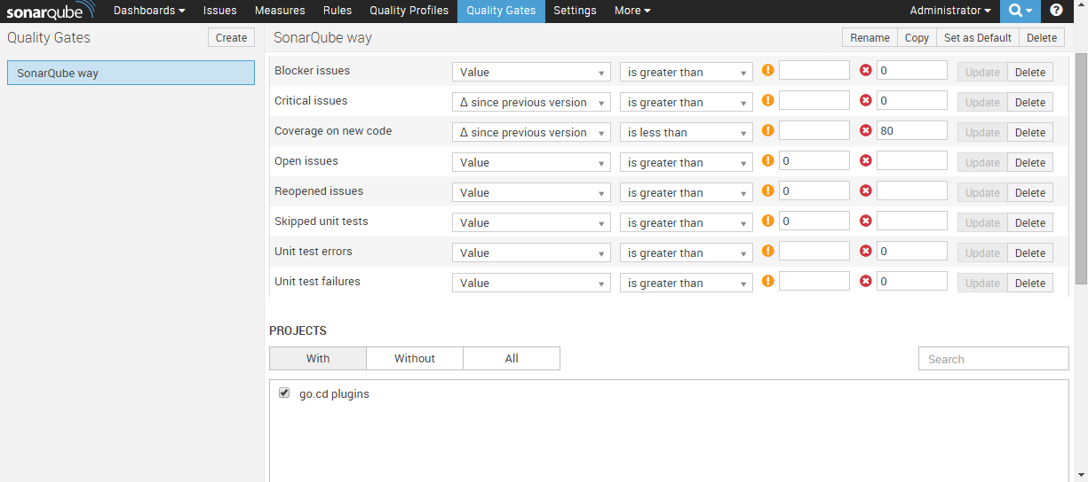
Sonar Code Coverage
2) Add the Jacoco plugin in POM.XML
1) Add the sonar.properties file
3) QG/CC/B&V
4)QG threshold setup in Sonar

Slide 6
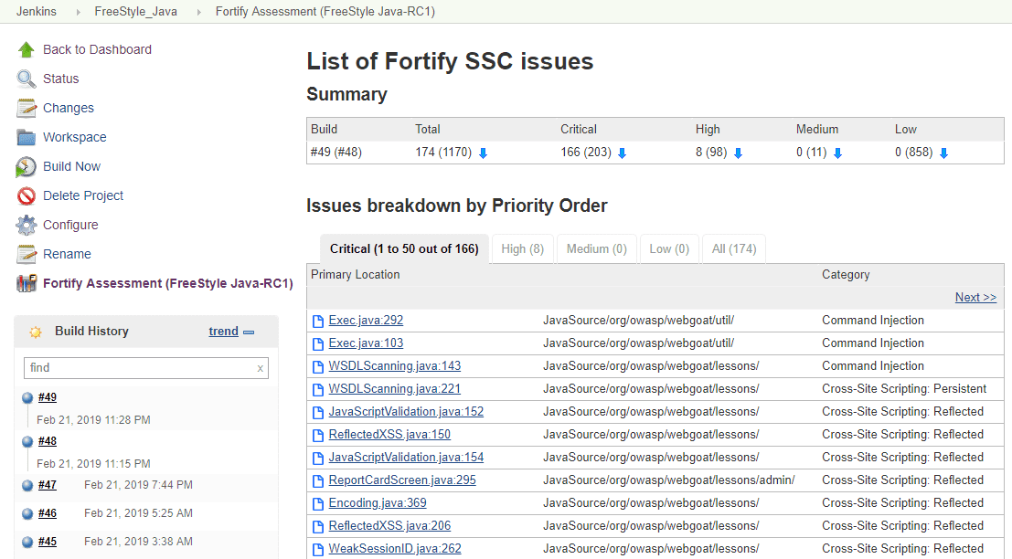
Fortify(Security Tool)
Static Analysis, also known as Static Application Security Testing (SAST), available from Fortify Static Code Analyzer (SCA).
Detects more types of potential vulnerabilities than any other detection method
Pinpoints the root cause of vulnerabilities with line-of-code detail
Helps you identify critical issues during development when they are easiest and least expensive to fix

Slide 7
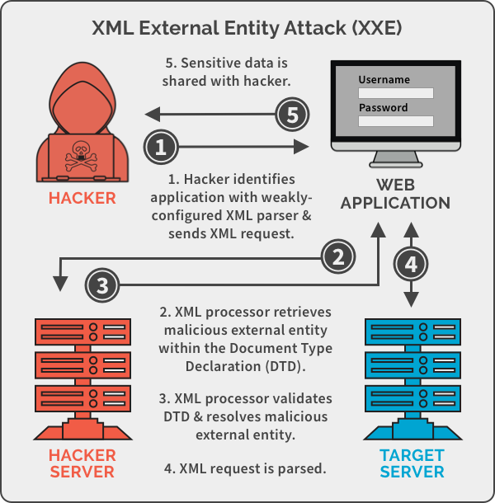
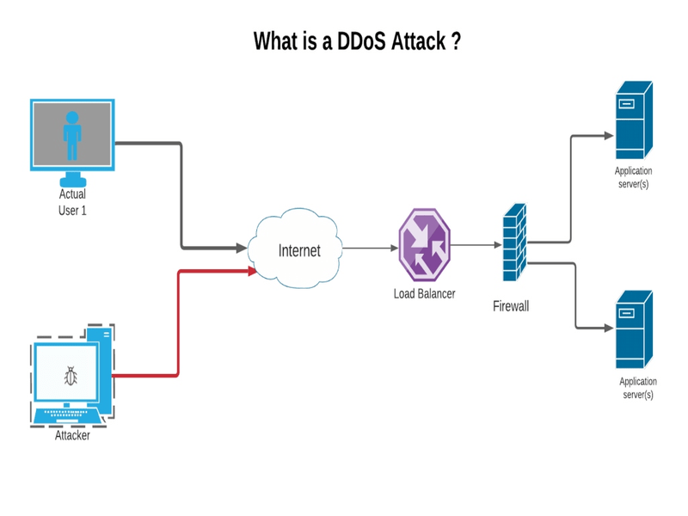
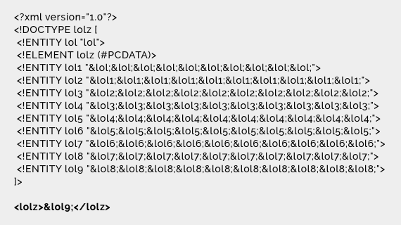
Fortify issues
Denial of service attack – Do not allow untrusted data to be used as regex like in headers (*)
XML external Entity attack - XML should be configured securely(For example you upload adhaar in portal then the doc should not bring any vulnerabilities into live environment)
Values shading – Not to take data from HTTP request instead take from cookies
Password management/Hardcode password

Slide 8
Fortify vs Sonarqube
SonarQube
static analysis
can add rules, using configuration as code
has standard rules based on language being used
automated code upload use case, has tooling for major frameworks
provide git branch perspectives, improvements over other branches
provide all code quality metrics, including security
opensource
has paid support model
Fortify
static analysis
can't add rules
manual file upload use case, no easy way of pipeline integration
does not provide git branch perspectives, improvements over other branches
provide only security code metrics
not opensource
has only paid support model

Slide 9
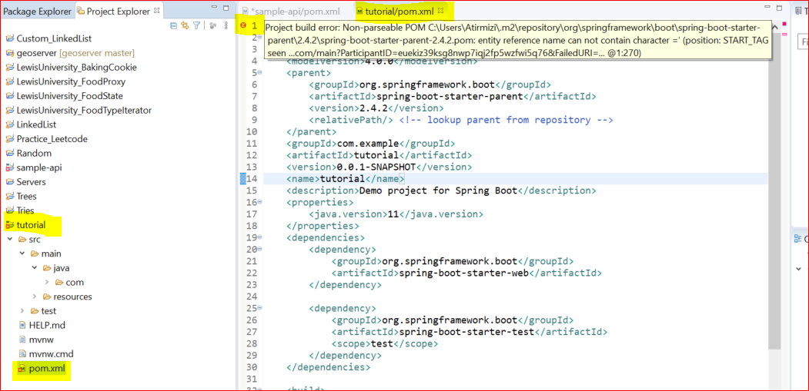
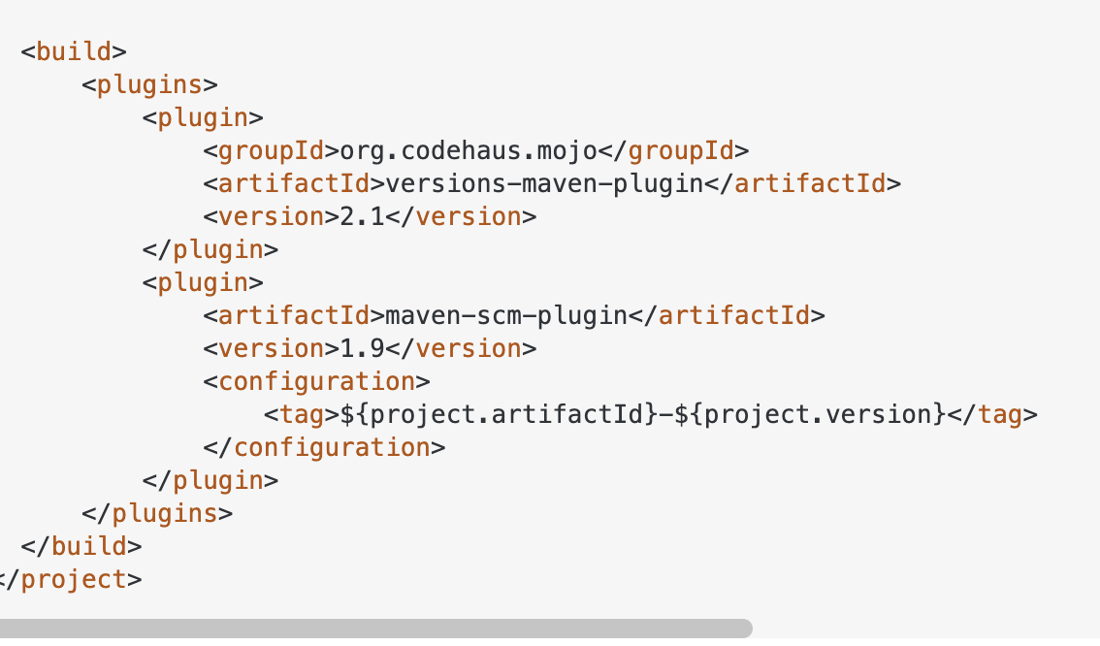
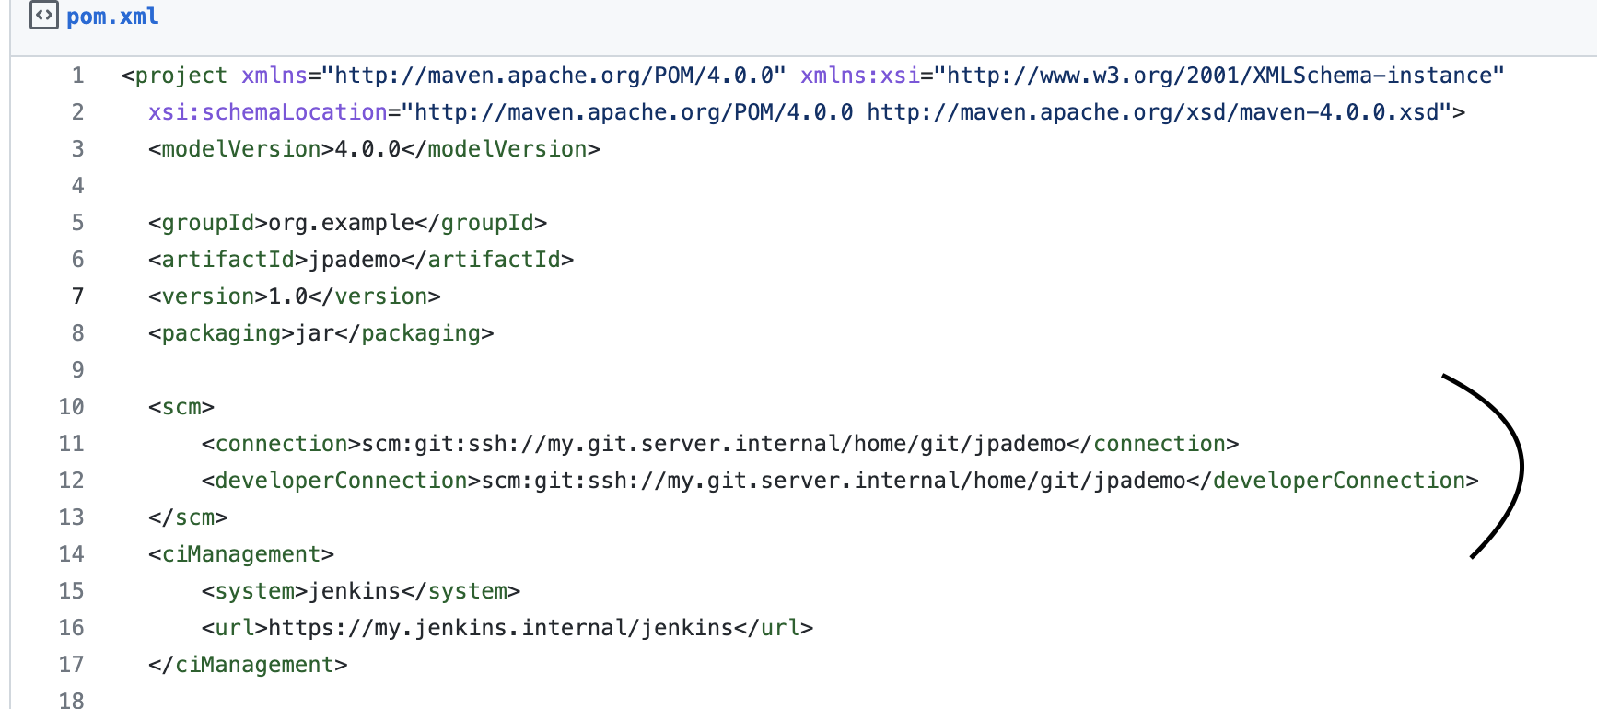
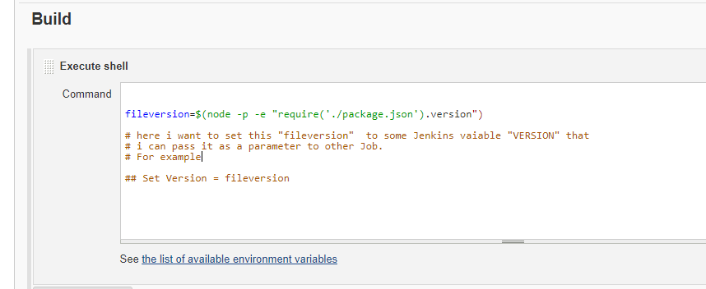
Maven E2E
1) POM.XML
2) SCM PLUGIN ADD IN POM.XML
3) SCM TAG IN POM.XML
4) SHELL SCRIPT TO BE ADDED IN JENKINS TO INVOKE SCM
Mvn clean install
mvn build-helper:parse-version versions:set \
-DnewVersion=\${parsedVersion.nextMajorVersion}.0.1-SNAPSHOT
\ versions:commit
OUTPUT
Tutorial-1.0.1-SNAPSHOT.war

Slide 10
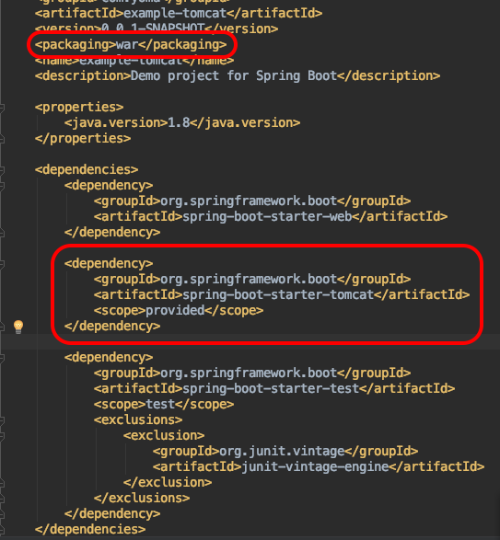
MAVEN AUTO VERSION UPDATE
Apache Maven is a software project management and comprehension tool. Based on the concept of a project object model (POM)
<majorversion [> . <minorversion [> . <incrementalversion ] ] [> - <buildnumber | qualifier ]>
[formattedPropertyPrefix].nextMajorVersion [formattedPropertyPrefix].nextMinorVersion [formattedPropertyPrefix].nextIncrementalVersion [formattedPropertyPrefix].nextBuildNumber

Slide 11
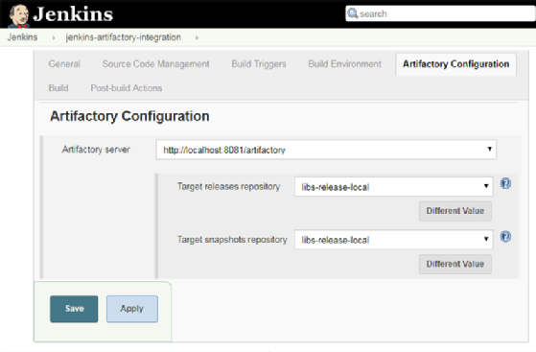
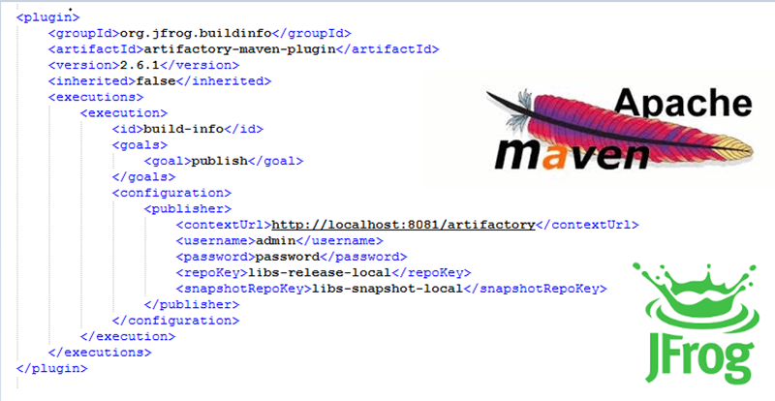
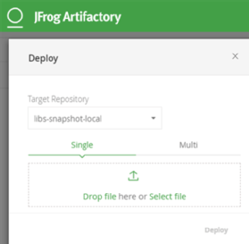
JFROG
CASE 3 – Add Plugin in Jenkins
The Version which will be created in the above step is now sent to JFROG i.e. Tutorial-1.0.1-SNAPSHOT.war
How to upload the JAR/WAR or any binary into JFROG:
CASE 1 - Curl COMMAND to upload a artifact
curl -X PUT -u username:password –T Tutorial-1.0.1-SNAPSHOT.war http://localhost:8081/artifactory/libs-release-local/ Tutorial-1.0.1-SNAPSHOT.war
CASE 2 – Add the plugin in pom.xml
CASE 4 – Upload to Jfrog repo manually

Slide 12
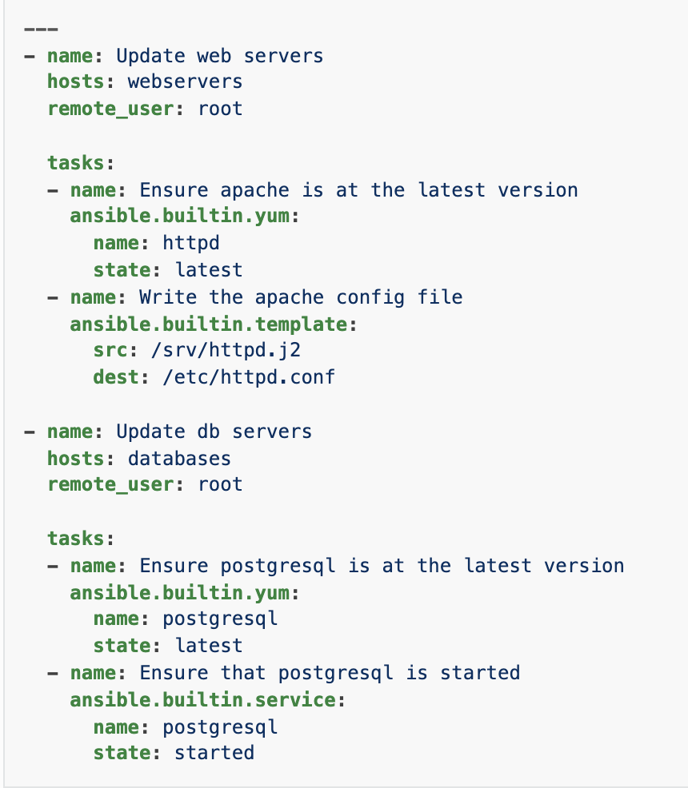
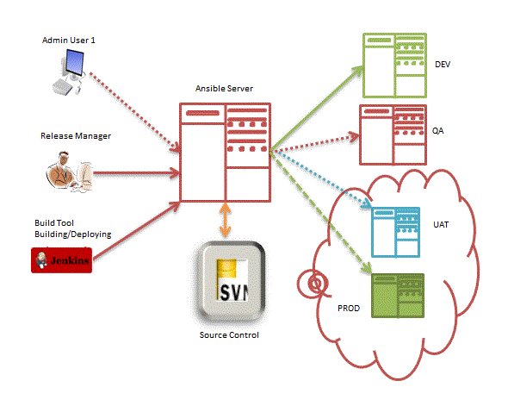
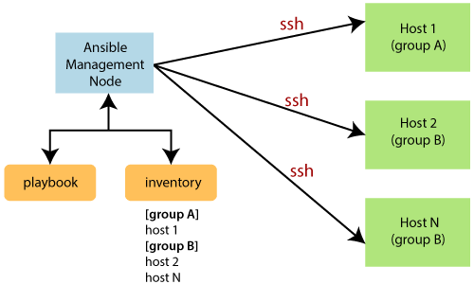
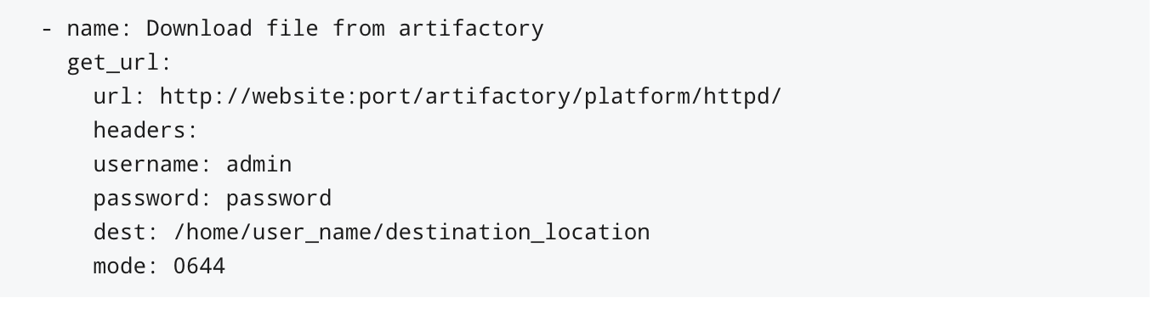
Ansible

