Slide 1
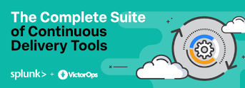
By Praveen Singampalli
#DOCKER CD SESSION3
#Saturday
4-6 PM

Slide 2
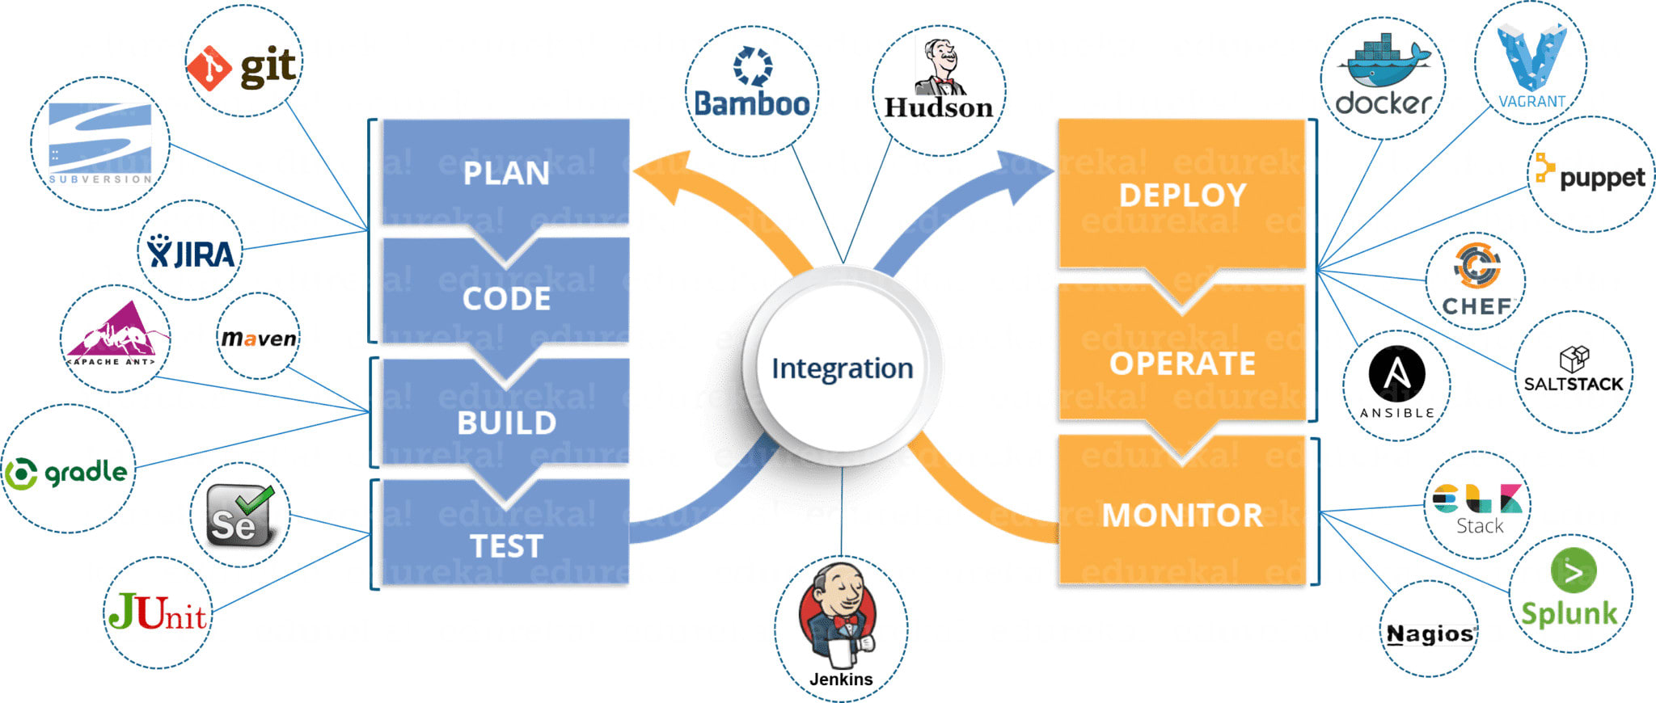
Continuous Delivery Tools

Slide 3
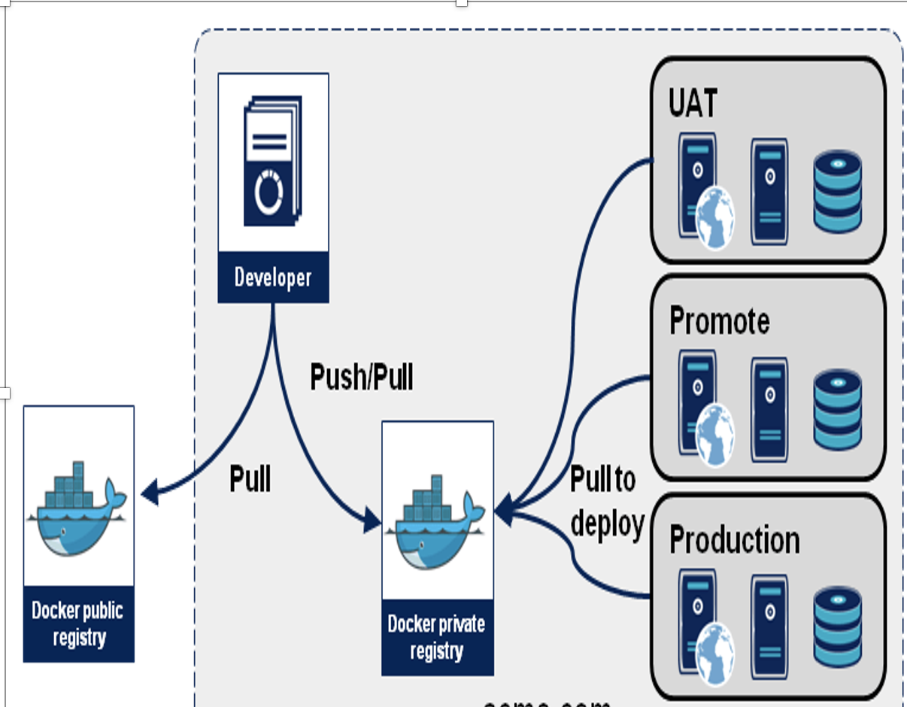
What is Docker?
Docker is an open platform for developing, shipping, and running applications.
Docker enables to separate the applications from infrastructure so that the delivery of software is quick.
Docker provides the ability to package and run an application in a loosely isolated environment called a container.
The isolation and security allow you to run many containers simultaneously on a given host.

Slide 4
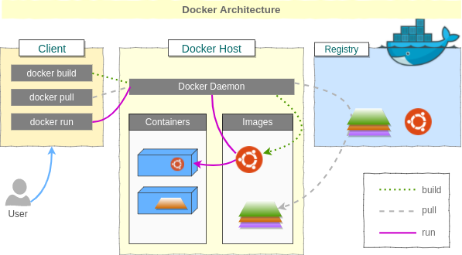
Docker Architecture
Docker uses a client-server architecture.
The Docker client talks to the Docker daemon, which does the heavy lifting of building, running, and distributing your Docker containers. The Docker client and daemon can run on the same system, or you can connect a Docker client to a remote Docker daemon.
The Docker client and daemon communicate using a REST API, over UNIX sockets or a network interface. Another Docker client is Docker Compose, that lets you work with applications consisting of a set of containers.
Docker Client
Docker Daemon
Docker Registry
Docker Image
Docker Container

Slide 5
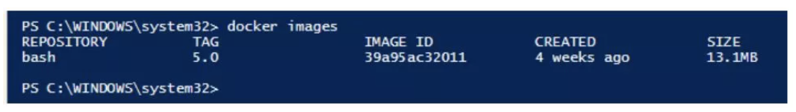
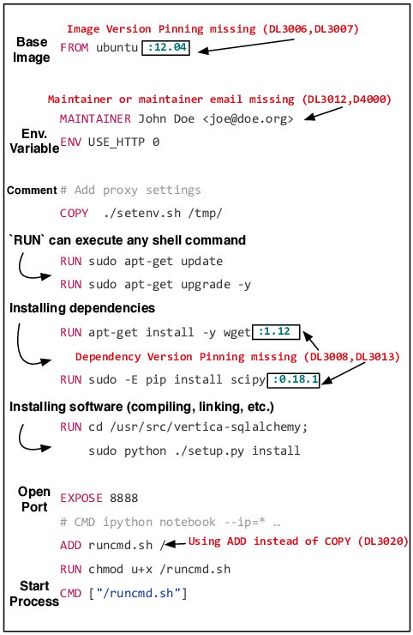
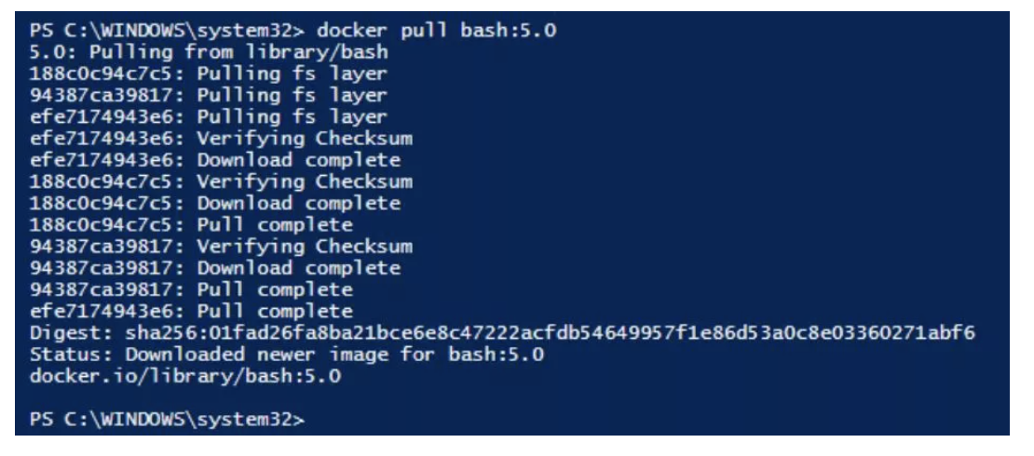
Docker Image/Container and DockerFile Commands
A Docker image is a read-only, inert template that comes with instructions for deploying containers. In Docker, everything basically revolves around images.
An image consists of a collection of files (or layers) that pack together all the necessities—such as dependencies, source code, and libraries—needed to set up a completely functional container environment.
Images are stored on a Docker registry, such as the Docker Hub, or on a local registry.
A Docker container is a virtualized runtime environment that provides isolation capabilities for separating the execution of applications from the underpinning system. It’s an instance of a Docker image.

Slide 6
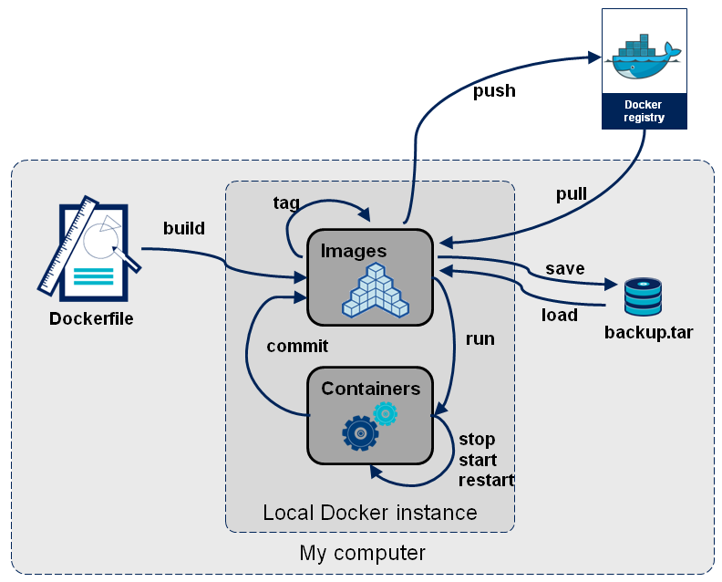
Docker Main Commands
docker pull ubuntu. (To pull image from hub/repo)
docker run –it –name c1 –d –p 82:80 ubuntu (To run an image as container)
docker exec –it c1 bash (To login into container)
Backup of container as Image
docker commit c1 apache-on-ubuntu:1.0(To save the container data as new Image)
docker save apache-on-ubuntu:1.0 --output backup.tar (To save the image as tar)
docker load -i backup.tar (To unzip the image from tar)
docker start/stop/restart c1 (Conatiner commands)
docker push image-name (To push the image to conatiner)
docker build Dockerfile

Slide 7
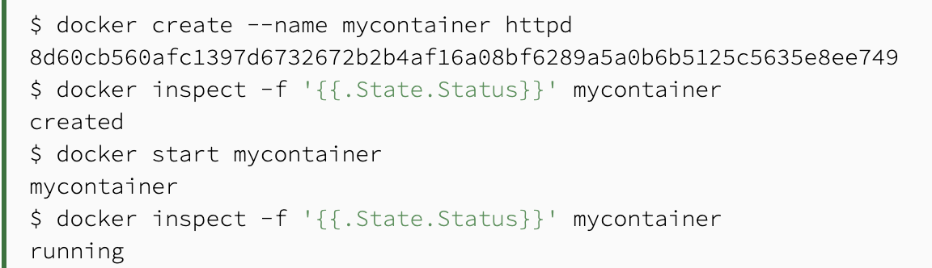
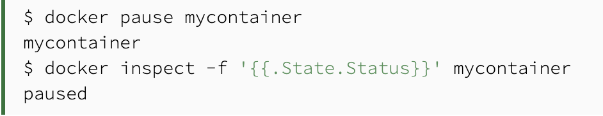
Docker Container States
Created - Docker assigns the created state to the containers that were never started ever since they were created. Hence, no CPU or memory is used by the containers in this state.
Running - When we start a container having created a state using the docker start command, it attains the running state. This state signifies that the processes are running in the isolated environment inside the container.
Restarting - Docker supports four types of restart policies, namely – no, on-failure, always, unless-stopped. Restart policy decides the behaviour of the container when it exit. By default, the restart policy is set to no, which means that the container will not be started automatically after it exits.
Exited - This state is achieved when the process inside the container terminates. No CPU and memory are consumed by the container.
The process inside the container was completed, and so it exited.
The process inside the container encountered an exception while running.
A container is intentionally stopped using the docker stop command.
No interactive terminal was set to a container running bash.
Pause - A paused container consumes the same memory used while running the container, but the CPU is released completely

Slide 8
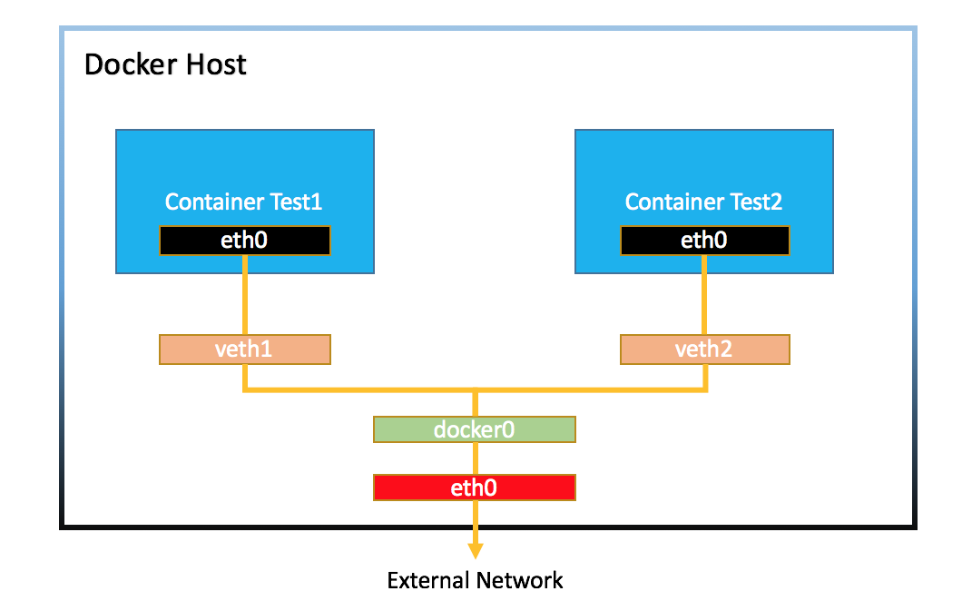
Docker Networking
1) Bridge: The default network driver. Bridge networks apply to containers running on the same Docker daemon host
2) Host: For standalone containers, remove network isolation between the container and the Docker host, and use the host’s networking directly
3) Overlay: Overlay networks connect multiple Docker daemons together and enable swarm services to communicate with each other. You can also use overlay networks to facilitate communication between a swarm service and a standalone container, or between two standalone containers on different Docker daemons.
User-defined bridges provide better isolation
Containers can be attached and detached from user-defined networks on the fly.
Each user-defined network creates a configurable bridge.
Managing User defined bridge network
docker network create -d docker0 (Basic command)
docker network rm my-net (To remove the network)
docker network create -d overlay docker0 (To connect to multiple daemons)
docker network create --driver=bridge --subnet=172.28.0.0/16 --ip-range=172.28.5.0/24 --gateway=172.28.5.254 docker0
docker create --name my-nginx --network docker0 --publish 8080:80 nginx:latest (To create a container without start state)
docker network disconnect docker0 my-nginx

Slide 9
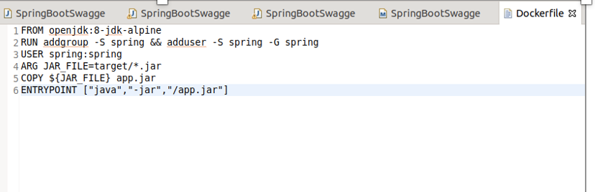
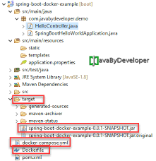
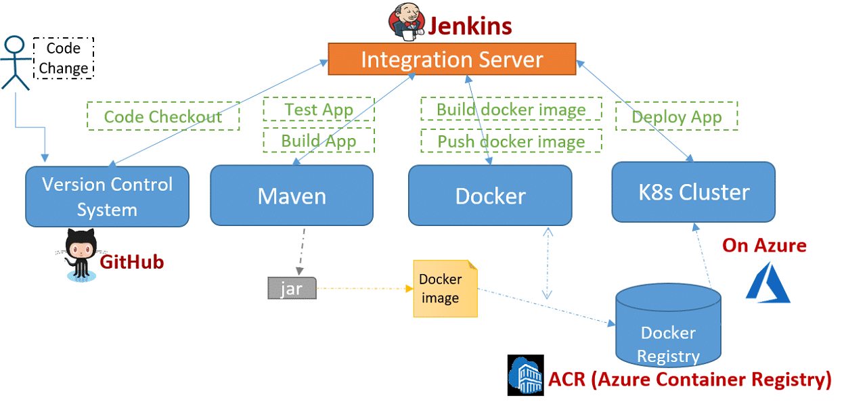
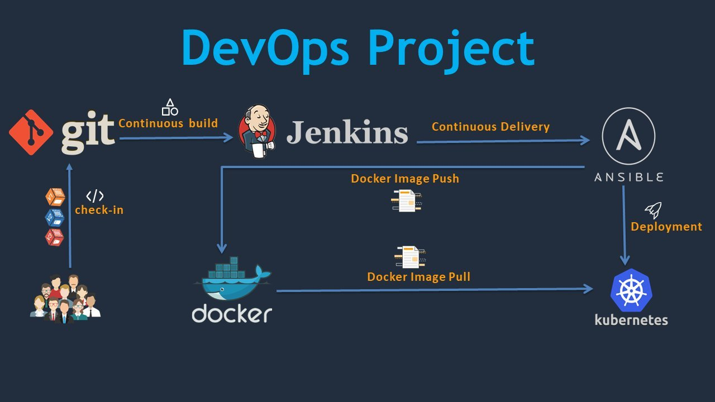
DockerFile
Stage 1 - Developer commits the JAVA code in GITHUB with Dockerfile
Stage 2 - Jenkins will check for changes with webhook(Trigger)
Stage 3 - Maven build happens with command (mvn clean install)
Stage 4 - Docker build command is given in Jenkins (docker build .)
Stage 4.1 -The docker image is created with the help of dockerfile
Stage 4.2 - Docker push to dockerregistry or Jfrog
Stage 5(Deploy App) - ANSIBLE (Which will pull the image from dockerregistry and deploy into K8s)

Slide 10
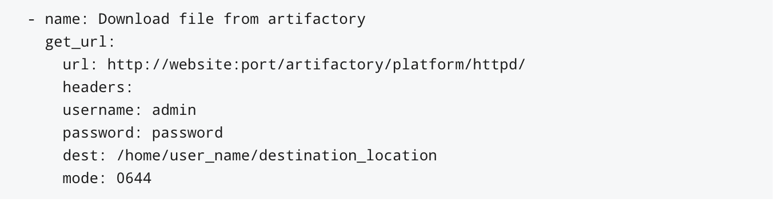
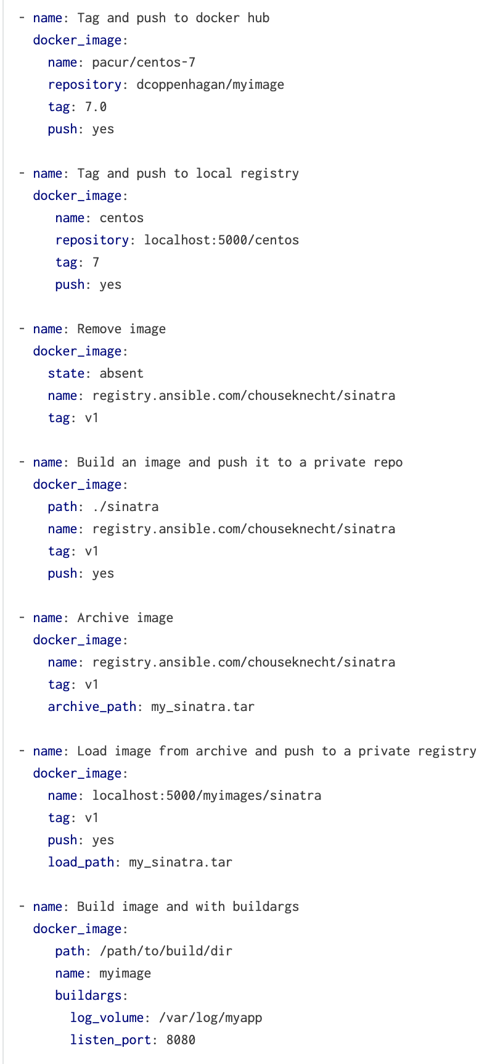
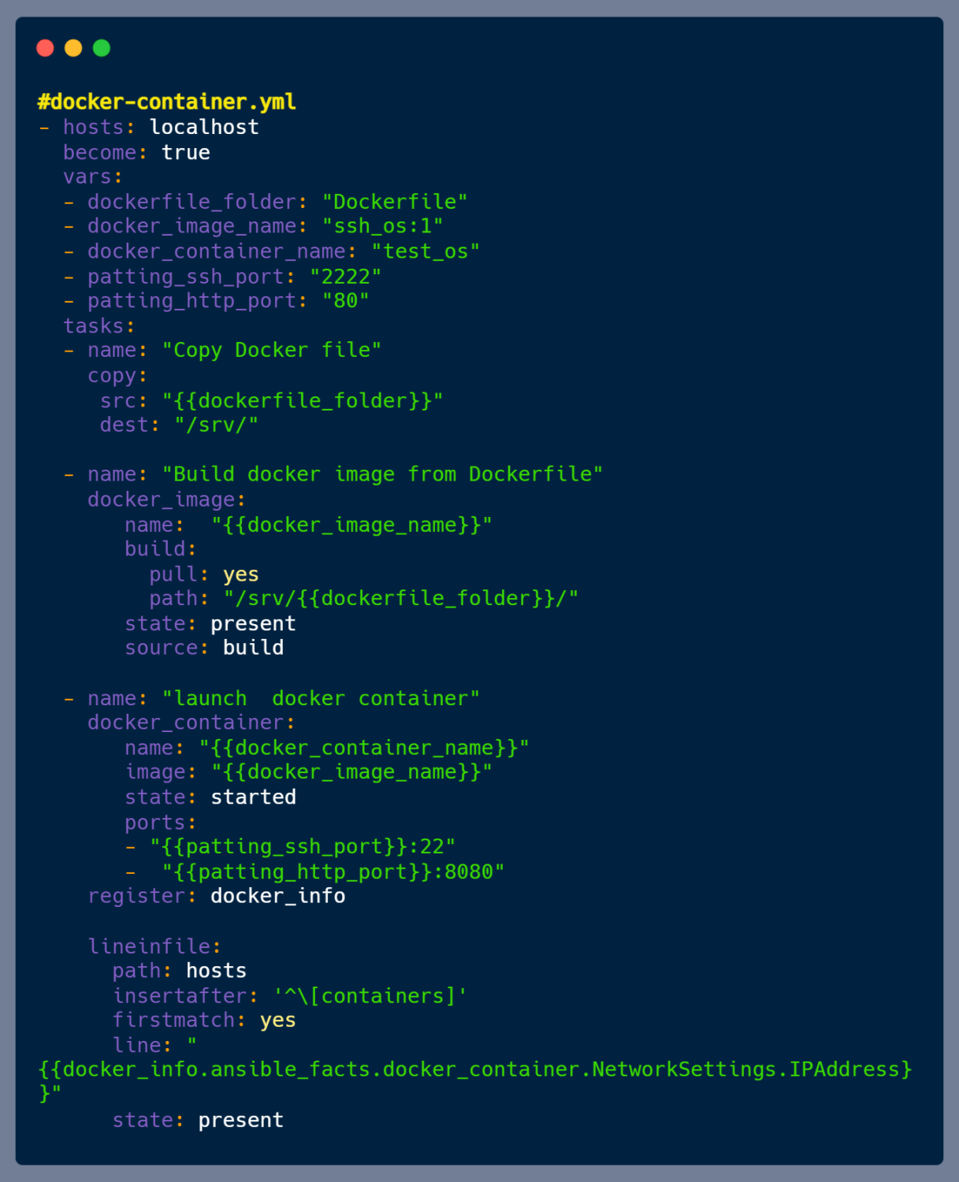
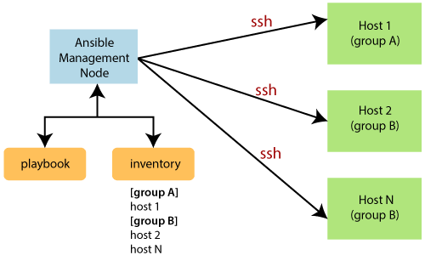
Ansible

Slide 11
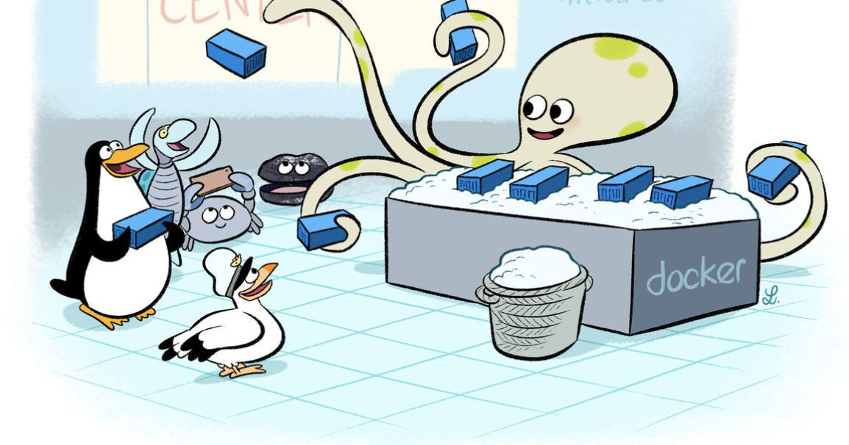
Thank you all for joining today’s session ☺☺☺

