Slide 1
MOVIE RECOMMENDATION SYSTEM USING MACHINE LEARNING
PROJECT BY- Sukhmaninder Singh
ROLL NO. – 27
INDUSTRIAL TRAINING – Artificial Intelligence and Machine Learning

Slide 2
INTRODUCTION
A Movie Recommendation System is an intelligent application designed to suggest movies to users based on their interests, preferences, and past behavior. By utilizing machine learning algorithms, such systems analyze large volumes of data to generate personalized recommendations. This project focuses on developing a movie recommendation system that leverages machine learning techniques to recommend relevant movies efficiently. The proposed system analyzes user ratings, movie features, and interaction history to identify patterns and predict user preferences. The project demonstrates the real-world application of machine learning concepts such as data preprocessing, similarity computation, and predictive modeling.

Slide 3
PROBLEM STATEMENT
Traditional movie recommendation systems suffer from the following limitations:
1. The increasing number of movies available on online platforms has led to the problem of information overload.
2. Traditional browsing and search methods are insufficient to provide personalized recommendations.
PROBLEM DEFINITION
1. The problem addressed in this project is the lack of an intelligent and personalized movie recommendation system that can automatically adapt to user preferences
2. There is a need for a system that can analyze user behavior and recommend movies accurately using machine learning techniques.

Slide 4
TECHNOLOGIES USED
Python - Programming Language
TensorFlow / Keras – Deep learning model training
NumPy & Pandas – Data handling and preprocessing
Front end – HTML,CSS and Java Script
API – Spotify API and YouTube API

Slide 5
OBJECTIVES
The primary objectives of the project are:
1.To design and develop a movie recommendation system using machine learning.
2.To analyze user preferences based on ratings and viewing history.
3.To implement collaborative filtering and content-based filtering techniques.
4.To improve the accuracy and relevance of movie recommendations.
5.To reduce the time and effort required for users to select movies.
6.To build a scalable and efficient recommendation system.

Slide 6
METHODOLOGY
The project follows the steps below:
DATA COLLECTION - Data collection from publicly available movie datasets.
DATA PREPROCESSING - Data preprocessing including cleaning, normalization, and transformation.
GENERATION - Generation of movie recommendations.
PERFORMANCE EVALUATION - Evaluation of system performance.

Slide 7
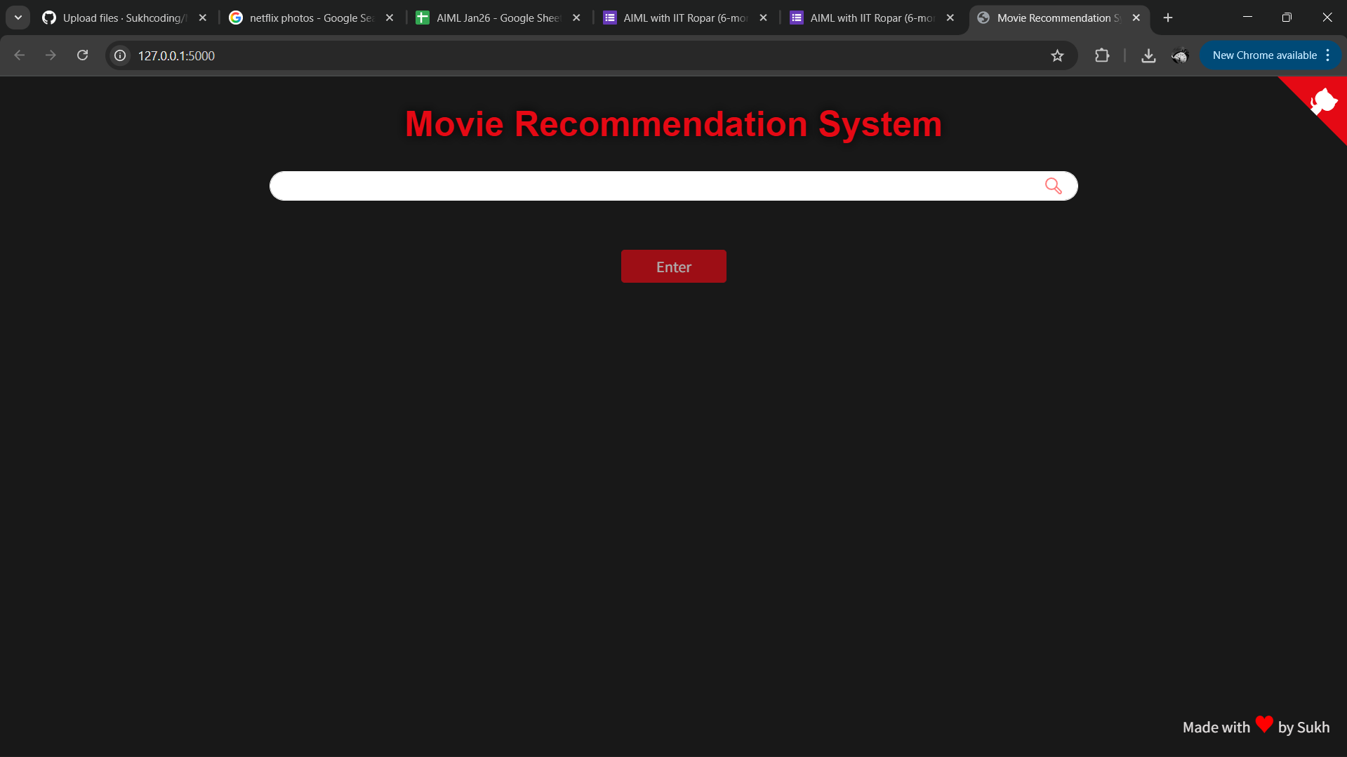
USER INTERFACE AND RESULT

Slide 8
FUTURE SCOPE
The system can be enhanced in the future by:
1. Implementing a hybrid recommendation system.
2. Incorporating deep learning algorithms.
3. Adding real-time user feedback and learning.
4. Deploying the system as a web or mobile application.
5. Integrating user reviews and sentiment analysis.
6. Supporting multi-language and regional content.

Slide 9
THANK YOU

