Slide 1
Exceptions in Python
Understanding and Handling Errors

Slide 2
What are Exceptions?
Sometimes while executing a Python program, the program does not execute at all or the program executes but generates unexpected output or behaves abnormally.
These occur when there are syntax errors, runtime errors or logical errors in the code.
In Python, exceptions are errors that get triggered automatically.

Slide 3
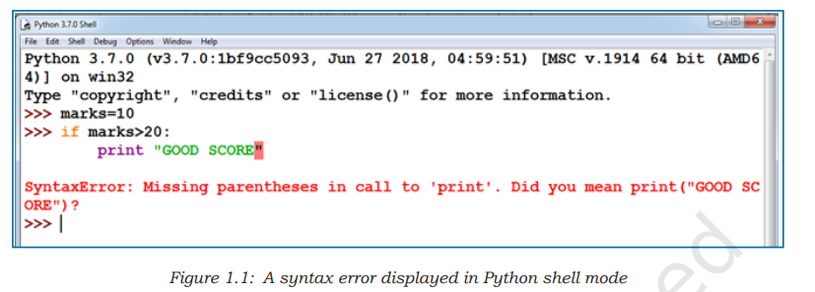
Syntax errors
Syntax errors are detected when we have not followed the rules of the particular programming language while writing a program.

Slide 4
Logical Errors
Logical errors occur when the program runs without crashing, but the output is not what you expected.
These errors are typically caused by mistakes in the program's logic.
Example: Writing a program to add two numbers but getting an incorrect sum because of a mistake in the addition logic.

Slide 5
Runtime Error
Runtime errors occur when the program is running and encounters an operation that is illegal or impossible to execute.
These errors cause the program to terminate unexpectedly.
Example: Dividing a number by zero will raise a ZeroDivisionError at runtime.

Slide 6
Built-in Exceptions in Python
SyntaxError
TypeError
ValueError
IndexError
KeyError
NameError
AttributeError
IOError
ZeroDivisionError
MemoryError
ImportError

Slide 7
SyntaxError
A SyntaxError occurs when the parser detects a syntactically incorrect statement.
Example:
if x > 10
print('x is greater than 10')
# This will raise a SyntaxError because the colon (:) is missing after the if statement.

Slide 8
TypeError
A TypeError occurs when an operation or function is applied to an object of inappropriate type.
Example:
x = '10'
y = 5
result = x + y
# This will raise a TypeError because you cannot add a string and an integer.

Slide 9
ValueError
A ValueError occurs when a function receives an argument of the correct type but inappropriate value.
Example:
x = int('abc')
# This will raise a ValueError because 'abc' cannot be converted to an integer.

Slide 10
IndexError
An IndexError occurs when trying to access an index that is out of range.
Example:
list = [1, 2, 3]
print(list[5])
# This will raise an IndexError because there is no index 5 in the list.

Slide 11
KeyError
A KeyError occurs when trying to access a key that does not exist in a dictionary.
Example:
dict = {'name': 'Alice', 'age': 25}
print(dict['gender'])
# This will raise a KeyError because 'gender' is not a key in the dictionary.

Slide 12
NameError
A NameError occurs when a variable is not defined.
Example:
print(age)
# This will raise a NameError because the variable 'age' has not been defined.

Slide 13
AttributeError
An AttributeError occurs when trying to access an attribute that does not exist.
Example:
x = 10
x.append(5)
# This will raise an AttributeError because integers do not have an 'append' method.

Slide 14
IOError
An IOError occurs when an input/output operation fails.
Example:
file = open('nonexistentfile.txt', 'r')
# This will raise an IOError because the file does not exist.

Slide 15
ZeroDivisionError
A ZeroDivisionError occurs when dividing by zero.
Example:
x = 10
y = 0
result = x / y
# This will raise a ZeroDivisionError because you cannot divide a number by zero.

Slide 16
MemoryError
A MemoryError occurs when an operation runs out of memory.
Example:
x = []
while True:
x.append(1)
# This will eventually raise a MemoryError as the list grows indefinitely.

Slide 17
ImportError
An ImportError occurs when an import statement fails to find the module definition.
Example:
import nonexistentmodule
# This will raise an ImportError because the module does not exist.

Slide 18
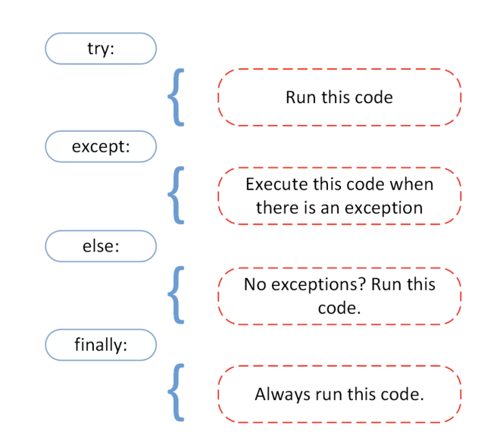
Handling Exceptions

Slide 19
Exception handling
When an error happens, it can cause the program to stop running unexpectedly.
Exception handling provides a way to manage these errors so that the program can continue running or fail gracefully without crashing.

Slide 20
Why Exception Handling is Important
Prevents Crashes: Exception handling allows the program to manage the error and continue running.
Provides Clear Error Messages: It helps in providing meaningful error messages to the user or developer
Allows Recovery: Exception handling allows the program to recover from certain errors without stopping.

Slide 21
try
What it does: The code inside the try block is where you place the code that might cause an error or exception.
Explanation: Python will "try" to run this code. If everything goes well and there are no errors, it will move on to the next part.

Slide 22
except
What it does: The code inside the except block runs only if there is an error (an exception) in the try block.
Simple Explanation: If Python encounters an error while trying to run the code in the try block, it will "catch" the error and run the code inside this block instead. This way, the program doesn't crash.

Slide 23
else
What it does: The code inside the else block runs if no errors occurred in the try block.
Explanation: If the try block runs without any problems (no exceptions), then Python will run the code in the else block. This is like saying, "If everything went fine, now do this."

Slide 24
finally
What it does: The code inside the finally block will always run, no matter what happened before whether there was an error or not.
Simple Explanation: This block is for code that should always run at the end, whether there was an error or not. It's like saying, "Finally, always do this."

Slide 25
Handling Exceptions
Use `try` and `except` blocks to handle exceptions.
The `try` block contains the code that might throw an exception.
The `except` block contains the code to execute if an exception occurs.
Optionally, use `else` to execute code if no exceptions are raised.
The `finally` block can be used for code that must run regardless of exceptions.

Slide 26
Example: Handling Exceptions
try:
result = 10 / 0
except ZeroDivisionError:
print('Cannot divide by zero')
else:
print('Division successful')
finally:
print('Execution complete')

Slide 27
Conclusion
- Exceptions are crucial for handling errors in Python.
- Proper use of try-except blocks ensures robust and error-resistant code.
- Understanding exceptions allows for better debugging and error handling.

