Slide 1
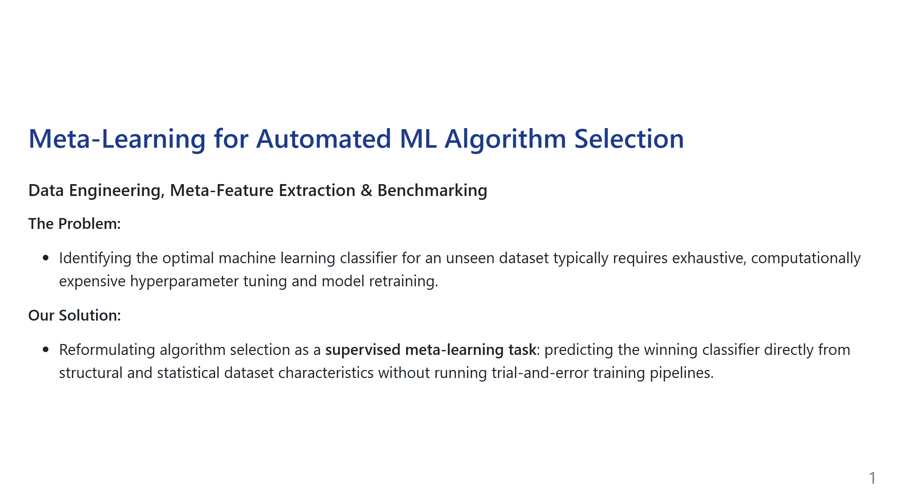
Notes:
Speaker Talking Point:
"Good morning/afternoon. In automated machine learning, running every algorithm on a new dataset wastes substantial compute time. Our project builds a meta-model that acts as an intelligent recommender system: it analyzes the geometric and statistical fingerprint of a dataset and immediately recommends the best machine learning classifier."

Slide 2
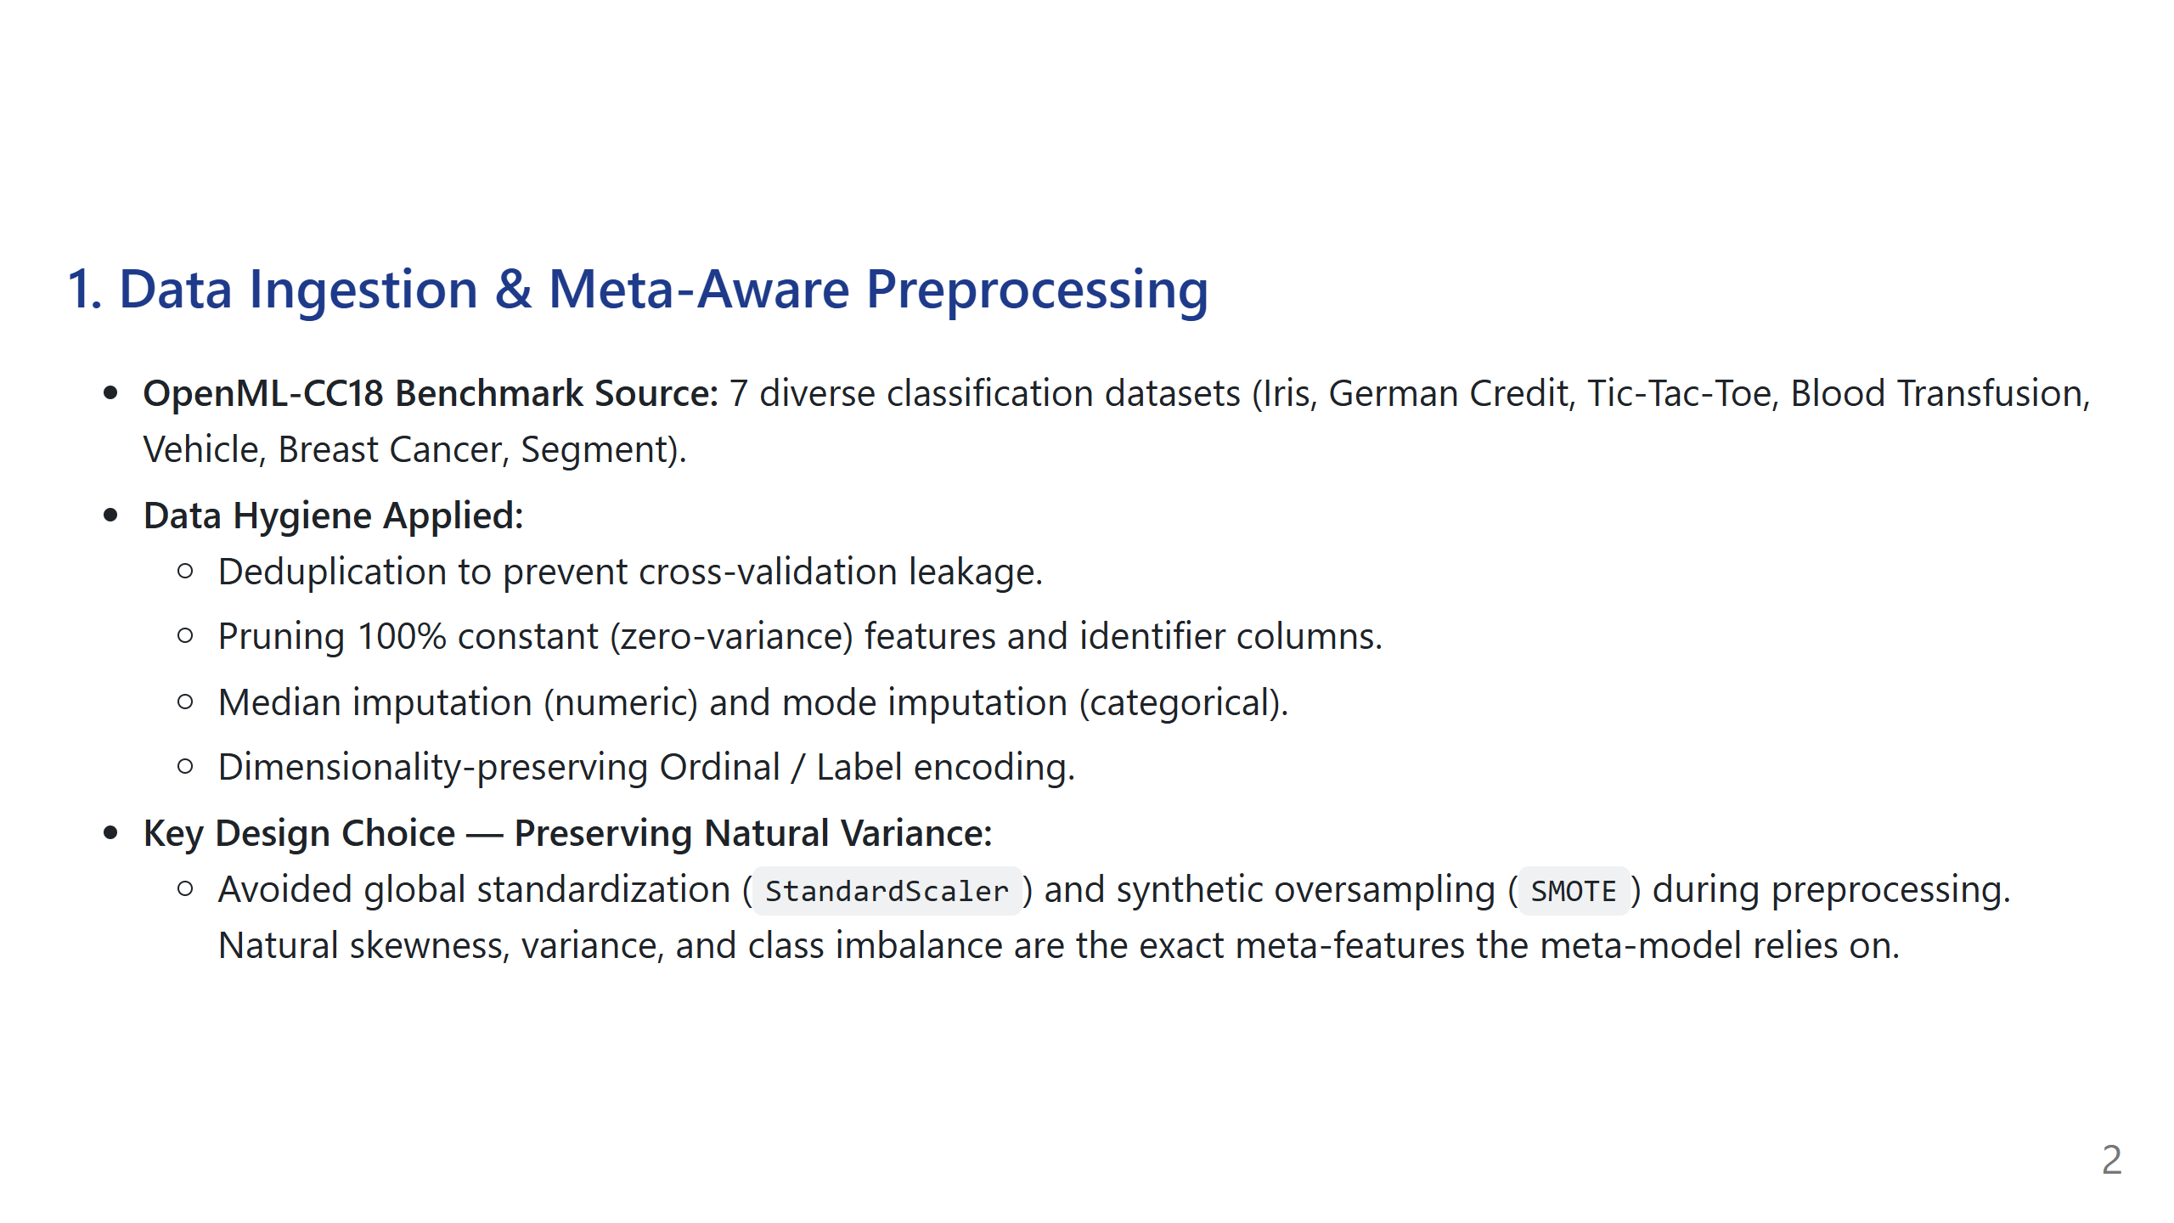
Notes:
Speaker Talking Point:
"For our benchmark foundation, we ingested 7 datasets from OpenML-CC18 with varying scales, features, and balance ratios. Crucially, we made an intentional architectural decision: unlike standard ML pipelines that artificially normalize or oversample datasets with SMOTE, we preserved natural skewness and class imbalance. If we artificially smoothed them, the meta-model would lose the very signals it needs to recommend one algorithm over another."

Slide 3
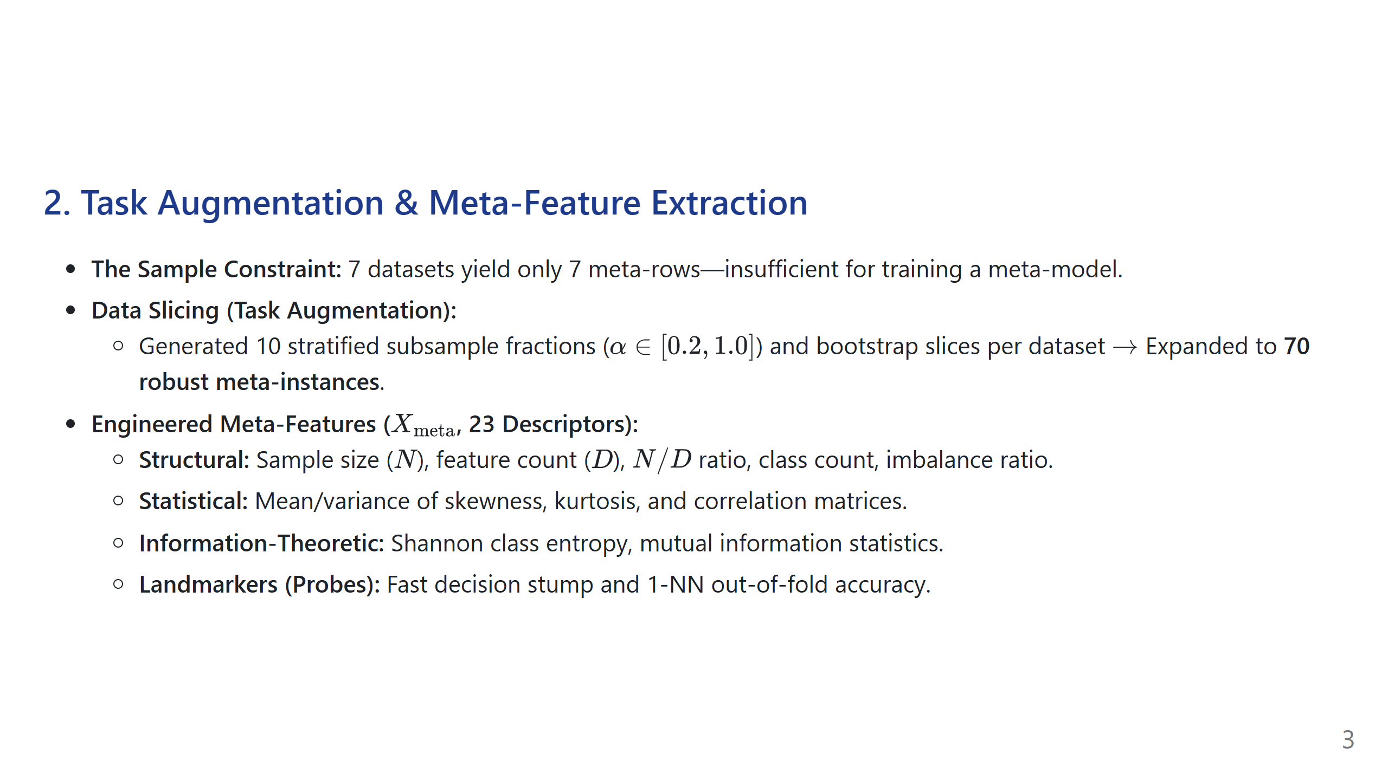
Notes:
Speaker Talking Point:
"In meta-learning, one entire dataset equals one row in the meta-dataset. To overcome sample scarcity, we implemented stratified task augmentation—slicing each dataset across 10 deterministic fractions and bootstrap iterations. This yielded 70 high-quality training instances. We then engineered 23 meta-features capturing geometry, statistical moments, information entropy, and lightweight landmarking probes."

Slide 4
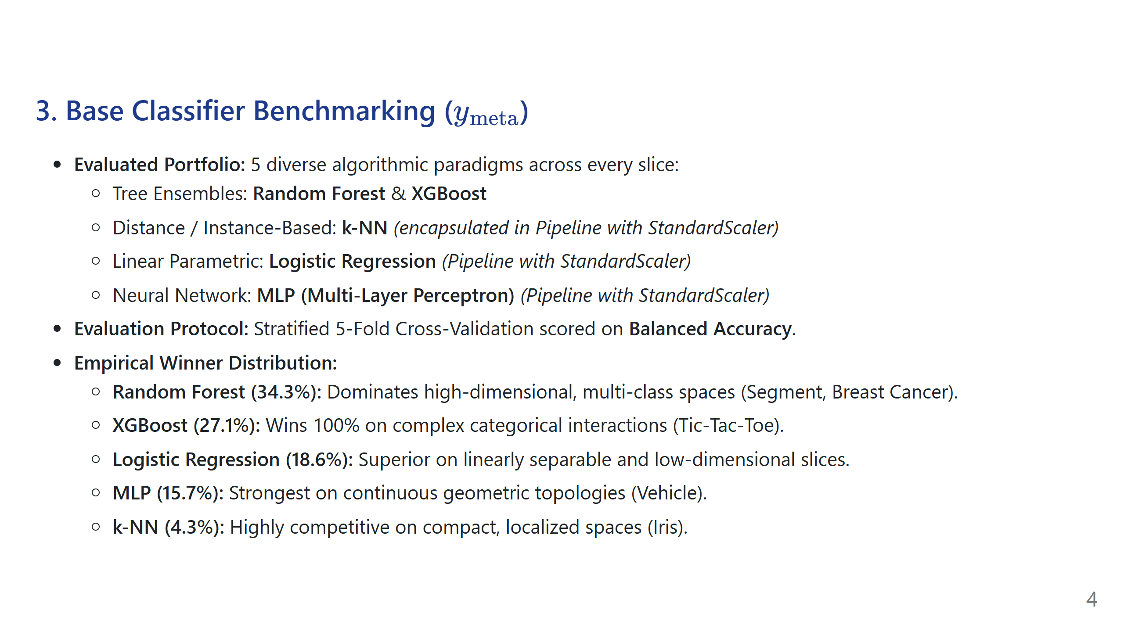
Notes:
Speaker Talking Point:
"To obtain our ground-truth labels, we benchmarked five distinct model families using stratified 5-fold cross-validation evaluated on balanced accuracy. Random Forest and XGBoost captured over 61% of wins, but Logistic Regression and MLP proved superior in specific linear and continuous geometric environments. This empirical divergence confirms that no single model is universally optimal, validating the need for automated selection."

Slide 5
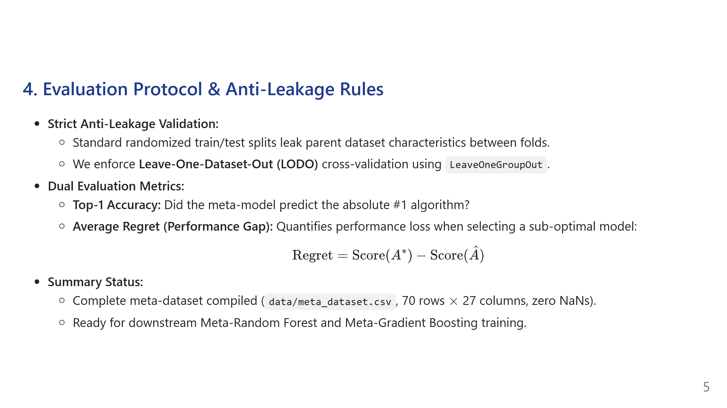
Notes:
Speaker Talking Point:
"To ensure rigorous scientific validation, we forbid standard train/test splits, which cause data leakage across slices. Instead, we use Leave-One-Dataset-Out cross-validation so the meta-model is evaluated on completely unseen datasets. Beyond Top-1 accuracy, we evaluate using Average Regret to measure how near-optimal our recommendations are in real-world deployments. The data pipeline is complete and ready for meta-model training."

