Slide 1
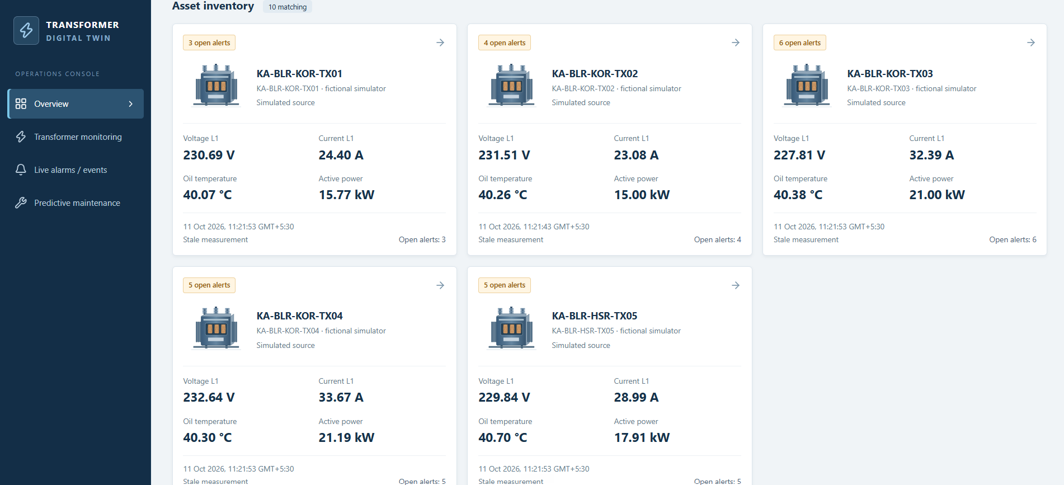
Transformer Digital Twin
POWERNEXT AI HACKATHON
Team - Hackops4G

Slide 2
Beyond Sensors: Seeing Inside the Transformer
Measured data
+
Physics models
+
AI
→
Actionable digital twin
Conventional monitoring
Our proposed solution
Relies on directly measured sensor values
Fixed thresholds may miss evolving thermal stress
Limited visibility into internal transformer conditions
Combine live telemetry with transformer physics equations
Estimate internal winding hot-spot temperature and thermal ageing
Detect abnormal thermal response and assess cooling effectiveness
Generate explainable, evidence-based maintenance insights
Objectives
1
Simulate transformer behaviour under changing loads
2
Reconstruct hidden thermal conditions using physics models
3
Estimate hot-spot temperature and insulation ageing
4
Detect anomalies using physics-informed AI
5
Simulate operating scenarios and assess risk
6
Visualize transformer health, uncertainty and maintenance priorities

Slide 3
What we ingest and normalize
1
Thermal / environment
2
Electrical
3
Condition / protection
Oil temperature
Ambient temperature
Phase currents L1 / L2 / L3
Phase voltages in canonical telemetry; source VL12 / VL23 / VL31 excluded by the adapter
Active, reactive, apparent power
Power factor
Neutral current
Oil level / oil-leak indicator
Alarms / trips
Loading and asset configuration
!
Oil leak is never inferred from oil temperature alone
Adapter normalizes to a canonical schema
An oil-level anomaly appears only when an oil-level sensor or scenario signal exists.
Checks units, identity and timestamps. Missing values stay null, never zero.

Slide 4
From simulator to dashboard: one traceable pipeline
Historical CSV
synthetic generator
Canonical adapter
and scenario engine
Modbus register map
(FC04)
Modbus bridge
+ durable spool
MQTT broker
QoS 1
Shared FastAPI ingestion
HTTP, batch/replay and MQTT converge here
HTTP telemetry
batch / historical replay
committed receipt ack
React + TypeScript
dashboard
Versioned REST
read APIs
PostgreSQL
raw telemetry, receipts, history
Empirical ML pipeline
Schema, units, identity,
timestamp, idempotency checks
Opt-in physics demo

Slide 5
Architecture
simulator
FastAPI backend
Telemetry and batch APIs
MQTT consumer
Canonical validation + idempotent ingestion
Empirical analytics
Anomaly, health, maintenance
PostgreSQL
Read APIs
latest, history, trends, alerts, maintenance, physics
React / TS operations console
Historical CSV replay
Controlled synthetic physics
with 2-D sheet FEM reference
Future sensor / SCADA adapter
Stack
React 19 + TypeScript + Vite
FastAPI + Pydantic + SQLAlchemy
NumPy / pandas / SciPy / scikit-learn
pymodbus + Paho MQTT
Mosquitto + Docker Compose
Empirical ML and physics estimates are distinct. The physics demo is a physics-informed analytical branch, not an ML model; the production physics contract may return typed "unavailable" results unless eligibility and configuration are satisfied.

Slide 6
Analytics turn telemetry into explainable signals
Loading percentage
Injected abnormal telemetry
Apparent-power utilization
Thermal model
Model temperature and residual
Changed loading / thermal / electrical indicators
Anomaly detection
Anomaly score and flag
Health Index 0–100
Health / anomaly reason codes
Higher is healthier; component scores and reason codes
Maintenance priority
NORMAL / WATCH / PLAN / URGENT with explanatory recommendation
Alert / maintenance context
Protection indicators
Oil-level deviation and alarm / trip indicators where inputs exist

Slide 7
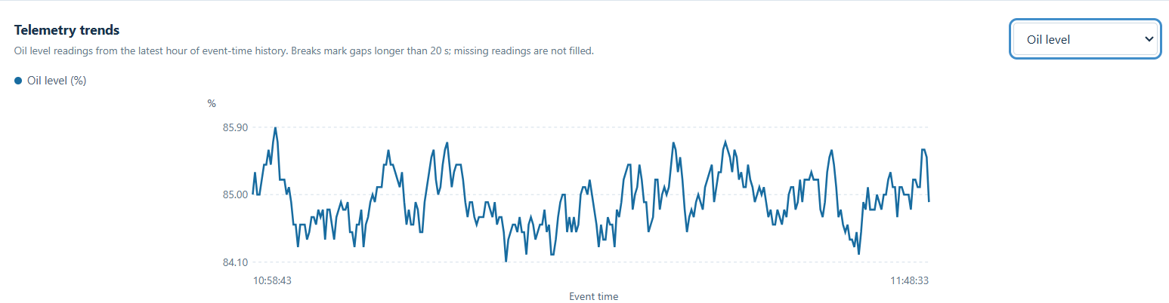
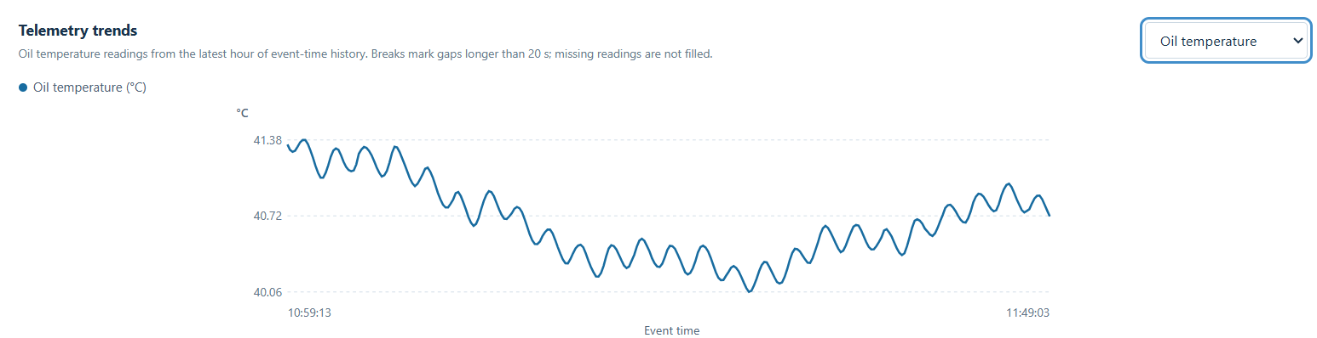

Slide 8
Indicators derived Through Measurable Parameters
Simulated oil-sensor temp
[°C]
Ts(t+Δt) = To(t) + [Ts(t) − To(t)]·e^(−Δt/τs)
Standalone τs = 5 s; full-stack uses a separate 1200 s lag, passed in as input.
Top-oil temperature estimate
[°C]
T_oil,est = To − 273.15
Oil-node / top-oil proxy from the simplified node model.
Oil-node temperature rise
[K]
ΔTo = To − Ta
Oil-node rise above the held ambient temperature.
Winding hotspot estimate
[°C]
T_winding,proxy = Tw − 273.15
Winding-node proxy, not the true local maximum hot spot.
Winding-to-oil gradient
[K]
ΔT_w−o = Tw − To
Gradient between the winding-node proxy and the oil node.
Total transformer loss
[W]
P_loss = P0 + P_load,rated · (1/3) Σ (Ii / I_rated)²

Slide 9
Indicators derived Through Measurable Parameters
Aging acceleration factor
[unitless]
F_age = exp((Tw − 310 K) / 20 K)
The 310 K reference and 20 K scale are invented for the demo; not an IEEE/IEC ageing equation or insulation-life truth.
Equivalent aging hours
[h]
H_eq,new = H_eq,old + (F_prev + F_curr)/2 · Δt/3600
Trapezoidal integration over contiguous synthetic history, Δt in seconds. H = 0 means no supported history; not Remaining Useful Life.
FEM reference temperature
[°C or K]
T_FEM,mean = (1/A) ∫_A Tw(x,y) dA
Area-average winding-sheet temperature of the 2-D two-sheet synthetic FEM; not the maximum point, not a measurement.
Estimator-vs-FEM difference
[K]
ΔT_est−FEM = T_winding,proxy − T_FEM,mean
Matched mean / proxy under the same forcing; near zero tests mean/energy consistency, not spatial hot-spot accuracy.

Slide 10
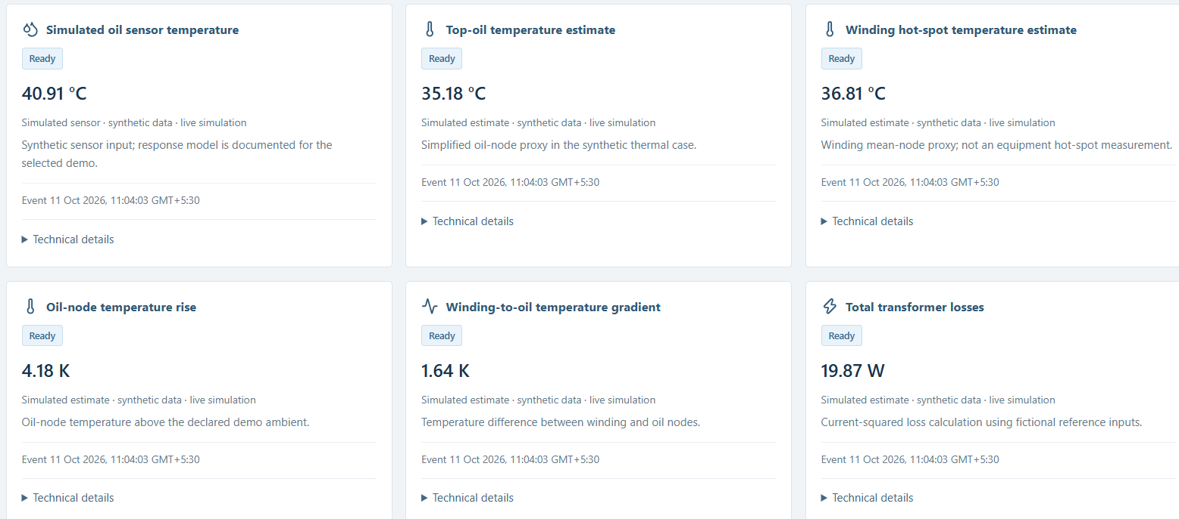
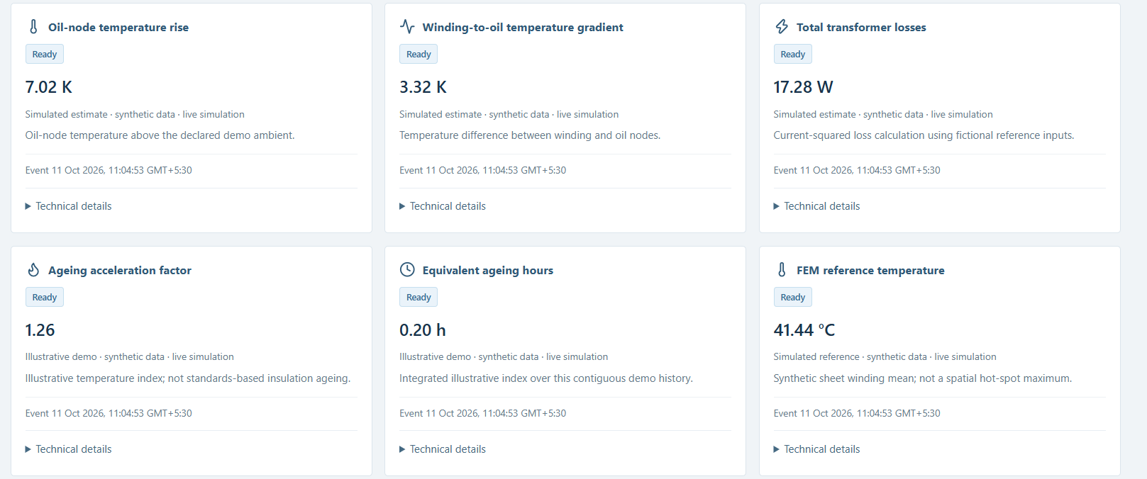

Slide 11
Demonstration: controlled fault scenarios
1
2
3
4
5
Healthy baseline
Overload
Thermal stress
Current imbalance
Low oil level or alarm / trip
Reference behaviour
Loading rises; thermal indicators follow
Rapid oil-temperature rise
Phase currents diverge; neutral current rises
Optional, when the field is present
Scenario injection
Coherent telemetry change
Ingestion
Analytics and eligible synthetic physics
Status, trend, alerts, reason codes
Maintenance priority and recommendation

Slide 12
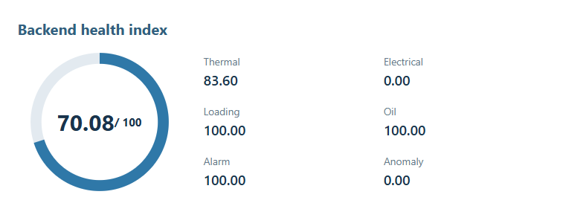
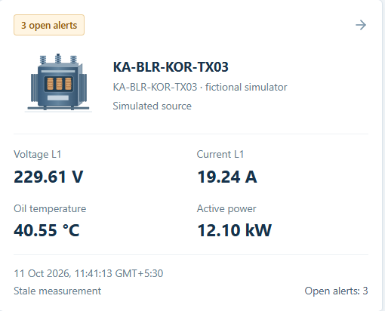
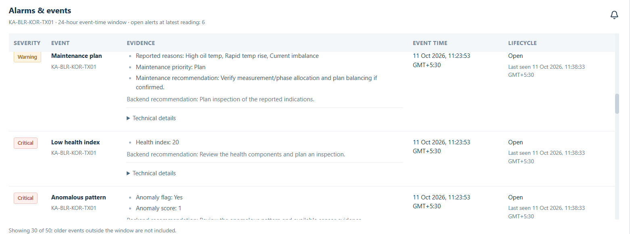

Slide 13
Scaling the twin dashboard
1
Pressure and oil-system monitoring
4
Insulation ageing and cumulative thermal damage
Tank / relief pressure and oil-system behaviour once real sensors exist. Fields stay null until then.
Extend the illustrative ageing-hours demo toward cumulative thermal-damage tracking, only after calibration and field validation.
2
Cooling-system effectiveness
Compare observed oil temperature with the thermal model at the same load; a growing residual is a candidate cooling indicator.
5
3D thermal digital twin using FEM
Create a simulated spatial temperature map of transformer components rather than displaying only one temperature number.
3
Advanced electrical health
Expand beyond basic current and voltage monitoring:
Phase imbalance and current asymmetry
Voltage deviation and power factor, if the required signals exist
Harmonic distortion, if waveform or harmonic measurements are available
Illustrative spatial map

