Slide 1


Slide 2
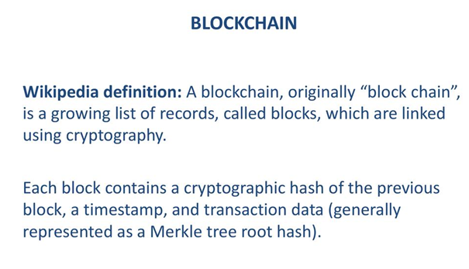

Slide 3
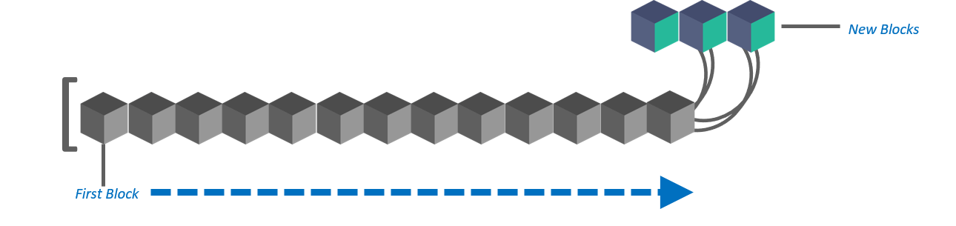
Blockchain consists of a list of records. Such records are stored in blocks. These blocks are in turn linked with other blocks and hence constitute a chain called Blockchain.

Slide 4
Each block contains a hash (a digital fingerprint or unique identifier),timestamped batches of recent valid transactions, and the hash of the previous block.
The previous block hash links the blocks together and prevents any block from being altered or a block being inserted between two existing blocks.
In this way, each subsequent block strengthens the verification of the previous block and hence the entire blockchain.
The method renders the blockchain tamper-evident, lending to the key attribute of immutability.

Slide 5
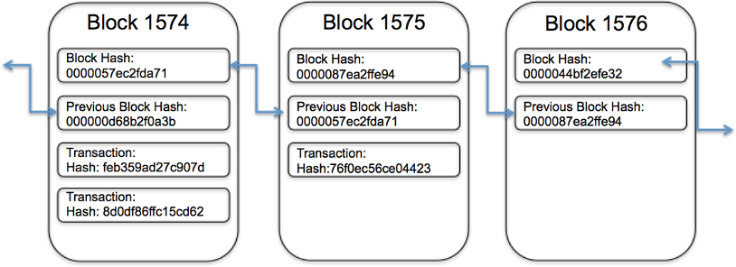

Slide 6
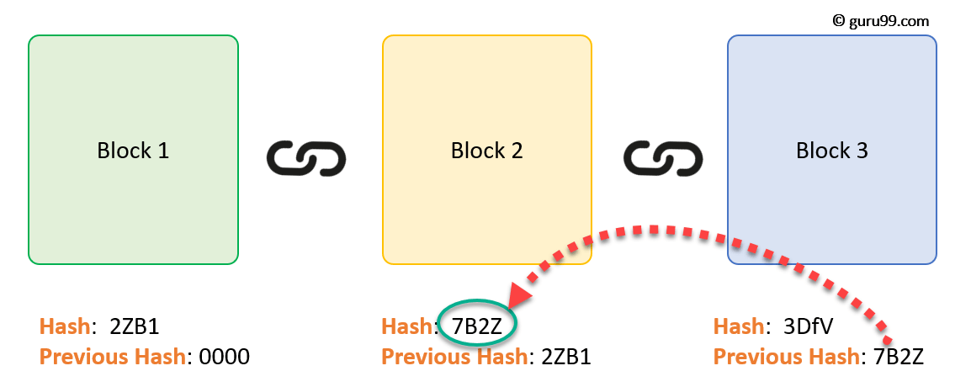
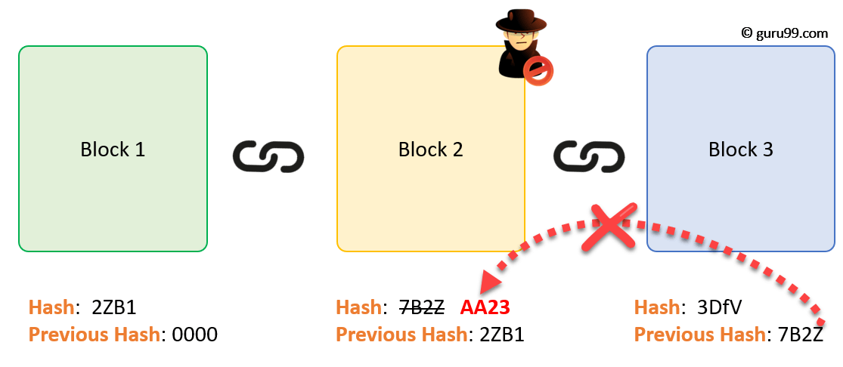

Slide 7
The Technology Behind Bitcoin
Think of Bitcoin as an electronic asset (as well as a digital currency)
A network of computers keeps track of Bitcoin payments, and adds them to an ever-growing list of all the Bitcoin payments that have been made, called “The Bitcoin Blockchain”
The file that contains data about all the Bitcoin transactions is often called a “ledger”
Bitcoin value is created through transaction processing, referred to as “mining,” which is performed by distributed processors called “nodes” of the peer-to-peer network

Slide 8
The birth of blockchain
Blockchain provides the means for recording Bitcoin transactions — the shared ledger — but this shared ledger can be used to record any transaction and track the movement of any asset whether tangible, intangible, or digital.
Bitcoin is only the first use case for blockchain

Slide 9
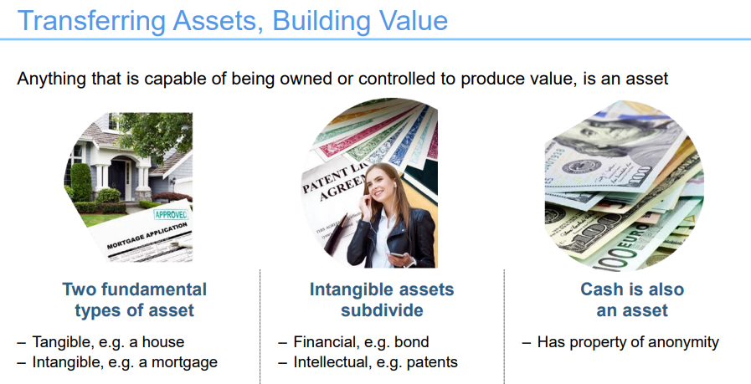
Assets
Anything that is capable of being owned or controlled to produce value, is an asset.

Slide 10
Ledger is a principal book (or computer file) for recording asset transfer between participants.
Distributed ledger(shared ledger) is a ledger that is replicated, synchronized and spread across multiple sites, countries, and/or institutions.

Slide 11
History of block chain
The first blockchain was conceptualized by a person (or group of people) known as Satoshi Nakamoto in 2008.
The design was implemented the following year by Nakamoto as a core component of the cryptocurrency bitcoin, where it serves as the public ledger for all transactions on the network.

Slide 12
History of block chain
In 2009 bitcoin was launched.
In August 2014, the bitcoin blockchain file size, containing records of all transactions that have occurred on the network, reached 20 GB (gigabytes).
In January 2015, the size had grown to almost 30 GB, and from January 2016 to January 2017, the bitcoin blockchain grew from 50 GB to 100 GB in size.
The words block and chain were used separately in Satoshi Nakamoto's original paper, but were eventually popularized as a single word, blockchain, by 2016.

Slide 13
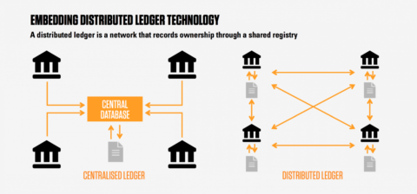
Distributed Ledgers
A distributed ledger (also called a shared ledger or distributed ledger technology or DLT) is a consensus of replicated, shared, and synchronized digital data geographically spread across multiple sites, countries, or institutions.
There is no central administrator or centralized data storage.

Slide 14
Distributed Ledgers
When a ledger update happens, each node constructs the new transaction, and then the nodes vote by consensus algorithm on which copy is correct.
Once a consensus has been determined, all the other nodes update themselves with the new, correct copy of the ledger.
Security is accomplished through cryptographic keys and signatures.

Slide 15
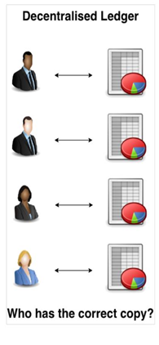
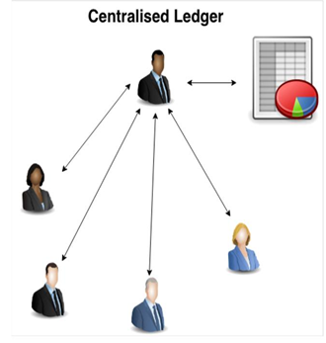
Distributed Ledgers

Slide 16
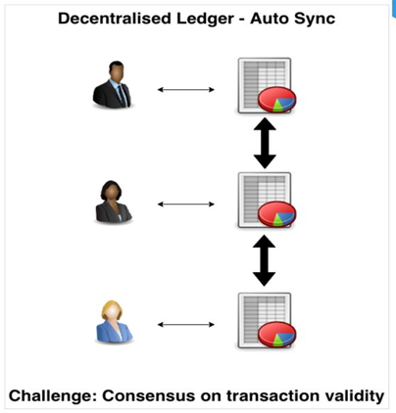
Distributed Ledgers

Slide 17

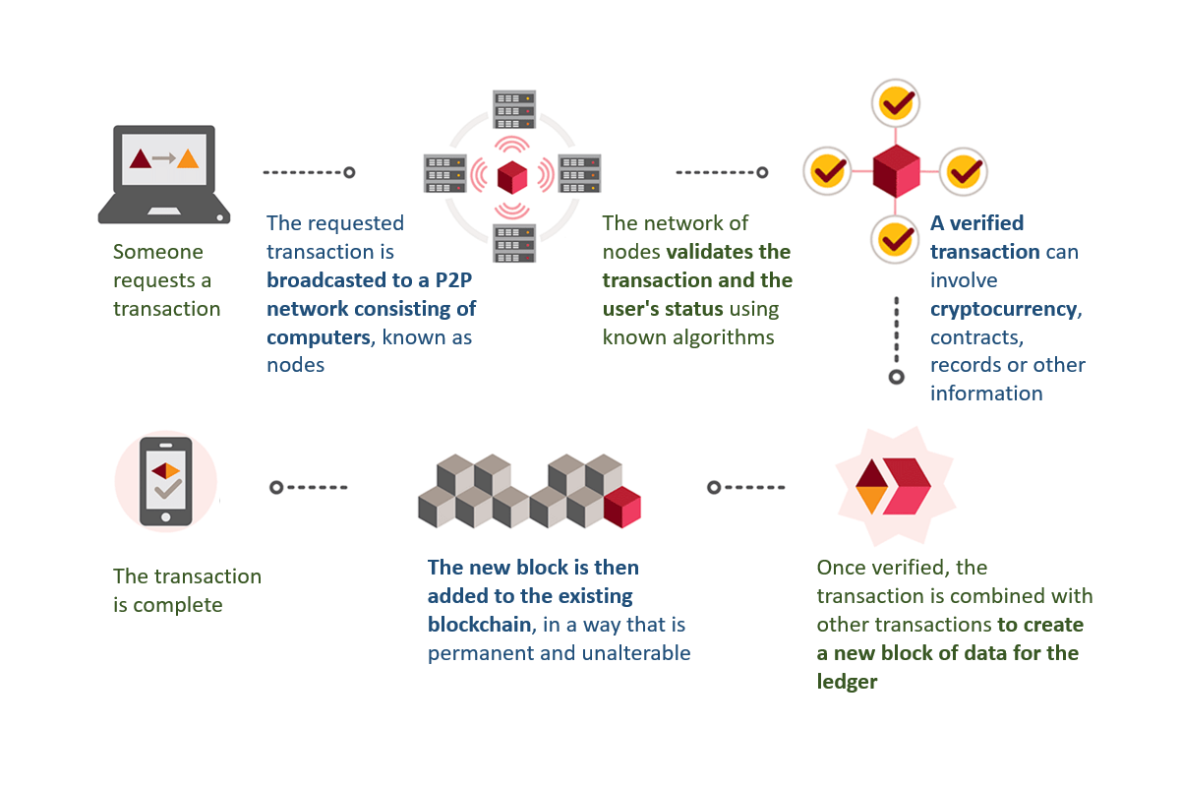
How blockchain works

Slide 18
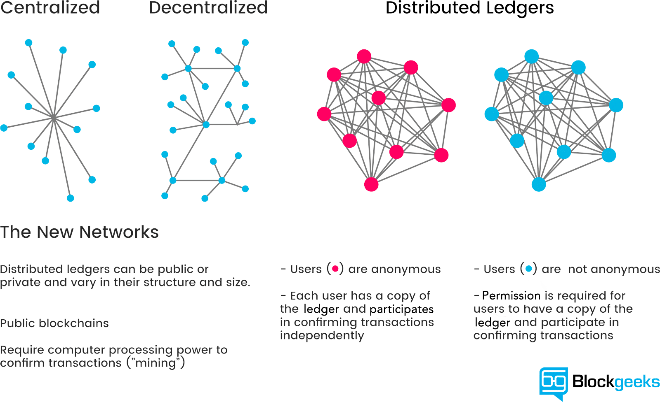

Slide 19
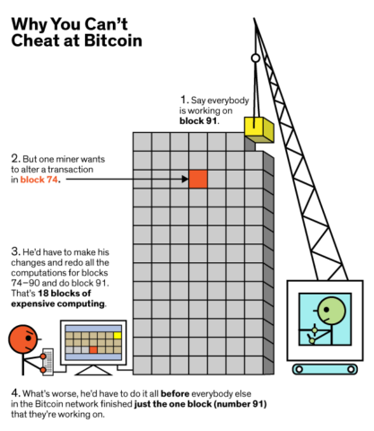

Slide 20
Blockchain characteristics:
»»Consensus: For a transaction to be valid, all participants
must agree on its validity.
»»Provenance: Participants know where the asset came from
and how its ownership has changed over time.
»»Immutability: No participant can tamper with a transaction
after it has been recorded to the ledger. If a transaction is in
error, a new transaction must be used to reverse the error,
and both transactions are then visible.
»»Finality: A single, shared ledger provides one place to go to
determine the ownership of an asset or the completion of a
transaction.

Slide 21
Blockchain builds trust through the following five attributes:
»»Distributed and sustainable: The ledger is shared, updated with every transaction, and selectively replicated among participants in near real time.
»»Secure, private, and indelible: Permissions and cryptography prevent unauthorized access to the network and ensure that participants are who they claim to be.

Slide 22
Blockchain builds trust through the following five attributes:
»Transparent and auditable: Because participants in a transaction have access to the same records, they can validate transactions and verify identities or ownership without the need for third-party intermediaries. Transactions are time-stamped, ordered, and can be verified in near real time.
»»Consensus-based and transactional: All relevant network participants must agree that a transaction is valid. This is achieved through the use of consensus algorithms. Each blockchain network can establish the conditions under which a transaction or asset exchange can occur.

Slide 23
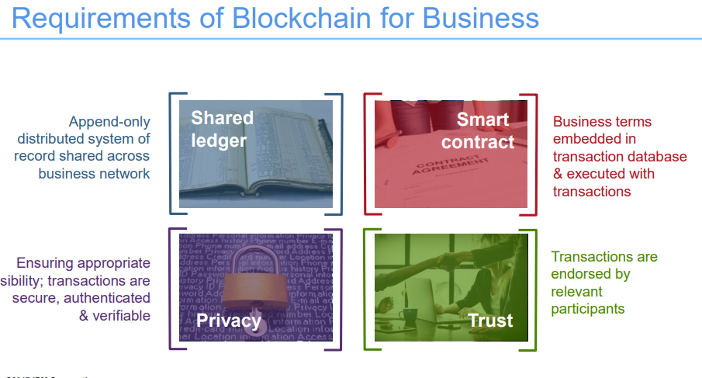

Slide 24
Advantages of Blockchain
Transparency: Every participant in the Blockchain network can see all transactions, all the way back to the genesis block
Accountability: Every transaction is accountable by the transaction initiator since they have digitally signed it
Peer to Peer: A Blockchain does not require a central third party to build trust in the transactions. All transactions are valid and between untrusted parties
Automatic Redundancy: There are no single points of failure in the network. If a node goes down, the network continues operating normally. New nodes can automatically discover nearby (or trusted) nodes and sync their ledgers with them
Non-Corruptible: Data in a Blockchain cannot be corrupted. The consensus mechanism ensures that wrong or irrelevant data never gets recorded in the ledger
Asset Representation: A Blockchain can represent assets and the transfer of assets between multiple parties

Slide 25
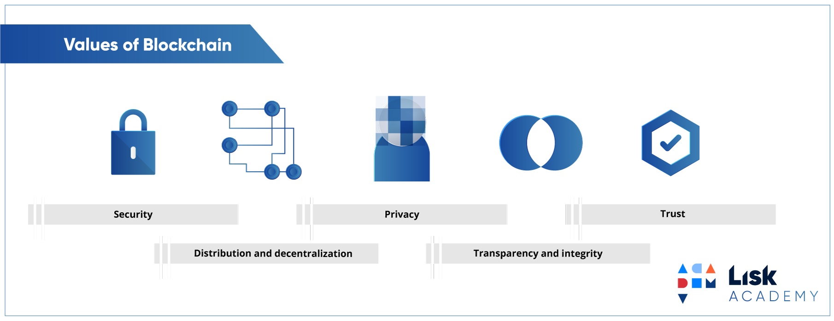
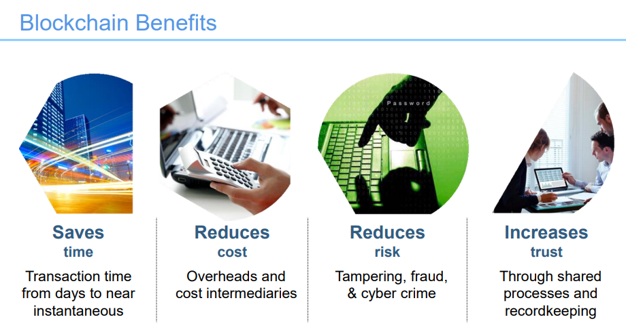

Slide 26
Disadvantages of Blockchain
Slow: Due to the requirement of a consensus mechanism, a Blockchain is currently slower than a normal database in writing transactions to the ledger.
51% Attack: If more than 51% of the node in a network collaborate for malicious intent, funds can be stolen or lost.
Highly Volatile: Due to peer to peer trading without any upper or lower bounds / circuit breakers, the prices of cryptocurrencies tend to be extremely volatile
Not User Friendly: Blockchain is a complex technology and it is difficult for normal users to understand and use it safely.

Slide 27
Blockchain Use Cases
Original use case of Bitcoin: As an electronic cash system (digital money) that can be used for peer to peer transactions and eliminate dependency on third parties like banks
Many other projects have come up to support different use cases

Slide 28

IOT | Agricultural & drone sensor networks Smart home networks Integrated smartcity. Smart home sensors Self-driving car Personalized robots, robotic component Personalized drones Digital Assistants
Health | Data management Universal EMR Health databanks QS Data Commons Big health data stream analytics Digital health wallet Smart property Health Token Personal development contracts

Slide 29
Consensus:
Mechanism by which a transaction is accepted as valid by majority participants and added to the blockchain
Blockchain consensus protocols are how to keep all the nodes on a network synchronized with each other, while providing an answer to the question: how do we all make sure that we agree on what the truth is?

Slide 30
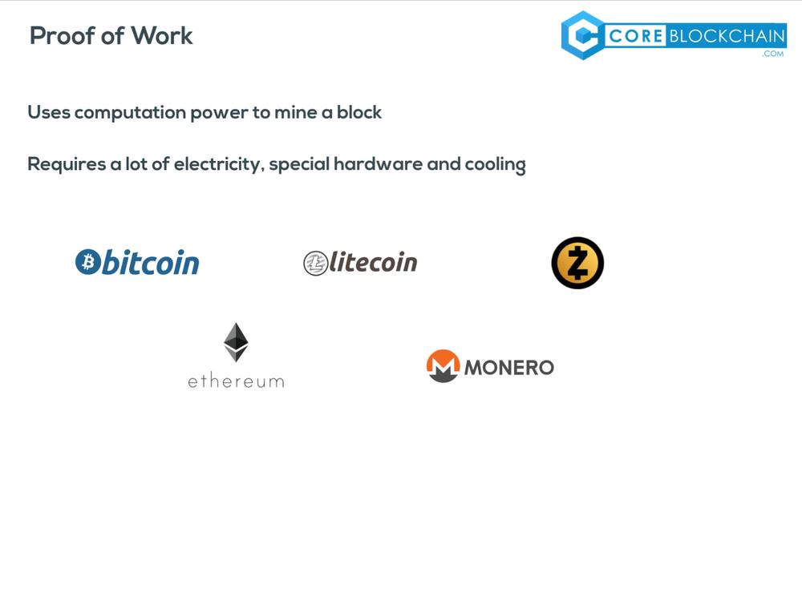
A proof-of-work is a computational problem that takes certain to effort to solve. But the time required to verify the results of the computational problem is very less compared to the effort it takes to solve the computational problem itself.
In case of Bitcoin, it takes almost 10 minutes to calculate the required proof-of-work to add a new block to the chain.

Slide 31
So, to successfully tamper with a blockchain
You will need to tamper with all blocks on the chain
Redo the proof-of-work for each block
Take control of greater than 50% of the peer-to-peer network.
After doing all these, your tampered block become accepted by everyone else. This is next to impossible task. Hence, Blockchains are so secure.

Slide 32
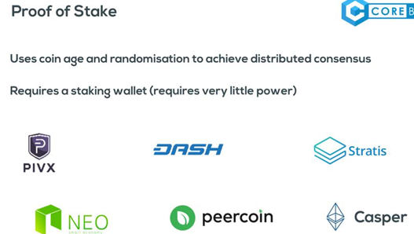
In a proof of stake system, the creator of the next block is determined by a randomized system that is, in part, dictated by how much of that cryptocurrency a user is holding or, in some cases, how long they have been holding that particular currency.

Slide 33
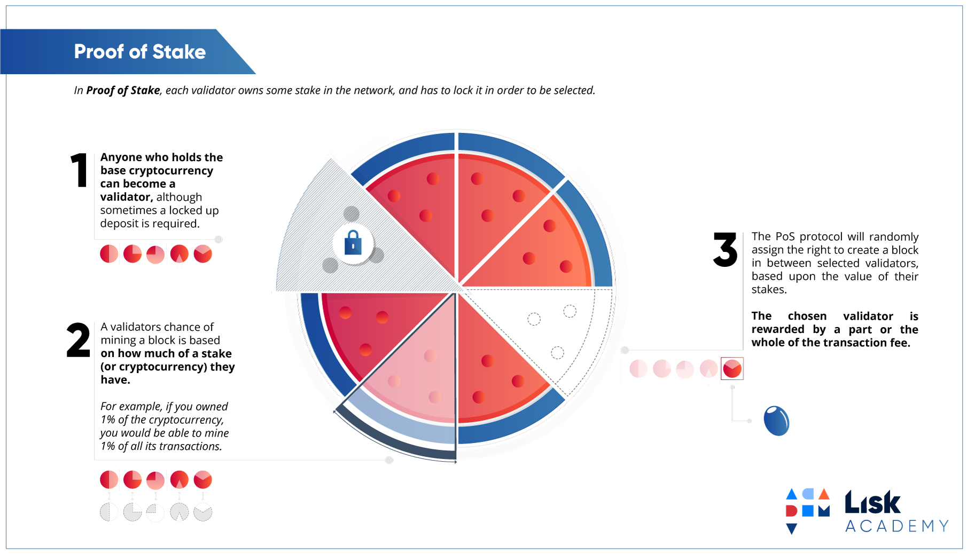

Slide 34
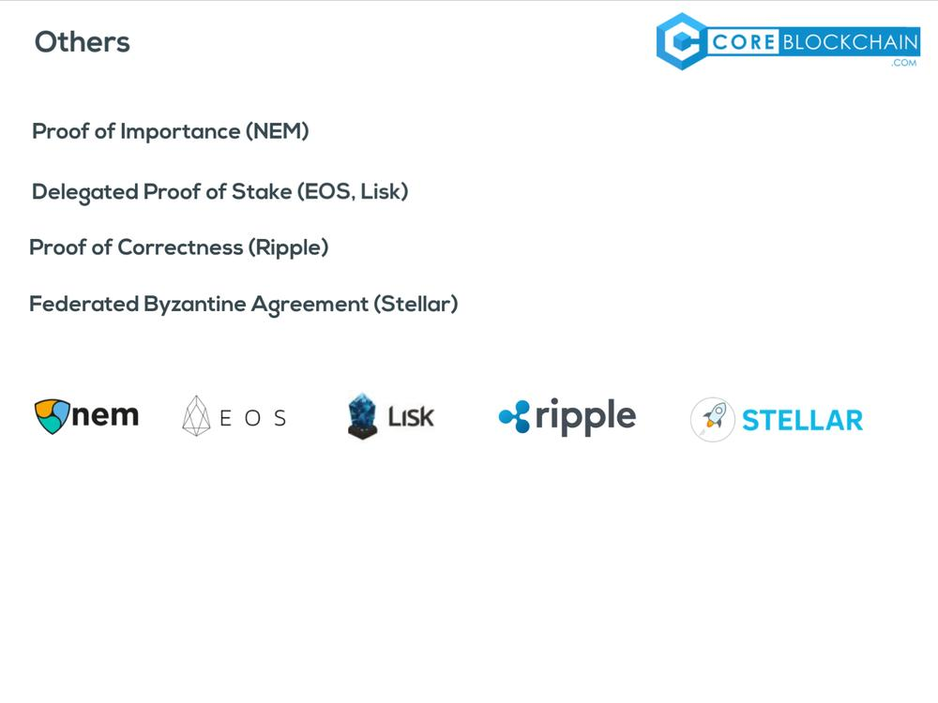

Slide 35
Types of Blockchains
There mainly three types of Blockchains that have emerged after Bitcoin introduced Blockchain to the world.
Public Blockchain
Private Blockchain
Consortium or Federated Blockchain

Slide 36
Public blockchain
A public blockchain is‘ for the people, by the people and of the people’
But a natural question that comes to our mind is that when no one is in charge here then how the decisions are taken on these types of the blockchain.
So the answer is that decision making happens by various decentralized consensus mechanisms such as proof of work (POW) and proof of stake(POS) etc.
Example: Bitcoin, Litecoin etc

Slide 37
Private Blockchain
It is a private property of an individual or an organization.
There is an in charge who looks after of important things such as read/write or whom to selectively give access to read or vice versa.
Here the consensus is achieved on the whims of the central in-charge who can give mining rights to anyone or not give at all.
That’s what makes it centralized again where various rights are exercised and vested in a central trusted party but yet it is cryptographical secured from the company’s point of view and more cost-effective for them.
Example: Bankchain

Slide 38
Consortium or Federated Blockchain
So here instead of one in charge, you have more than one in charge.
Basically, you have a group of companies or representative individuals coming together and making decisions for the best benefit of the whole network.
Such groups are also called consortiums or a federation that’s why the name consortium or federated blockchain

Slide 39
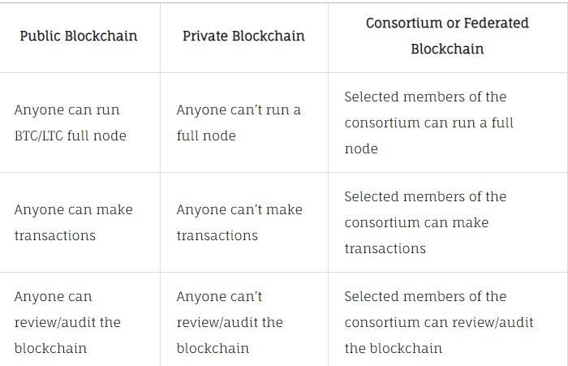

Slide 40
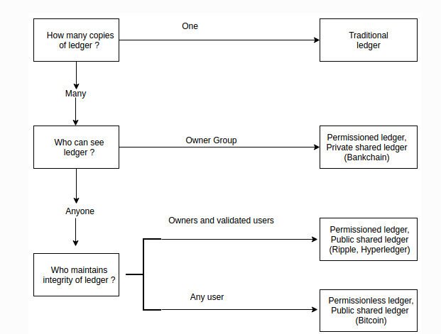

Slide 41
Two types of blockchains:
Permissionless:
Anyone can join the network.
They can read/write/verify transactions.
The system is open. There's no central authority.
This system makes sense when no one wants to use a trusted third party (TTP).
Trust is therefore established among peers via an agreed consensus mechanism.

Slide 42
Two types of blockchains:
Permissioned:
A central authority grants permissions to only some folks to read/write/verify transactions.
Since write access is given to a trusted few, consensus is achieved in a simpler and more efficient way.
Public read access may be allowed.

Slide 43
Genesis block
A genesis block is the first block of a block chain. Modern versions of Bitcoin number it as block 0, though very early versions counted it as block 1.
The genesis block is almost always hardcoded into the software of the applications that utilize its block chain
The Genesis Block is the first-ever block of Bitcoin mined by creator Satoshi Nakamoto.

Slide 44
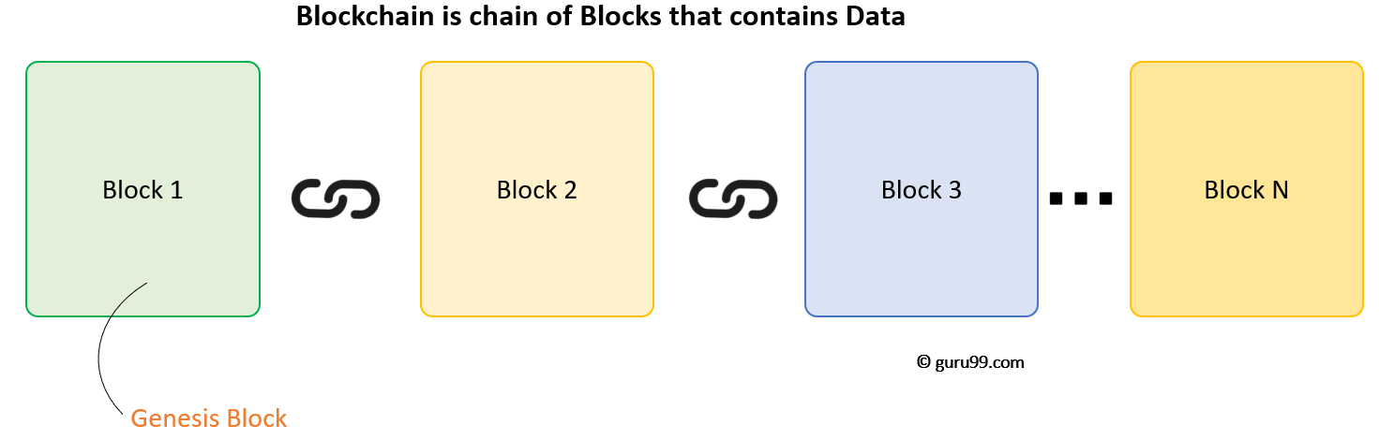
Genesis Block
The original block has 50 bitcoins in it and was mined over the course of six days in 2009.
The 50 bitcoins within the block are unspendable, however, and it's a subject of much debate whether this was intentional or a fluke on Nakamoto's part.

Slide 45
Types of wallet
5 Cryptocurrency Wallet Types
Wallets allow you to manage your cryptocurrency accounts, view balances and transact with other accounts.
Online Wallet.
Online wallets run on the cloud.
Therefore, they can be accessed from multiple devices with an internet connection.
Like every cloud service, online wallets are practical and convenient.
However, they are also more susceptible to theft and often require extra layers of security.

Slide 46
Types of wallet
Mobile Wallet.
Mobile wallets are your phone applications.
They are very handy
install an app on your phone and open an account.
mobile wallets are considered to be safer than cloud wallets.
The risks associated with mobile wallets are losing your assets in case your phone breaks down or encounters a security breach.

Slide 47
Types of wallet
Desktop wallet.
They are downloaded and installed on a PC or laptop and are accessible from the installation device.
However, if your computer is infected with a virus, gets hacked or experiences external damage, there is a chance to lose all your funds.
Hardware wallet.
Hardware wallets store users private keys on a device, typically a USB drive.
Various manufacturers make hardware wallets compatible with different web interfaces.
Hardware storage is also convenient because of its ability to send and receive currencies by merely plugging them into the internet enabled device and authorizing yourself.
Therefore, hardware wallet is the most expensive, but also one of the safest options.

Slide 48
Types of wallet
Paper wallet.
Paper wallets are by far the safest option to store your digital assets.
A paper wallet is a physical copy of your generated public and private keys and can even refer to a printed sheet of paper.
You can send funds by transferring the money to wallet’s public address and you can withdraw or send your currencies by entering your private keys or by scanning the QR code on the paper wallet.

Slide 49
Peer to peer (P2P) applications
Peer to peer and distributed, decentralized applications are considered to be the holy grail of Blockchain applications.
The below websites have a list of Blockchain based distributed applications (also known as DApps):
https://www.stateofthedapps.com/
https://dappradar.com/
A popular P2P E-Commerce application is OpenBazaar: https://openbazaar.org/

Slide 50
Dapps-decentralized blockchain application
Open-source software that leverage on the blockchain technology are called Dapps.
Common features of Dapps:
Open Source. Ideally, it should be governed by autonomy and all changes must be decided by the consensus, or a majority, of its users. Its code base should be available for scrutiny.
Decentralized. All records of the application’s operation must be stored on a public and decentralized blockchain to avoid pitfalls of centralization.
Incentivized. Validators of the blockchain should be incentivized by rewarding them accordingly with cryptographic tokens.
Protocol. The application community must agree on a cryptographic algorithm to show proof of value. For example, Bitcoin uses Proof of Work (PoW) and Ethereum is currently using PoW with plans for a hybrid PoW/Proof of Stake (PoS) in the future.

Slide 51
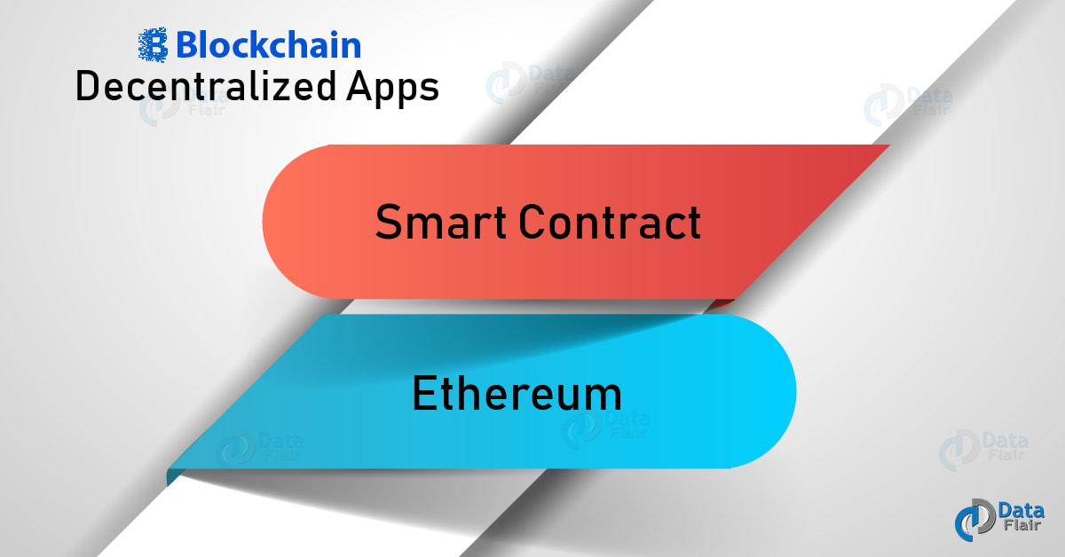
Dapps

Slide 52
Dapps
The first Dapp was in fact Bitcoin itself
While both Bitcoin and Ethereum may be loosely defined as Dapps aimed at solving real-world problems, Ethereum has a much bigger plan in mind.
Armed with its very own language, Solidity, Ethereum enables developers to form smart contacts using the Ethereum Virtual Machine (EVM).

Slide 53
MetaMask
MetaMask is a bridge that allows you to visit the distributed web of tomorrow in your browser today. It allows you to run Ethereum dApps right in your browser without running a full Ethereum node.
Ethereum is a type of blockchain that is built for applications that need to store data or run programs in the distributed web.
Ethereum allows programmers to write apps that can run on many people’s computers. Such type of apps are called dApps, which stands for distributed applications

Slide 54
MetaMask
Metamask is an Ethereum web browser extension that acts as a Ethereum wallet. MetaMask allows users to sign smart contracts and interface with Ethereum dApps (distributed Ethereum-based applications) without running a full Ethereum node.
In other words, MetaMask allows users to store Ethereum related data like public addresses and private keys like any other Ethereum wallet, and it allows websites running Ethereum-based apps and smart contracts to talk to the Ethereum blockchain.
It essentially turns your browser into an Ethereum browser!

Slide 55
MetaMask
Gas is a unit of measuring the computational work of running transactions or smart contracts in the Ethereum network.
Gas limit refers to the maximum amount of gas you’re willing to spend on a particular transaction. A higher gas limits mean that more computational work must be done to execute the smart contract. A standard ETH transfer requires a gas limit of 21,000 units of gas.

Slide 56
Demo
BLOCKCHAIN DEMO
Installing Metamask
Showing live and past transactions
Creating wallet using MEW

Slide 57
Gas price refers to the amount of Ether you’re willing to pay for every unit of gas, and is usually measured in “Gwei”.
Wei is the smallest unit of Ether, and a Gwei consists of a billion wei.
If you want your transaction to be executed at a faster speed, then you have to be willing to pay a higher gas price

