Slide 1
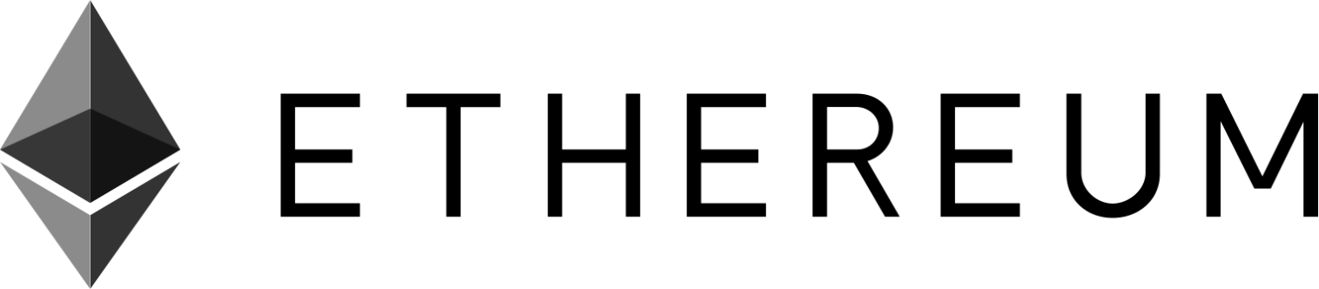

Slide 2
Ethereum
Ethereum is the second major innovation in Blockchain since the invention of Bitcoin.
While Bitcoin can be described as a digital money/ cryptocurrency
Ethereum is a decentralized platform for programming a digital money and multipurpose platform with its digital currency as the fuel for smart contracts functionality.

Slide 3
Comparison
Merits | Bitcoin | Ethereum
Concept | Digital Money | World Computer
Founder | Satoshi Nakamoto | Vitalik Buterin & Team
Scripting Language | Turing Incomplete | Turing Complete
Release Date | Jan 2009 | July 2015
Coin Release Method | Early Mining | Through ICO
Average Block Time | ~10 minutes | ~12-15 seconds
Purpose | Alternative to Regular Money | Peer to peer Contracts

Slide 4


What is Ethereum?
Ethereum is a platform that makes it possible for any developer to build and publish next-generation distributed applications.

Slide 5
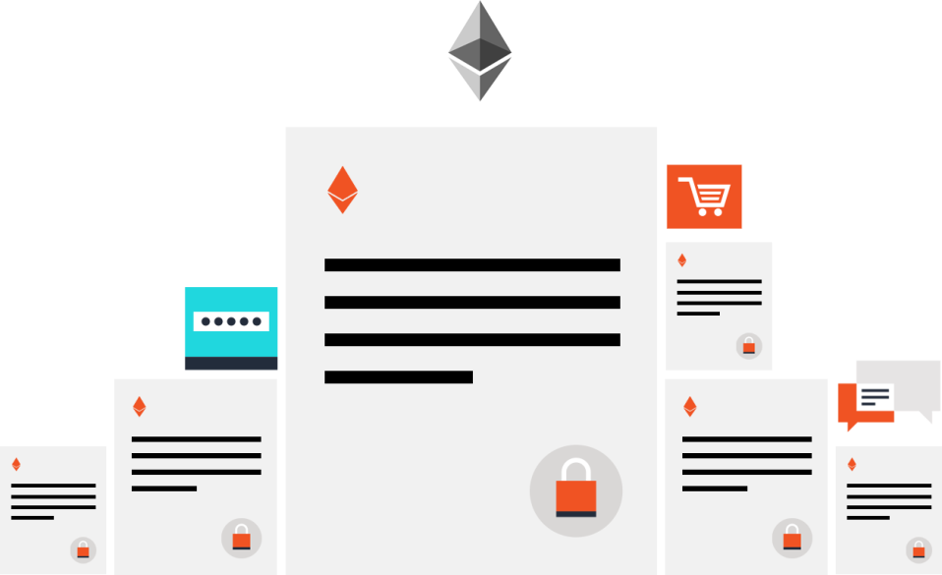
CONTRACT-BASED
Code-based contracts are the main building blocks of Ethereum.

Slide 6
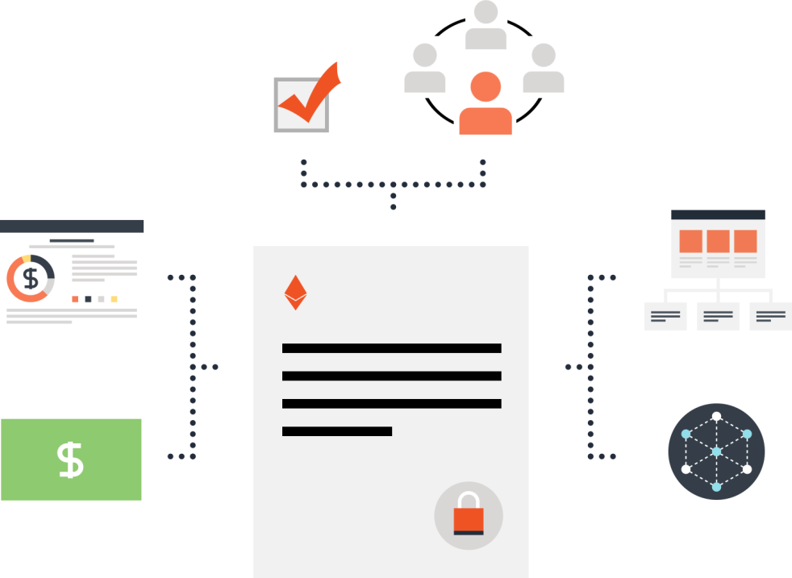
ETHEREUM IS VERSATILE
Contracts can be used to build currencies, financial derivatives, voting systems, decentralized organizations, data feeds and thousands of other applications.

Slide 7
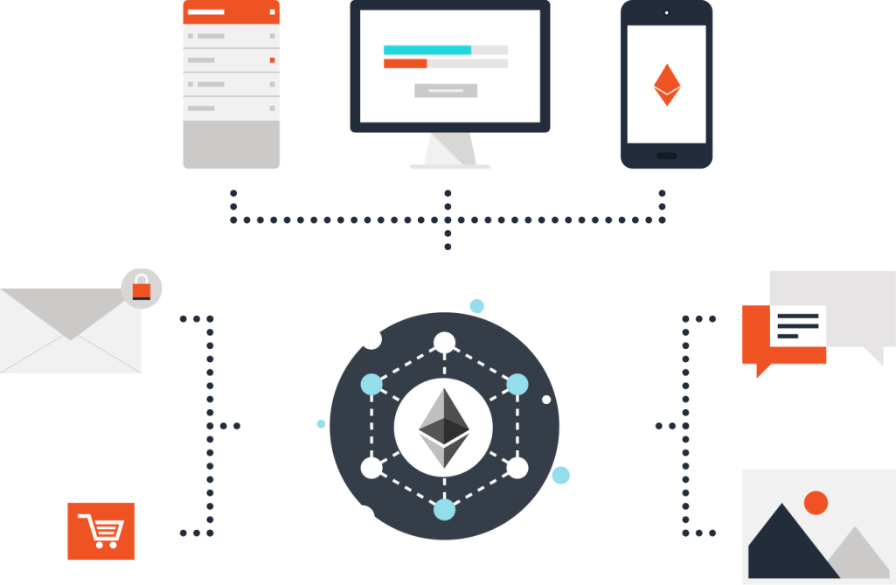
ETHER IS THE FUEL
Ether is Ethereum's cryptofuel. It is a type of digital token that powers the applications on the decentralized network.

Slide 8
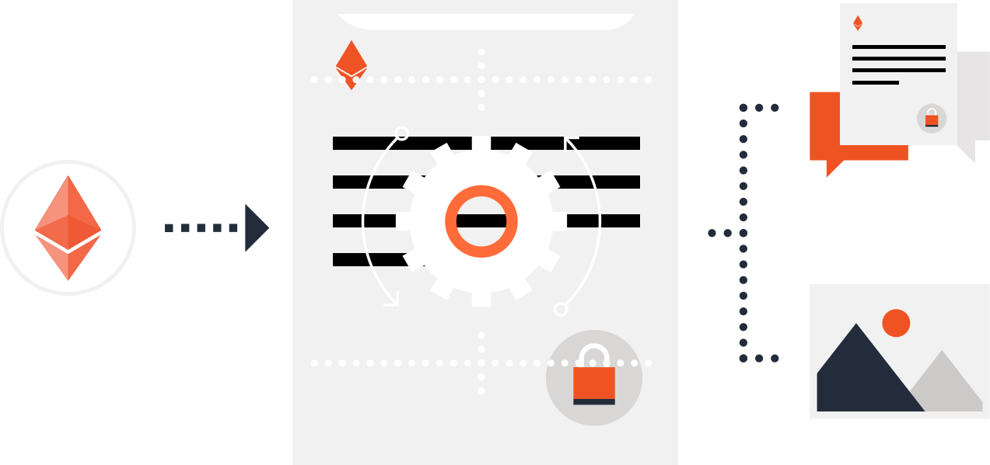
ETHER IS THE FUEL
Sending a transaction to a contract causes its code to execute. Contracts can store data, send transactions and interact with other contracts.

Slide 9
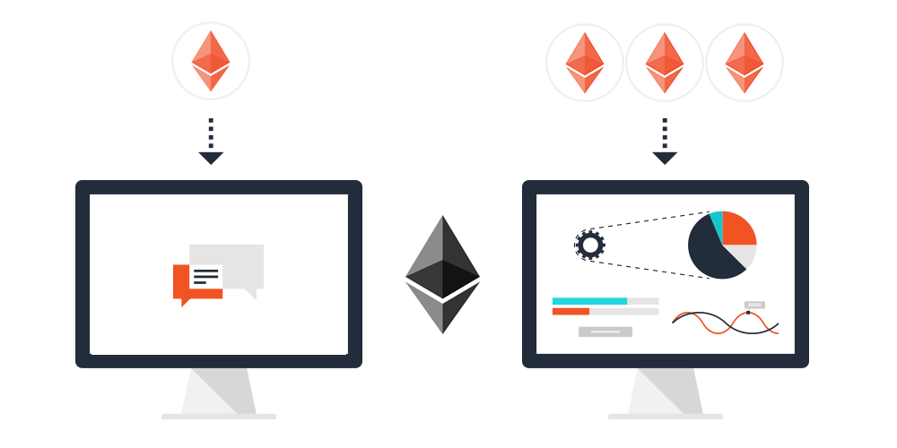
NOT ALL CONTRACTS ARE ALIKE
The more computation a transaction requires the more ether it consumes.

Slide 10
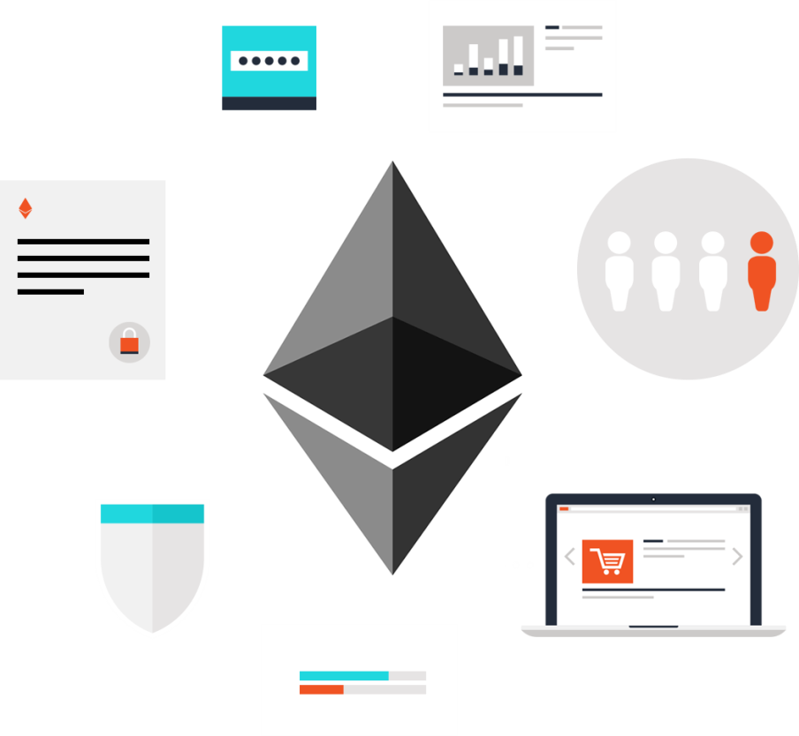
BUILD (ALMOST) ANYTHING
Ethereum can be used to codify, decentralize, secure and trade almost anything.

Slide 11
What is Ethereum?
Ethereum is an open-source & public blockchain based distributed computing platform for building decentralized applications.
Like Bitcoin, no one controls or owns Ethereum – it is an open-source project built by many people around the world.
Reference
http://www.ethdocs.org/en/latest/ether.html

Slide 12
Ethereum History
2013 - Vitalik Buterin started working on extending the capabilities of Bitcoin and Mastercoin (a protocol that extended Bitcoin to offer basic smart contracts).
December 2013 - Ethereum white paper released by Vitalik Buterin. Dr.Gavin Wood joins Vitalik to work on the protocol side of Ethereum
July 30, 2015 - The first ethereum block was mined

Slide 13
Ethereum Development Stages
Prerelease Step 0: Olympic testnet - launched May 2015
1. Frontier: Initial stage (July 30, 2015 till March 2016) 2. Homestead: Launched in March 2016 3. Metropolis - Launched on October 2017 - present 4. Serenity - Final stage to move to proof of stake
In between, there were multiple hard forks of the network with various names like Ice Age, DAO split, Tangerine Whistle, Spurious Dragon and Constantinople

Slide 14
Components of Ethereum Blockchain
P2P network Ethereum runs on the Ethereum main network, which is addressable on TCP port 30303, and runs a protocol called ÐΞVp2p. Consensus rules Ethereum’s consensus rules are defined in the reference specification, the Yellow Paper. Transactions Ethereum transactions are network messages that include (among other things) a sender, recipient, value, and data payload. State machine Ethereum state transitions are processed by the Ethereum Virtual Machine (EVM), a stack-based virtual machine that executes bytecode (machine-language instructions). EVM programs, called "smart contracts," are written in high-level languages (e.g., Solidity) and compiled to bytecode for execution on the EVM.

Slide 15
Components of Ethereum Blockchain
Data structures Ethereum’s state is stored locally on each node as a database (usually Google’s LevelDB), which contains the transactions and system state in a serialized hashed data structure called a Merkle Patricia Tree. Consensus algorithm Ethereum uses Bitcoin’s consensus model, Nakamoto Consensus, which uses sequential single-signature blocks, weighted in importance by PoW to determine the longest chain and therefore the current state. However, there are plans to move to a PoS weighted voting system, codenamed Casper, in the near future. Economic security Ethereum currently uses a PoW algorithm called Ethash, but this will eventually be dropped with the move to PoS at some point in the future. Clients Ethereum has several interoperable implementations of the client software, the most prominent of which are Go-Ethereum (Geth) and Parity.

Slide 16
DApps (Decentralized Applications)
Web 1.0 - static content
Web 2.0 - reactive applications
Web 3.0 - reactive, decentralized / distributed applications
A DApp = smart contracts + web UI
A DApp is a web application that is built on top of open, decentralized, peer-to-peer infrastructure services
A DApp is composed of at least: - Smart contracts on a blockchain (written in a language like solidity) - A web frontend user interface (written using JS, HTML and CSS)
In addition, many DApps include other decentralized components, such as: - A decentralized (P2P) storage protocol and platform (Swarm, IPFS) - A decentralized (P2P) messaging protocol and platform (Whisper)

Slide 17
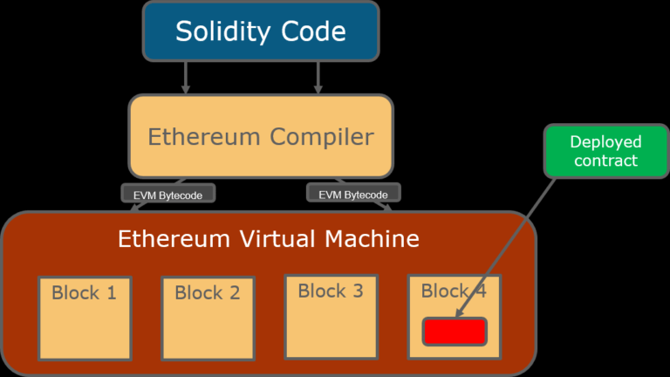
Ethereum Virtual Machine

Slide 18
Ethereum virtual machine
The Ethereum virtual machine is the engine in which transaction code gets executed
E.V.M. enables the development of potentially thousands of different applications all on one platform
Contracts written in a smart contract-specific programming language are compiled into ‘bytecode’, which an EVM can read and execute
It actually handles the internal state and computation in Ethereum.
Practically, EVM can be thought of as a large decentralized computer with millions of objects called “accounts” which have the ability to maintain an internal database, execute code and also they can talk to each other.

Slide 19
Ethereum Development Culture
. Ethereum’s development culture is characterized by rapid innovation, rapid evolution, and a willingness to deploy forward-looking improvements, even if this is at the expense of some backward compatibility. One of the big challenges facing developers in Ethereum is the inherent contradiction between deploying code to an immutable system and a development platform that is still evolving. You can’t simply "upgrade" your smart contracts. You must be prepared to deploy new ones, migrate users, apps, and funds, and start over.

Slide 20
Ethereum Networks
Mainnet (ETH): Main network
Ropsten: TestNet, Proof of Work, Supports Geth and Parity clients
Kovan: TestNet, Proof of Authority, Supports Parity client only
Rinkeby: TestNet, Proof of Authority, Supports Geth client only

Slide 21
Ether Faucets
Ether faucets help us in getting free ethers for testing and development use on various test networks.
Two of the most popular faucets are listed below:
- Ropsten Test Network Faucet at https://faucet.metamask.io/
- Rinkeby Test Network Faucet at https://faucet.rinkeby.io/

Slide 22
Ether Currency Units
Ethereum’s currency unit is called ether, identified also as "ETH" or with the symbols Ξ (from the Greek letter "Xi" that looks like a stylized capital E)
Ether is subdivided into smaller units, down to the smallest unit possible, which is named wei.
One ether is 1 quintillion wei (1 * 10¹⁸ or 1,000,000,000,000,000,000).

Slide 23
Ethereum Cryptocurrency
Ethereum runs on its native token called ether which serves two main purposes:
Ether payment is required for applications to perform any operation so that broken and malicious programs are kept under control
Ether is rewarded as an incentive to the miners who contribute to the Ethereum network with their resources- much like bitcoin’s structure.
Every time a contract is executed, Ethereum consumes token which is termed as ‘gas’ to run the computations.
The open-ended (Turing-complete) computation model requires some form of metering in order to avoid denial-of-service attacks or inadvertently resource-devouring transactions

Slide 24
Ether Denominations
Unit | Wei Value | Wei
wei | 1 wei | 1
Kwei (babbage) | 1e3 wei | 1,000
Mwei (lovelace) | 1e6 wei | 1,000,000
Gwei (shannon) | 1e9 wei | 1,000,000,000
microether (szabo) | 1e12 wei | 1,000,000,000,000
milliether (finney) | 1e15 wei | 1,000,000,000,000,000
ether | 1e18 wei | 1,000,000,000,000,000,000
Table 1. Ether denominations and unit names

Slide 25
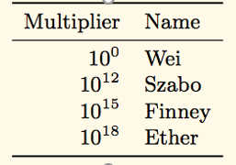
Ether Denominations
Wei - lowest denomination
Named after Wei Dai - author of b-money paper (1998), many core concepts used in BTC implementation
1/1,000,000,000,000,000,000 (quintillion)
Szabo - next denomination
Named after Nick Szabo - author of Bit-Gold
Finney – 2nd highest denomination
Named after Hal Finney - received first Tx from Nakamoto

Slide 26
Gas in Ethereum
Gas is required to be paid for every operation performed on the Ethereum blockchain.
Its price is expressed in ether and it’s decided by the miners, which can refuse to process the transaction with less than a certain gas price.

Slide 27
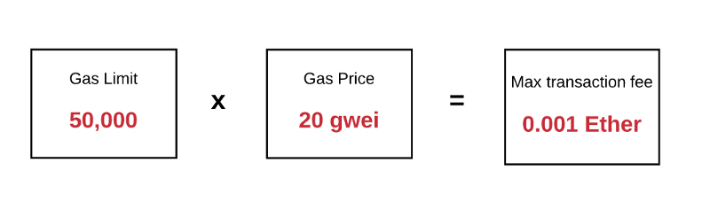
Gas
Gas is the fuel of Ethereum. Gas is not ether—it’s a separate virtual currency with its own exchange rate against ether.. Gas Price - The price (in wei) that the sender is willing to pay in exchange for gas. Price is measured in wei per gas unit
Gas Limit - The maximum amount of gas that the sender is willing to spend for a transaction

Slide 28
Gas
Problem: Cannot tell whether or not a program will run infinitely from compiled code
Solution: charge fee per computational step to limit infinite loops and stop flawed code from executing
Gas Price: current market price of a unit of Gas (in Wei)
Check gas price here: https://ethgasstation.info/
Is always set before a transaction by user
Gas Limit: maximum amount of Gas user is willing to spend
Helps to regulate load on network

Slide 29
Account Types
In Ethereum, we have two types of Blockchain accounts:
Externally Owned Accounts (EOA): These are regular accounts that are backed by a private key and held by people to store funds and transact with the network
Contract Accounts: These accounts are created when a contract is deployed using an EOA. Contract accounts do not have a private key.
EOAs hold account balances while contract accounts hold balances and state in contract storage

Slide 30
Account Types
External Account (EOA, Valid Ethereum Address)
Has an associated nonce (amount of transactions sent from the account) and a balance
codeHash - Hash of associated account code, i.e. a computer program for a smart contract (hash of an empty string for external accounts, EOAs)
Storage Root is root hash of Merkle-Patricia trie of associated account data

Slide 31
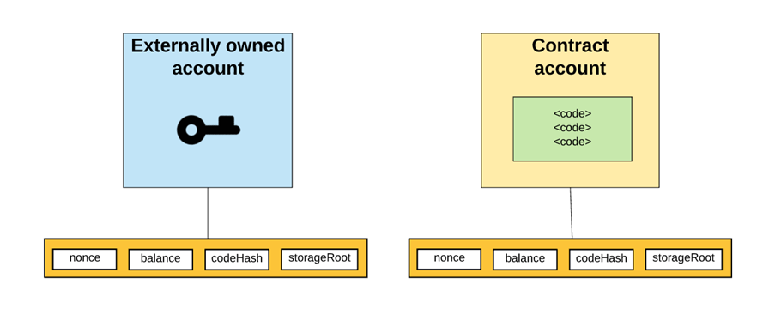
Account Types
Contract Account
Ethereum accounts can store and execute code
Has an associated nonce and balance
codeHash - hash of associated account code storageRoot contains Merkle tree of associated storage data

Slide 32
Demo
MyEtherWallet Demo
https://www.myetherwallet.com/
Create Accounts
- Transact Between Account
MetaMask Demo
https://metamask.io
- Create Accounts
- Transact Between Account
Mist Browser
You can download the Mist wallet/browser at the below link:
https://github.com/ethereum/mist/releases

Slide 33
https://medium.com/coinmonks/how-to-transfer-any-erc20-or-any-erc-tokens-using-myetherwallet-18dd623ed05b
https://blog.eristica.com/how-to-transfer-ert-erc20-tokens-using-myetherwallet-2ea84b35a473
https://medium.com/@attores/step-by-step-guide-getting-started-with-ethereum-mist-wallet-772a3cc99af4
https://kb.myetherwallet.com/transactions/how-to-send-transaction.html
https://medium.com/@chim/ethereum-how-to-setup-a-local-test-node-with-initial-ether-balance-using-geth-974511ce712
https://medium.com/swlh/ico-help-how-to-create-your-ethereum-wallet-4a78c1ef9022

Slide 34
Ethereum wallet
We will use the term "wallet" to mean a software application that helps you manage your Ethereum account.
In short, an Ethereum wallet is your gateway to the Ethereum system.
It holds your keys and can create and broadcast transactions on your behalf

Slide 35
Ethereum wallet
The following are some good starter wallets:
MetaMask is a browser extension wallet that runs in your browser (Chrome, Firefox, Opera, or Brave Browser). It is easy to use and convenient for testing, as it is able to connect to a variety of Ethereum nodes and test blockchains. MetaMask is a web-based wallet.
Jaxx is a multiplatform and multicurrency wallet that runs on a variety of operating systems, including Android, iOS, Windows, macOS, and Linux. It is often a good choice for new users as it is designed for simplicity and ease of use. Jaxx is either a mobile or a desktop wallet, depending on where you install it.
MyEtherWallet is a web-based wallet that runs in any browser. It has multiple sophisticated features we will explore in many of our examples. MyEtherWallet is a web-based wallet.

Slide 36
'Ethereum client
An 'Ethereum client' is just a term. It refers to any node able to parse and verify the blockchain, its smart contracts and everything related. It also allows you/provides interfaces to create transactions and mine blocks which is the key for any blockchain interaction.
Official reference implementations (CLI)
There are currently three reference implementations available, as you already highlighted:
eth - C++ client of the webthree project. It was formerly known as cpp-ethereum: https://github.com/ethereum/webthree-umbrella
geth - Golang client of the go-ethereum project: https://github.com/ethereum/go-ethereum
pyethapp - Python client of the pyethereum project: https://github.com/ethereum/pyethapp

Slide 37
As of September 2016, the leading implementations are go-ethereum and Parity.
Client | Language | Developers | Latest release
go-ethereum | Go | Ethereum Foundation | go-ethereum-v1.4.18
Parity | Rust | Ethcore | Parity-v1.4.0
cpp-ethereum | C++ | Ethereum Foundation | cpp-ethereum-v1.3.0
pyethapp | Python | Ethereum Foundation | pyethapp-v1.5.0
ethereumjs-lib | Javascript | Ethereum Foundation | ethereumjs-lib-v3.0.0
Ethereum(J) | Java | <ether.camp> | ethereumJ-v1.3.1
ruby-ethereum | Ruby | Jan Xie | ruby-ethereum-v0.9.6
ethereumH | Haskell | BlockApps | no Homestead release yet

