Slide 1

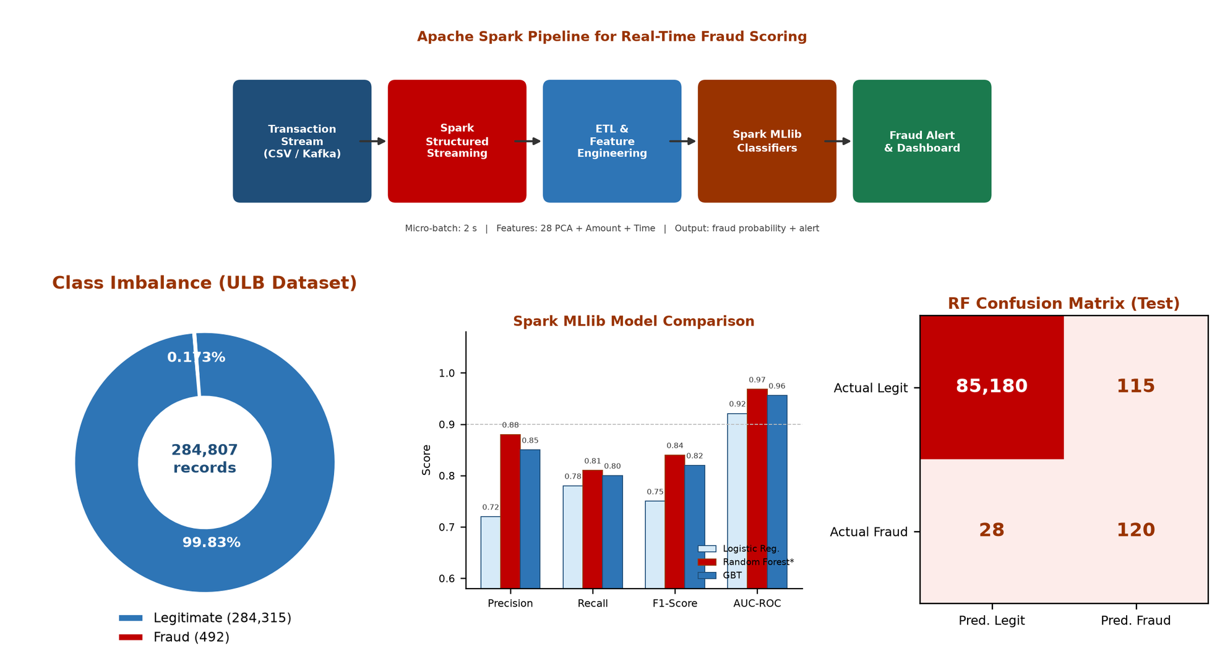
Department of Artificial Intelligence and Machine Learning
Big Data Analytics Poster AY 2026-27
Real-Time Credit Card Fraud Detection using Apache Spark Streaming
Abstract
Screen Shot photos/ Results/Outcome
Credit-card networks produce high-velocity, highly imbalanced transaction streams that batch analytics cannot score in time to block fraud.
This project builds an Apache Spark Structured Streaming and MLlib pipeline on the ULB Credit Card Fraud dataset (284,807 transactions; only 0.172% fraud).
A class-weighted Random Forest flags suspicious payments in 2-second micro-batches with AUC-ROC 0.968 and F1-score 0.84, enabling near real-time bank alerts.
Project Objectives/Aim
Ingest and clean large-scale, imbalanced card-transaction data using Apache Spark.
Engineer amount, time and PCA-based features that capture rare fraud patterns.
Train and compare Logistic Regression, Random Forest and GBT models in Spark MLlib.
Deploy a Structured Streaming scorer with micro-batch latency under two seconds.
Project Working/Methodology
Dataset: ULB/Kaggle Credit Card Fraud (Sept 2013; 31 features — Time, Amount, V1–V28 PCA components).
ETL: Spark DataFrame load, null handling, StandardScaler, 70:30 stratified split and class-weighting for the 0.172% fraud rate.
Models: Spark MLlib Logistic Regression, Random Forest (100 trees) and Gradient-Boosted Trees, evaluated with Precision, Recall, F1 and AUC-ROC.
Streaming: Structured Streaming (2 s micro-batches) applies the fitted pipeline and emits fraud probability plus an alert to a monitoring dashboard.
Stack: Apache Spark 3.5, PySpark, Spark MLlib and Python 3.11 on a local cluster-style workflow.
References: (APA Style)
Dal Pozzolo, A., et al. (2015). IEEE SSCI. Carcillo, F., et al. (2018). Information Fusion, 41, 182–194.
Apache Software Foundation. (2024). Spark MLlib guide. https://spark.apache.org/docs/latest/ml-guide.html
Student Name (PRN): Sukhada Dhingra (24070126505)
Programme: B.Tech — Artificial Intelligence and Machine Learning | AY 2026–27
Subject Teacher: Dr. Archana Choudary

