Slide 1
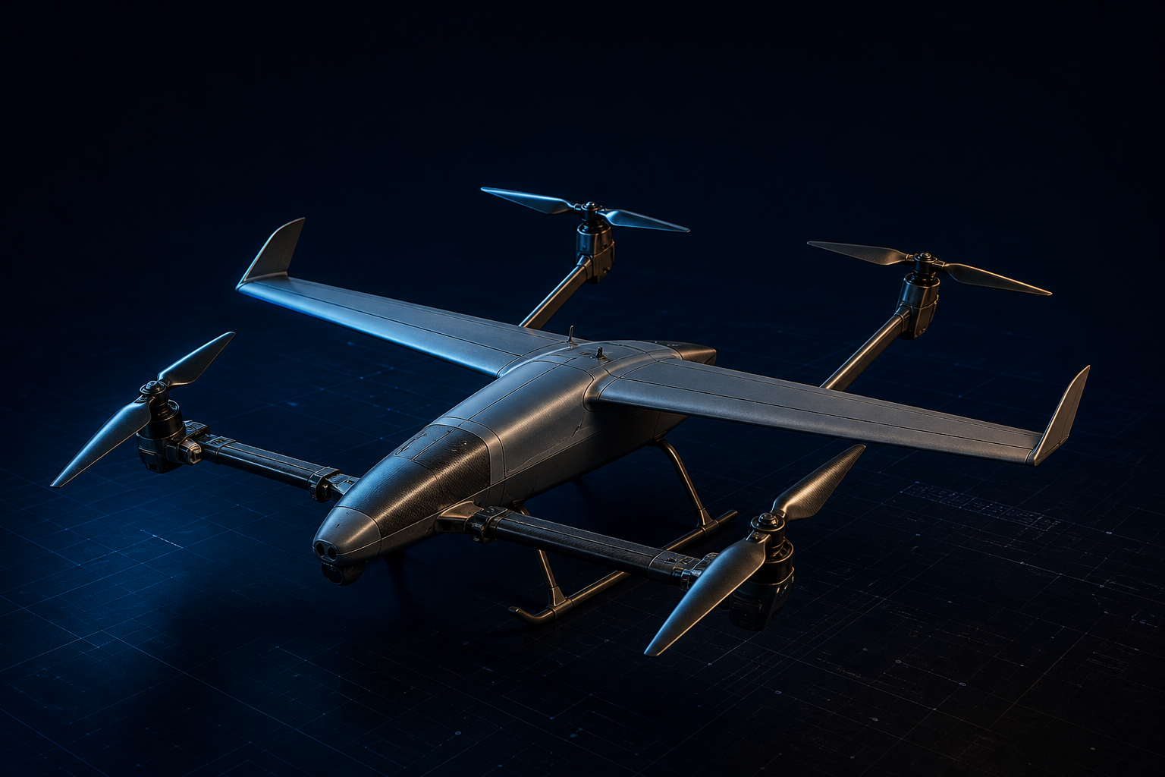
DESIGN REVIEW · 2026
PUSHPAK V1
Tilt-Rotor VTOL UAV Demonstrator
Mission: demonstrate electrical-power reduction in forward
flight through wing-borne lift vs pure rotor-borne flight.
4 ROTORS
4.5 kg
FRONT + REAR TILT PAIRS
DESIGN-POINT MTOW
1.0 kg
PIXHAWK
PAYLOAD
ARDUPILOT + ESP32
PROJECT TEAM
Ishaan Bafna · PRN 23070125017
Aman Ravat · PRN 23070125004
Krit Verma · PRN 230701250
PUSHPAK V1 · TILT-ROTOR VTOL DEMONSTRATOR · FINAL YEAR DESIGN REVIEW
01 / 40
Notes:
Open on the aircraft, then the mission in one sentence: we are not building a product UAV — we are proving that wing-borne lift cuts electrical power versus a pure multirotor of the same mass.
Introduce the team and PRNs. Flag MTOW 4.5 kg and 1 kg payload as the frozen design point.
Transition: the next slide frames the whole system before we dive into the problem.

Slide 2
01 / PROJECT
Project Overview
RC tilt-rotor VTOL demonstrator · four rotors · fixed wing
Prove that wing-borne lift reduces electrical power in forward flight relative to pure rotor-borne flight at the same MTOW.
AIRCRAFT
DESIGN POINT
PROPULSION
RC tilt-rotor VTOL
4 rotors + fixed wing
Front & rear tilt pairs
MTOW 4.5 kg
Target 4.0–4.5 kg
Payload 1.0 kg
4 × MY4215 400KV
16-inch class props
6S Li-ion ~20 Ah
AVIONICS
TILT
GEOMETRY
Pixhawk + ArduPilot
ESP32 companion
Pitot · GPS · mag encoders
2 × STS3215-C018
One servo per axis
Max tilt 75°
Wing span 1300 mm
Fuselage 1200–1300 mm
Rotor span 1700–1900 mm
PUSHPAK V1 · TILT-ROTOR VTOL DEMONSTRATOR · FINAL YEAR DESIGN REVIEW
02 / 40
Notes:
Walk the four identity cards left to right. Emphasize that Pushpak V1 is a demonstrator, not an operational ISR air vehicle.
Call out the mission banner — every later requirement traces to power reduction via the wing.
Close on the configuration: two tilt axes, 75° stop, Pixhawk/ArduPilot.

Slide 3
02 / PROBLEM
Problem Statement
CONSTRAINT
RESPONSE
Rotor-borne flight carries the full weight through the propellers.
Add a wing. Offload lift. Measure the electrical power that disappears.
▸ Induced power scales with disk loading, not with airspeed.
▸ A 4.5 kg quadrotor still burns hundreds of watts just to stay aloft.
▸ Edgewise forward flight adds profile and parasite penalties.
▸ Endurance and range collapse before a useful payload mission is complete.
▸ Student-class VTOL demonstrators rarely isolate the wing-lift benefit with flight data.
▸ Wing target: 70% of weight at 20 m/s cruise.
▸ Rotors unload, then tilt to 75° to provide thrust.
▸ Same airframe flown wing-on vs wing-off (or rotor-borne equivalent).
▸ Success = a documented reduction in electrical power, not a paper polar.
▸ Demonstrator mass, cost and complexity stay inside a university build.
PUSHPAK V1 · TILT-ROTOR VTOL DEMONSTRATOR · FINAL YEAR DESIGN REVIEW
03 / 40
Notes:
Multirotors hover well and waste energy in cruise because the rotors still carry 100% of weight.
Fixed-wing aircraft cruise efficiently but cannot take off or land without a runway.
Pushpak closes that gap at 4.5 kg so we can measure the power delta on one airframe.

Slide 4
03 / CONCEPT
Why VTOL + Fixed Wing
Attribute | Multirotor | Fixed wing | Tilt-rotor VTOL
Runway | None | Required | None
Hover | Native | No | Native (4 rotors)
Cruise lift | Rotor-borne | Wing-borne | Wing + residual rotor
Cruise power | High | Low | Target: reduced
Propulsion sets | 1 | 1 | 1 (reused)
Transition | N/A | N/A | Scheduled tilt + throttle
Instrumentation | Easy | Easy | Tilt angle + airspeed + power
Fit to mission | No (no wing benefit) | No (no VTOL) | Selected
Selection logic · one motor set · two tilt axes · measurable wing-offload · ArduPilot VTOL heritage
PUSHPAK V1 · TILT-ROTOR VTOL DEMONSTRATOR · FINAL YEAR DESIGN REVIEW
04 / 40
Notes:
Do not sell tilt-rotor as universally best — sell it as the right demonstrator: hover like a quad, cruise like a wing, one propulsion set.
Tailsitters are simpler but ugly in hover handling. Tilt-wing is heavier. Dual-system (lift + cruise props) duplicates motors.
Pushpak uses two coupled tilt axes so we can instrument both front and rear independently.

Slide 5
04 / MISSION
Mission Requirements
MR-1
PRIMARY
Quantify electrical-power reduction in wing-borne forward flight versus rotor-borne flight at the same mass.
MR-2
VTOL
Vertical take-off and landing from an unprepared 10 × 10 m pad, no catapult, no net.
MR-3
PAYLOAD
Carry 1.0 kg payload at design-point MTOW 4.5 kg (empty aircraft ≤ 3.5 kg).
MR-4
CRUISE
Sustain 20 m/s with the wing producing ~70% of lift (CL ≈ 0.395 on 0.32 m²).
MR-5
TRANSITION
Stable hover → 75° tilt transition using Pixhawk / ArduPilot with logged states.
MR-6
DATA
Log airspeed, tilt, RPM, bus voltage/current, actuator current, and inertial rates.
PUSHPAK V1 · TILT-ROTOR VTOL DEMONSTRATOR · FINAL YEAR DESIGN REVIEW
05 / 40
Notes:
MR-1 is the only success criterion that cannot be traded. Everything else exists to make that measurement honest.
Call out payload 1 kg as a mass stand-in — it forces a real MTOW, not a bare airframe.
75° is a mechanical stop, not a cruise-optimal number; we will map power vs tilt in flight test.

Slide 6
05 / OBJECTIVES
Design Objectives
O1
O2
O3
O4
Power experiment
Thrust margin
Wing-offload
Tilt authority
Wing-on vs wing-off (or rotor-borne) electrical-power comparison at matched mass and speed.
≥ 2.0× hover thrust (target 9 kgf static on 4.5 kg).
NACA 4412, 0.32 m², AR 5.3, CL 0.395 at 20 m/s.
Front and rear axes independent, 0–75°, magnetic angle closed-loop.
O5
O6
O7
O8
Open-source FC
Buildable
Traceable mass
Safe envelope
ArduPilot VTOL stack on Pixhawk; ESP32 for high-rate tilt / power I/O.
University workshop: 3D-printed mounts, composite/foam wing, COTS propulsion.
Empty ≤ 3.5 kg; live mass budget from CAD + weigh-ins.
Mechanical tilt stops, current limits, geofence, RTL, dual-axis jam detect.
PUSHPAK V1 · TILT-ROTOR VTOL DEMONSTRATOR · FINAL YEAR DESIGN REVIEW
06 / 40
Notes:
O1 is the experiment. O2–O6 are the vehicle that makes the experiment possible.
If mass grows past 4.9 kg we descope structure or battery — we do not silently drop the 70% lift target.
Safety objectives are equal priority for a student-flown 4.5 kg VTOL.

Slide 7
06 / REQUIREMENTS
System Requirements
ID | Requirement | Target | Verification
SR-P1 | Hover thrust per motor | ≥ 1.125 kgf (design 2.25) | Static thrust stand
SR-P2 | Total static thrust | ≈ 9 kgf | 4-motor stand, 6S
SR-P3 | Propulsion mass | Motors 0.80 kg; ESC 0.25 kg | Scale + CAD
SR-A1 | Wing area / AR / airfoil | 0.32 m² · 5.3 · NACA 4412 | CAD + template
SR-A2 | Cruise CL at 20 m/s | ≈ 0.395 (70% weight) | CFD + pitot + load
SR-A3 | Rotor / wing clearance | 50–75 mm min | CAD + ground spin
SR-C1 | Tilt range / axes | 0–75° · front + rear | Encoder log
SR-C2 | Flight stack | Pixhawk + ArduPilot + ESP32 | HIL + taxi
SR-T1 | Power comparison | Wing-on vs wing-off | Flight / trolley test
SR-S1 | Empty mass | ≤ 3.5 kg | Weigh-in
PUSHPAK V1 · TILT-ROTOR VTOL DEMONSTRATOR · FINAL YEAR DESIGN REVIEW
07 / 40
Notes:
This is the shall-statement set we will verify. SR-P propulsion, SR-A airframe, SR-C control, SR-T test.
Hover 1.125 kgf per motor is the physics floor; 2.25 kgf is the design target with margin.
Verification column tells faculty we are not leaving this as a paper airplane.

Slide 8
07 / CONFIGURATION
Aircraft Configuration Selection
SELECTED
A TAILSITTER
B TILT-WING
C DUAL-SYSTEM
D TILT-ROTOR
Single attitude change. Poor hover precision. Hard to instrument a clean wing-off comparison.
Wing + rotors tilt together. High hinge moment, complex structure, poor student-build risk.
Lift rotors + cruise prop. Two motor sets. Mass and power electronics kill the 3.5 kg empty target.
Four rotors, two tilt shafts. Hover as a quad. Cruise on the wing. One propulsion set. SELECTED.
FROZEN CONFIGURATION
4 rotors · front pair tilts together · rear pair tilts together · max tilt 75° · high wing + 2 winglets · Pixhawk / ArduPilot
PUSHPAK V1 · TILT-ROTOR VTOL DEMONSTRATOR · FINAL YEAR DESIGN REVIEW
08 / 40
Notes:
Four classical VTOL families. Dual-system wastes mass on a second propulsion set — fatal at 4.5 kg.
Tilt-wing moves the entire wing; too much actuator work for this class.
Tailsitter is the cheapest and the worst hover-to-cruise handling for a first student VTOL.
Tilt-rotor with paired front/rear shafts is the selected architecture.

Slide 9
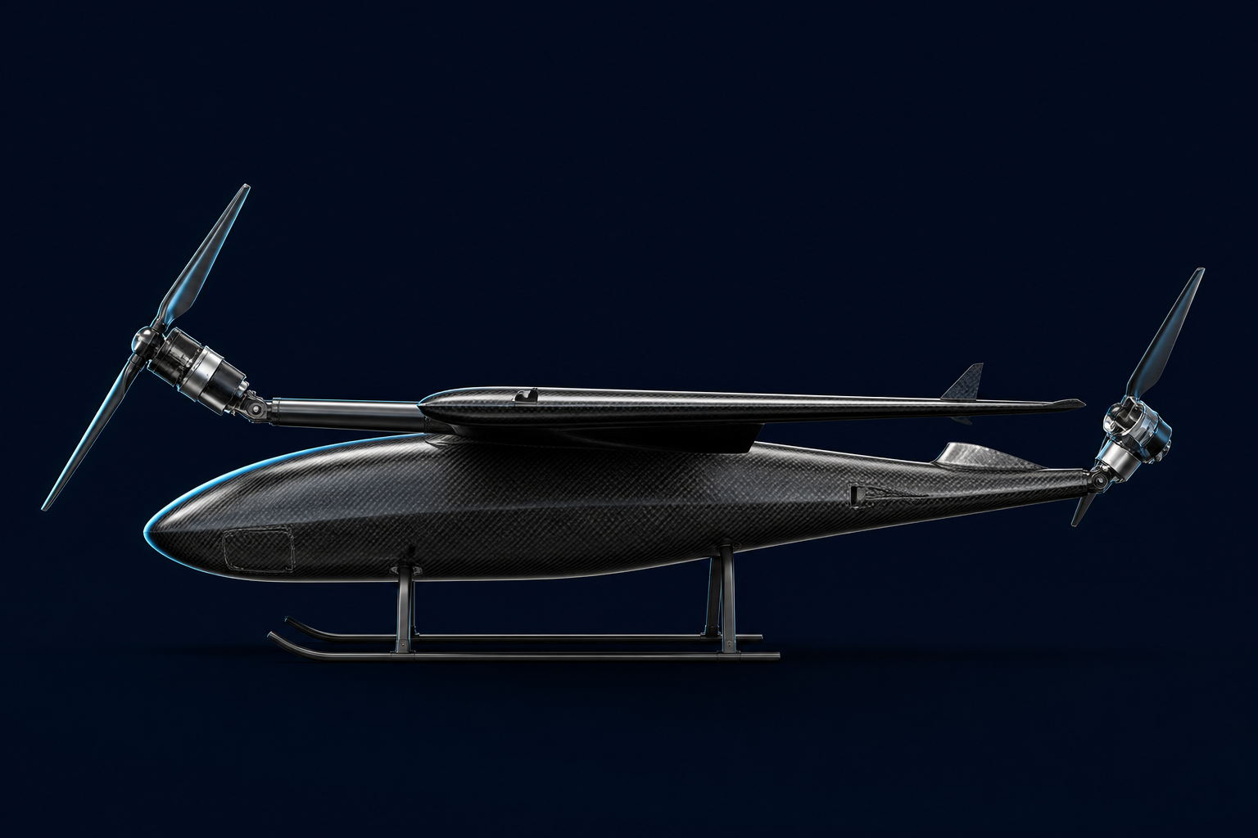
08 / ARCHITECTURE
Overall Aircraft Architecture
TILT
ENERGY
2 shafts · 2 servos
8 bearings · stops
Mag angle sensors
6S Li-ion ~20 Ah
1.0–1.5 kg pack
Current / voltage log
GNC
PAYLOAD
Pixhawk + ArduPilot
ESP32 companion
Pitot · GPS · IMU
1.00 kg dummy
CG hard point
Not a sensor suite
AIRFRAME
PROPULSION
Fuselage 1.2–1.3 m
Wing 1.30 m · 0.32 m²
Winglets × 2 · skids
4 × MY4215 400KV
16-in class · 6S
Target 9 kgf static
FRONT AXIS
REAR AXIS
Tilt together
Left + right motors
Tilt together
Left + right motors
PUSHPAK V1 · TILT-ROTOR VTOL DEMONSTRATOR · FINAL YEAR DESIGN REVIEW
09 / 40
Notes:
Treat this as the product breakdown: airframe, propulsion, tilt, energy, GNC, payload.
Front and rear tilt are mechanically identical — one design, two installs.
Payload is a 1 kg mass dummy with a hard point on the CG.

Slide 10
09 / PROPULSION
Propulsion System
4 ×
800 g
16 in
6S
HGLRC MY4215
TOTAL MOTOR MASS
PROPELLER CLASS
LI-ION PACK
400 KV · 200 g each
18% of 4.5 kg MTOW
D = 406 mm
Initial concept ~20 Ah
Item | Spec | Qty | Role
Motor | HGLRC MY4215 400KV | 4 | Hover + cruise thrust
Motor mass | 200 g (800 g set) | 4 | Mass budget line
Propeller | 16-inch class / 406 mm | 4 | Disk area for hover
ESC | From 0.25 kg allocation | 4 | 6S capable, logged current
Battery | 6S Li-ion ~20 Ah | 1 | Energy + CG
Bus | 6S power distribution | 1 | Voltage / current sense
Mounts | Tilt-shaft motor mounts | 4 | Interface to tilt axis
PUSHPAK V1 · TILT-ROTOR VTOL DEMONSTRATOR · FINAL YEAR DESIGN REVIEW
10 / 40
Notes:
MY4215 400KV on 6S is in the 16-inch efficiency band we need for hover margin without a 2 kg motor set.
Four identical corners — no mixed motor types. That keeps the quad mixer honest in hover.
Battery is Li-ion for energy density; C-rate will be confirmed on the thrust stand before first hover.

Slide 11
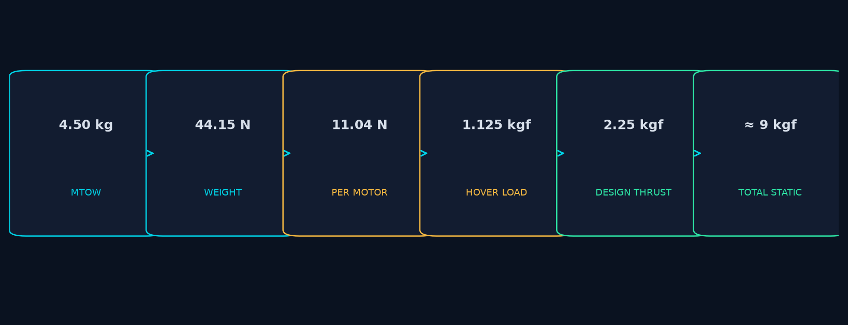
10 / HOVER
Hover Thrust Analysis
MTOW 4.5 kg · g = 9.81 m/s² · four equal motors
W = MG
T_HOVER / MOTOR
KGF EQUIVALENT
4.50 × 9.81 = 44.15 N
44.15 / 4 = 11.04 N
11.04 / 9.81 = 1.125 kgf
DESIGN T / MOTOR
TOTAL STATIC T
THRUST / WEIGHT
2.25 kgf (≈ 22.1 N)
≈ 9.0 kgf (≈ 88 N)
9.0 / 4.5 ≈ 2.0
PUSHPAK V1 · TILT-ROTOR VTOL DEMONSTRATOR · FINAL YEAR DESIGN REVIEW
11 / 40
Notes:
Walk the cascade: 4.5 kg → 44.15 N → 11.04 N per motor → 1.125 kgf. That is the physics floor, not the design.
Design is 2.25 kgf per motor, 9 kgf total — about 2.0× hover. We need that for climb, tilt transients, and one-motor-soft failures.
16-inch disk at this loading is why 400KV / 6S was chosen.

Slide 12
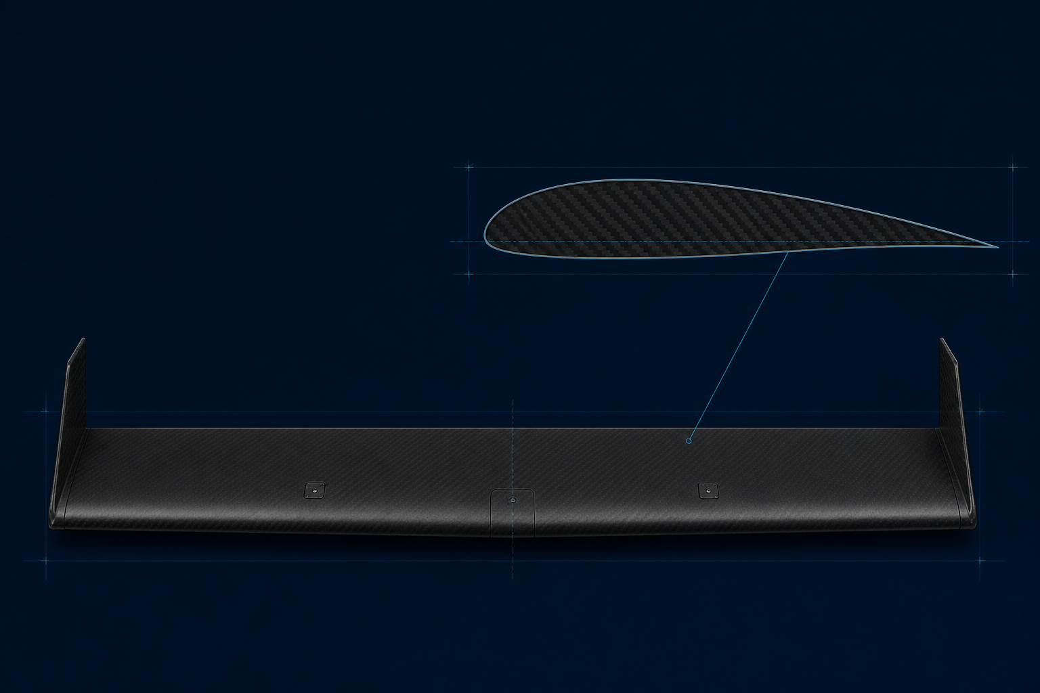
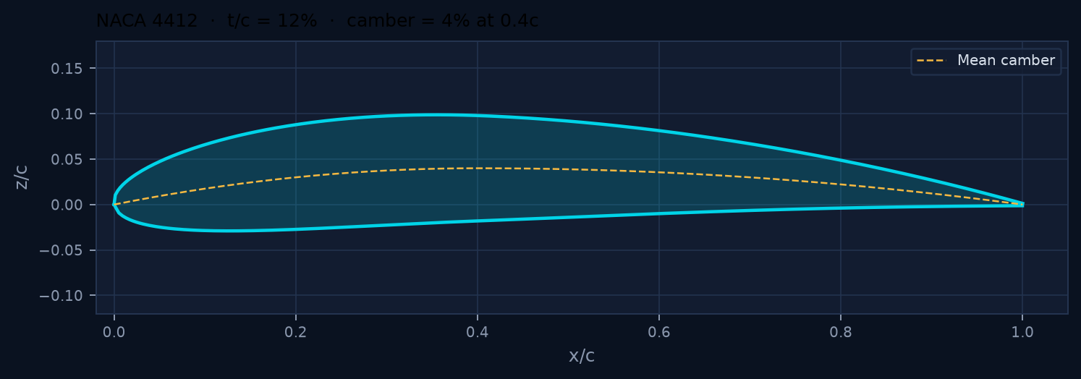
11 / WING
Wing Design Methodology
Lift target
Pick V, S
Compute CL
Select airfoil
Fix AR / span
Winglets
SPAN
AREA
CHORD
AR
FOIL
TIPS
1300 mm
0.32 m²
246 mm
5.3
4412
2 winglets
PUSHPAK V1 · TILT-ROTOR VTOL DEMONSTRATOR · FINAL YEAR DESIGN REVIEW
12 / 40
Notes:
Start from cruise lift, not from a pretty span. 70% of 44.15 N at 20 m/s fixes CL·S.
S = 0.32 m² and AR 5.3 are a student-build compromise: enough span for induced-drag, short enough for 1.3 m transport.
NACA 4412 is a known cambered section with gentle stall — appropriate for a first VTOL wing, not a racing foil.

Slide 13
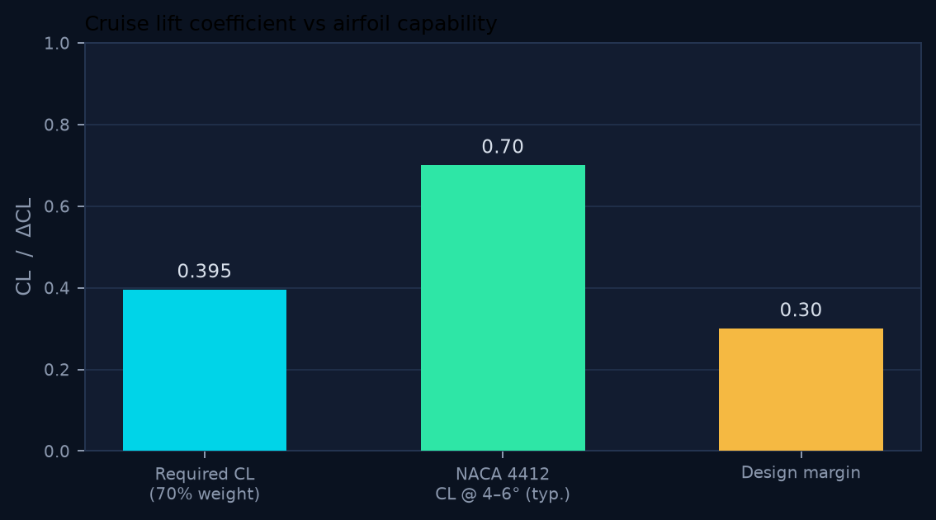
12 / LIFT
Lift Calculations
CRUISE LIFT EQUATION
20 m/s
L = ½ ρ V² S CL → CL = L / (q S)
CRUISE SPEED
ρ = 1.225 kg/m³ · V = 20 m/s · q = 245 Pa · S = 0.32 m² · L_target = 0.70 × 44.15 = 30.90 N
70%
WING LIFT SHARE
0.395
REQUIRED CL
30.90 N
WING LIFT
PUSHPAK V1 · TILT-ROTOR VTOL DEMONSTRATOR · FINAL YEAR DESIGN REVIEW
13 / 40
Notes:
L = ½ ρ V² S CL. At 20 m/s, q = 245 Pa. For 70% of weight, L = 30.90 N → CL = 0.395.
NACA 4412 produces that CL at a modest angle of attack with margin to stall.
The remaining 30% of weight is residual rotor lift at 75° tilt — conservative, not minimum-power.

Slide 14
13 / GEOMETRY
Aircraft Geometry
Station | Dimension
Fuselage length | 1200–1300 mm
Wing span | 1300 mm
Rotor span (tip-to-tip) | 1700–1900 mm
Propeller diameter | 406 mm
Mean chord | 246 mm
Wing area | 0.32 m²
Max rotor tilt | 75°
Min prop clearance | 50–75 mm
LAYOUT INTENT
High wing keeps the prop disks clear of the fuselage and simplifies landing-gear length. Front tilt shaft sits ahead of the leading edge; rear shaft sits aft of the trailing edge. CG is between the two shafts so hover moments stay small.
PUSHPAK V1 · TILT-ROTOR VTOL DEMONSTRATOR · FINAL YEAR DESIGN REVIEW
14 / 40
Notes:
These envelopes bound CAD, not a freeze of every millimetre. Rotor span 1700–1900 mm is set by 16-inch props plus 50–75 mm clearance.
Fuselage length carries battery, Pixhawk, and the 1 kg payload on CG.
75° is a hard stop — never software-only.

Slide 15
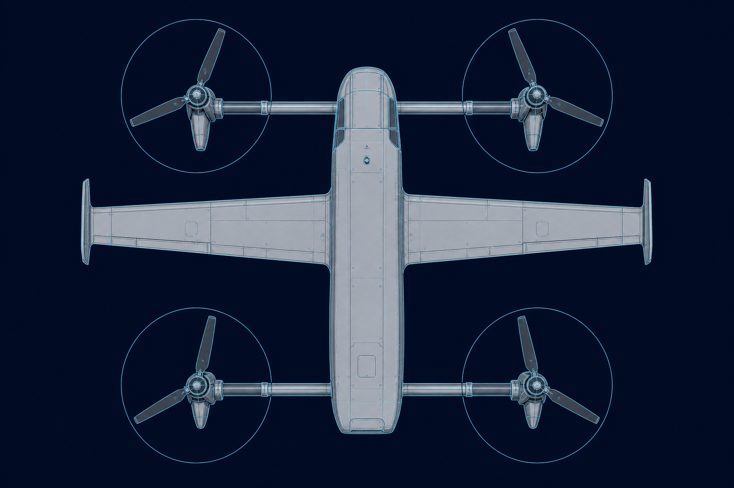
14 / ROTORS
Rotor Placement Layout
FRONT LEFT
On front tilt shaft · tilts with FR
FRONT RIGHT
On front tilt shaft · 1 servo
REAR LEFT
On rear tilt shaft · tilts with RR
REAR RIGHT
On rear tilt shaft · 1 servo
Minimum propeller clearance 50–75 mm · rotor span 1700–1900 mm · propeller D 406 mm · wing span 1300 mm (between the two shafts)
PUSHPAK V1 · TILT-ROTOR VTOL DEMONSTRATOR · FINAL YEAR DESIGN REVIEW
15 / 40
Notes:
Top view is the configuration control drawing. Four disks, two shafts, wing in the middle.
Clearance 50–75 mm is a hard CAD constraint — downwash and blade flex eat the lower number.
Front-left / front-right share one shaft; they cannot tilt independently. Same at the rear.

Slide 16
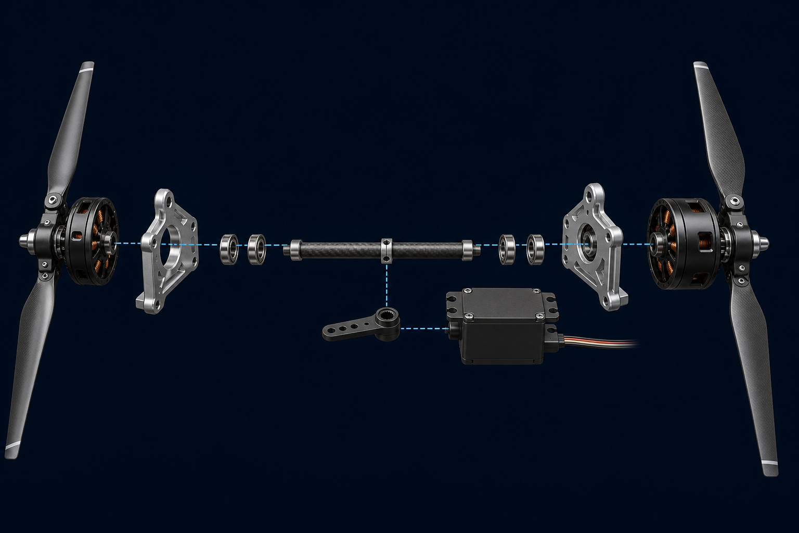
15 / TILT
Tilt Mechanism Architecture
PER AXIS
1 shaft · 2 motor mounts · 4 bearings · 1 servo · linkage · stops · 1 angle sensor
ACTUATOR
STS3215-C018 serial bus servo · one per axis · not per motor
STOPS
Hard mechanical limits at hover (0°) and cruise (75°) · independent of software
SENSOR
Absolute magnetic angle · logged to Pixhawk / ESP32 · jam detection
MOTOR
MOUNT
SHAFT
BEARINGS
LINKAGE
SERVO
PUSHPAK V1 · TILT-ROTOR VTOL DEMONSTRATOR · FINAL YEAR DESIGN REVIEW
16 / 40
Notes:
One mechanism, two copies. Front and rear are the same drawing with mirrored servo handedness.
The shaft is the structural spine — motors never hang off the servo horn.
Magnetic angle sensors close the loop; mechanical stops are the last line of defence at 0° and 75°.

Slide 17
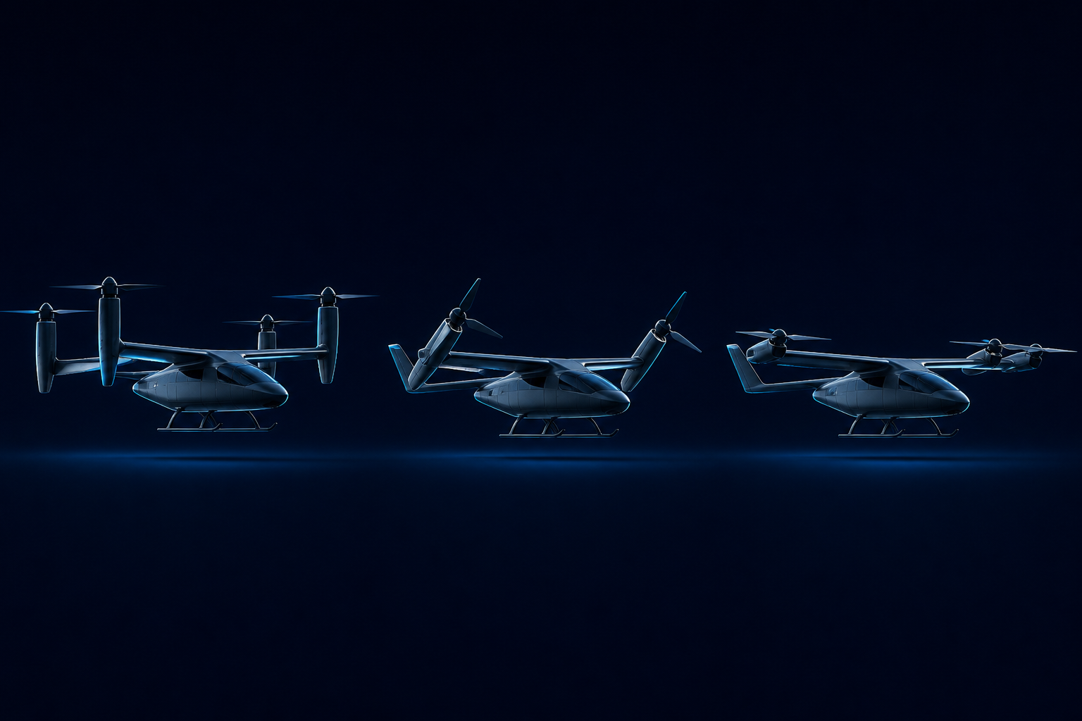
16 / TILT LOGIC
Tilt Mechanism Working Principle
01 HOVER
02 TRANSITION
03 CRUISE
Tilt 0° · T vertical
Wing lift ≈ 0
Quad mixer active
Tilt scheduled vs airspeed
Wing loading rising
Collective reducing
Tilt 75° · T mostly axial
Wing ~70% of weight
Power experiment window
LOAD PATH MOTOR → MOUNT → TILT SHAFT → BEARINGS → AIRFRAME
COMMAND PATH FC → SERVO → LINKAGE → SHAFT (servo never carries rotor loads)
PUSHPAK V1 · TILT-ROTOR VTOL DEMONSTRATOR · FINAL YEAR DESIGN REVIEW
17 / 40
Notes:
Hover: thrust vector vertical, wing is a passenger. Transition: tilt with airspeed, not with a timer.
Cruise: 75° — rotors mostly axial for thrust, residual vertical component plus wing lift equal weight.
The kinematic chain is Motor → Tilt shaft → Bearings → Linkage → Servo. The servo never carries rotor loads.

Slide 18
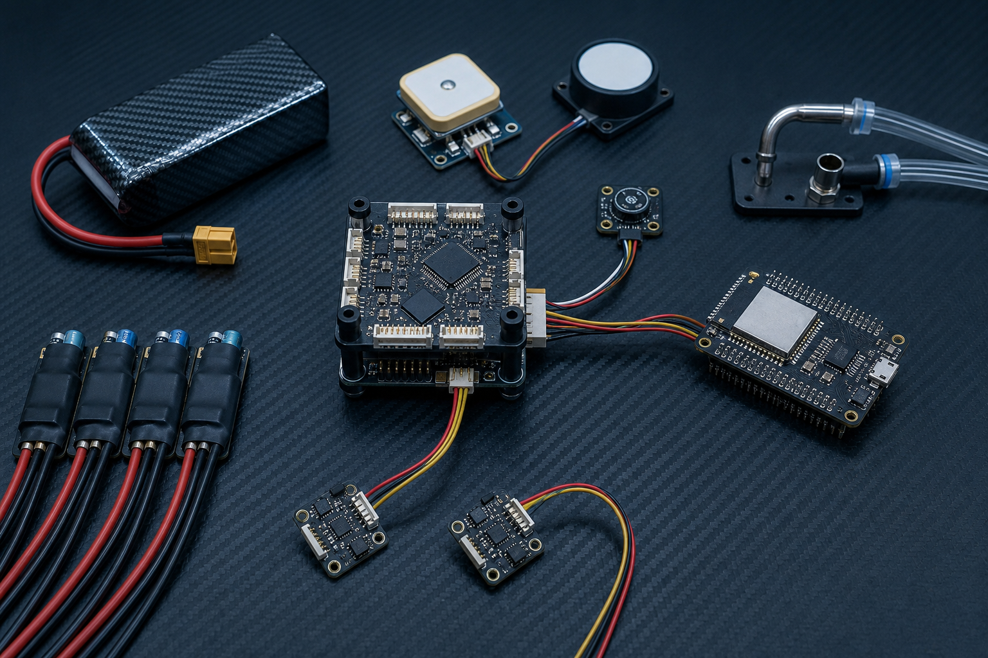
17 / AVIONICS
Electronics Architecture
SENSE
Pitot · GPS · compass · mag angle ×2 · IMU · V/I bus · actuator current
DECIDE
Pixhawk / ArduPilot flight laws · ESP32 companion I/O and experiment log
ACT
4 × ESC / motor · front tilt servo · rear tilt servo
Node | Function
Pixhawk | Attitude, VTOL mixer, failsafes, logging
ArduPilot | QHOVER / QLOITER / FBWA / AUTO
ESP32 | Tilt telemetry, power DAQ, experiment flags
Pitot | Calibrated airspeed for tilt schedule
GPS + compass | Position, heading, RTL
Mag angle | Absolute tilt on each shaft
PUSHPAK V1 · TILT-ROTOR VTOL DEMONSTRATOR · FINAL YEAR DESIGN REVIEW
18 / 40
Notes:
Three layers: sense, decide, act. Pixhawk is the real-time flight computer. ESP32 is the companion for tilt telemetry, power sensing and experiment logging.
Do not put motor PWM on the ESP32. ArduPilot owns the motors.
Pitot is mandatory — transition is airspeed-scheduled.

Slide 19
18 / INTEGRATION
Pixhawk–ESP32 Integration
PIXHAWK / ARDUPILOT
ESP32 COMPANION
▸ Owns motor mixer and VTOL modes.
▸ Runs attitude / position loops.
▸ Issues front and rear tilt PWM / bus commands.
▸ Hosts failsafes: batt, GCS, geofence, RTL.
▸ Records onboard .bin log (IMU, GPS, RC).
▸ Reads pitot as airspeed sensor.
▸ If companion dies → freeze last tilt or revert to hover.
▸ Samples magnetic tilt encoders at high rate.
▸ Samples battery voltage, current, actuator current.
▸ Stamps experiment events (wing-on / wing-off run IDs).
▸ Forwards compact telemetry to GCS / SD.
▸ Does not command motor throttle.
▸ Watchdog heartbeats to Pixhawk.
▸ Can inhibit further tilt if encoder disagreement.
PUSHPAK V1 · TILT-ROTOR VTOL DEMONSTRATOR · FINAL YEAR DESIGN REVIEW
19 / 40
Notes:
Split of authority is a safety argument: if ESP32 locks, the aircraft must still hover and RTL as a quadrotor.
Interface is serial (MAVLink or a framed UART) plus discrete experiment enable.
Tilt servos can be driven from Pixhawk outputs with ESP32 monitoring the encoder — preferred for first flight.

Slide 20
19 / CONTROL
Control System Architecture
INPUTS
OUTPUTS
Pilot command
FLIGHT MODE LOGIC
Airspeed (pitot)
Front tilt command
▸ Hover mixer (quad X / H).
▸ Tilt schedule vs calibrated airspeed.
▸ Front / rear tilt may use a slight split to manage pitch.
▸ Collective reduction as wing lift rises.
▸ Power experiment flag (wing-on / wing-off).
▸ Failsafe overlay (always on).
▸ ArduPilot VTOL state machine + ESP32 inhibit.
Tilt angle ×2
Vertical velocity
Altitude
Rear tilt command
RPM ×4
Battery voltage
Battery current
Motor throttle ×4
Actuator current
Roll rate
Flight mode logic
Yaw rate
Vert. acceleration
PUSHPAK V1 · TILT-ROTOR VTOL DEMONSTRATOR · FINAL YEAR DESIGN REVIEW
20 / 40
Notes:
This is an I/O context diagram, not a Simulink file. Left = measured and commanded inputs. Centre = mode logic. Right = the four effectors plus the two tilt axes.
Vertical velocity, altitude and vertical acceleration are what keep transition from ballooning or settling.
Battery current is both a health signal and the primary experiment observable.

Slide 21
20 / SENSORS
Sensor Suite
PITOT
GPS
COMPASS
MAG ANGLE ×2
Calibrated airspeed
Position / groundspeed
Heading
Shaft tilt
Transition gate · CL reconstruction
Geofence · RTL · track
Yaw reference in hover & cruise
Closed-loop tilt · jam detect
IMU (FC)
BARO (FC)
V / I BUS
I_ACTUATOR
Rates + accel
Altitude / Vz
Electrical power
Servo / ESC current
Att. loop · n_z during transition
Climb hold in QHOVER / QLOITER
Primary experiment observable
Jam, stall, ESC health
PUSHPAK V1 · TILT-ROTOR VTOL DEMONSTRATOR · FINAL YEAR DESIGN REVIEW
21 / 40
Notes:
Every sensor exists because a later plot needs it. Pitot for tilt schedule and CL. Mag angle for the two shafts. V/I for the power experiment.
Compass + GPS are navigation and RTL — not the science.
Absolute magnetic angle is preferred over servo-potentiometer because the servo horn is not the shaft.

Slide 22
21 / MODES
Flight Modes
01
02
03
QSTABILIZE
QHOVER
QLOITER
Manual throttle, attitude stabilize. Tilt locked at 0°. First tether hover.
Alt-hold hover. Used for CG check, tilt-servo health, and pad ops.
Position hold. Precision take-off and landing once GPS is trusted.
04
05
06
TRANSITION
FBWA / CRUISE
RTL / QRTL
Airspeed-scheduled tilt 0→75°. Collective reduced as wing unloads rotors.
Wing-borne science window. Power logging at 20 m/s. Tilt held at 75°.
Failsafe home. Tilt back toward hover, then vertical descent on pad.
PUSHPAK V1 · TILT-ROTOR VTOL DEMONSTRATOR · FINAL YEAR DESIGN REVIEW
22 / 40
Notes:
ArduPilot VTOL vocabulary. First flights stay in QSTABILIZE / QHOVER. Transition is a gated climb into a forward mode, not a leap into AUTO.
FBWA or CRUISE is the wing-borne science mode. AUTO is last.
A mode that cannot revert to hover in one switch is not a student mode.

Slide 23
22 / TRANSITION
Transition Strategy
Pad hover
Nose into wind
Build V
Tilt ramp
Wing hold
Cruise log
T+0
QHOVER 1.5–2 m AGL. Confirm mag-angle 0°, bus healthy, pitot alive.
T+1
Command a small positive pitch / forward cyclic. Groundspeed rising, Vz ≈ 0.
T+2
At V1 (to be set in taxi tests, expected 8–12 m/s) start tilt ramp, limited °/s.
T+3
As CL builds, lower collective so that altitude does not balloon.
T+4
Hold 75° once V ≈ 20 m/s and n_z is quiet. Open the power-log window.
T+5
Abort line: airspeed decay, tilt jam, or Vz > band → reverse tilt, QHOVER.
PUSHPAK V1 · TILT-ROTOR VTOL DEMONSTRATOR · FINAL YEAR DESIGN REVIEW
23 / 40
Notes:
Transition is a schedule, not a stunt. Gates are airspeed, climb rate, and tilt-rate limit.
Front/rear split is a pitch trim tool — if the nose drops, lag the front shaft.
Abort is always available: freeze tilt, add collective, settle to QHOVER.

Slide 24
23 / SAFETY
Safety Features
Layer | Feature | Intent
Mechanical | Hard stops at 0° and 75° | Blade / wing collision impossible via software fault
Mechanical | Shaft bearings carry rotor loads | Servo is a commander, not a structure
Sense | Dual mag-angle disagreement | Inhibit further tilt; hold last safe angle
Sense | Pitot fail detect | Inhibit transition; remain in VTOL modes
Electrical | Bus undervoltage | QRTL / land
Electrical | Actuator overcurrent | Freeze tilt; alert GCS
FC | Lost GCS / geofence | QRTL
FC | Companion watchdog | ESP32 death does not kill motors
Ops | Tethered first hover | Contain first-flight energy
Ops | Prop clearance 50–75 mm | Flex and downwash margin
PUSHPAK V1 · TILT-ROTOR VTOL DEMONSTRATOR · FINAL YEAR DESIGN REVIEW
24 / 40
Notes:
Mechanical stops are not optional. A servo that can drive through 75° will put a blade into the wing.
Electrical: current limits, low-voltage RTL, lost-link RTL.
Operational: tether for first hovers, geofence, two-person crew (pilot + caller).

Slide 25
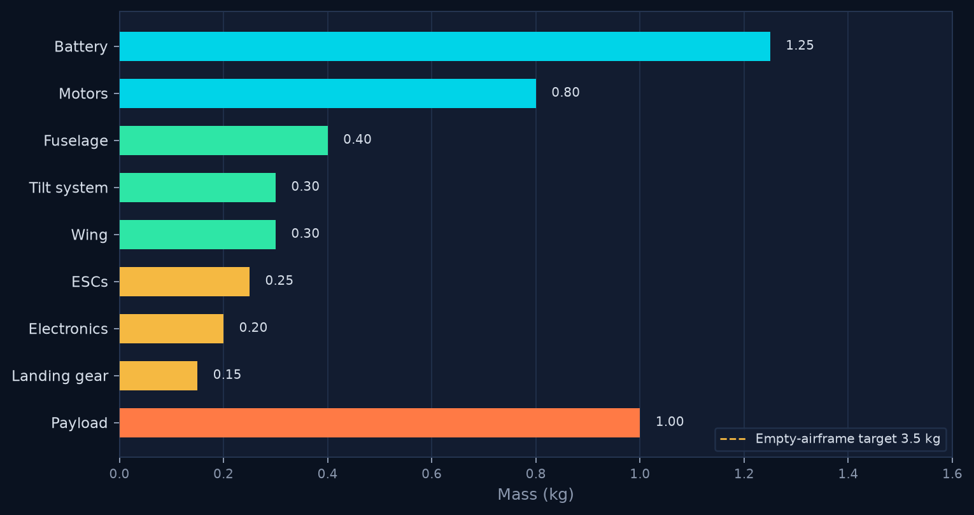
24 / MASS
Mass Budget
Group | Mass (kg)
Payload | 1.00
Motors | 0.80
ESCs | 0.25
Battery | 1.0–1.5
Tilt system | 0.30
Wing | 0.30
Fuselage | 0.40
Electronics | 0.20
Landing gear | 0.15
Estimated MTOW | 4.4–4.9
Empty target | ≤ 3.50
Design point | 4.50
PUSHPAK V1 · TILT-ROTOR VTOL DEMONSTRATOR · FINAL YEAR DESIGN REVIEW
25 / 40
Notes:
Read the bar chart first: battery and payload dominate. Motors are heavy because hover margin is non-negotiable.
Empty target 3.5 kg leaves 1.0 kg payload inside a 4.5 kg design point. Estimated roll-up today is 4.4–4.9 kg — we are on the edge and we know it.
If battery lands at 1.5 kg, something else must come out of structure or we fly a 4.9 kg aircraft and recompute hover.

Slide 26
25 / BOM
Component Selection Matrix
Propulsion · tilt · flight control · electronics · battery · airframe
PROPULSION
TILT MECHANISM
FLIGHT CONTROL
Item | Spec | Qty
Motor | HGLRC MY4215 400KV | 4
Propeller | 16-inch class / 406 mm | 4
ESC | 6S, 0.25 kg set | 4
Item | Spec | Qty
Servo | STS3215-C018 | 2
Tilt shaft + mounts | Front / rear axis | 2+4
Bearings / stops | 4 per axis + hard stops | 8+
Item | Spec | Qty
FC | Pixhawk | 1
Stack | ArduPilot VTOL | 1
Companion | ESP32 | 1
ELECTRONICS
BATTERY SYSTEM
AIRFRAME
Item | Spec | Qty
Airspeed | Pitot probe + sensor | 1
Nav | GPS + compass | 1+1
Tilt sense | Abs. magnetic angle | 2
Item | Spec | Qty
Pack | 6S Li-ion ~20 Ah | 1
Sense | Bus V and I | 1
Mass alloc. | 1.0–1.5 kg | —
Item | Spec | Qty
Wing | 1300 mm NACA 4412 | 1
Winglets | Tip treatments | 2
Fuselage / gear | 1200–1300 mm / skids | 1
PUSHPAK V1 · TILT-ROTOR VTOL DEMONSTRATOR · FINAL YEAR DESIGN REVIEW
26 / 40
Notes:
This is the buying list, not a catalogue dump. Six groups map to the mass budget.
STS3215-C018 is a bus servo with stall torque suited to a 4.5 kg tilt shaft, not a hobby 9-gram.
Pixhawk + ArduPilot is chosen for VTOL heritage, not because we cannot write a controller.

Slide 27
26 / CAD
CAD Development Plan
Master
Tilt axis
Airframe
Harness
CG / MOI
Drawings
WP-1 MASTER
WP-2 TILT
WP-3 AIRFRAME
Top-down skeleton: wing, fuselage, two shafts, prop disks as clearance solids. Frozen interfaces.
Shaft, mounts, bearings, servo horn, linkage, stops, encoder target. Motion study 0–75°.
Wing skins/spars, winglets, fuselage bays for 6S pack, Pixhawk, payload 1 kg hard point.
WP-4 EQUIPMENT
WP-5 MASS
WP-6 RELEASE
Motor/ESC/servo envelopes, pitot boom, GPS mast, antenna clear of props.
Assigned densities, live CG vs MAC and vs shaft plane. MOI for hover tuning.
Exploded views, 2D for 3D-print, laser, and composite templates. Configuration log.
PUSHPAK V1 · TILT-ROTOR VTOL DEMONSTRATOR · FINAL YEAR DESIGN REVIEW
27 / 40
Notes:
CAD is the configuration control system. Master assembly owns CG and clearance.
Tilt axis is the first model to freeze — everything else hangs off those shafts.
Weigh properties from CAD weekly against the mass budget; do not wait for the prototype.

Slide 28
27 / CFD
CFD Validation Plan
C1 WING POLAR
SUCCESS METRICS
Isolated wing + winglets. α sweep at Re ≈ 3.3×10⁵ (c=0.246 m, 20 m/s). Extract CL, CD, CM. Confirm CL=0.395 is a comfortable α.
▸ CL_req 0.395 inside linear range.
▸ Wing stall α > cruise α + 6°.
▸ Download increment quantified.
▸ No hidden pitch-up at 30–45°.
▸ Drag polar for power estimate.
▸ Mesh / residual report in annex.
C2 HOVER WASH
Four 16-inch disks as actuator disks or MRF, wing at 0° tilt. Map download penalty and elevator blanking.
C3 CRUISE
Full airframe, rotors at 75°, V=20 m/s. Residual rotor lift vs wing lift split. Nacelle / boom drag.
C4 TRANSITION
One or two snapshots at 30–45° tilt. Identify pitch-up/pitch-down and a safe ramp rate.
PUSHPAK V1 · TILT-ROTOR VTOL DEMONSTRATOR · FINAL YEAR DESIGN REVIEW
28 / 40
Notes:
CFD is not decoration. Three campaigns: isolated wing polar, hover downwash on the wing, and a transition snapshot.
We will not claim full-aircraft accuracy in ground effect. We will claim trends and a CL check against 0.395.
Power comparison remains a flight measurement; CFD sizes the wing and flags surprises.

Slide 29
28 / STRUCTURES
Structural Analysis Plan
ID | Load case | Factor / condition | Pass criterion
LC-1 | Hover thrust on mounts | 2.25 kgf × 2.0 per motor | No yield; bolt bearing OK
LC-2 | Tilt-shaft torsion / bending | Max motor torque + gyro | Deflection does not eat clearance
LC-3 | Wing +2.5 / −1.0 g | Cruise 20 m/s, 70% lift | Spar cap / foam shear OK
LC-4 | Landing 3.5 g spike | Skids, fuselage keel | No FC tray crush
LC-5 | Servo linkage stall | STS3215 stall torque | Horn / pin shear OK; stop takes load
LC-6 | Prop burst / FOD | Containment awareness | Layout keeps blades off boom/wing
LC-7 | Modal (shaft + wing) | Hover RPM range | No 1/rev coincidence
LC-8 | CG / hard-point | 1 kg payload 10 g | Insert pull-out margin
PUSHPAK V1 · TILT-ROTOR VTOL DEMONSTRATOR · FINAL YEAR DESIGN REVIEW
29 / 40
Notes:
This is a 4.5 kg UAV, not a Part 23 aircraft. We still analyse the parts that kill people or the project: blades into wing, shaft yield, motor-mount fatigue, landing spike.
Load cases are conservative factors on hover thrust and a 3-point landing.
3D-printed mounts get extra scrutiny — they are the usual failure.

Slide 30
29 / MANUFACTURE
Prototype Manufacturing Plan
01
02
03
PROPULSION
TILT AXIS
WING
Source MY4215, 16-in props, 6S ESCs. Thrust-stand characterisation before airframe lock.
Shaft, printed/CNC mounts, bearings, stops, STS3215, mag targets. Bench 0–75° cycle test.
Hot-wire or CNC foam core, spars, NACA 4412 templates, bonded winglets. Mass ≤ 0.30 kg.
04
05
06
FUSELAGE
INTEGRATION
QA
Pod for battery, Pixhawk, payload. Skids. Harness channels. Access panels.
Harness, pitot boom, GPS, encoder routing, CG weigh, control-surface or trim if any.
Prop clearance 50–75 mm, tilt-stop inspection, insulation, photo log, mass report.
PUSHPAK V1 · TILT-ROTOR VTOL DEMONSTRATOR · FINAL YEAR DESIGN REVIEW
30 / 40
Notes:
Student-build rule: COTS propulsion, printed interfaces, simple wing. Do not open a composites factory for V1.
Tilt shafts are the precision parts — buy tube, machine ends, or print jigs.
First article is a fit-check airframe before we commit foam/composite skins.

Slide 31
30 / GROUND TEST
Ground Testing Plan
ID | Test | Setup | Pass
GT-1 | Motor / prop map | Single-motor stand, 6S | ≥ 2.25 kgf / motor; temps OK
GT-2 | 4-motor hover T | Frame locked, pads | ≥ 9 kgf total; vibration log
GT-3 | Tilt kinematics | Axis jig, encoder | 0–75°, no bind, stop contact
GT-4 | Tilt endurance | 500 cycles loaded | No play, no mag-angle drift
GT-5 | Servo stall / current | Locked horn | Current trip works
GT-6 | Pitot calibration | Wind / car boom | IAS vs reference
GT-7 | Power DAQ | Known shunt load | W within 5%
GT-8 | EMI / compass | Motors spinning | Heading stable
GT-9 | Failsafe dry-run | FC on bench | RTL, batt, GCS loss
GT-10 | Tether hover | Outdoor, short tether | QHOVER 30 s, no oscillation
PUSHPAK V1 · TILT-ROTOR VTOL DEMONSTRATOR · FINAL YEAR DESIGN REVIEW
31 / 40
Notes:
Nobody flies a 4.5 kg VTOL that has not been on a thrust stand and a tilt rig.
GT-4 (tilt endurance) is the test that finds print-layer cracks.
Power instrumentation is calibrated on the bench so the flight comparison is not a sensor argument.

Slide 32
31 / FLIGHT TEST
Flight Testing Plan
Sortie | Objective | Mode | Abort
FT-1 | Hover 30–60 s, CG, vibration | QHOVER | Oscillation / mag-angle noise
FT-2 | Pad ops, QLOITER box | QLOITER | GPS / compass disagree
FT-3 | Low-speed translation, tilt 0° | QHOVER | Pilot PIO
FT-4 | Partial tilt to 20–30° | Transition | Pitch upset, Vz band
FT-5 | Full 75° to 20 m/s, short | Trans. + FBWA | Airspeed decay
FT-6 | Wing-on power point 20 m/s | CRUISE | Current / temp
FT-7 | Wing-off / rotor-borne compare | VTOL fwd | Power > limit
FT-8 | Repeatability ×3 | FT-6 profile | Inconsistent IAS
FT-9 | QRTL from cruise | QRTL | Tilt reverse stall
FT-10 | Demo for faculty | Rehearsed profile | Any red abort
PUSHPAK V1 · TILT-ROTOR VTOL DEMONSTRATOR · FINAL YEAR DESIGN REVIEW
32 / 40
Notes:
Envelope expansion, not a show flight. FT-1 is a hover. Science happens at FT-6/7.
Wing-off comparison is either a removable-wing article or a rotor-borne pass at the same mass with tilt locked at 0° in slow forward flight — we will pick one and freeze it in the test plan.
Weather: low wind for first transitions.

Slide 33
32 / RESULTS
Expected Results
2.0×
0.395
~40–55%
HOVER T/W
CRUISE CL
POWER CUT (EST.)
9 kgf static on 4.5 kg
70% weight at 20 m/s
Wing-on vs wing-off fwd
≤ 3.5 kg
75°
1.0 kg
EMPTY MASS
TILT STOP
PAYLOAD
Hard engineering target
Encoder-confirmed
Carried at design point
PUSHPAK V1 · TILT-ROTOR VTOL DEMONSTRATOR · FINAL YEAR DESIGN REVIEW
33 / 40
Notes:
These are predictions, clearly labelled. Faculty should hear the uncertainty bands.
The only result that defines success is a measured electrical-power reduction with uncertainty, at matched mass.
CL 0.395 is a design point, not a trophy — we will report the α that actually produced it.

Slide 34
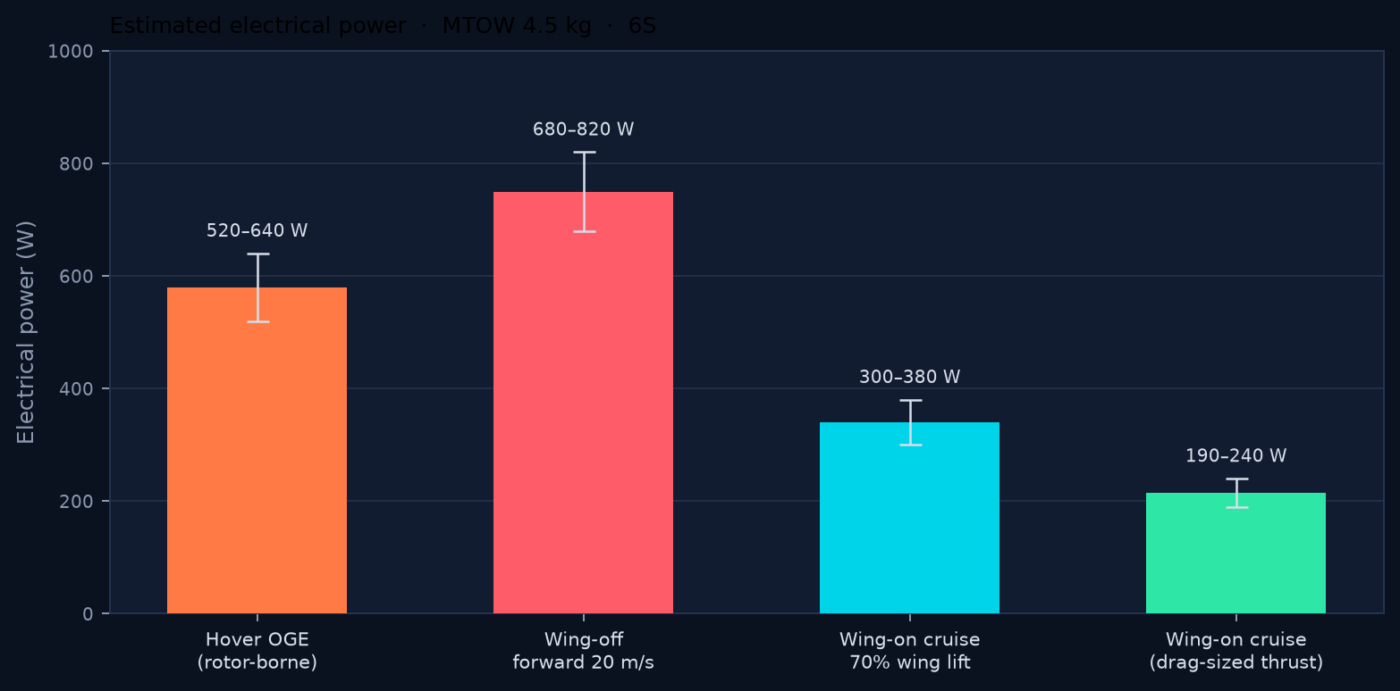
33 / EXPERIMENT
Wing-On vs Wing-Off Power Comparison
Estimates only · MTOW 4.5 kg · 6S · 16-inch class · V = 20 m/s
WHAT WE WILL FLY
▸ Same mass, same pack, same day.
▸ Stabilised 20 m/s run, level.
▸ Log W = V×I, IAS, tilt, RPM.
▸ Three repeats each config.
▸ Report mean, min, max — not a single heroic pass.
▸ If removable wing is unsafe, lock tilt at 0° for the rotor-borne leg.
Success criterion · statistically lower electrical power in the wing-on condition at matched MTOW and airspeed · uncertainty reported
PUSHPAK V1 · TILT-ROTOR VTOL DEMONSTRATOR · FINAL YEAR DESIGN REVIEW
34 / 40
Notes:
This is the money slide. Bars are momentum-theory plus a simple drag polar — not flight data.
Wing-off forward at 20 m/s is the expensive condition: rotors still lifting, now also dragging.
Wing-on at the 70% lift design point is conservative; a drag-sized thrust at 75° is the floor we hope to approach after tuning.
Flight test will replace these bands with mean ± scatter from FT-6 and FT-7.

Slide 35
34 / RISK
Risks and Mitigation
ID | Risk | L | C | Mitigation
R1 | MTOW > 4.9 kg (battery / prints) | M | H | Weekly CAD mass; foam wing; pack downsize
R2 | Static thrust < 2.25 kgf / motor | M | H | Stand map before CAD freeze; prop pitch options
R3 | Transition pitch-up / ballooning | M | H | CFD C4; slow tilt rate; abort to QHOVER
R4 | Tilt jam / servo stall | L | H | Stops, dual mag-angle, current trip, shaft bearings
R5 | Li-ion sag under hover current | M | H | Stand + IR test; keep LiPo backup pack
R6 | Pitot / IAS false transition | M | M | Fail-detect; inhibit tilt on IAS invalid
R7 | EMI on compass / mag angle | M | M | Routing, shielding, GT-8
R8 | Schedule slip on manufacture | H | M | COTS-first; parallel tilt bench article
R9 | Loss of vehicle on first free flight | M | H | Tether, geofence, two-person crew
R10 | Inconclusive power comparison | M | H | DAQ cal, repeats, locked test card
PUSHPAK V1 · TILT-ROTOR VTOL DEMONSTRATOR · FINAL YEAR DESIGN REVIEW
35 / 40
Notes:
Top risk is mass growth — it eats hover margin and the empty-mass promise.
Second is transition pitch. Third is Li-ion C-rate on 16-inch props.
We mitigate with a freeze date, a thrust stand, and a tether.

Slide 36
35 / NEXT
Future Improvements
V1.1
90° tilt option if 75° leaves unused axial efficiency.
V1.1
Folding props or larger disk if hover thermal is the limiter.
V2
Span / AR increase once manufacturing of the 1.3 m wing is proven.
V2
Independent motor-pod tilt (true tilt-rotor) vs paired shafts.
V2
Front/rear differential tilt as a pitch moment source.
V2
Onboard real-time CL estimator from pitot + IMU + mass.
V3
Redundant FC / dual battery if we ever leave the demo role.
V3
Mission payload (EO) replacing the 1 kg dummy — only after power is shown.
PUSHPAK V1 · TILT-ROTOR VTOL DEMONSTRATOR · FINAL YEAR DESIGN REVIEW
36 / 40
Notes:
V1 is the experiment. V2 is the aeroplane we would build if V1's power delta is real.
Do not promise autonomous delivery. Promise a cleaner tilt, a better polar, and maybe 90° if the data wants it.
Differential front/rear tilt as a pitch effector is the most interesting control upgrade.

Slide 37
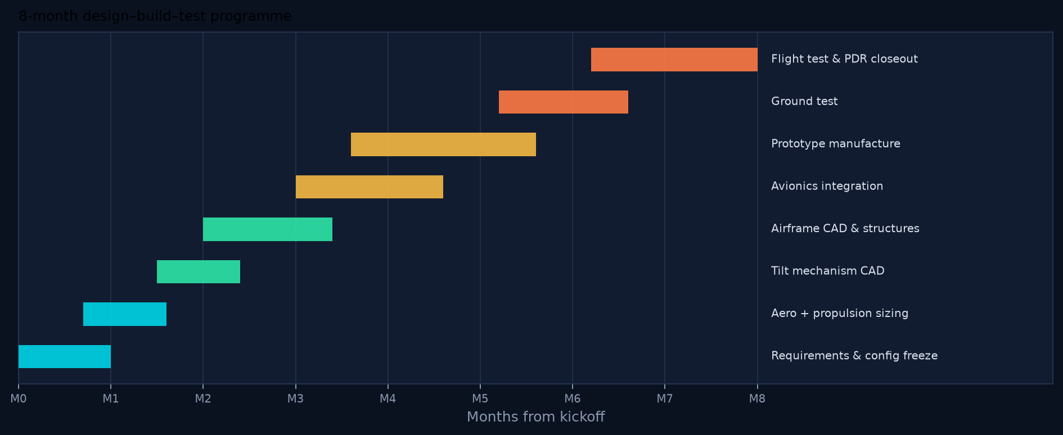
36 / SCHEDULE
Project Timeline
M2
M5
M7
M8
PDR
CDR / proto
FT-6/7
Closeout
Config, mass, thrust frozen
Vehicle complete, GT-10 done
Power comparison in hand
Report, demo, archive logs
PUSHPAK V1 · TILT-ROTOR VTOL DEMONSTRATOR · FINAL YEAR DESIGN REVIEW
37 / 40
Notes:
Eight months, one vehicle. The critical path is tilt CAD → printed axis → stand → tether.
Flight test is not a week at the end — it is a month of envelope expansion.
Faculty review gates sit at M2 (config freeze), M5 (prototype), M8 (results).

Slide 38
37 / BUDGET
Budget Estimate
Planning estimate · COTS-heavy · university workshop labour not costed
WBS | Group | Basis | Est. (INR)
1 | Propulsion (4× MY4215, props, ESCs) | COTS | 28,000
2 | Battery 6S Li-ion ~20 Ah + sense | COTS | 22,000
3 | Pixhawk + GPS/compass + pitot | COTS | 32,000
4 | ESP32, harness, PDB, connectors | COTS | 6,000
5 | Tilt (2× STS3215, bearings, shaft) | COTS + shop | 12,000
6 | Mag angle sensors ×2 | COTS | 5,000
7 | Airframe (foam/composite, prints, gear) | Shop | 18,000
8 | Test (stand, shunt, prints, props spares) | Shop | 8,000
9 | Contingency 15% | Risk | 19,650
 | TOTAL (planning) |  | ≈ 1,50,650
PUSHPAK V1 · TILT-ROTOR VTOL DEMONSTRATOR · FINAL YEAR DESIGN REVIEW
38 / 40
Notes:
Student-project money, not a company BOM. Figures are planning estimates in INR including contingency.
Propulsion plus avionics are half the spend. The wing is cheap until we break it.
Contingency 15% is for the second pack, the broken props, and the servo we will stall on the bench.

Slide 39
38 / CLOSE
Conclusion
Pushpak V1 is a 4.5 kg tilt-rotor VTOL demonstrator built to prove that wing-borne lift cuts electrical power versus rotor-borne flight.
Configuration frozen
01
4 rotors, paired front/rear tilt to 75°, high wing NACA 4412, Pixhawk / ArduPilot / ESP32.
Physics closed
02
Hover 1.125 kgf/motor floor, 2.25 kgf design; cruise CL 0.395 at 20 m/s on 0.32 m².
Experiment defined
03
Wing-on vs wing-off electrical power at matched mass — the only success metric that matters.
Path to flight
04
CAD → stand → tether → envelope expansion. Mass watched weekly against 3.5 kg empty.
PUSHPAK V1 · TILT-ROTOR VTOL DEMONSTRATOR · FINAL YEAR DESIGN REVIEW
39 / 40
Notes:
Restate the mission in one breath, then the frozen numbers, then the experiment.
Pushpak V1 exists to measure a power delta, not to look like an eVTOL poster.
Ask for the go-ahead to freeze configuration and buy long-lead motors, Pixhawk, and the 6S pack.

Slide 40
PUSHPAK V1
Thank you
Questions, technical discussion, and a configuration freeze.
PROJECT TEAM
Ishaan Bafna PRN 23070125017
Aman Ravat PRN 23070125004
Krit Verma PRN 230701250
Tilt-Rotor VTOL UAV Demonstrator
PUSHPAK V1 · TILT-ROTOR VTOL DEMONSTRATOR · FINAL YEAR DESIGN REVIEW
40 / 40
Notes:
Stop talking. Offer the test cards and the mass budget as handouts if asked.
Likely questions: why 75° not 90°; why Li-ion; why paired shafts not four independent pods; how you will fly wing-off safely.
Answers are on slides 8, 10, 16, and 34.

