Slide 1
NYC UBER RIDES · EXPLORATORY DATA ANALYSIS
What Actually Drives
an Uber Fare?
500,000 NYC rides

Slide 2
BEFORE ANYTHING ELSE
Cleaning the data changed mostly everything
Coordinates
Fares
Passengers
Distance
Stored in radians, not degrees — every map or distance check needed conversion first
Ranged from –$44 to $500 — negative and impossible values got removed
1,000 rides logged 0 passengers which is not a real trip
7,000 rides under 50m in pickuping and dropping off which means there was no real trips
02

Slide 3
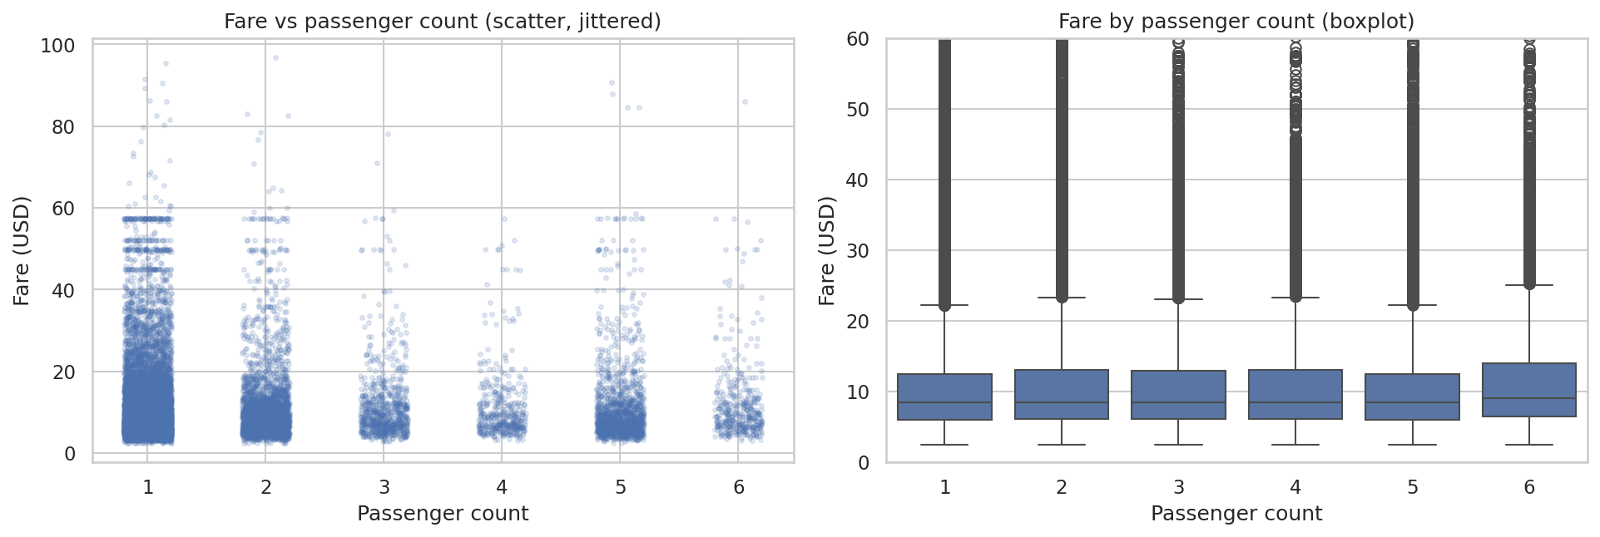
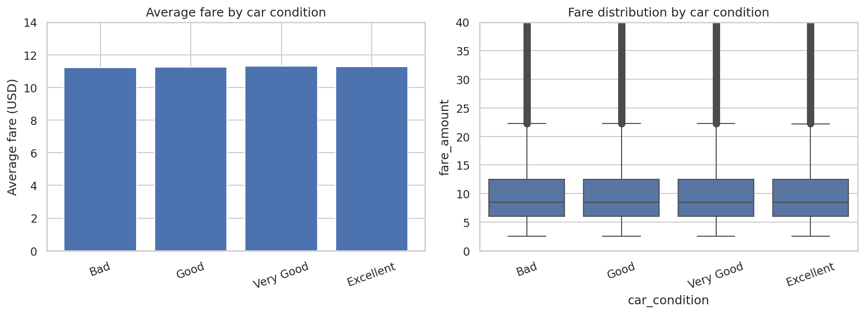
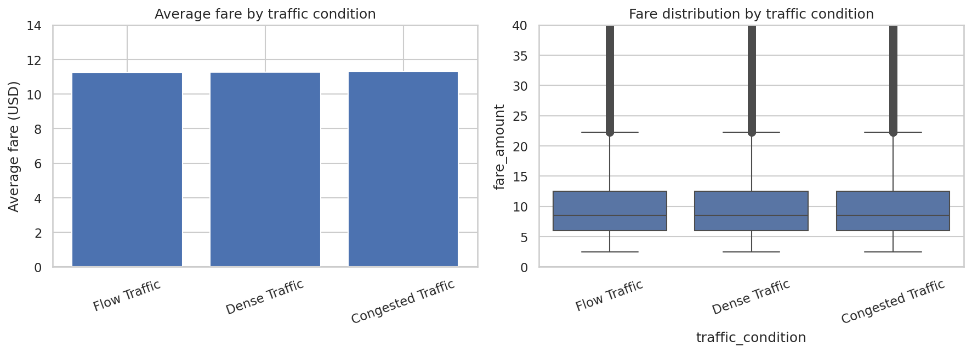
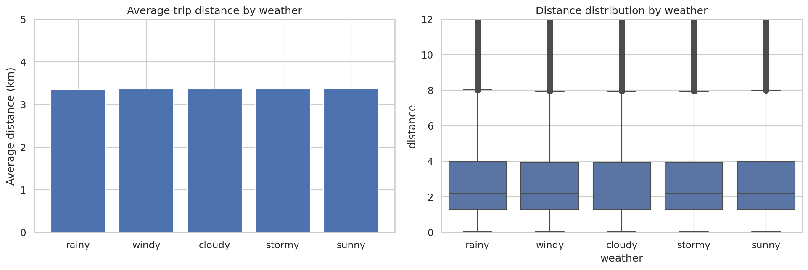
QUESTIONS 1, 2, 4, 7
Four plausible factors — none of them moved the fare
Q1 · Passengers
Q2 · Car condition
correlation with fare
gap, Bad → Very Good
Q4 · Traffic
Q7 · Weather
gap, Flow → Congested
spread across 5 conditions
05

Slide 4
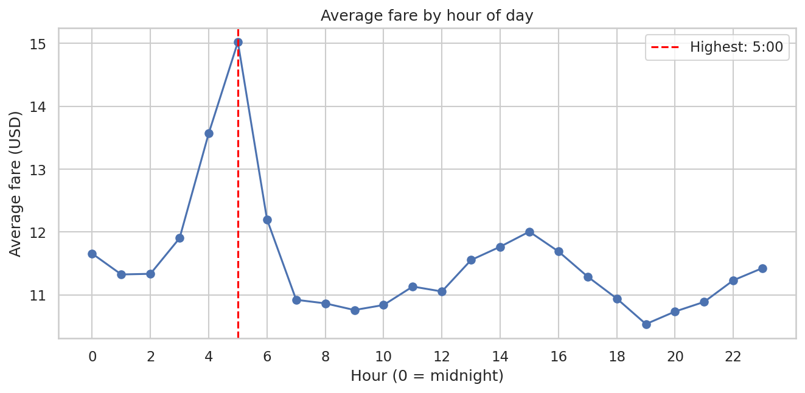
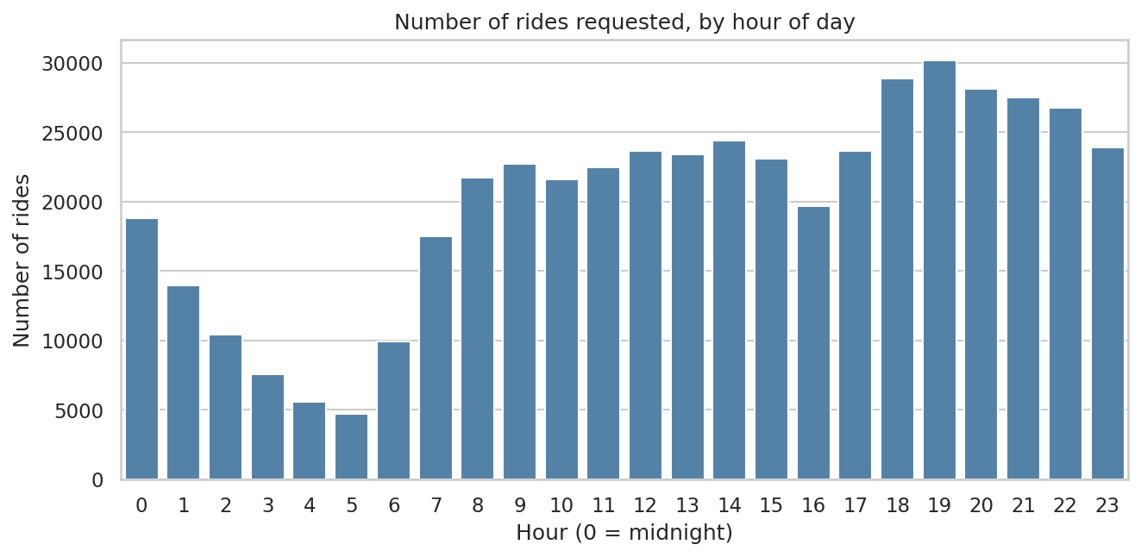
QUESTIONS 3 & 6
Expensive hours aren't busy hours
Q3 · Fare by hour
Q6 · Rides by hour
5 AM highest average fare — about $15
7 PM most ride requests — about 30,000
5 AM has the highest average fare and the fewest rides of the day. The fare peak comes from longer trips at that hour, not from demand-based pricing
06

Slide 5
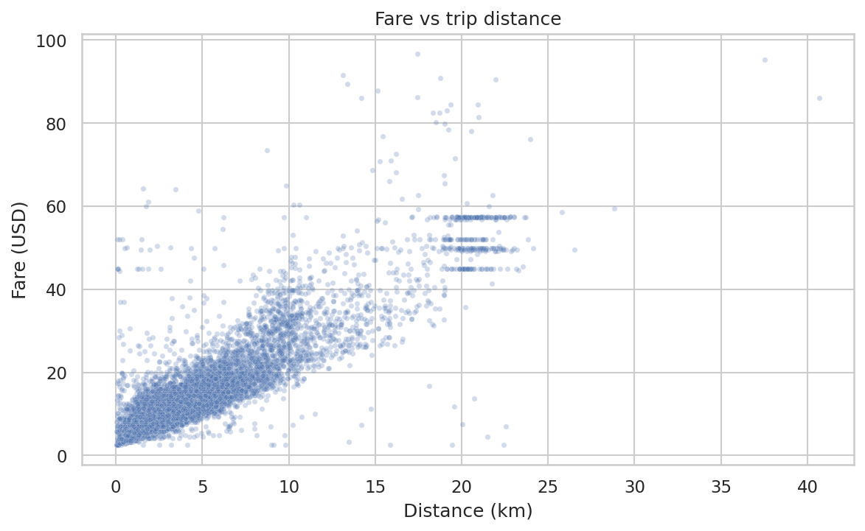
QUESTION 5
Is trip distance the strongest predictor of fare?
PLOT CHOICE
Scatter plot — the right choice for two numeric variables, since it shows both direction and shape of the relationship.
INSIGHT
A clear, almost straight line: as distance rises, fare rises with it. This is the single strongest relationship in the whole dataset.
0.90 correlation with fare
03

Slide 6
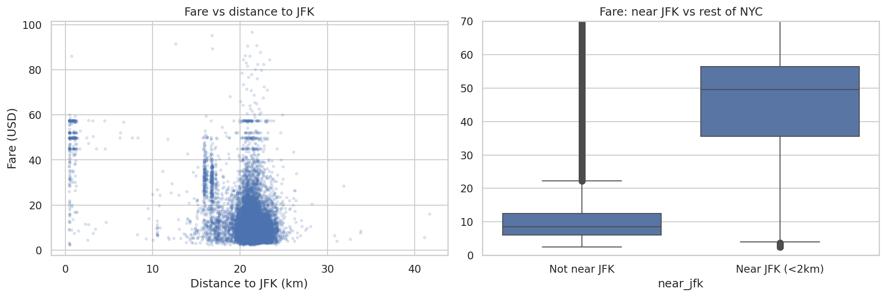
QUESTION 8 · THE EXCEPTION
Are rides that start closer to airports generally more expensive?
PLOT CHOICE
Scatter plot of fare vs. distance to JFK, backed by a boxplot comparing near-JFK pickups to the rest of NYC.
$44
$10
avg. fare within 2km of JFK
avg. fare everywhere else in NYC
Rides that start near JFK cost roughly 4x more than the rest of the city — the single largest effect anywhere in this dataset. If a pricing model were built from this data, airports would need their own rule, not just a distance multiplier.
07

Slide 7
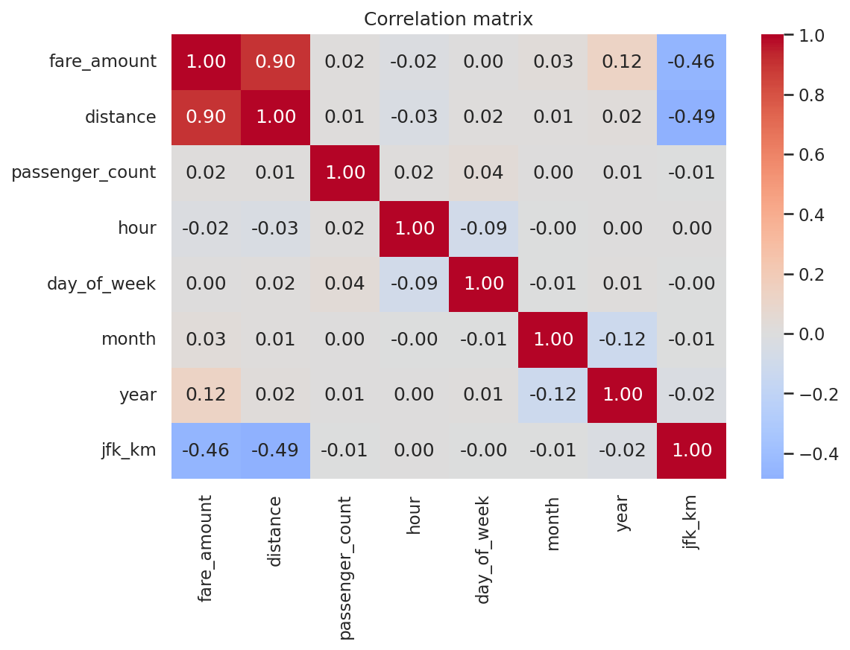
QUESTION 9
Which features actually correlate with fare?
PLOT CHOICE
Correlation heatmap which compares every numeric feature against fare at once, faster than eight separate scatter plots but it only catches straight-line relationships.
INSIGHT
Distance dominates at 0.90 , JFK is a distant second at –0.46 and the closer a pickup is to the airport, the higher the fare. Everything else — hour, passengers, weekday are below 0.03: essentially no relationship at all.
−0.46 jfk_km vs fare — the feature that matters
04

Slide 8
THANK YOU
Distance drives the fare.
Airports are the exception.
Questions?

