Slide 1
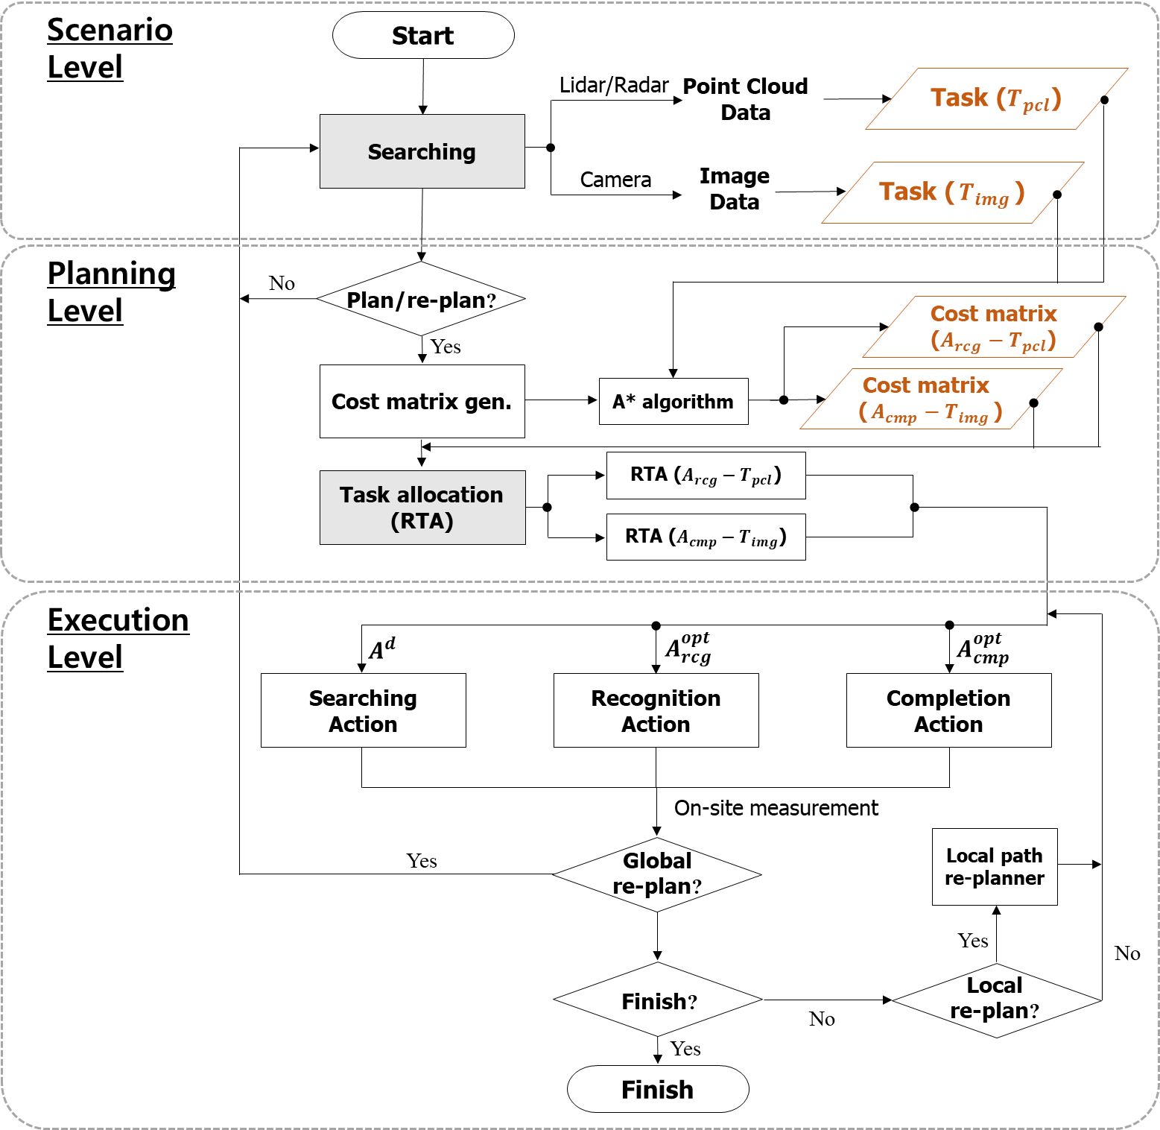









Scenario Level
Start
Lidar/Radar
Point Cloud
Data
Task ($T_{pcl}$)
Searching
Camera
Image
Data
Task ($T_{img}$)
Planning Level
No
Plan/re-plan?
Cost matrix
($A_{rcg}−T_{pcl}$)
Yes
Cost matrix gen.
A* algorithm
Cost matrix
($A_{cmp}−T_{img}$)
RTA ($A_{rcg}−T_{pcl}$)
Task allocation (RTA)
RTA ($A_{cmp}−T_{img}$)
Execution Level
$$A^{d}$$
$$A_{rcg}^{opt}$$
$$A_{cmp}^{opt}$$
Searching
Action
Recognition
Action
Completion Action
On-site measurement
Yes
Global
re-plan?
Local path
re-planner
Yes
No
Local
re-plan?
Finish?
No
Yes
Finish

