Slide 1
Story size: Page format is 16:9 (1920x1080p)
Be aware:
Mobile can be implemented. In this case, design should be reviewed and adapted accordingly. To the current stand, responsive design cannot be generated using Storyline 3.
1/4 of
page size

Slide 2


Logo: 128 x 128 px
2/30 of horizontal page size
32px
Buffer around logo: 32px
1/60 of horizontal page size
Buttons = 90 x 90 px
Same size as the circle in the CERN logo
Buffer around Button: 32px
1/60 of horizontal page size
32px
The button area may be empty
if no buttons are needed.
1 square = 64 x 64 px
1/30 of horizontal page size

Slide 3
Text, 21 pt.
The lime colored area indicates the area that can be used freely. Please, respect the alignments and the grid.
The yellow area indicates where you may cross the grid. You can ONLY break the parameters to respect a design flow or to extend a visual element. Any additional button in the lower navigation or extended titles and subtitles must be considered as a red area.
The red area isolates basic elements. It should NEVER be invaded by other elements. (Exception: Background picture.)
Following Font-sizes can be used: 5 – 7 – 9 – 12 – 16 – 21 – 37 – 50 – 67 – 89 – 119. These fonts are suitable for a full HD screen. The sizes differ from each other by increasing exactly 1/3 of the size.
Real scale fonts: 5 – 7 – 9 – 12 – 16 – 21 – 37 – 50 – 67 – 89 – 119
The button area may be empty
if no buttons are needed.

Slide 4



















Button set
Library – background contrast

Slide 5
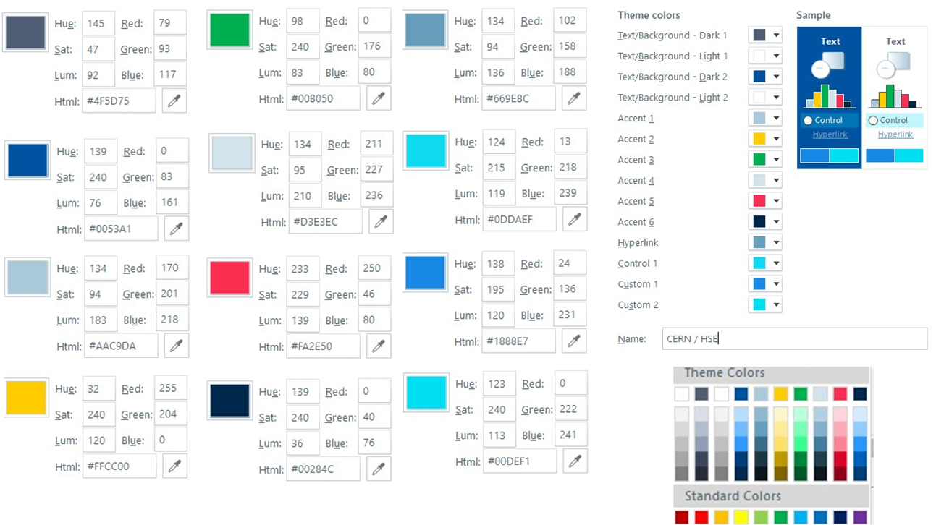
Colour scheme
HSE

Slide 6
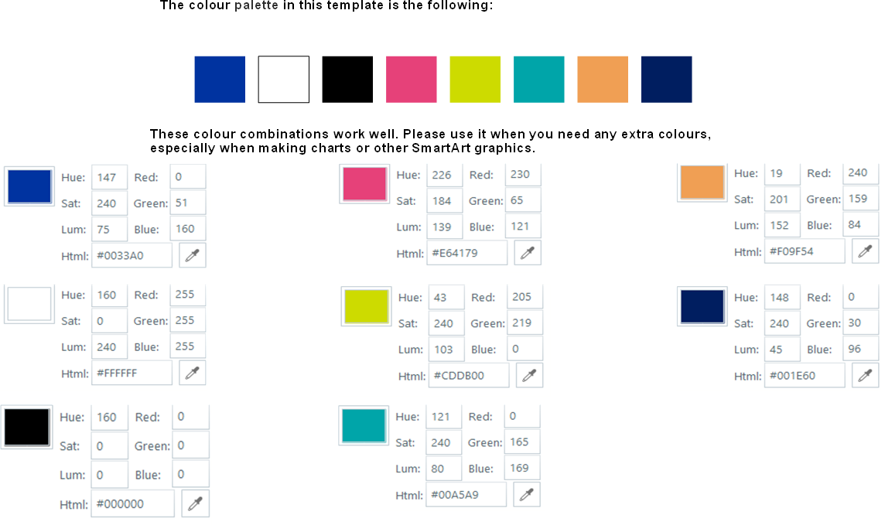
Colour Scheme
HR-LD

Slide 7
Chapter 1
Chapter 2
Chapter 3
Chapter 4
Second line
Recap

Slide 8
Version with many chapters
Chapter 1
Chapter 2
Chapter 3
Chapter 4
Subtitle 4.1
Chapter 5
Subtitle 4.2
Chapter 6
Subtitle 4.3
Chapter 7
Subtitle 4.4
Chapter 8
Subtitle 4.5

Slide 9
Quiz Slide
See next slide for the feedback master
This is the question. This works for any kind of freeform quiz, as long as you are using the built-in “submit” function on a player’s button or a custom button. (This example is a pick one with one try)
Wrong answer
Correct answer
Feedback
Submit

Slide 10
Quiz slide
Example of feedback
This is the question. This works for any kind of freeform quiz, as long as you are using the built-in “submit” function on a player’s button or a custom button. (This example is a pick one with one try)
Wrong answer
Incorrect
Correct answer
You did not select the correct response.
The text here should be the same as Feedback Layer and can be the same as the Correct layer.
from the next slide, come back here with the navigation button.
Feedback

Slide 11
Conclusion – wrap up
Additional resources, external links, «to go deeper», etc.
Find more information on the website
You may be interested in this training to learn more.

Slide 12
Customizable

