Slide 1
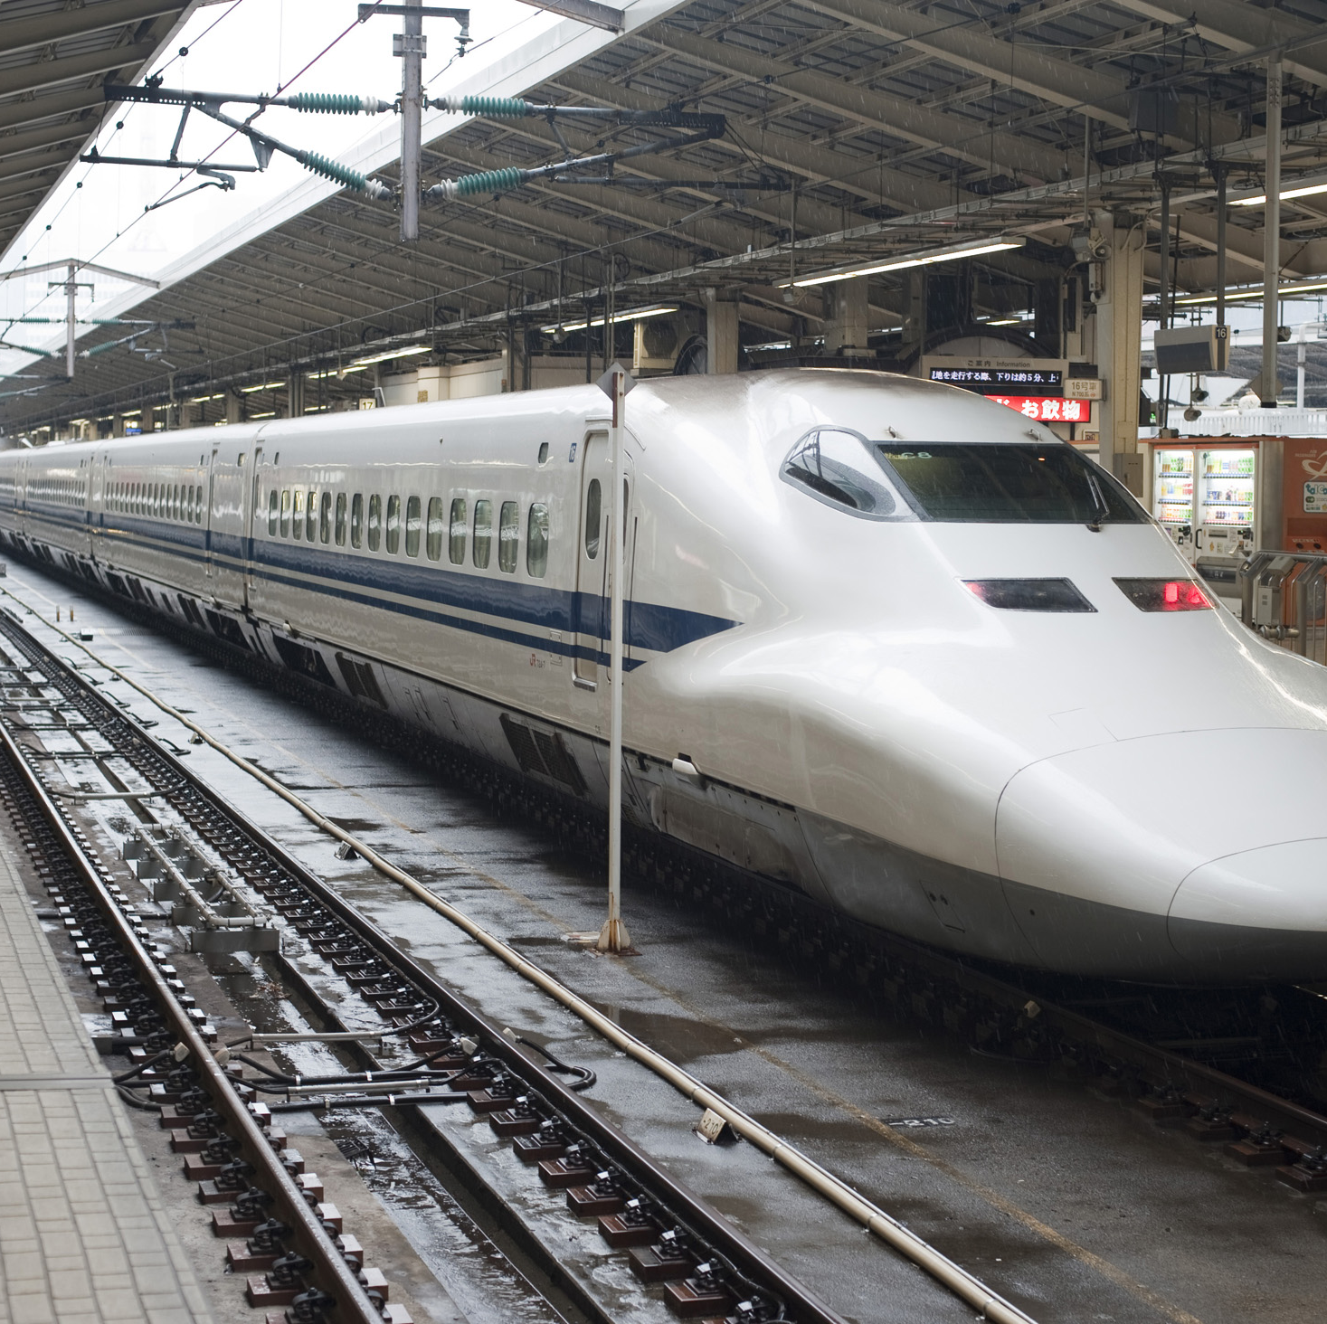
Railway E-ticketing Service
DBMS Lab Project
Sukrit
Kushagra
Satya

Slide 2
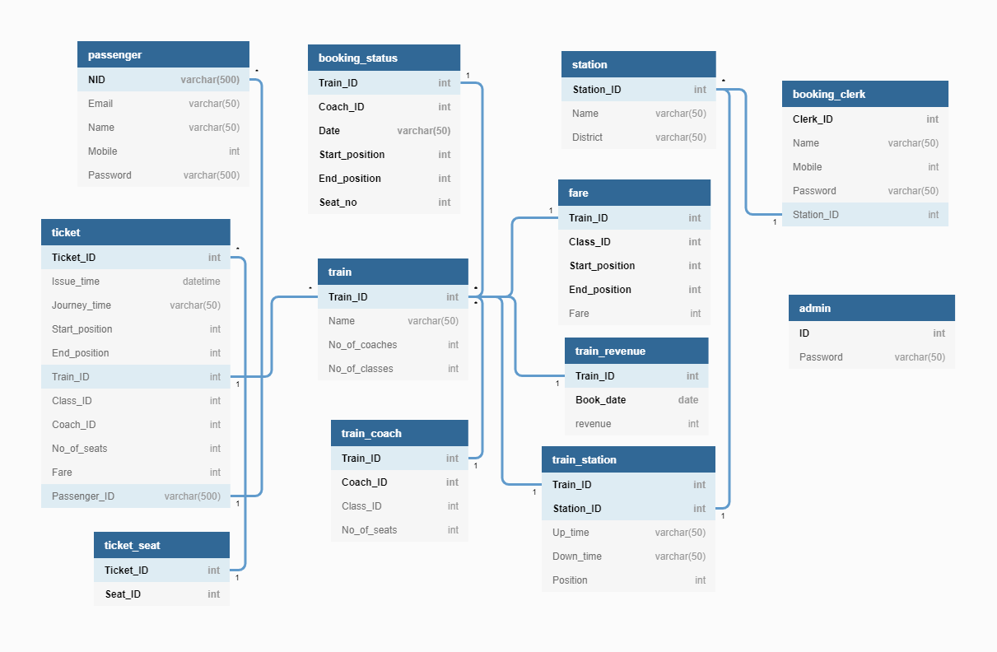
DATABASE SCHEMA

Slide 3

DATABASE ASPECTS

Slide 4
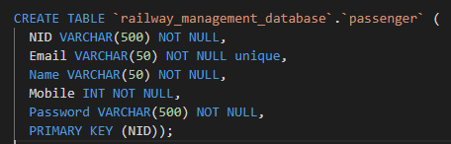
SCHEMA DESIGN
The schema contains various specialized tables that help drive key features of the app. Many larger tables were frequently split to (at least) maintain 2NF status, and do away with redundant and impractical large tables.

Slide 5
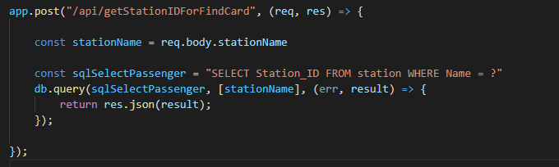
INTEGRATION WITH FRONTEND
The MySQL database is accessible on the node.js backend by means of appropriate drivers and modules.
Client side uses APIs to request data and records from the database which is located in the backend.

Slide 6
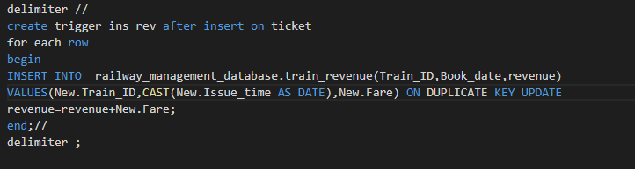
TRIGGERS
Revenue data is compiled automatically on booking of every new ticket. Revenue data pertaining to a particular train can be accessed by ADMIN.

Slide 7

FEATURES

Slide 8

LOGIN with ENCRYPTION
Secure Login
Uses bcrypt module for password-hashing
Three types of users: Admin, Clerk, Passenger with varied functionalities available to them

Slide 9

ADMIN
Add a new Station Add a new train with coach and fare specifications Add route for the newly added train Add a clerk for a station
Get revenue for a train
This Photo by Unknown author is licensed under CC BY-SA.

Slide 10

CLERK
Book a ticket on behalf of a passenger using email ID Check trains based on From and To location Book tickets based on availability and class preference Print the ticket

Slide 11

PASSENGER
Check trains based on From and To location Book tickets based on availability and class preference Print the ticket Access to dashboard to see all past bookings Verify ticket status

Slide 12

NON-LOGGED IN USER
Check trains based on From and To location Verify ticket status Register as a new passenger

Slide 13

MADE WITH
[Sukrit Bhatt]
(19CS01013)
[Kushagra Gupta]
(19CS01014)
[Satya Sangram Mishra]
(19CS01062)
Thank You!

