Slide 1
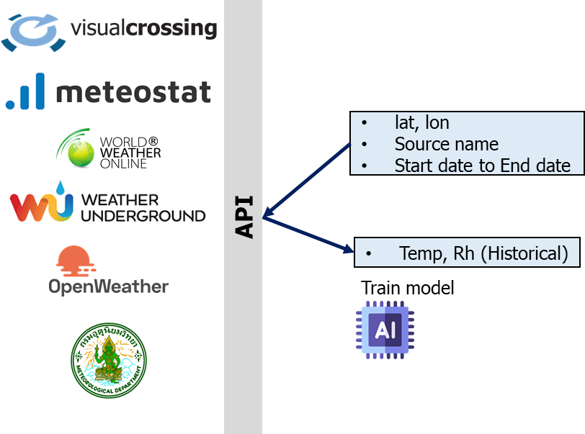
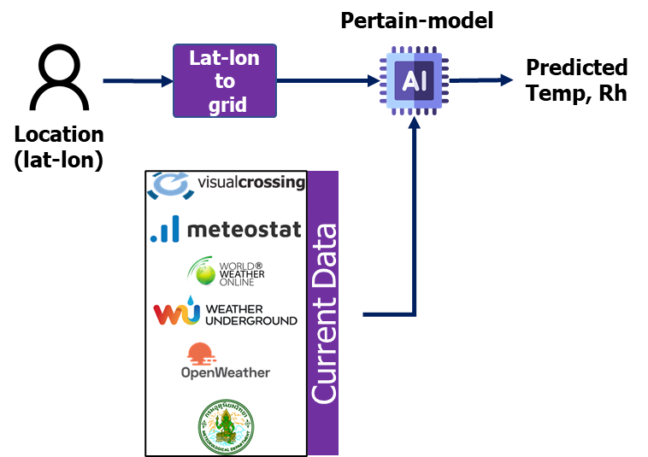

Training model
Real-time Prediction
GitHub: https://github.com/SukritJaAIproject/weather_api
Google Colab: https://colab.research.google.com/drive/1jN9PQjwhKO2xiZcnYNwovau26v-ojEyg?usp=sharing
Dataset: https://drive.google.com/drive/folders/1IK36-94dYoYeX2K1xfx1qqHDFZ_o3yKU?usp=sharing

Slide 2


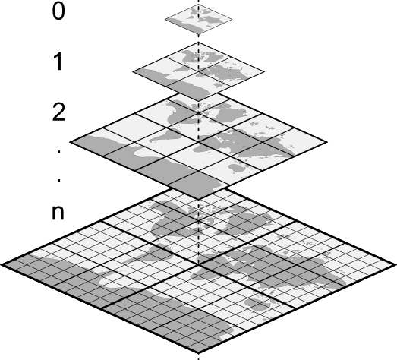






Training Process
Model’s Features/Input
Done
Meteostat
T, Rh
Estimate data
Lat-lon
his_data_point.py
T, Rh
Actual data
station_his_data.py
Lat-lon
T, Rh
Visualcross_hist.py
Estimate data
Update model
Lat-lon
T, Rh
InProgress
open_his_data.py
Estimate data
Lat-lon
T, Rh
wg_his_data.py
Actual data
Lat-lon
T, Rh
wwo_his_data.py
Estimate data
Lat-lon
T, Rh
tmd_forecast.py
Estimate data
สามารถเก็บข้อมูลเพื่อเอามา train model ภายหลังได้
Historical data

Slide 3
Real-time Process
Done
Meteostat
T, Rh
his_data_point.py
Estimate data
Lat-lon
T, Rh
nearby_stations_get_data.py
Actual data
Lat-lon
T, Rh
Estimate data
Visualcross_current.py
Pre-trained model
Lat-lon
T, Rh
InProgress
open_his_data.py
Estimate data
Lat-lon
T, Rh
wunderground_current.py
Actual data
Lat-lon
T, Rh
wwo_curr_data.py
Estimate data
Lat-lon
T, Rh
current_tmd_data.py
Estimate data
สามารถเก็บข้อมูลเพื่อเอามา train model ภายหลังได้
Current data

Slide 4





Algorithm
Meteostat
Algo.

Slide 5
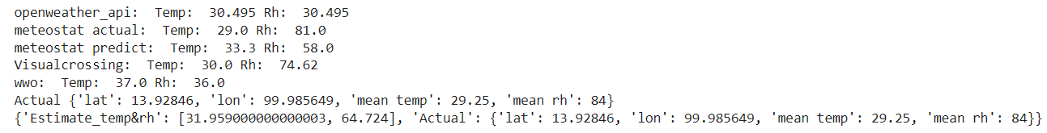
Result
Test site : EECU

Slide 6
Visualization

Slide 7
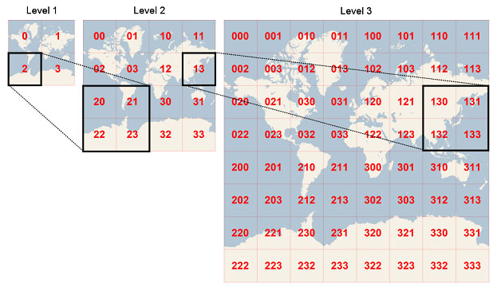

Slide 8


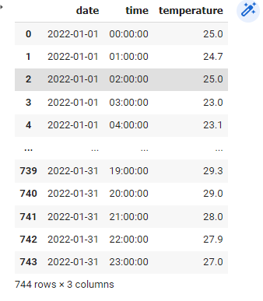
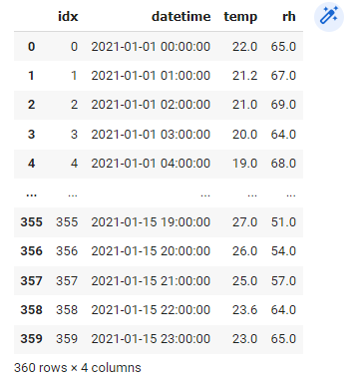
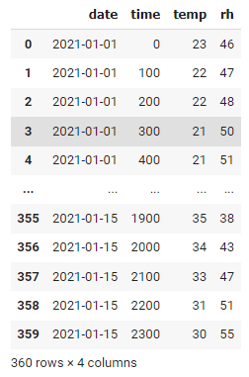
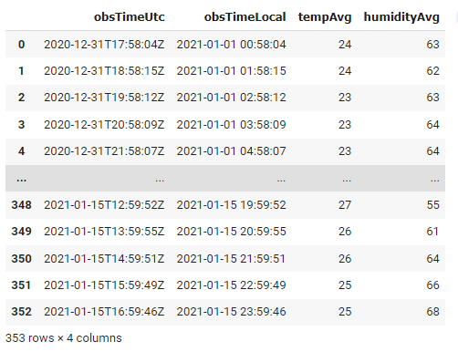
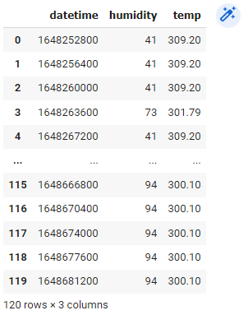

Slide 9
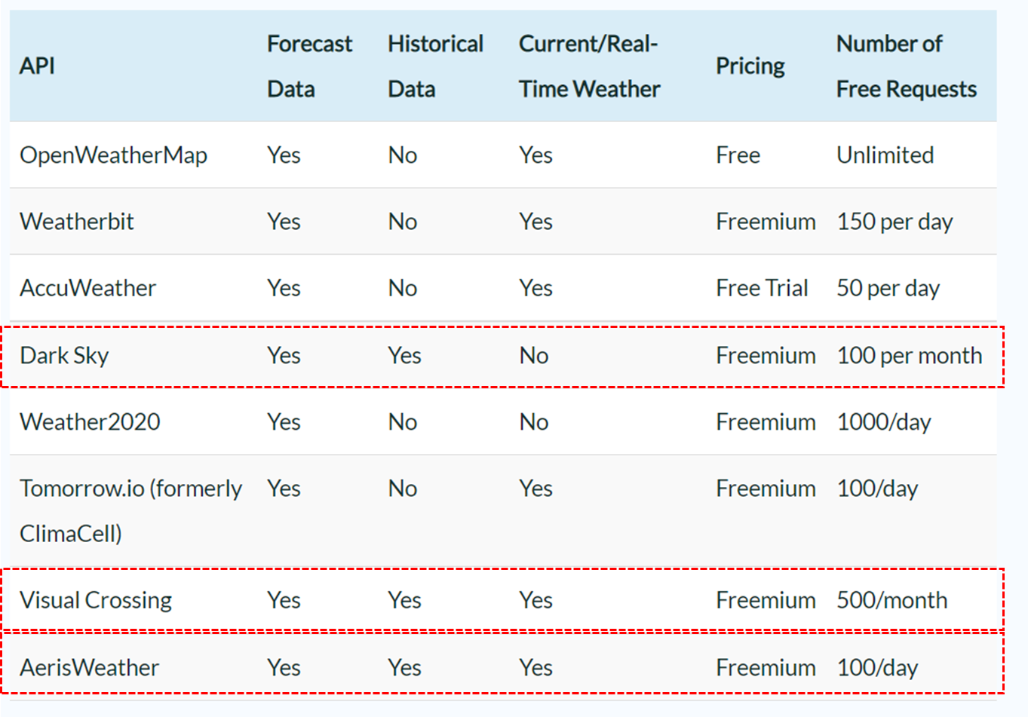
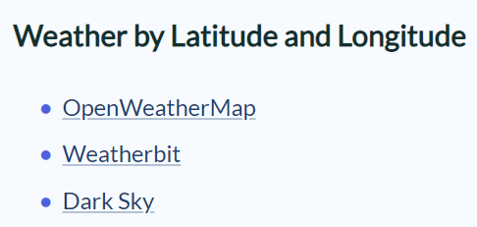

Slide 10
Input
Lat, lon
Start date to End date
Forecast data
Temp, Rh
Hourly
Forecast (T to T+14 )
Historical data
Temp, Rh
Hourly

Slide 11
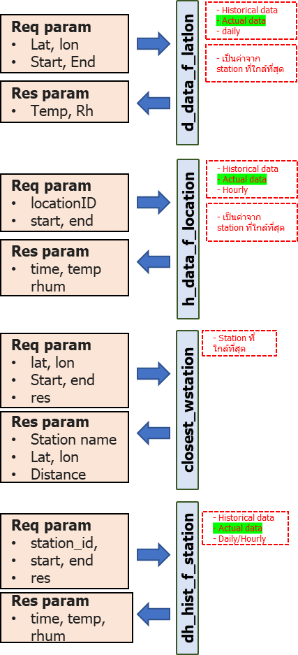
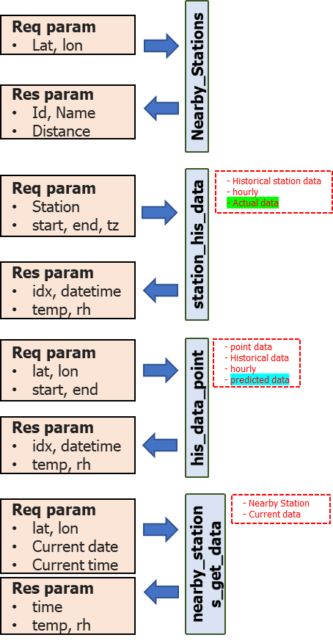

Slide 12
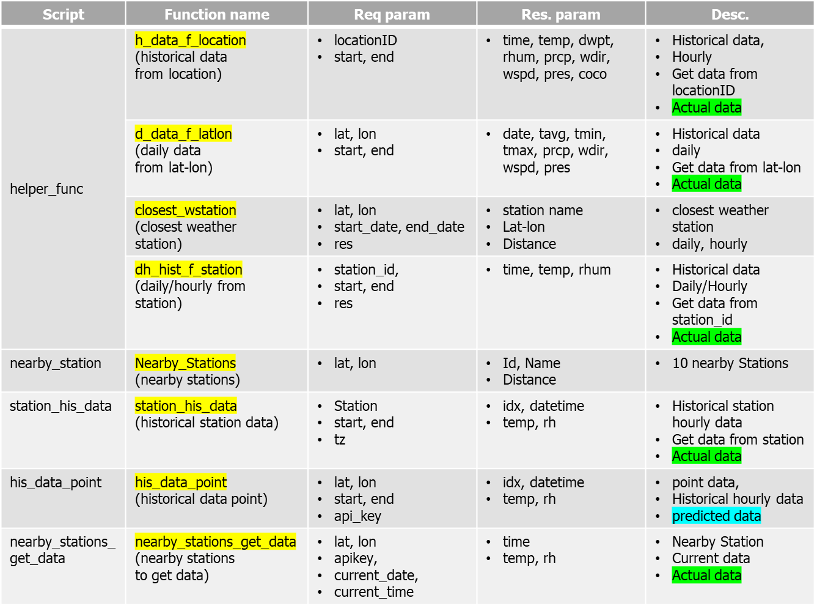
Meteostat

Slide 13
Input
Lat, lon
Date
Historical data
Temp, Rh
Hourly

Slide 14
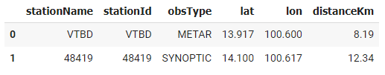
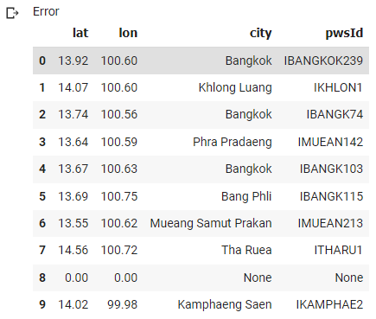
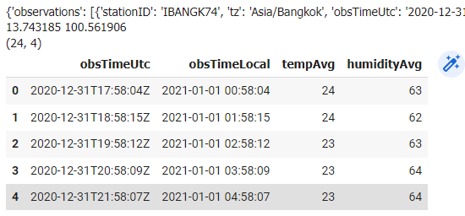
stationName
stationId
obsType
Lat, lon
distanceKm
Input
Lat, lon
near Location
Lat, lon
City
locId
pwsId
Input
Lat, lon
location_point
actual data
Temp, Rh
Hourly
Input
pwsId
Date
Get value

Slide 15
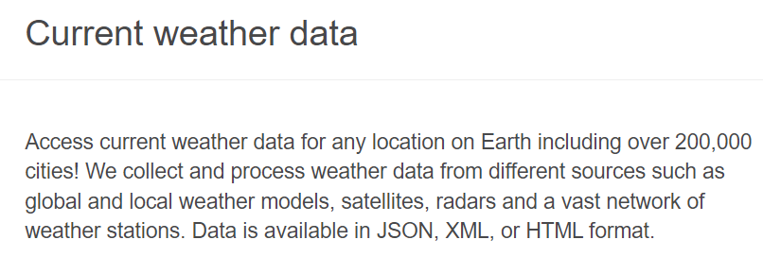

Input
Lat, lon
Date
Historical data
Temp, Rh
Hourly
Current data
Temp, Rh
Hourly

Slide 16
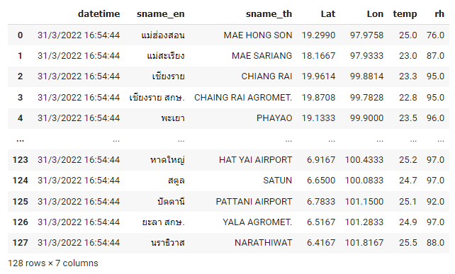

Input
None
Current data
*actual data from stations
Temp, Rh
3 Hourly

Slide 17
Dataset
01/01/2565-15/01/2565

Slide 18
Meteostat
Script | Function name | Req param | Res. param | Desc.
helper_func | h_data_f_location (historical data from location) | locationID start, end | time, temp, dwpt, rhum, prcp, wdir, wspd, pres, coco | Historical data, Hourly Get data from locationID Actual data
 | d_data_f_latlon (daily data from lat-lon) | lat, lon start, end | date, tavg, tmin, tmax, prcp, wdir, wspd, pres | Historical data daily Get data from lat-lon Actual data
 | closest_wstation (closest weather station) | lat, lon start_date, end_date res | station name Lat-lon Distance | closest weather station daily, hourly
 | dh_hist_f_station (daily/hourly from station) | station_id, start, end res | time, temp, rhum | Historical data Daily/Hourly Get data from station_id Actual data
nearby_station | Nearby_Stations (nearby stations) | lat, lon | Id, Name Distance | 10 nearby Stations
station_his_data | station_his_data (historical station data) | Station start, end tz | idx, datetime temp, rh | Historical station hourly data Get data from station Actual data
his_data_point | his_data_point (historical data point) | lat, lon start, end api_key | idx, datetime temp, rh | point data, Historical hourly data predicted data
nearby_stations_get_data | nearby_stations_get_data (nearby stations to get data) | lat, lon apikey, current_date, current_time | time temp, rh | Nearby Station Current data Actual data

Slide 19



lat, lon
Source name
Start date to End date
Pertain-model
Lat-lon
to
grid
Predicted
Temp, Rh
API
Location
(lat-lon)
Temp, Rh (Historical)
Train model
Current Data

Slide 20
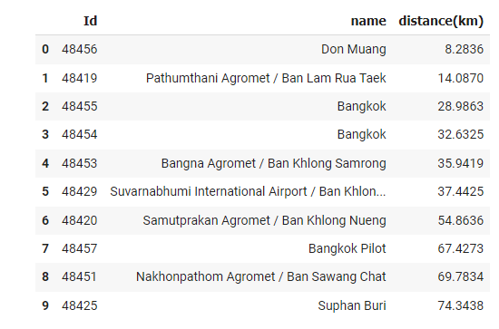
Historical data
*actual data from station
Temp, Rh
Hourly
เป็นค่าจาก station ที่ใกล้ที่สุดจาก lat lon ที่ป้อน
Input
Lat, lon
Start date to End date
Input
Lat, lon
สามารถค้นหาสถานีที่ใกล้ที่สุดรอบๆได้
Input
Station
Start date
End date
Historical data
*actual data from station
Temp, Rh
Hourly
Historical data
* predicted data (point data)
Temp, Rh
Hourly
Input
Lat, lon
Start date to End date

Slide 21
backup
Req param
Lat, lon
Start, End
- Historical data
- Actual data
- daily
- เป็นค่าจาก station ที่ใกล้ที่สุด
Req param
Lat, lon
d_data_f_latlon
Res param
Temp, Rh
Nearby_Stations
Mean
predict
Res param
Id, Name
Distance
Req param
locationID
start, end
- Historical data
- Actual data
- Hourly
Req param
Station
start, end, tz
- Historical station data
- hourly
- Actual data
- เป็นค่าจาก station ที่ใกล้ที่สุด
Res param
time, temp rhum
h_data_f_location
station_his_data
Res param
idx, datetime
temp, rh
Req param
lat, lon
Start, end
res
- Station ที่ใกล้ที่สุด
Req param
lat, lon
start, end
- point data
- Historical data
- hourly
- predicted data
Res param
Station name
Lat, lon
Distance
closest_wstation
his_data_point
Res param
idx, datetime
temp, rh
Req param
lat, lon
Current date
Current time
- Nearby Station
- Current data
Req param
station_id,
start, end
res
- Historical data
- Actual data
- Daily/Hourly
Final result
Expected temp
nearby_stations_get_data
dh_hist_f_station
Res param
time
temp, rh
Res param
time, temp, rhum

