Slide 1

REPAYING THE CREDIT
By Sukrit Singh Negi

Slide 2
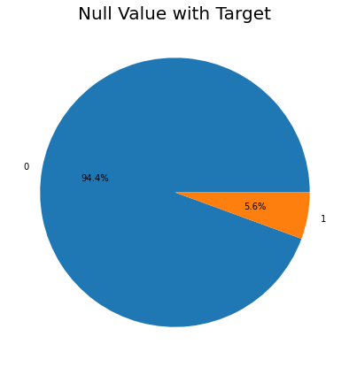
Decision For Null Value
Here we plotted the pie chart with respect to the ‘TARGET’ .
There is higher probability that Applicants with No Entries in ‘AMT_GOODS_PRICE’ have no difficulty in credit repayments.

Slide 3
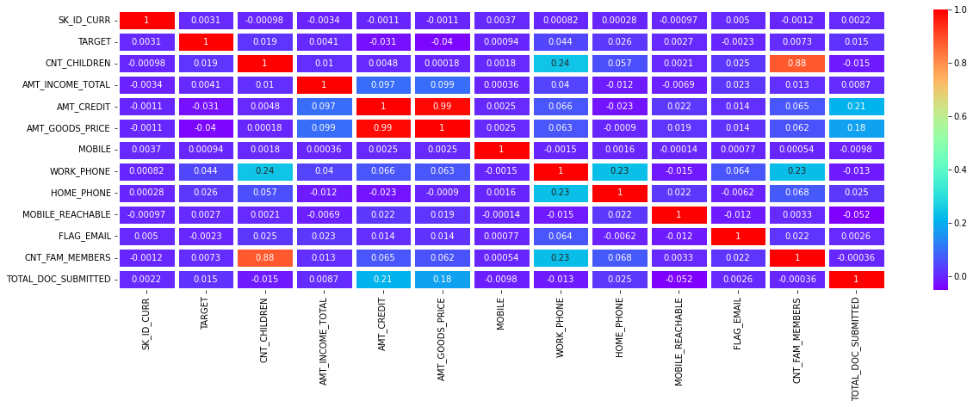
Correlation With Heat Map
From the Heat map we interpreted the following:
Strong positive relation between (‘AMT_GOODS_PRICE’ & ‘AMT_CREDIT’) and (‘CNT_FAM_MEMBERS’&’CNT_CHILDREN’)
Positive relation between(‘CNT_CHIDREN’&’WORK_PHONE’) ,(‘WORK_PHONE&HOME_PHONE’),(TOTAL_DOC_SUBMITTED& ‘AMT_CREDIT’& ‘AMT_GOODS_PRICE’) )

Slide 4
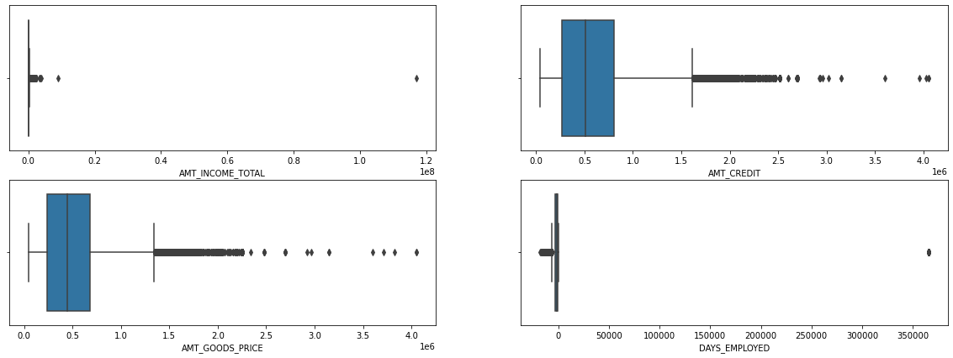
Continuous Data
Hence we concluded that we have to drop the ‘DAYS_EMPLOYED’ . As we found that ‘DAYS_EMPLOYED’ distribution is majorly in negative

Slide 5
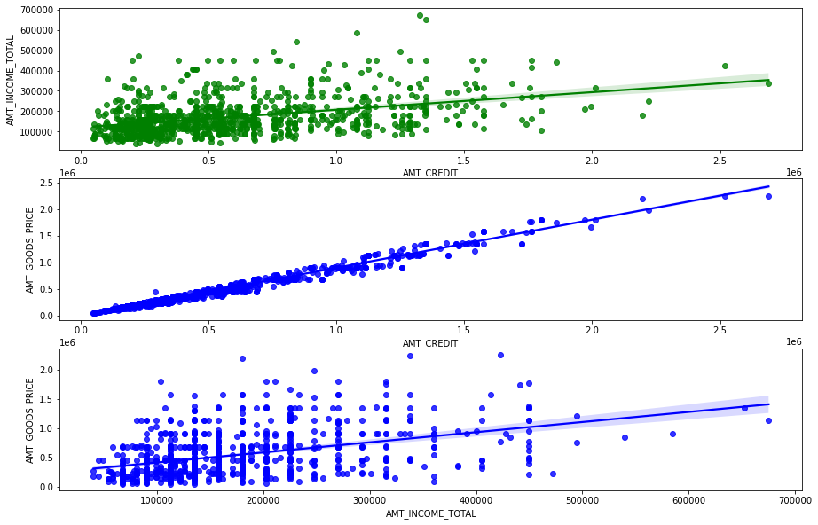
‘From the Scatter plot we interpreted the following:
AMT_GOODS_PRICE’ & ‘AMT_CREDIT’& AMT_INCOME_TOTAL all the have directly proportional relationship with each other (positive Trend)

Slide 6
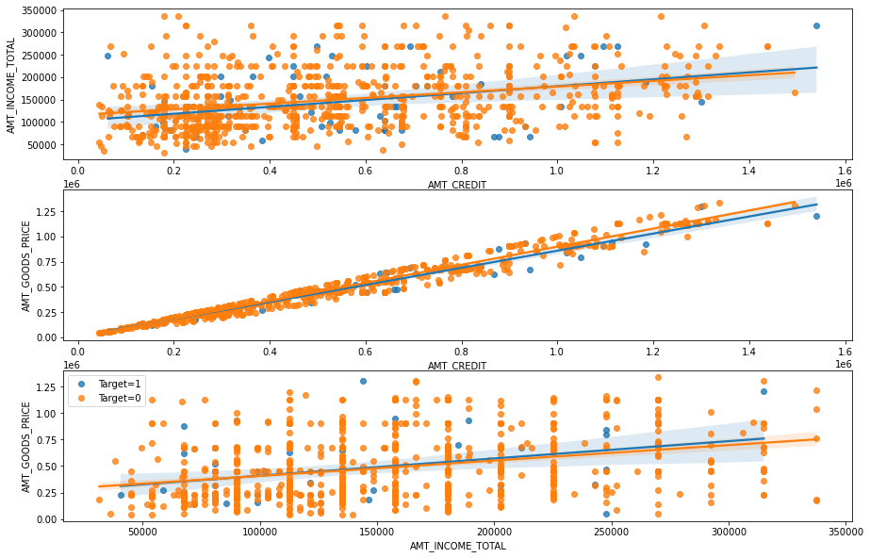

Slide 7
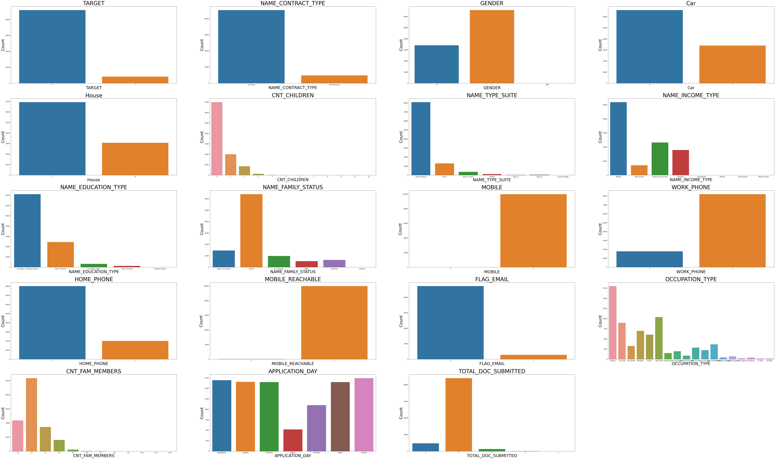
Total Count Of sub-categories With Respect To The Categories

Slide 8
Interpretation:
Maximum applicant who applied for loan:
0.TARGET = 0 (maximum applicants are returning the loan without delay)
1.Name_CONTRACT_TYPE = Cash Loans(maximum Applicants are applying for cash loan )
2.GENDER = Female (F)(maximum applicants are female)
3.Car = No(N)(maximum applicant don not have the car)
4.House = Yes(Y)(maximum applicant have house)
5.CNT_CHILDREN = NO(maximum applicant do not have children)
6.NAME_TYPE_SUITE = Unaccompanied
7.NAME_INCOME_TYPE= Working
8.NAME_EDUCATION_TYPE= Secondary/secondary special
9.NAME_FAMILY_STATUS = Married
10.MOBILE= yes(maximum applicant have mobile)
11.WORK_PHONE = Yes(maximum applicant have work phone)
12.Home_Phone= No(maximum applicant do not have home phone)
13.MOBILE_REACHABLE= Yes(maximum applicant have mobile are reachable)
14.FLAG_EMAIL= No(maximum applicant do not have email)
15.OCCUPATION_TYPE= Laborers
16.CNT_FAM_MEMBERS = (maximum applicant have 2 family members)
17.TOTAL_DOC_SUBMITTED=1(maximum applicant have submitted one document)

Slide 9
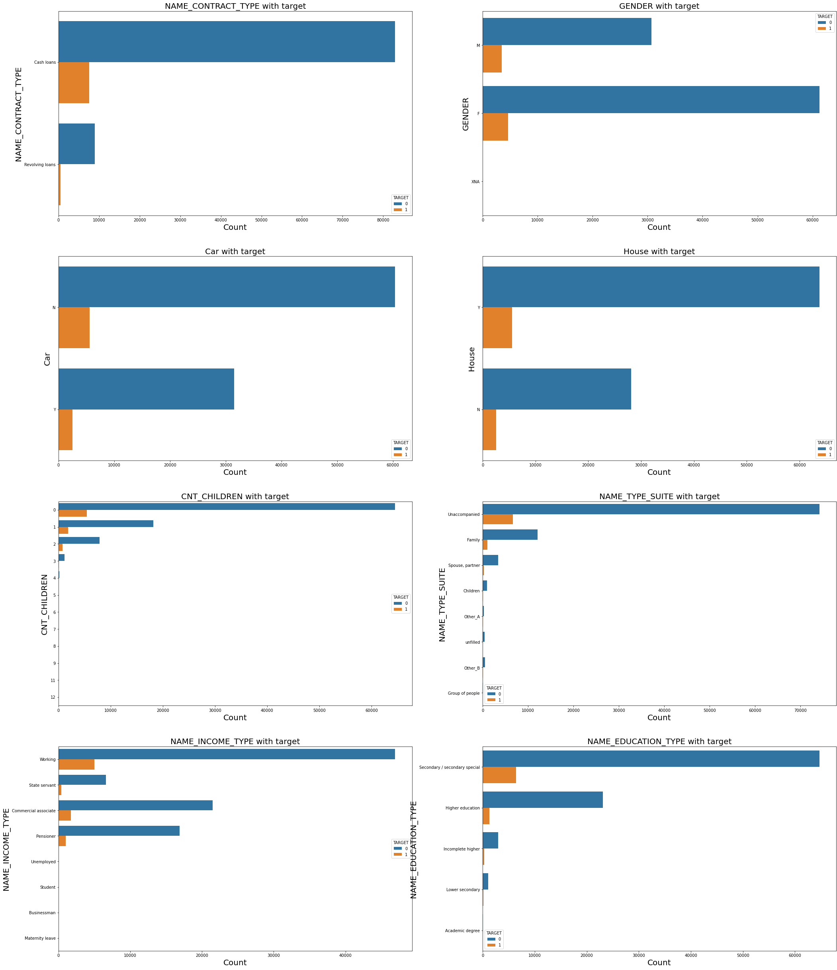
Probability
Of
All
Categories
With
Respect
To
Target

Slide 10
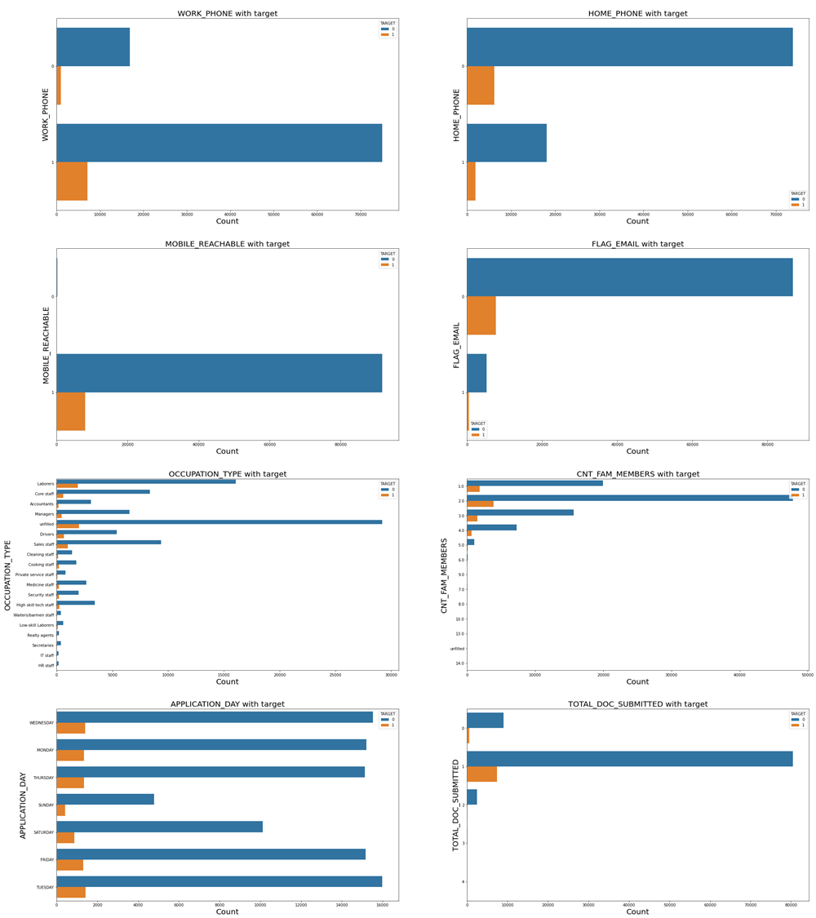
Probability
Of
All
Categories
With
Respect
To
Target

Slide 11
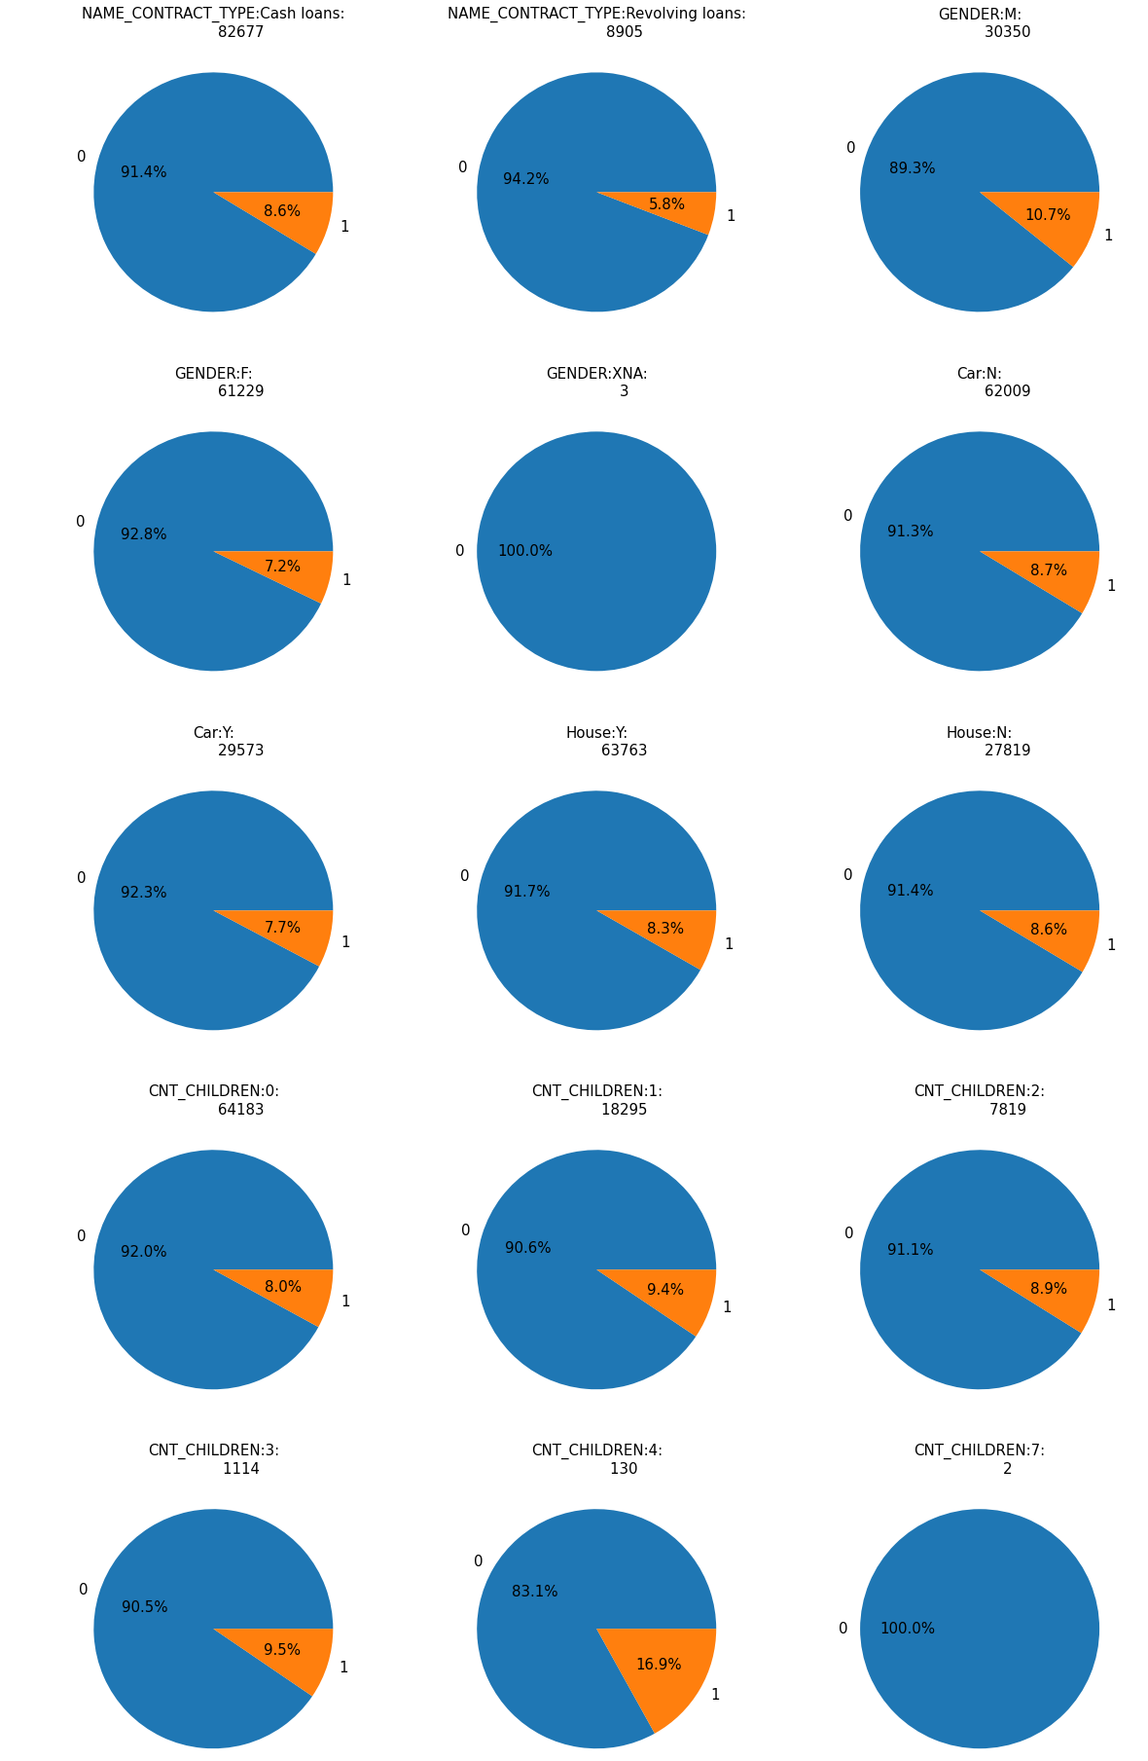
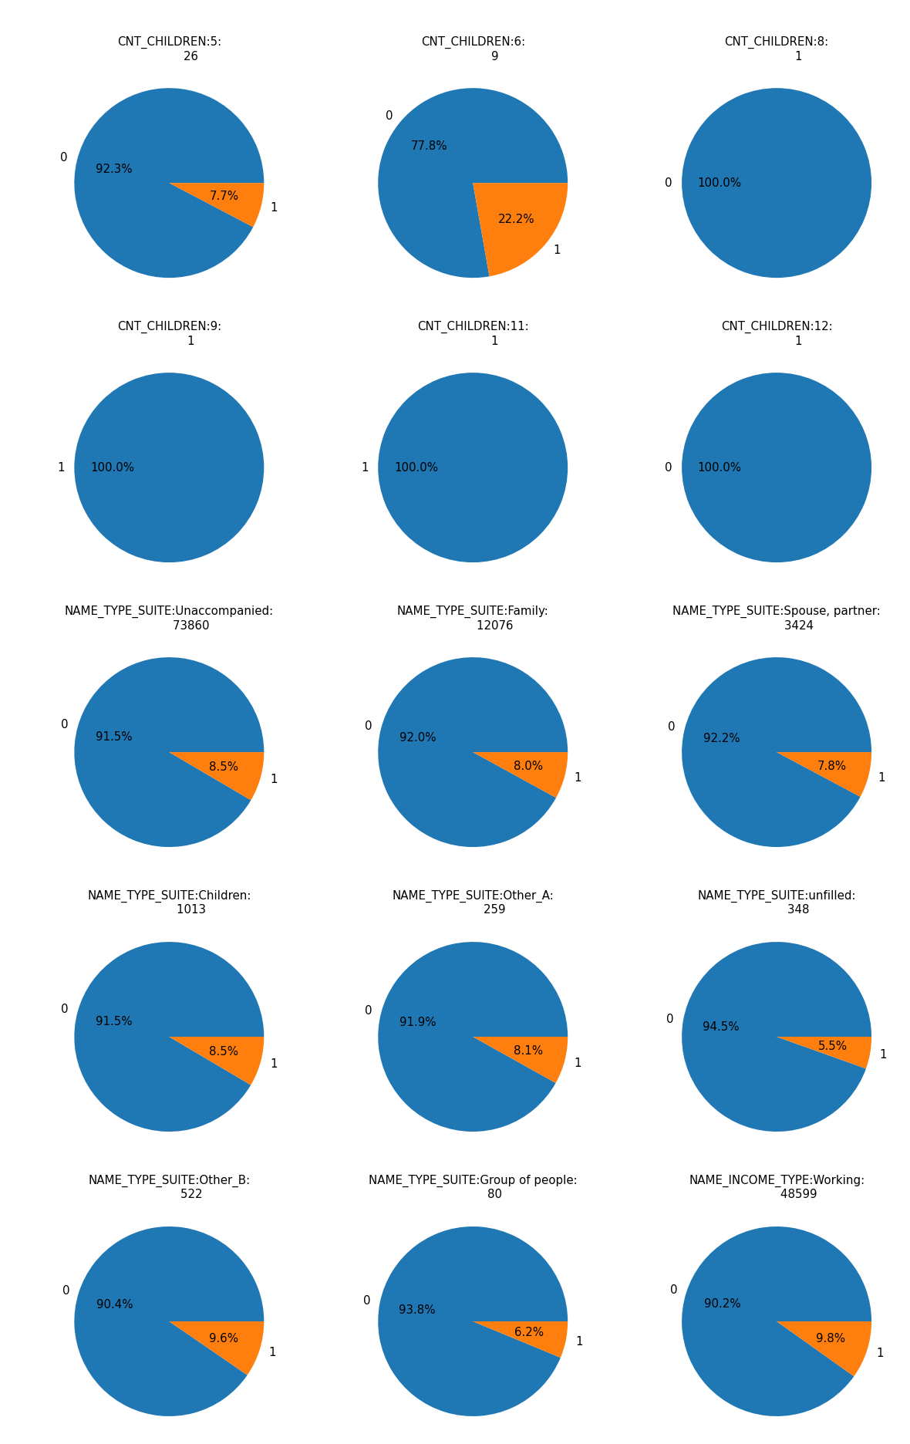
Probability
Of
All
Categories
With
Respect
To
Target

Slide 12
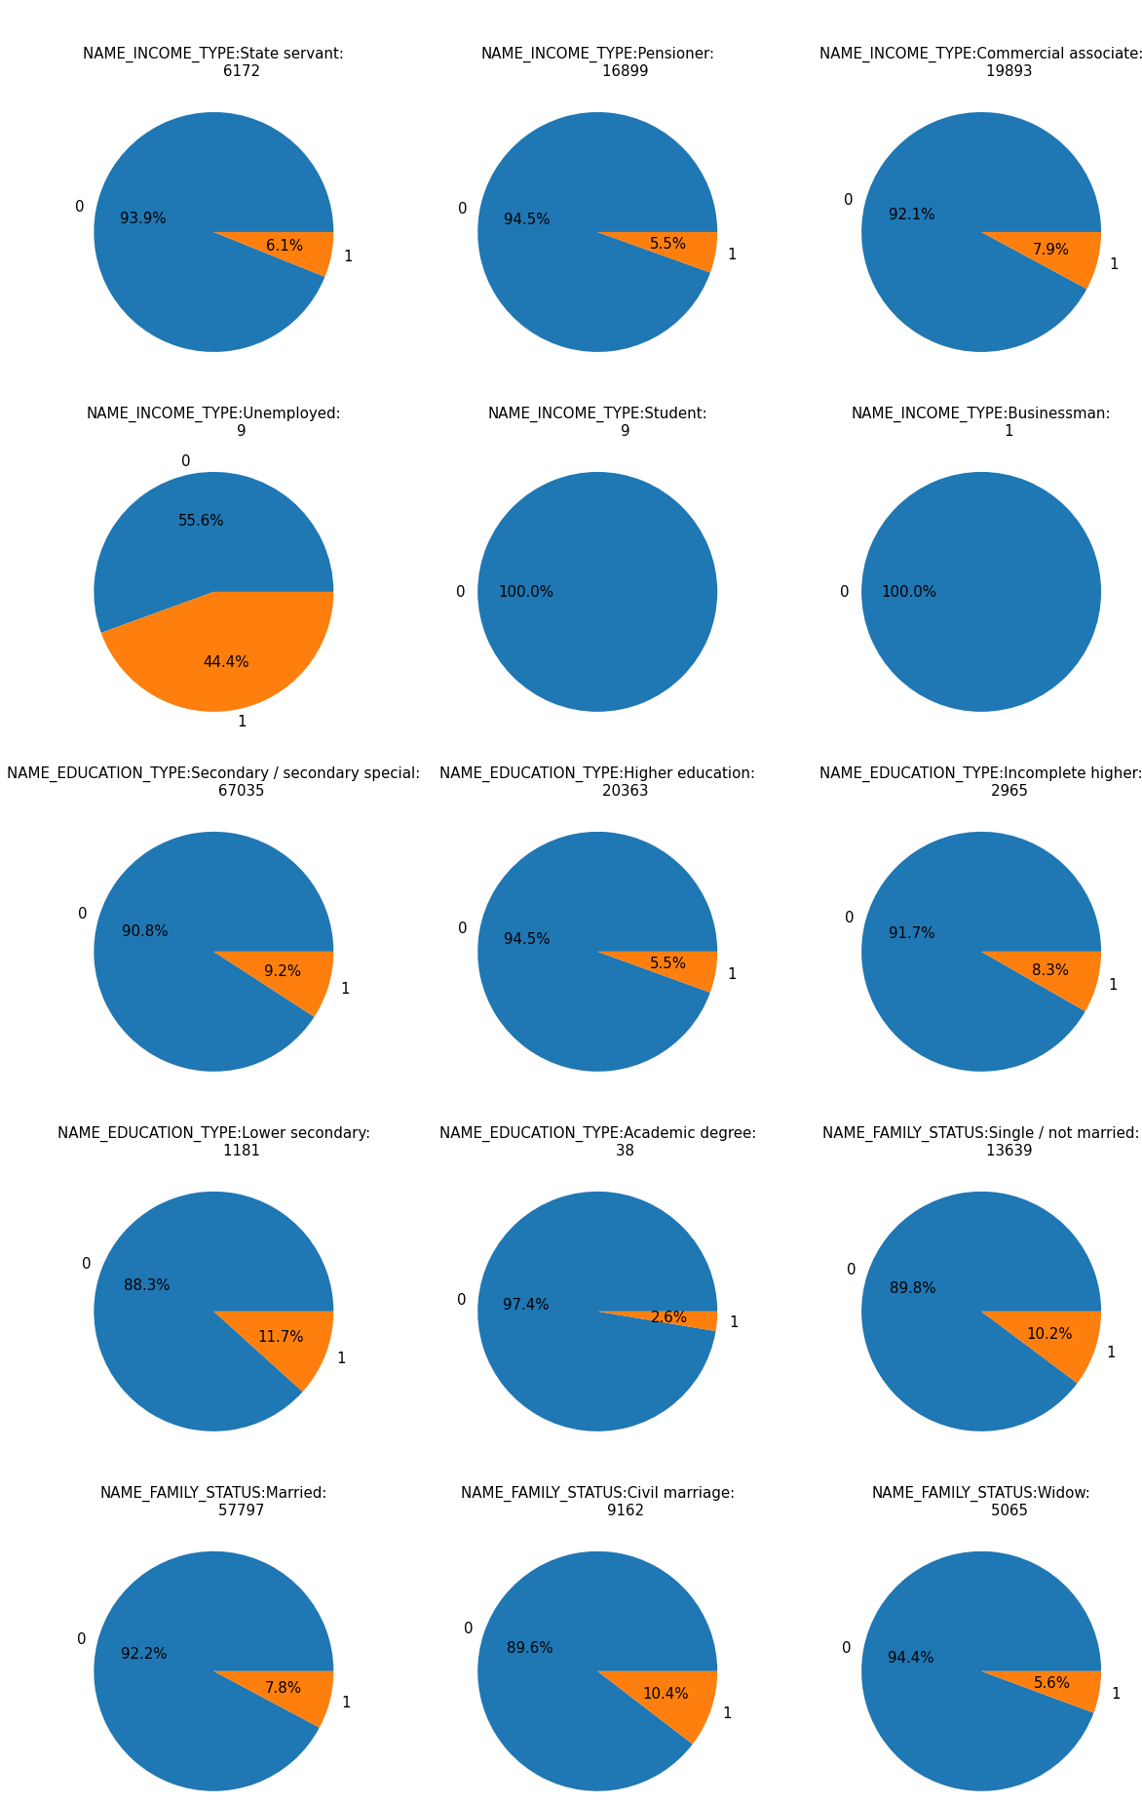
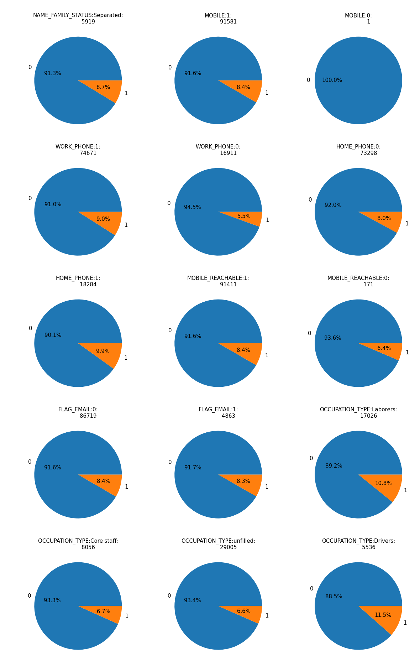
Probability
Of
All
Categories
With
Respect
To
Target

Slide 13
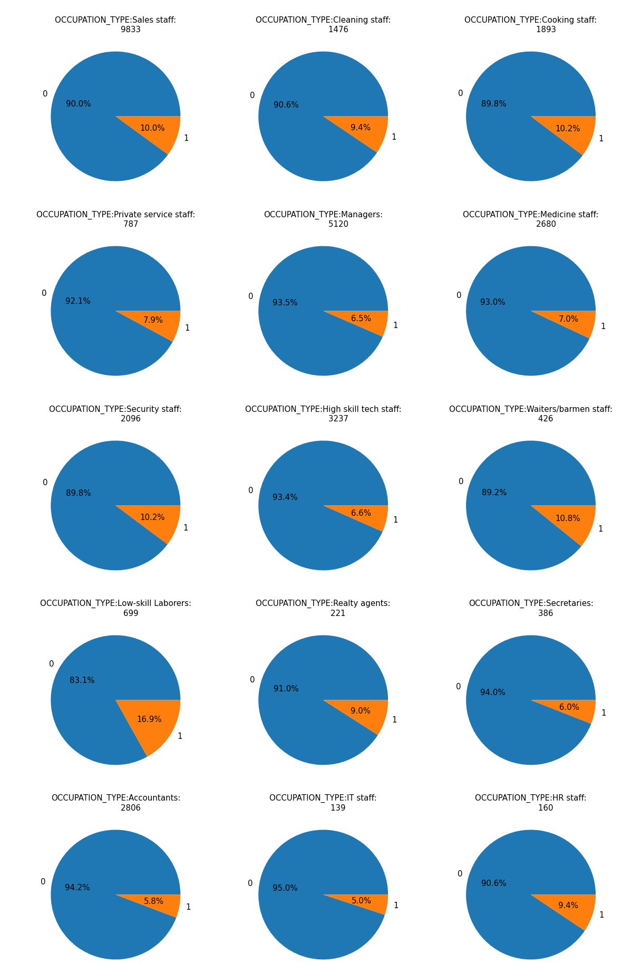
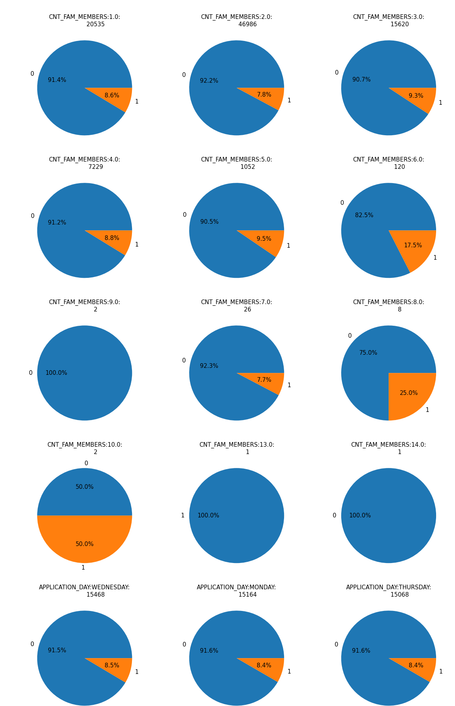
Probability
Of
All
Categories
With
Respect
To
Target

Slide 14
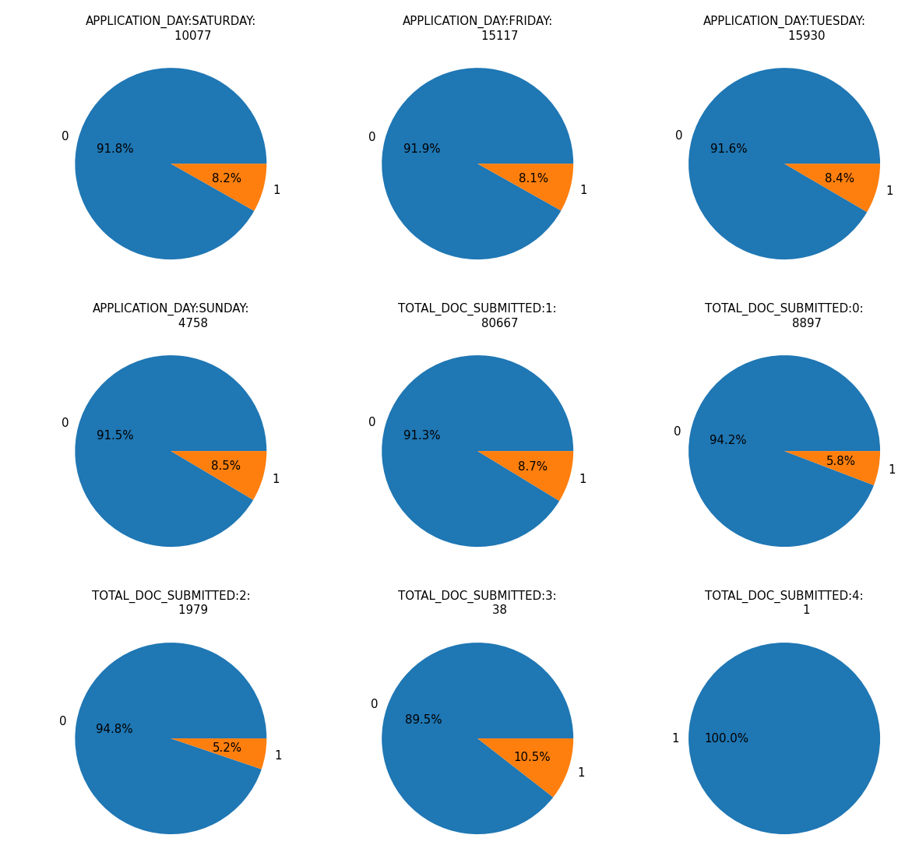
Probability
Of
All
Categories
With
Respect
To
Target

Slide 15
PREDICTION
Applicant with high probability of repayment will be satisfying following condition: 1.Name_CONTRACT_TYPE = Revolving 2.GENDER = Female 3.Car =Owns a car 4.House = Owns a house 5.CNT_CHILDREN = No children 6.NAME_TYPE_SUITE = unfilled , Group of People 7.NAME_INCOME_TYPE = Pensioner 8.NAME_EDUCATION_TYPE= Academic degree, Higher Education 9.NAME_FAMILY_STATUS = Widow , Married 10.WORK_PHONE = No(not having work phone) 11.HOME_PHONE = No(not having home phone) 12.MOBILE_REACHABLE = (Contact must be reachable) 13.FLAG_EMAIL = Yes(should have email id) 14.OCCUPATION_TYPE = IT staff, Accountants , Secretaries any of these by profession 15.CNT_FAM_MEMBERS =less the 6 family members 16.TOTAL_DOC_SUBMITTED=At least one document must be submitted

Slide 16
Prescription :
Few interpretations are after analysis the data
Kindly do the thorough inspection for the applicant who satisfying following condition: 1.Name_CONTRACT_TYPE = cash loan 2.GENDER = Male 3.Car =Not owns a car 4.House =Not Owns a house 5.CNT_CHILDREN = Have children 6.NAME_TYPE_SUITE = Other B 7.NAME_INCOME_TYPE = Unemployed 8.NAME_EDUCATION_TYPE= Lower Secondary 9.NAME_FAMILY_STATUS = Not Married or Civil Marriage 10.WORK_PHONE = No(not having work phone) 11.HOME_PHONE = No(not having home phone) 12.MOBILE_REACHABLE = NO(Contact is not reachable) 13.FLAG_EMAIL = No(Not have email id) 14.OCCUPATION_TYPE = Lower skill Laborers 15.CNT_FAM_MEMBERS =More then 6 family members 16.TOTAL_DOC_SUBMITTED=Not submitted any document

