Slide 1
Chatbot Demo
Employee sentiment

Slide 2
Human’s conversation with Machine
Chatbot is a software that emulates human conversation.
1966 ELIZA
Mimicked human conversation by matching user prompts to scripted response
1972 PARRY
1988 Jabberwacky
1992 Dr. Sabaitso
1995 A.L.I.C.E.
2006+
IBM Watson, SIRI, Google Now, Alexa

Slide 3
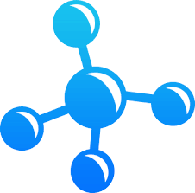



Chatbots
Key benefits
Tools
1
Motion.ai
2
3
Microsoft Bot Framework
4
5
Easy to reach large audience
Today’s chatbots can support large number of simultaneous conversations, while each conversation will be personalized.
Better customer satisfaction
By improving the response time for the customer and personalization, chatbots can improve satisfaction significantly.
Analytical insights
Chatbots supports digital data collection through which valuable insights can be generated for the business.
Automation
Using RPA chatbot can be integrated with any software systems, thus automating the entire customer life cycle.
.
Cost effective
Compared to human support staff, chatbots are significantly more cost effective

Slide 4
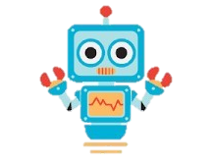

Our services
Chat scripting
Understand the internal process or function of the firm that needs a chat bot as first line of communication
Know the pertinent and department specific language and keywords for human like chat bot experience
Develop close and personalized responses to make it more realistic and reliable form of communication
Bot development
Design and develop a customized bot that can be used for various client internal and external functions
Use the best market resource and service available for fast, efficient, and robust design that is easy to implement
Use RPA to integrate chatbot with enterprise systems to provided end to end automation and great customer experience.
Analytics/Insights
Retrieve conversation logs form various users over a period of time for internal audit and analytics purpose
Perform data analytics to identify specific clients needs that could be addressed immediately
Derive business insights and create detailed reports that could be presented to the Senior Management
Maintenance & Upgrade
Improve and redesign the bot’s interaction style based on logs collected form client conversations
Adapt to the dynamic business environment to match with client and customer requirements
Scale chat bot services across other business processes and functions as per requirements

Slide 5
Demo
https://sukritgoel.github.io/HRbot/

