Slide 1
Mathematics in the Human Sciences and the Arts
By Shubham, Sumer, and Pratik

Slide 2
Contents
Introduction
1st Area of Knowledge: Human Sciences
2nd Area of Knowledge: Arts
Conclusion
What to expect

Slide 3

Real Life Situation
Shubham’s math class
Differentiation in kinematics, motion, and waves in physics
Calculus involved in economics
https://www.uwcsea.edu.sg/centre/room-set-ups

Slide 4
Knowledge Question
To what extent does mathematics enhance our understanding of the human sciences and the arts?

Slide 5
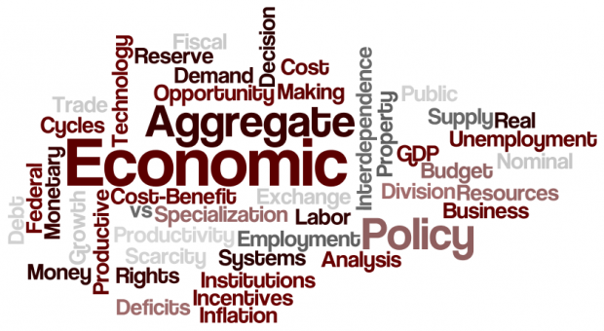
Human Sciences
Economics
http://www.economics-tuition.sg/3-tips-to-ace-your-economics-at-your-a-levels/

Slide 6
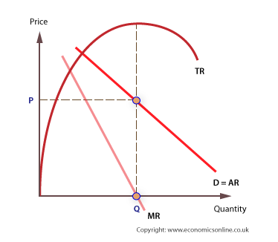
Enhancements
Total revenue and marginal revenue curve
Marginal revenue is the derivative of total revenue
Enhances all aspects of economics
http://www.economicsonline.co.uk/Business_economics/Revenue_theory.html

Slide 7
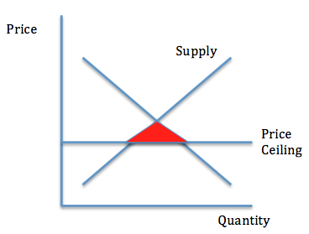
Limitations
More than one variable changes in reality
“Math of reality” is more complex than linear, exponential, or log linear relationships
Statistics aren’t sufficient always, and normative judgements may be more significant
http://www.macrobasics.com/chapters/chapter5/lesson55/

Slide 8

Human Sciences
Psychology
http://study.com/academy/subj/psychology.htmlImage

Slide 9
Enhancements
Quantitative data analysis
Help support theories
Cause-effect relationship with numerical data (Statistics)
Correlational studies (Rabkin and Struening 1976)

Slide 10
Limitations
Qualitative data analysis
Cannot assume causation in correlation
Help construct theories
Schema theory
Subjective experience, study of behaviour

Slide 11

Arts
Music
http://www.thedj.co.uk/category/wedding-music/

Slide 12
the past
Contemporary music
Rhythmic structures
Different WOKs

Slide 13

Modern-time limitations
Diversification
Pop music
Simplicity, 4/4 time signature, 4 chords
Emotional connection

Slide 14
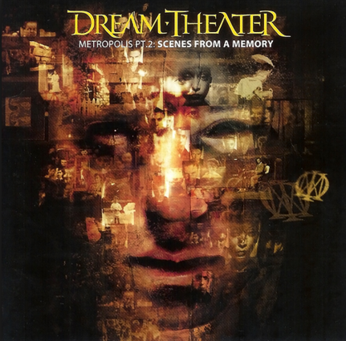
enhancements
Math Rock
Non-standard time signatures
Complexity
Dream Theater “The Dance of Eternity”
Personal connection

Slide 15

Arts
Theatre
http://www.theatrekingdom.com/blog/others

Slide 16
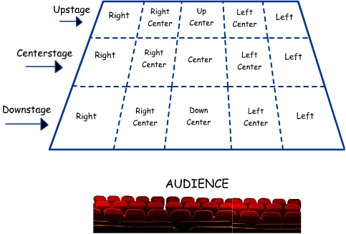
Enhancements
Stage directions
Semi circular organisation- symbolic of geometric presence for aesthetic purposes.
Actors walk in a parabolic manner for stage optimization.
Lighting uses trigonometry to enhance the performance.

Slide 17

Limitations
Mainly based on emotions
Maths plays a minor role
Contrasting WOKs(reason and logic for maths and emotions and language for theatre)
Studies showing maths equations controlling emotions, but not yet proven
Applications of maths may not be desired.

Slide 18
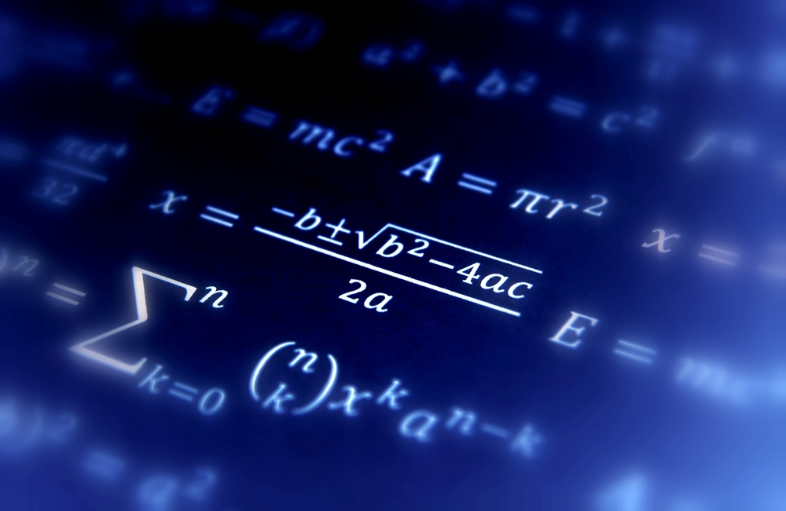
Conclusion
http://www.todayifoundout.com/index.php/2014/11/origins-mathematical-convention-using-x-unknown/

Slide 19
Works Cited
Evans, Gary R. "Chapter 1 Economic Models."D:BooksModelsChap1a.PDF (1997): 11-13. Web. 23 Apr.
2016. <http://pages.hmc.edu/evans/chap1.pdf>.
"How Our Brains Can Control Our Emotions." BBC. 2016 BBC, 14 Aug. 2014. Web. 25 Apr. 2016.
<http://www.bbc.com future/story/20140812-deciphering-our-emotions-code>.
Marcuse, Peter. "ON RENT CONTROLS." The New York Times. The New York Times Company, 31 July
1981. Web. 23 Apr. 2016. <http://www.nytimes.com/1981/08/01/opinion/on-rent-controls.html>.
Whiteford, Tim. "Mathematics and Theatre." Saint Michael's College. 2016 Saint Michael's
College, Nov. 2012. Web. 25 Apr. 2016. <http%3A%2F%2Facademics.smcvt.edu%2Ftwhiteford%2F
Math%2FENotebooks%2FFall2012%2FMath%2520and%2520Theatre.pdf+>.

