Slide 1
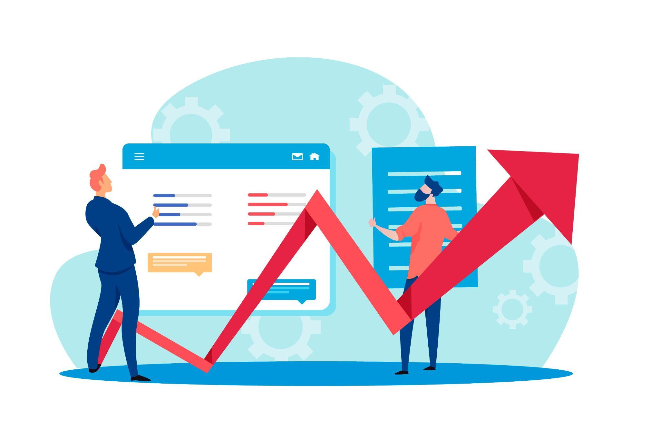
4A Investment Advisor

Slide 2
GROUP MEMBER
Sukrut Deshmukh
Bhoori Singh
Nihal Raghav
Saurabh Jagtap [ Emergency ]

Slide 3
Objective
To analyze and understand about stock market [BSE 500] sheet.
To understand the KPI provided for stock selection.
To implement the logics in backend accordingly.
To get familiar with all the stock market terms.
To build an more effective KPI for providing stock suggestions.
To extract the insights with the help of meaningful visuals.

Slide 4

Task Status
User Info Output
Stock Filtration
Data Insights
Some Visuals
KPI Study

Slide 5
General Purpose of Investment Advisor
Provide ongoing advice about buying , selling and holding investments.
Monitoring the performance of your investments and their alignment with your overall investment objectives.

Slide 6
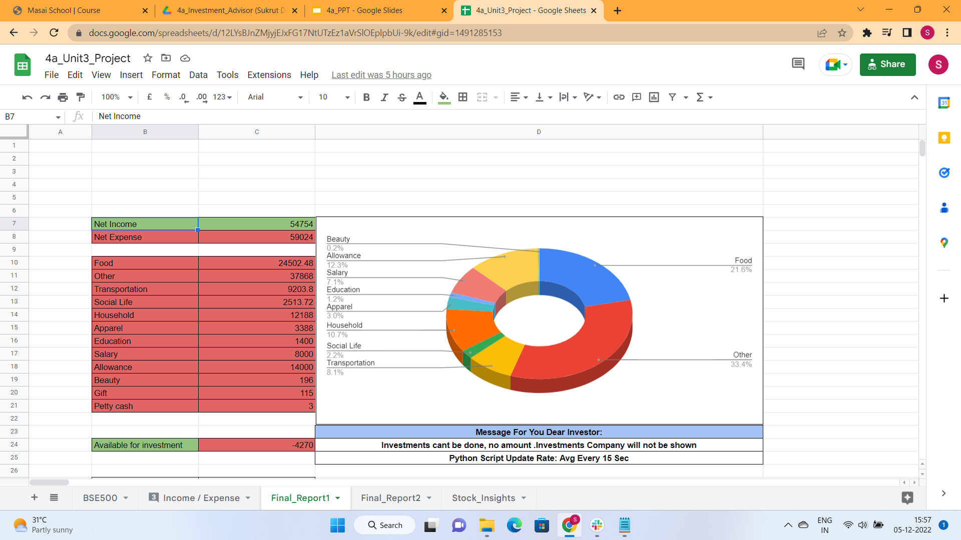
#1 Project Outcomes [ User Info ]
Data Cleaning (replace comma) , (to_numeric) ,fillna(0) [Pandas]
Data Filtration based on Category , Income/ Expense Column [Pandas]
Dropdown validation & Conditions [Python,Request Syntax]
Chart using gsheet manually

Slide 7
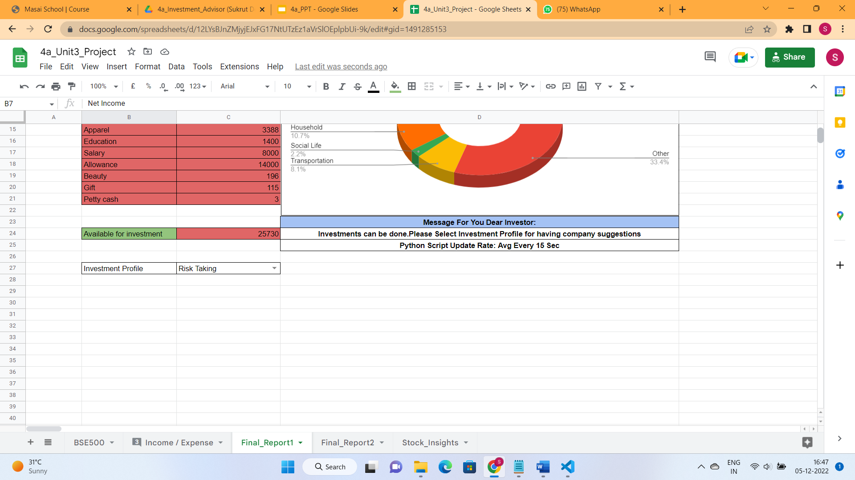
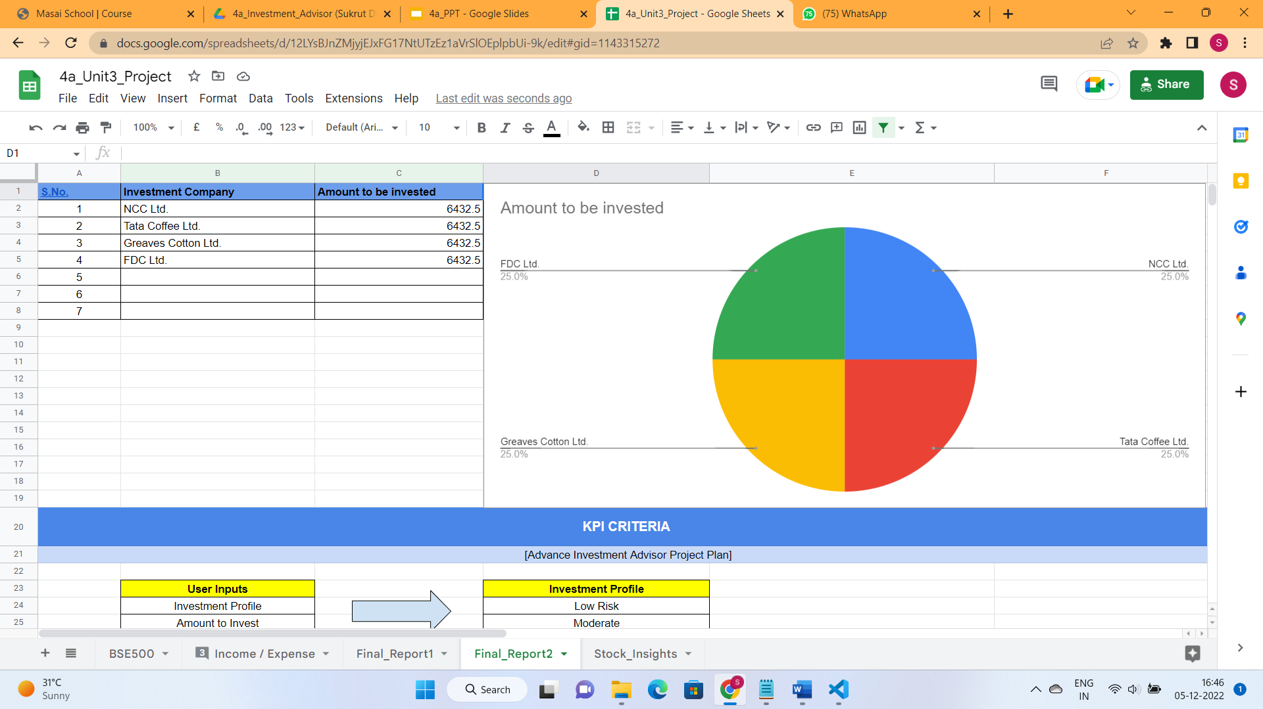
#2 Project Outcomes [ Investment Companies ]
Data Cleaning (replace comma) , (to_numeric) ,fillna(0) [Pandas]
Data Filtering [ Pandas ]
Data filtering based on user selection.
Using nested if (Python )
For company suggestions having equal to 5 or more. Had been splitted in 5 only.Company suggestion has been restricted to 7 maximum.
And less than that has been splitted equally depending number of company suggestion list. (Little Add - On)
Chart is added using gsheet manually.

Slide 8
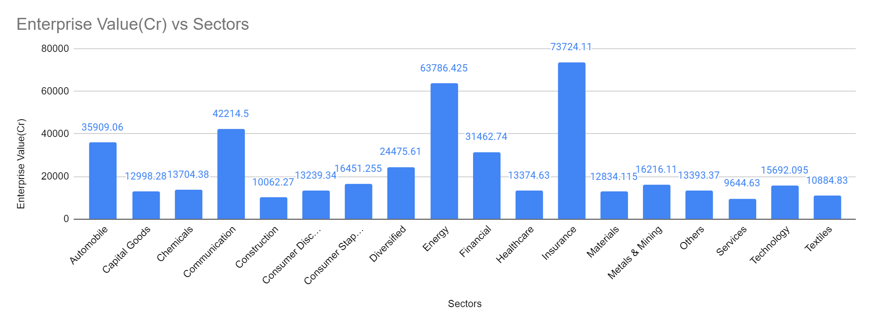
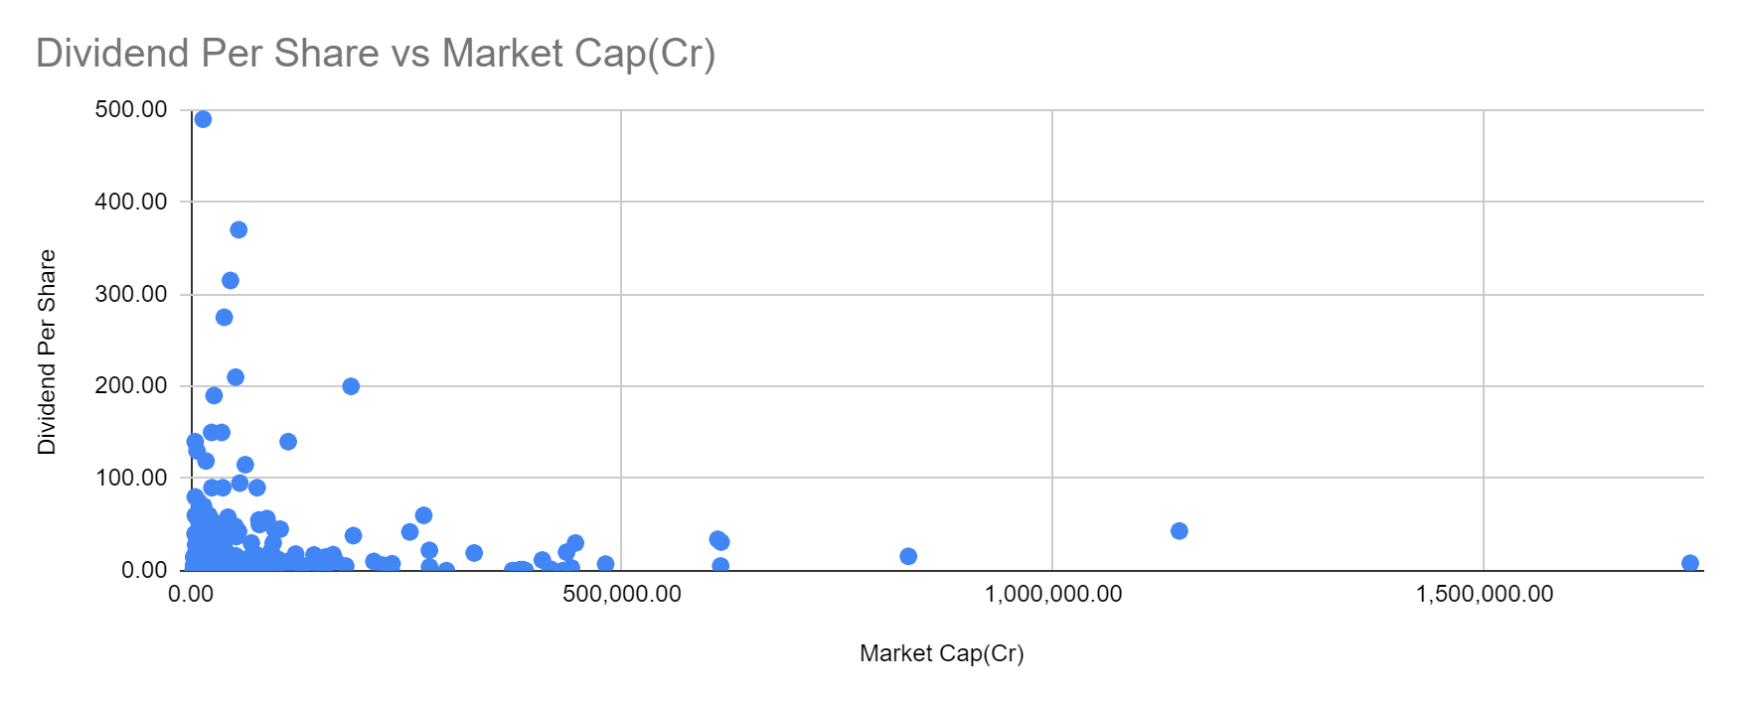
#3 Project Outcomes [ Study & Learnings ]
Company [ 20000 to 60000 Cr ] has more dividend.Low market cap most probably have more dividend. According to cluster formed.
But according deep overall study there is no such direct link between both parameters.
Technology Sector has more median enterprise value than service (Approx 6 K more)

Slide 9
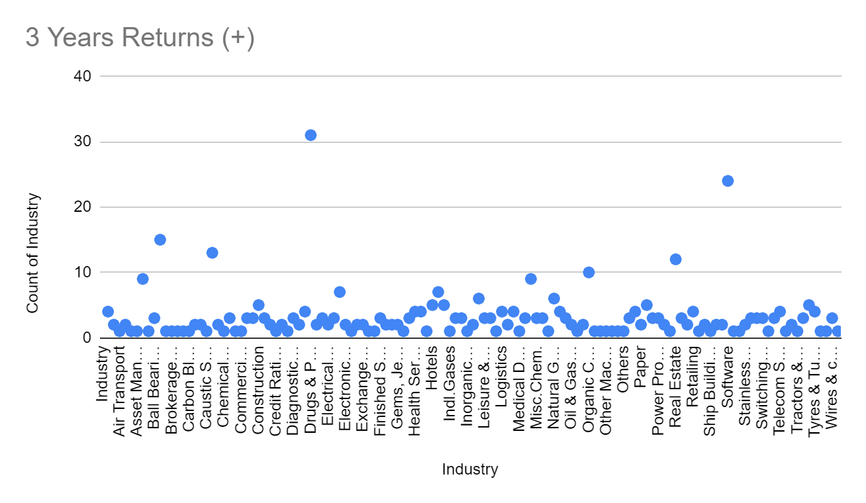
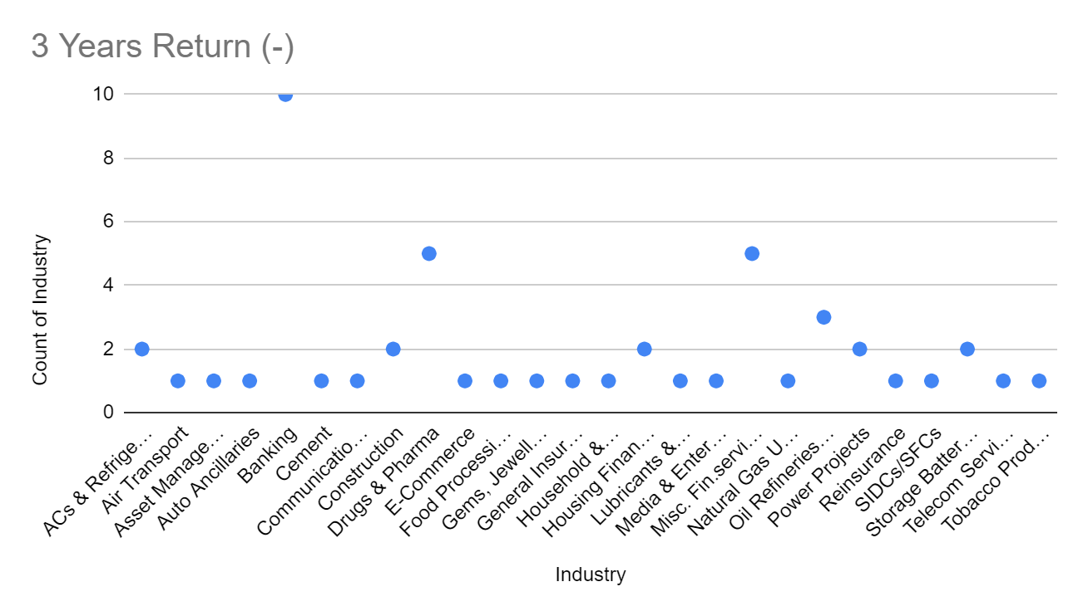
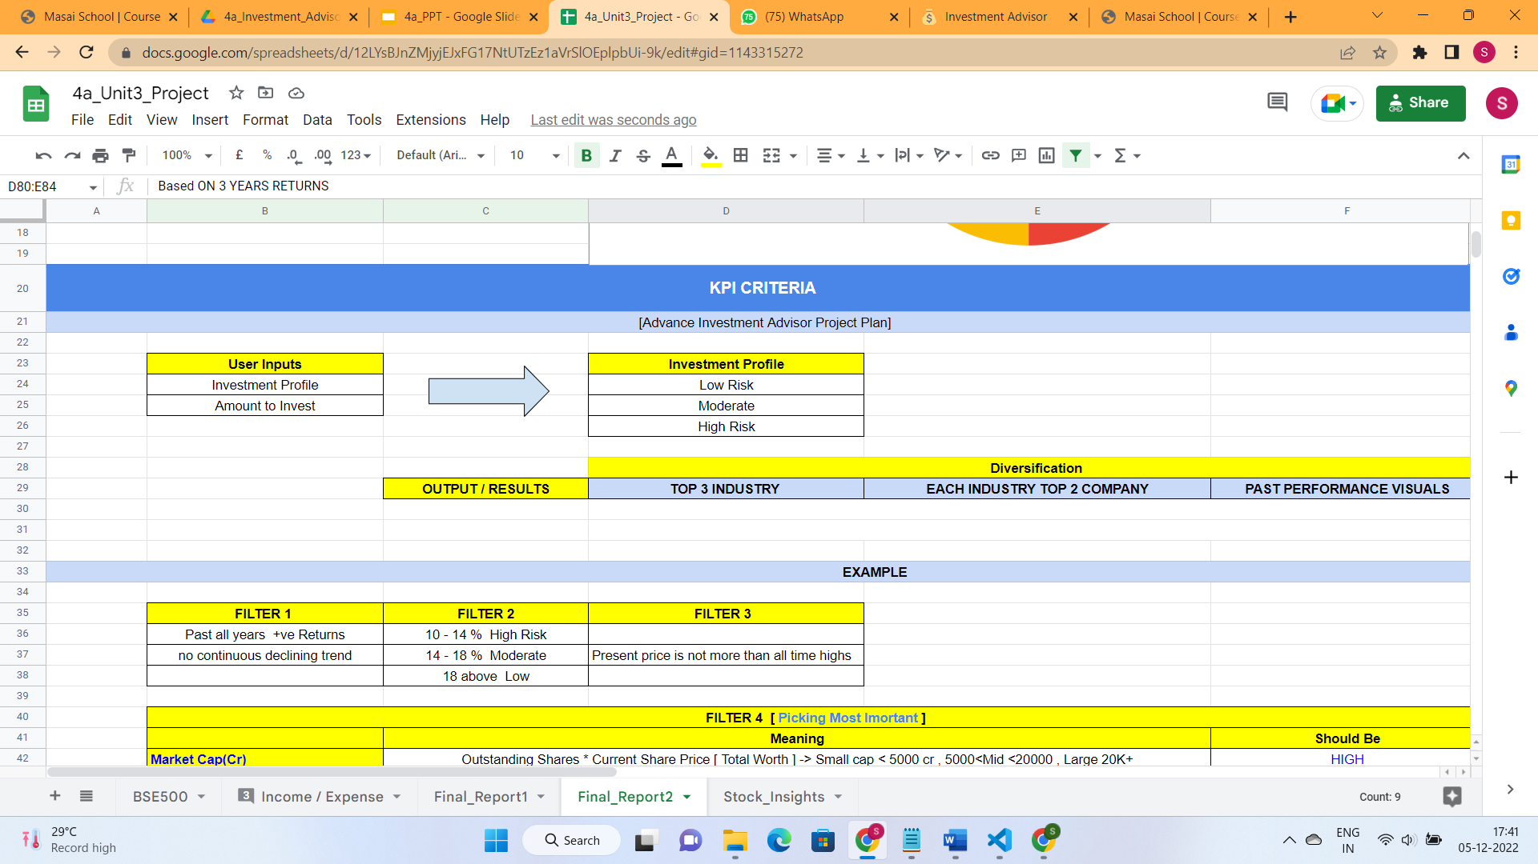
#3 Project Outcomes [ Study & Learnings ]
NEW KPI
Based ON 3 YEARS RETURNS
Top 3 Industry for Investment | 3 Industry to avoid
Drugs & Pharma | Banking
Software | Fin Services
Cement | Oil Refinery & Marketing

Slide 10
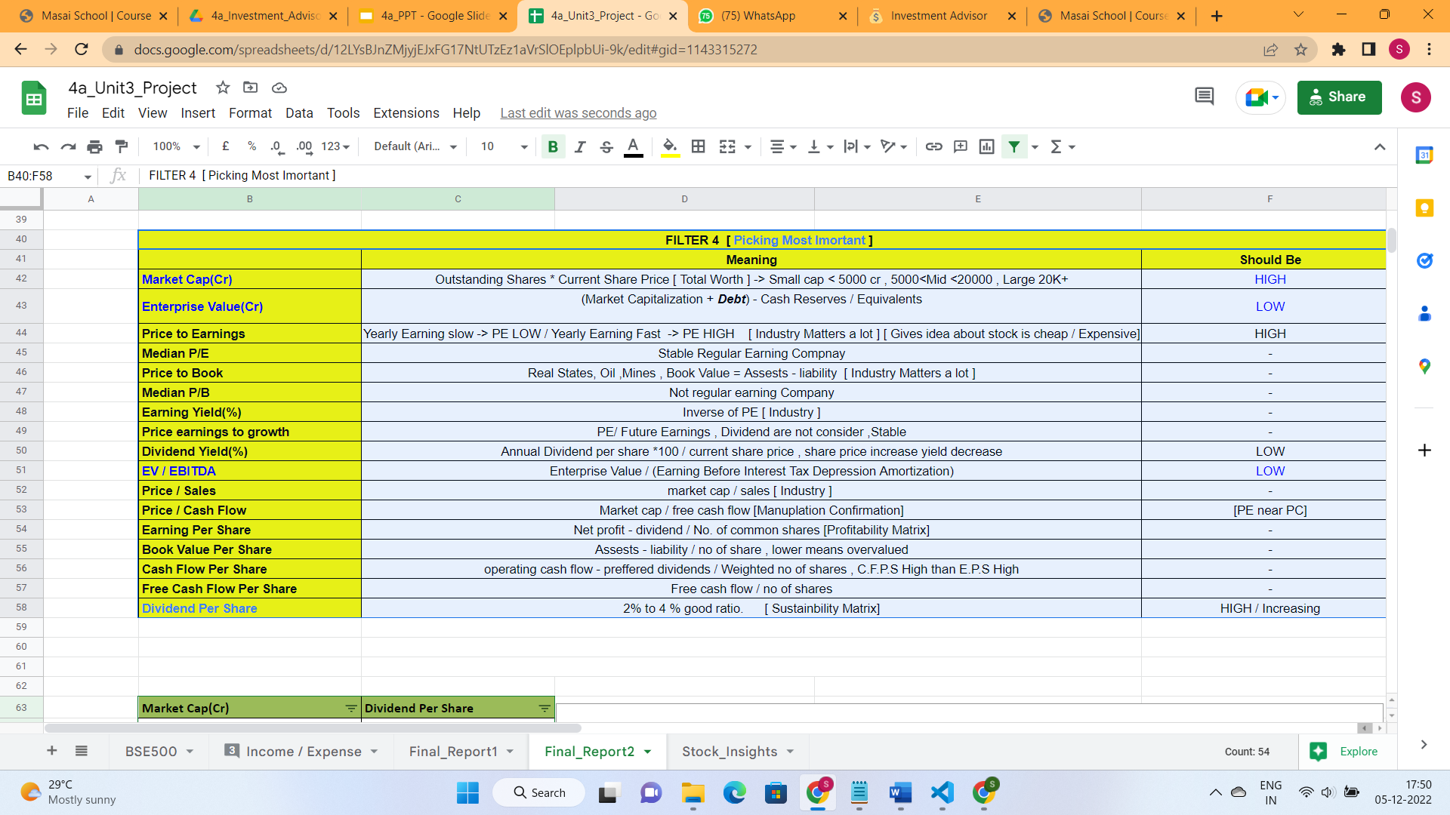
#3 Project Outcomes [ Study & Learnings ]

Slide 11
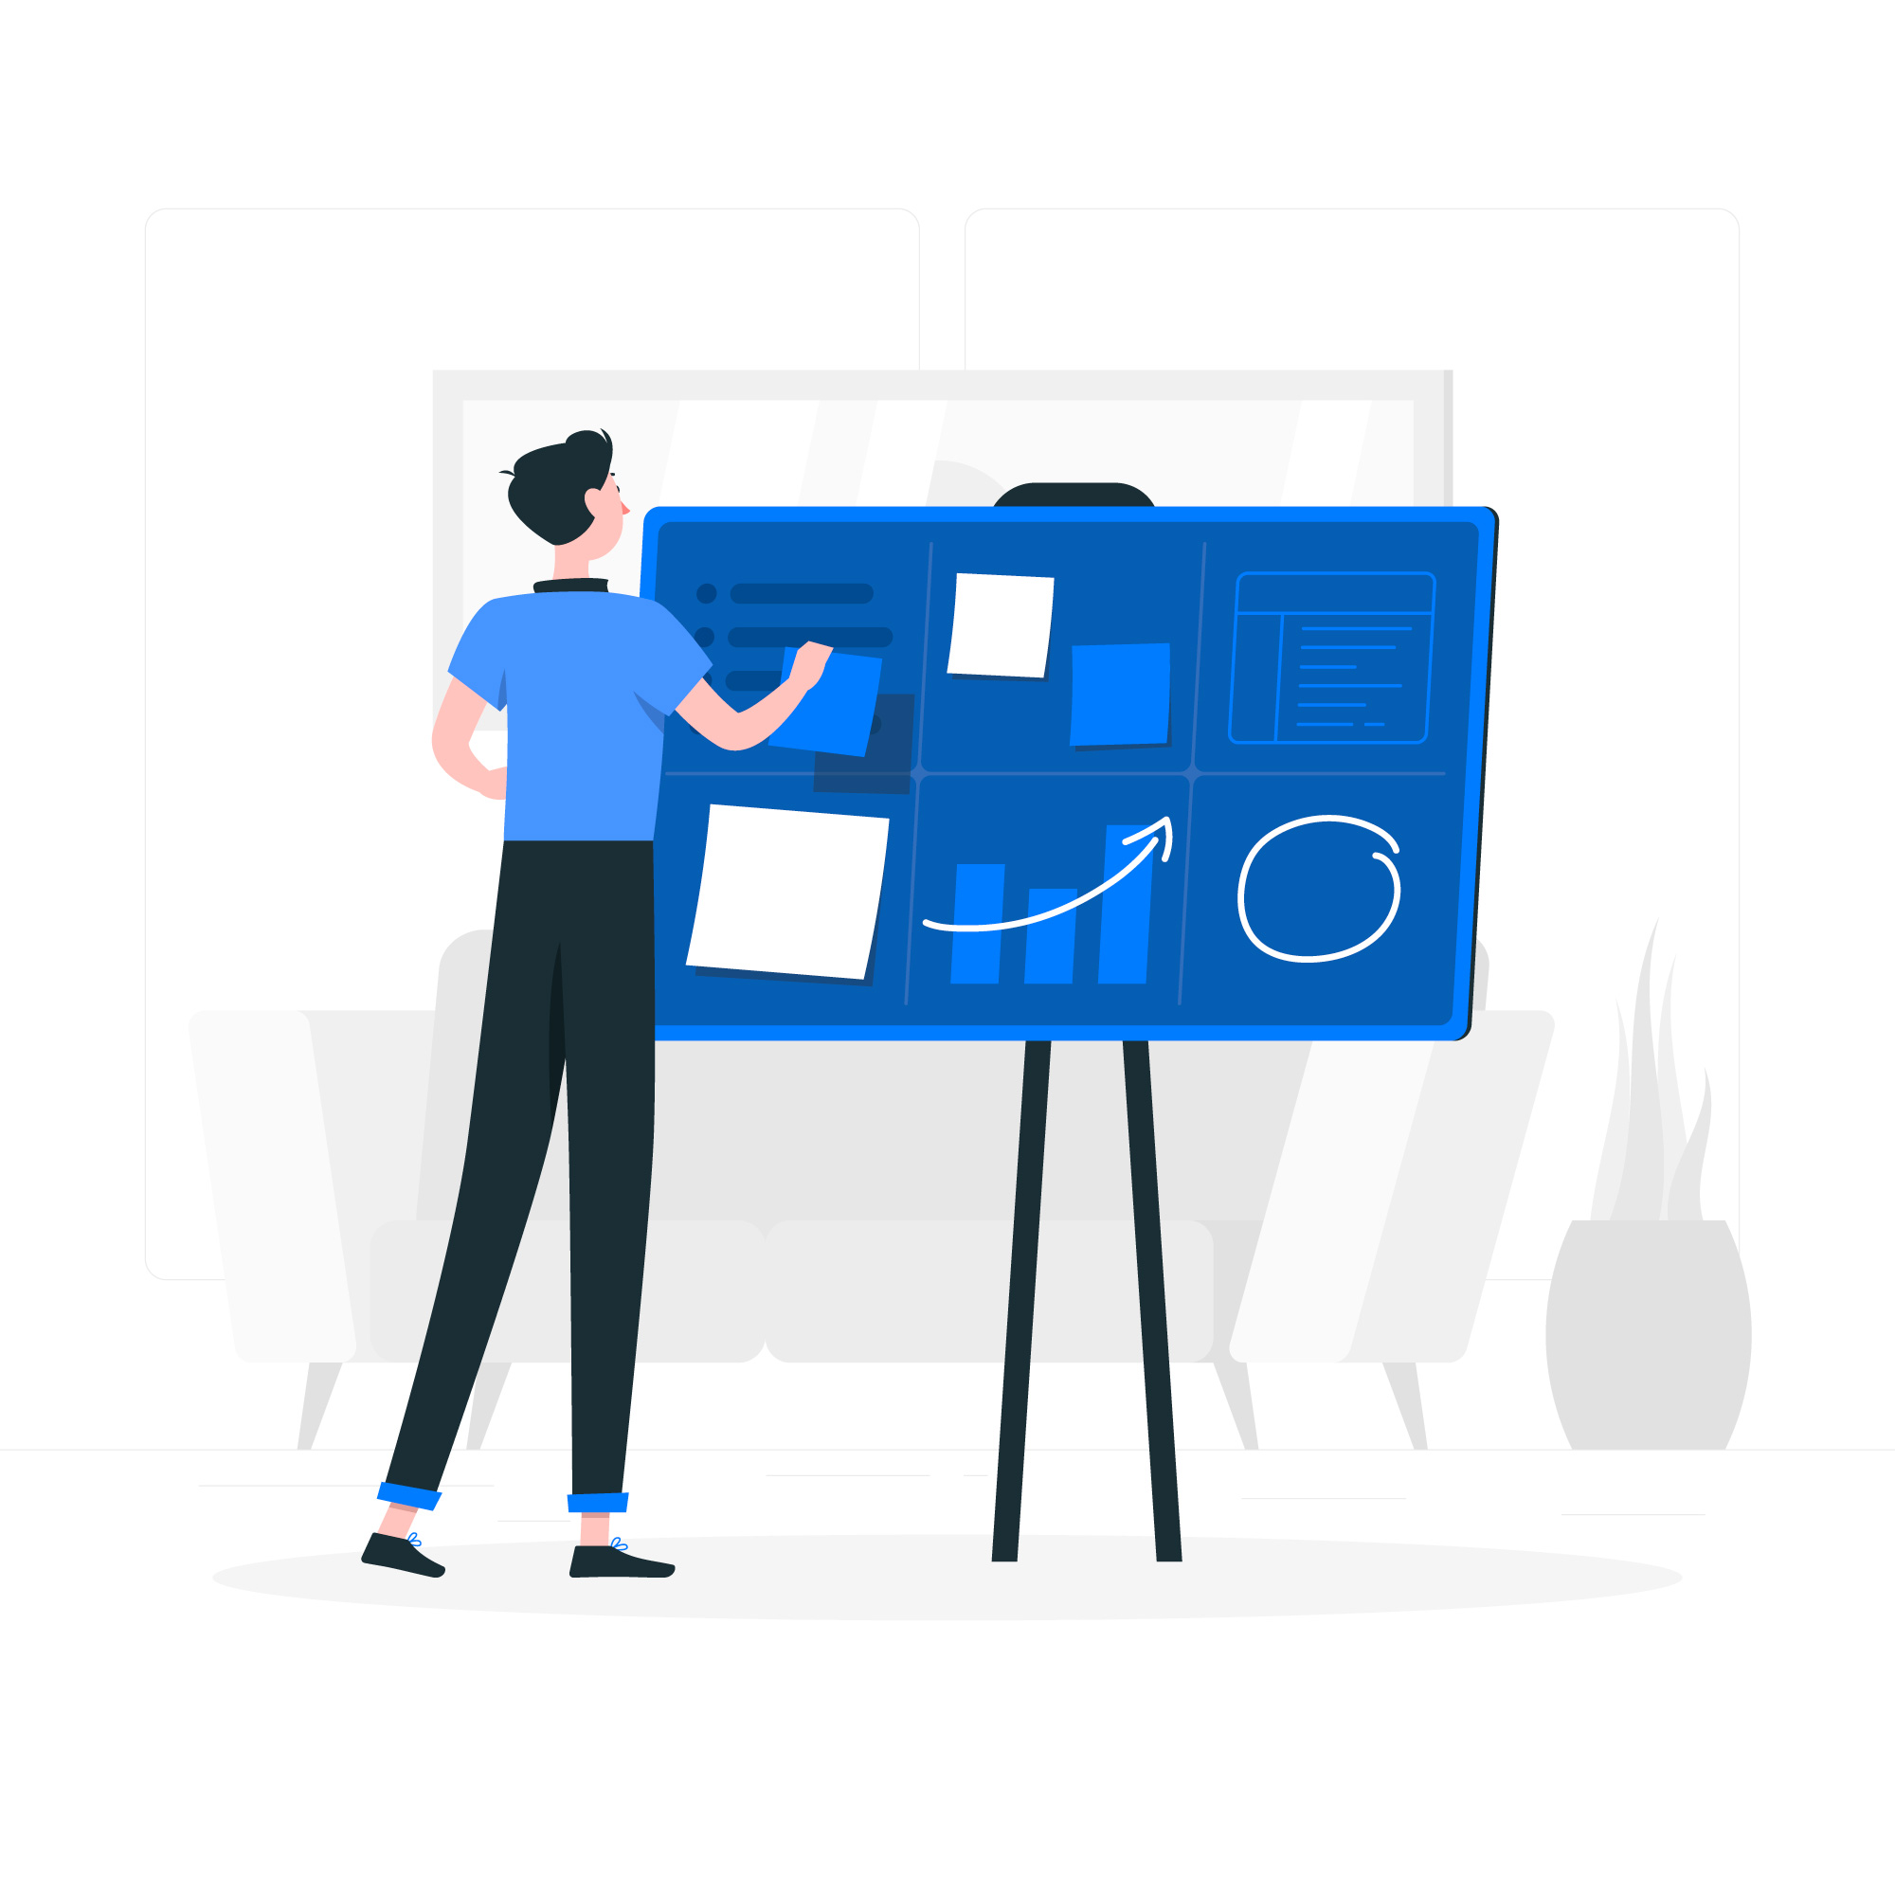
PROJECT JOURNEY

Slide 12
Noted down all the stock terms and studied about it.
Tried to make KPI based on Study.
Project Allocated
Understood complete Project
Revised Pandas
Implemented Required Filters using it task (2)
29 Nov
30 Nov
1 Dec
2 Dec
3 & 4 Dec
Learnt Gspread, Google API’s
Implement logics and achieved user info task (1)
Tested both the tasks outputs.
Implemented visuals and some additional logics.

Slide 13
Challenges | Learnings
Getting Familiar with google requests,gspread syntax. (dropdown has been implemented through python itself).
Optimizing the overall code.Have to work on calling functions & creating functions.Has it reduces repeatability in codes.(Will work on that part).
Learnt how we can use google API’s for different purposes.And what are the facilities provided by google.
Learnt how to execute the project by breaking down the problem statements in proper manner.[Proper Mindset]
Learn about stock market using various resources.
Learnt the process about how we can integrate python or any language for solving real world problems.The experience was amazing.

