Slide 1

CODEGENIE
AI EXPLAINER AND CODE GENERATOR
Presented By:-
Sukrutha bodapally

Slide 2
INTRODUCTION
CodeGenie is an intelligent web-based application that automates code generation and explanation using Large Language Models accessed through the Hugging Face Inference API. Users submit natural language prompts and receive complete, runnable code in Python, JavaScript, Java, C++, or C, accompanied by clear plain-English explanations.
The Challenge: Coding is complex — beginners struggle with syntax, and professionals lose time debugging or searching for snippets. Existing tools lack explanation, persistent storage, and admin visibility.
The Solution: An AI assistant that converts plain English prompts into accurate, syntax-highlighted code with plain-English explanations, a personal dashboard, and an admin analytics panel.
The Vision: To make coding faster, easier, and more accessible — for learners and developers worldwide — using open-source LLMs.

Slide 3
MILESTONE OVERVIEW
Milestone 1: The Core Foundation
Secure login and authentication
Persistent User accounts
Hugging Face API integration for code generation
Milestone 2: The Professional Workbench
Multi-Language Support
Syntax Highlighting
Explanation Panel
Milestone 3: Analytics and Engagement
Admin Dashboard with charts
Role Based access
Feedback System – Verified Badge

Slide 4
Tech stack overview
Frontend: HTML, CSS, JavaScript, Prism.js, Chart.js
Backend: Flask, Flask‑CORS, Flask‑SQLAlchemy
Database: SQLite (user accountslogs)
Security: Werkzeug password hashing, environment variables via .env
AI models: Qwen2.5-Coder-32B (Primary) -> Qwen2.5-Coder-7B -> Mistral-7B(Fallback)->Demo Stub

Slide 5
System architecture
Browser
User Interface
Flask App app.py Backend
Hugging Face AI API
SQLite DB codegenie.db
User REQUEST FLOW
User selects language & types prompt
Sends request to Flask ,builds system prompt
Hugging Face API generates code(with fall back model)
Response Split into code + explanation
Frontend highlights code and shows explanation

Slide 6
ADMIN FLOW
Sign In with Admin Credentials
View overall statistics (users, languages used, ratings)
Analyze ratings and comments to identify trends
Track registered users , comments and timestamps
Address user problems and enhance system performance.

Slide 7
Key features
🔐 Secure Authentication : Passwords hashed with bcrypt, sessions protected by Flask secret key, and API tokens kept safe in .env.
🤖 AI Code Generation : HF Interface Router · Cascading fallback: Qwen-32B → Qwen-7B → Mistral-7B → Demo stub
🎨 Syntax Highlighting : Prism.js runs client‑side with 5 language packs, giving instant color updates.
💡 Prompt Engineering : User input is wrapped in a structured prompt that enforces output format, with selected language, and gives parseable CODE: / EXPLANATION: responses every time.
💾 User Dashboard Saves all snippets with prompt, language, and code; shows activity graphs via Chart.js with a separate admin view.
⭐ Feedback System : Users rate each session by 5 stars and pick chip tags on sign-out (no typing needed) keeping it frictionless. After 12 submissions, users earn a Verified Badge on their avatar and are no longer prompted for feedback on future sign-outs.
📊 Admin Dashboard : Role-protected /admin panel showing — total users, snippets, avg rating, top language, verified count · 14-day activity bar chart · language usage bars · rating doughnut chart · feedback tags chart · registered users table with last-active status · full feedback list with stars, chips, and timestamps.

Slide 8
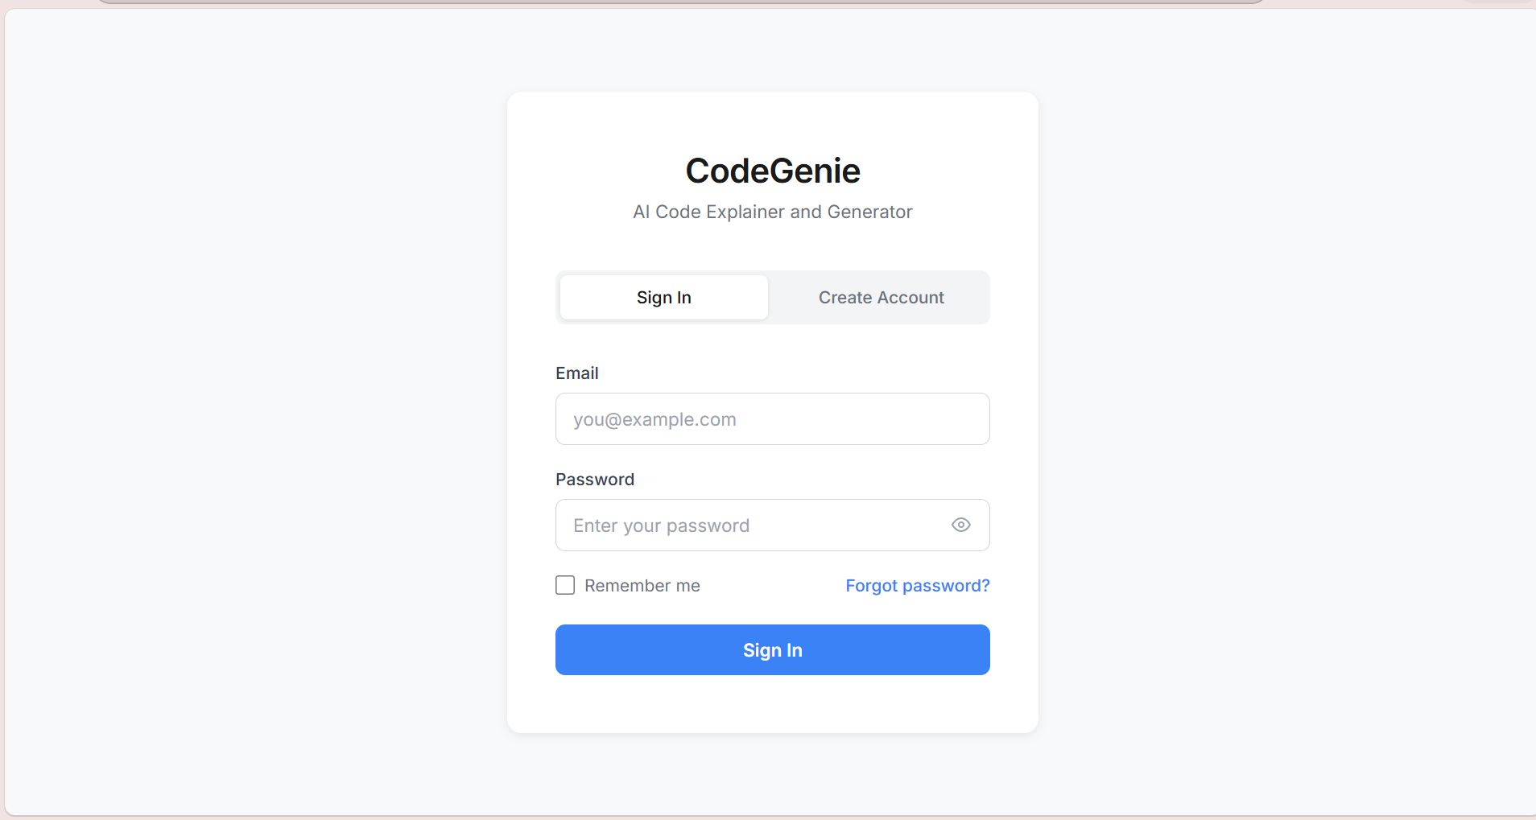
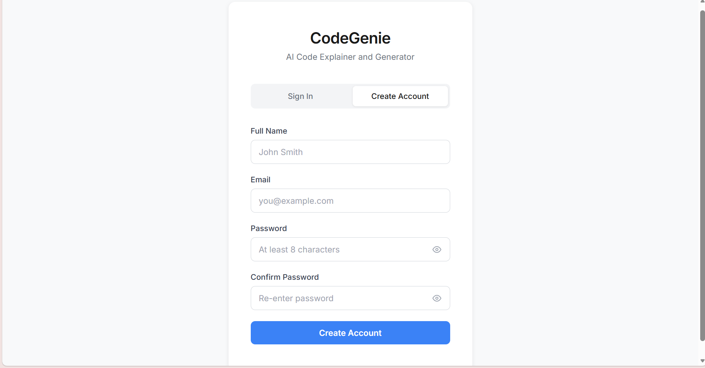
WORKING MODEL
1.Login page
2.Create account

Slide 9
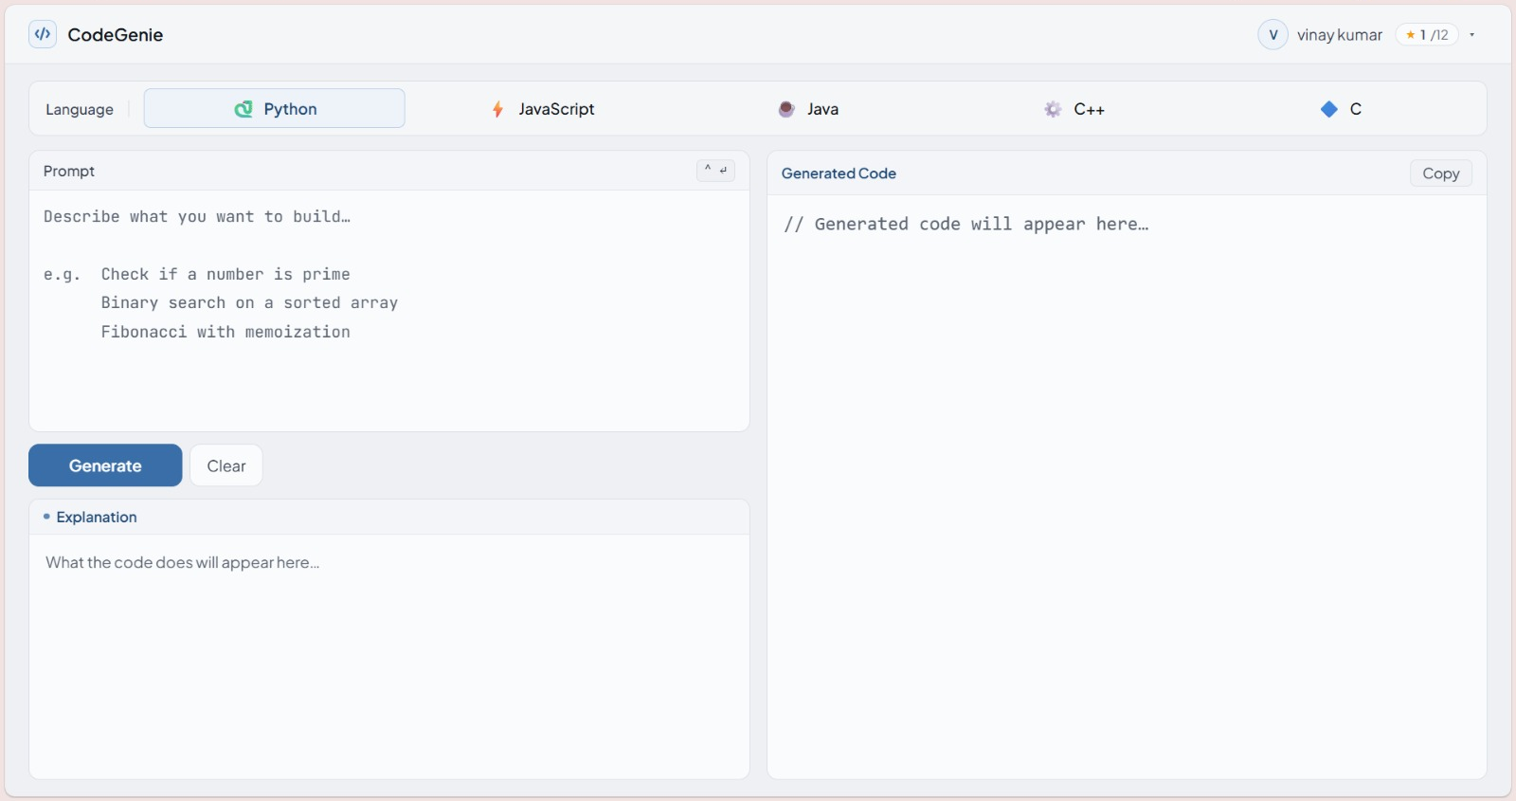
3.Homepage

Slide 10
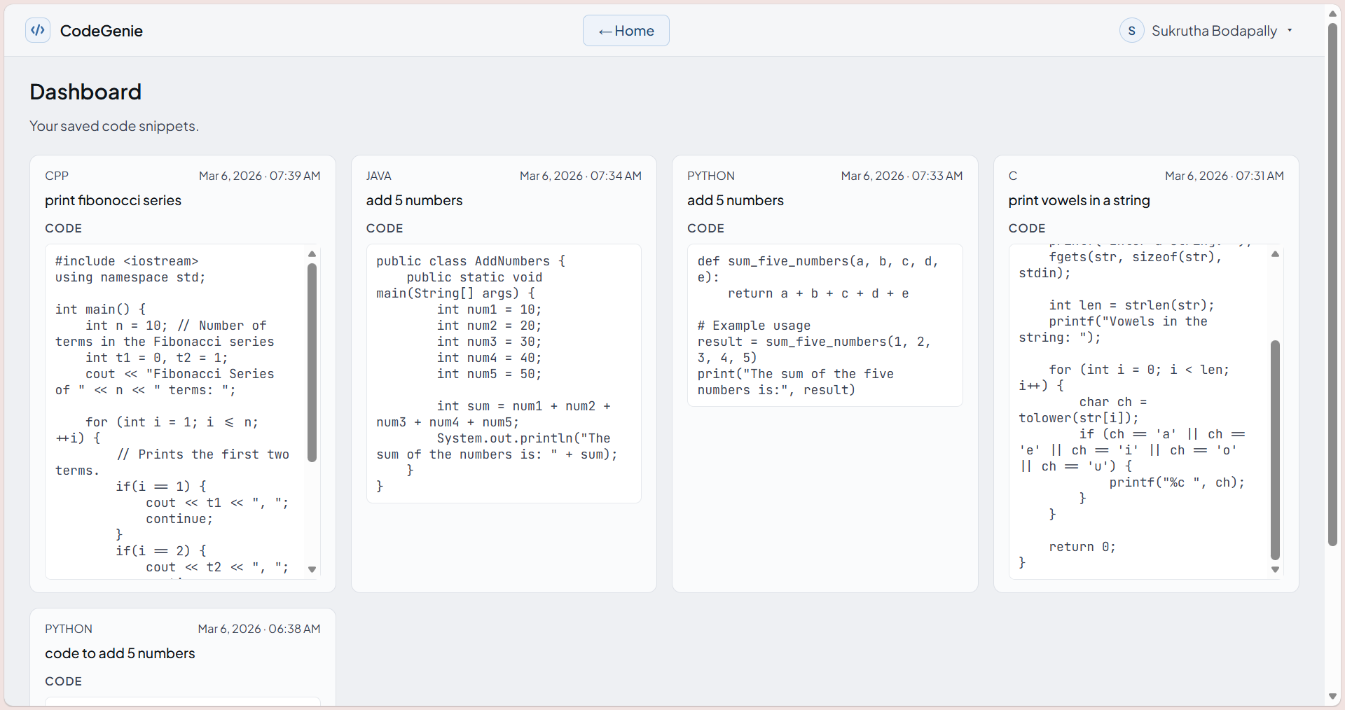
4.User’s Dashboard

Slide 11
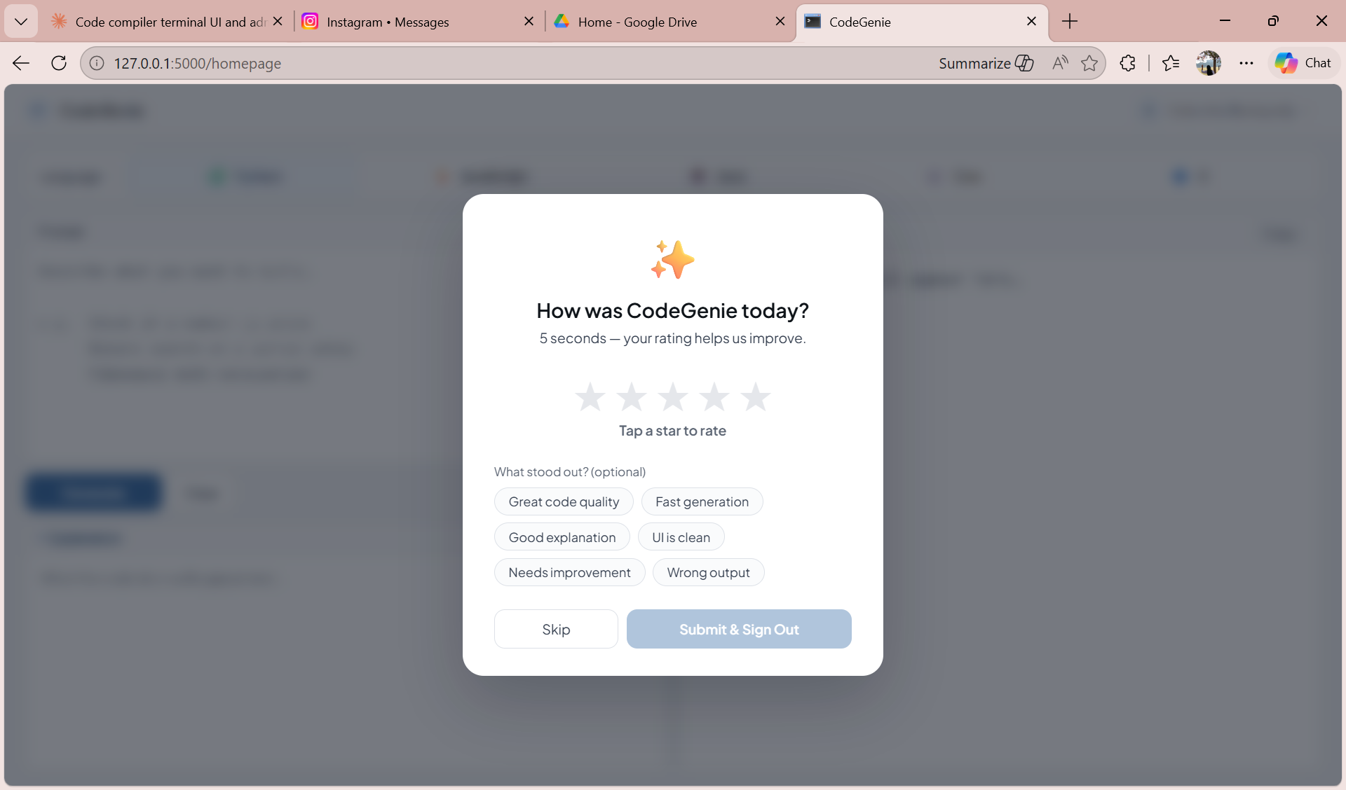
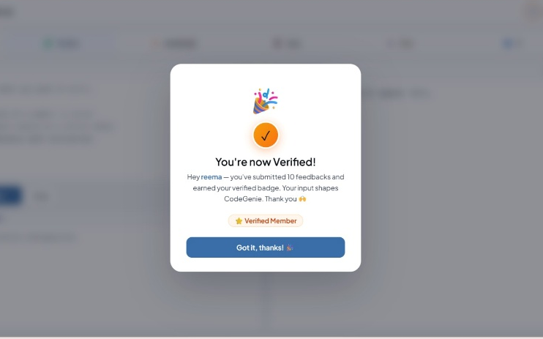
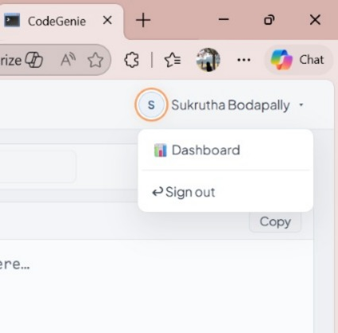
5.User’s Feedback, Verified Badge

Slide 12
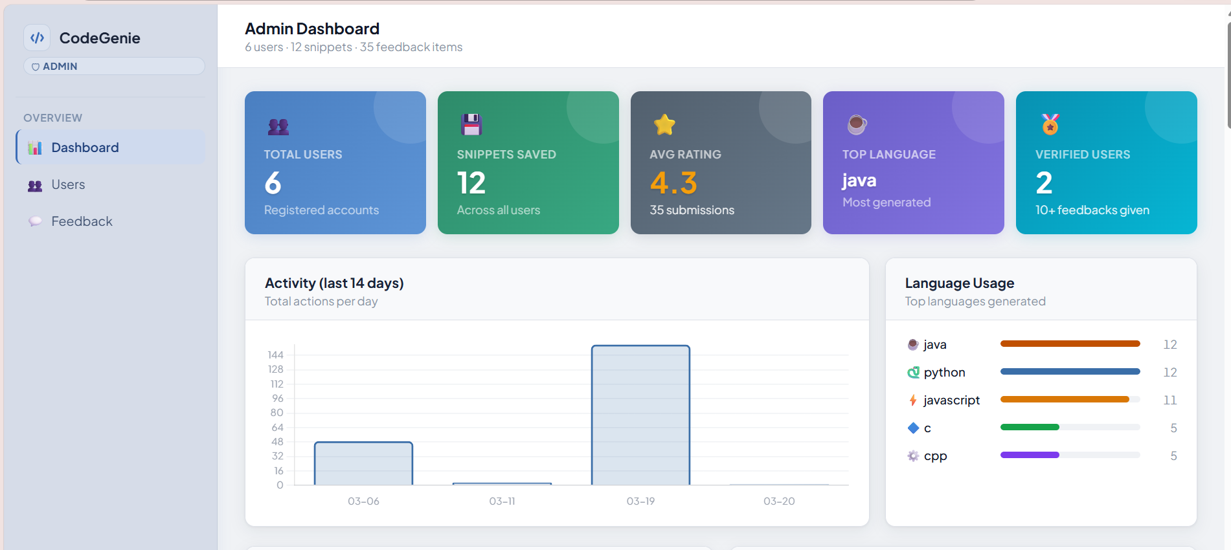
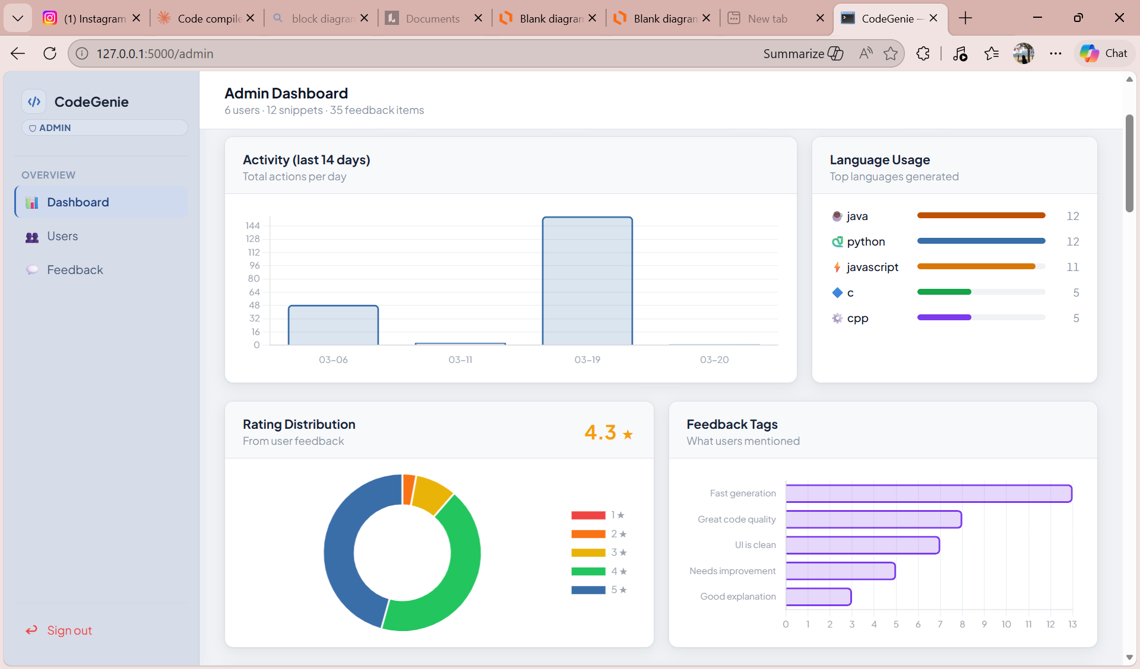
6.Admin’s Dashboard’s stats

Slide 13
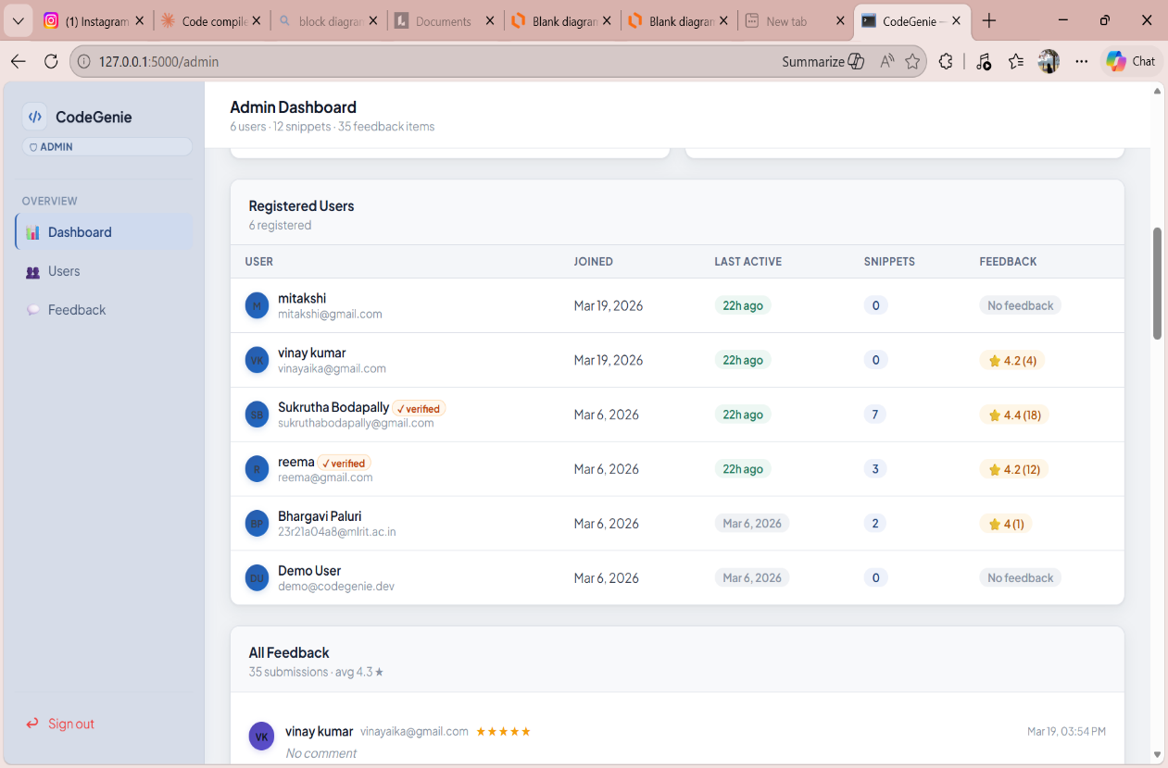
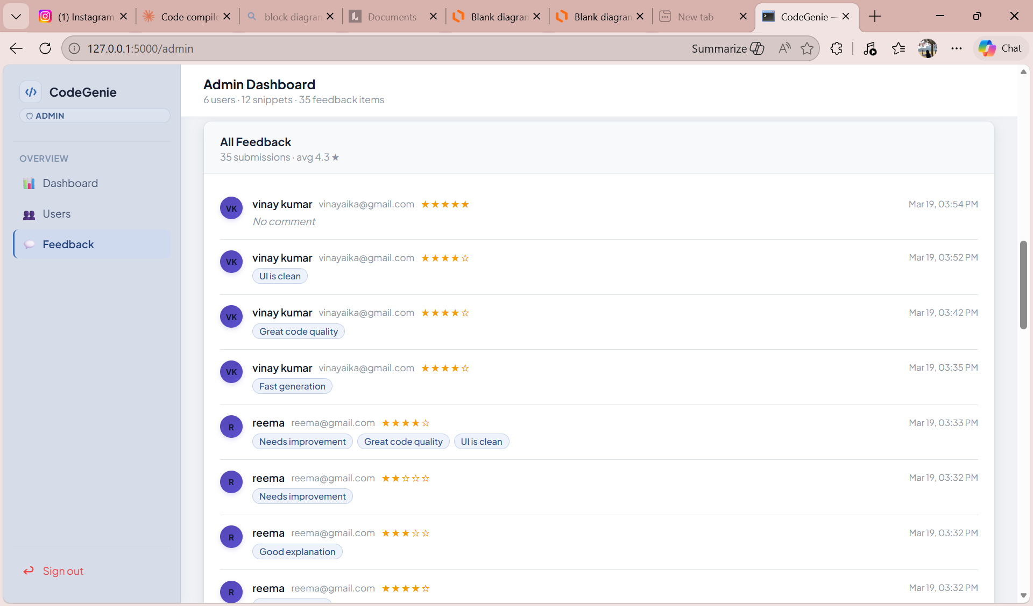
6.Users, Feedback log in admin dashboard

Slide 14
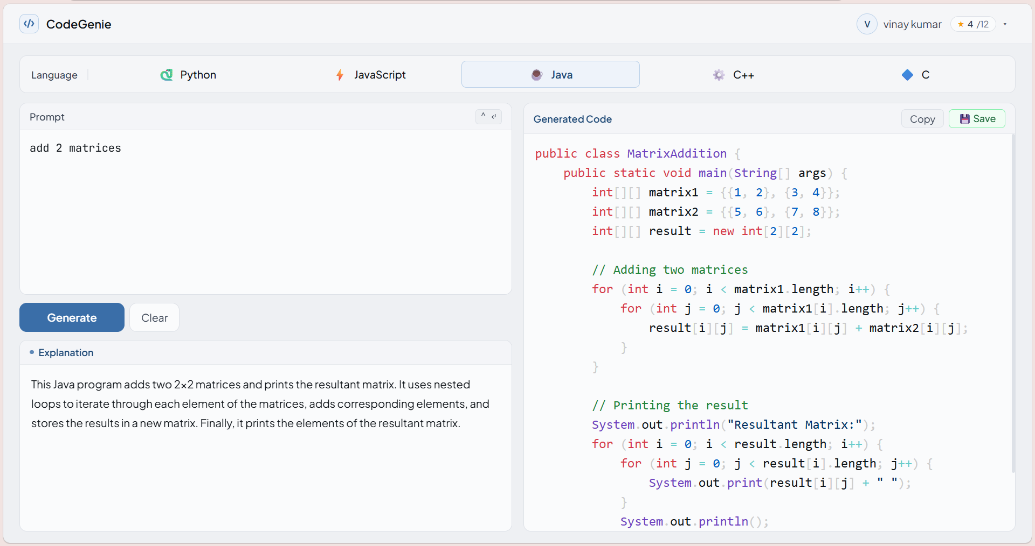
result

Slide 15
Conclusion
CodeGenie demonstrates the practical application of LLMs in an accessible, full-stack web environment. By accepting natural language prompts and returning syntax-highlighted, explained code across five languages, the system bridges the gap between programming intent and working implementation. Secure authentication, cascading AI fallback, a personal snippet dashboard, structured feedback collection, and a Chart.js admin analytics panel combine to deliver a cohesive, production-ready application.
Future enhancements
Code Execution Sandbox: Integrate Judge0 to run generated code directly in the browser
Snippet Search and Filtering: Search bar and language/date filters for the snippet dashboard
OAuth Login: Google and GitHub sign-in via trusted third-party providers
Multi-Model Selection: Expose model choice to users
speed vs. quality trade-off - Mobile Application: React Native / Flutter wrapper for Android and iOS

Slide 16

THANK YOU
SUKRUTHA BODAPALLY

