Slide 1
Conversation Emotion Classifier using Deep Learning Methods and Parallel Computing with PyTorch
Parallel Machine Learning & AI
CSYE7105
Guided By:
Prof. Handan Liu
Team-17
Sukruth Mothakapally and Nisarga Venkatesh

Slide 2
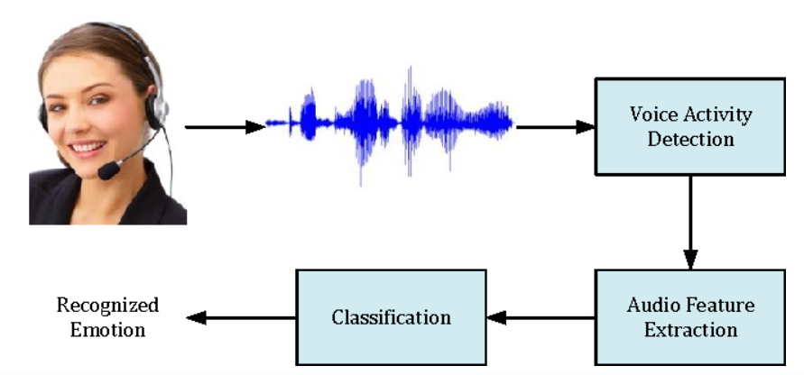
Introduction
Our project uses deep learning and Mel spectrograms for emotion classification. The key aspect is the use of parallel computing methods from PyTorch. This approach is crucial for
Handling large datasets and complex models
Overcoming GPU memory limitations
Ensuring scalability
Fully utilizing PyTorch capabilities
This positions our project at the forefront of innovation in emotion classification.

Slide 3
Introduction Continued…
Background
Computational challenges in deep learning models for emotion classification.
Traditional methods lack efficiency and speed for complex models and large datasets.
Motivation
Motivated by the need to optimize training processes for conversation emotion classification models.
Rising significance of deep learning in natural language processing.
Goal
Leverage PyTorch and parallel computing for reduced training times, significant speedup, and improved efficiency.
Exploration of various parallelism methods, including multiprocessing and Data Parallel.

Slide 4
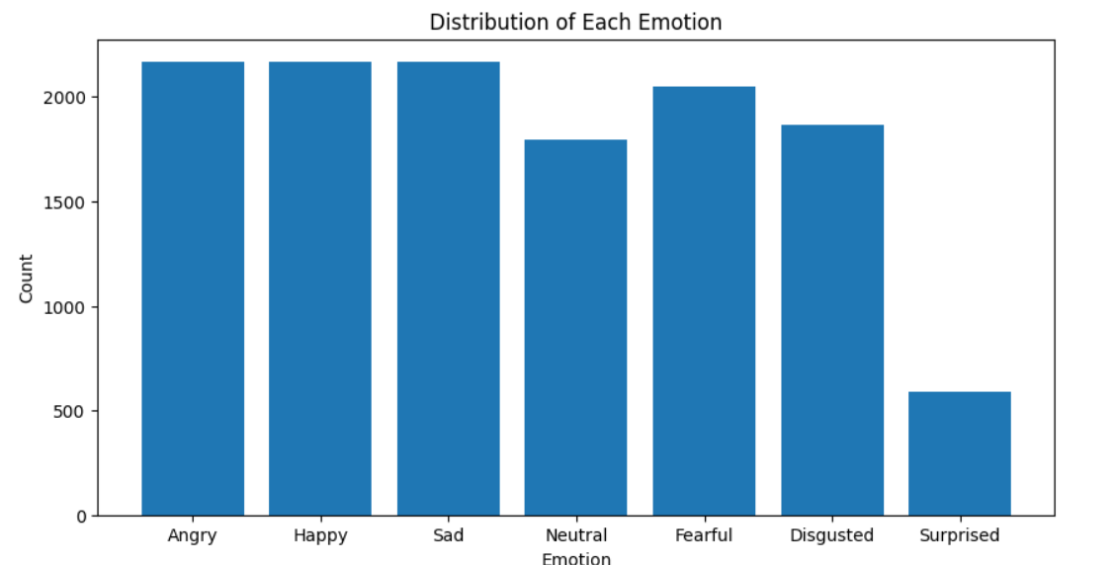
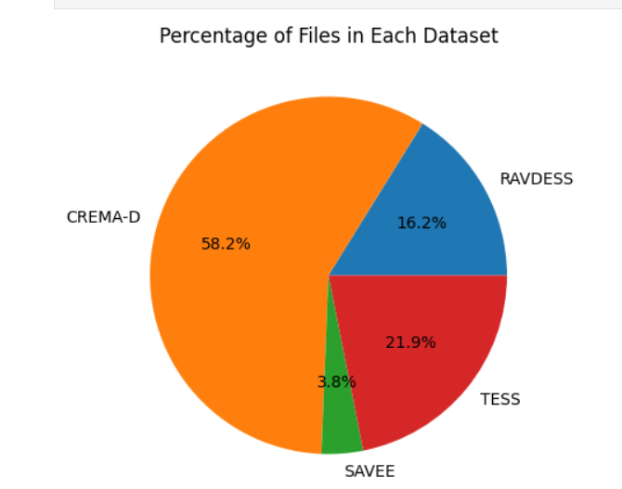
Dataset Description:
The dataset, sourced from Kaggle, is a diverse collection of audio files amounting to around 2 GB from four different sources, categorized into seven emotions: Angry, Happy, Sad, Neutral, Fearful, Disgusted, and Surprised.
The dataset includes a variety of types, ensuring a comprehensive and representative dataset for our emotion classification task.

Slide 5
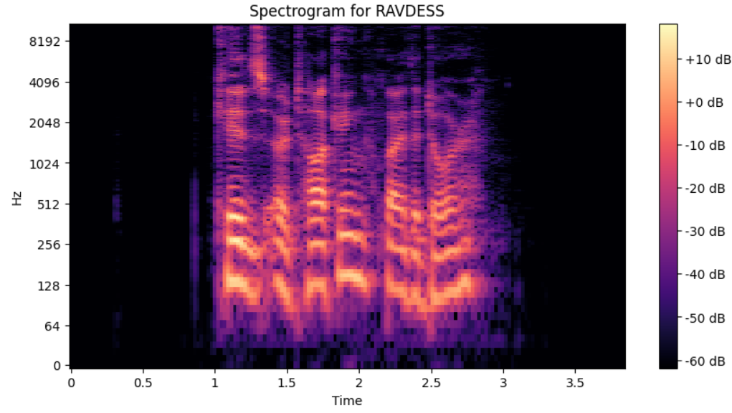
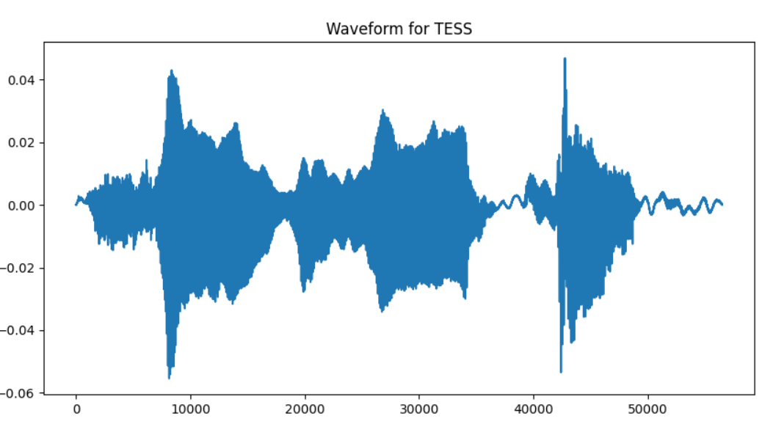
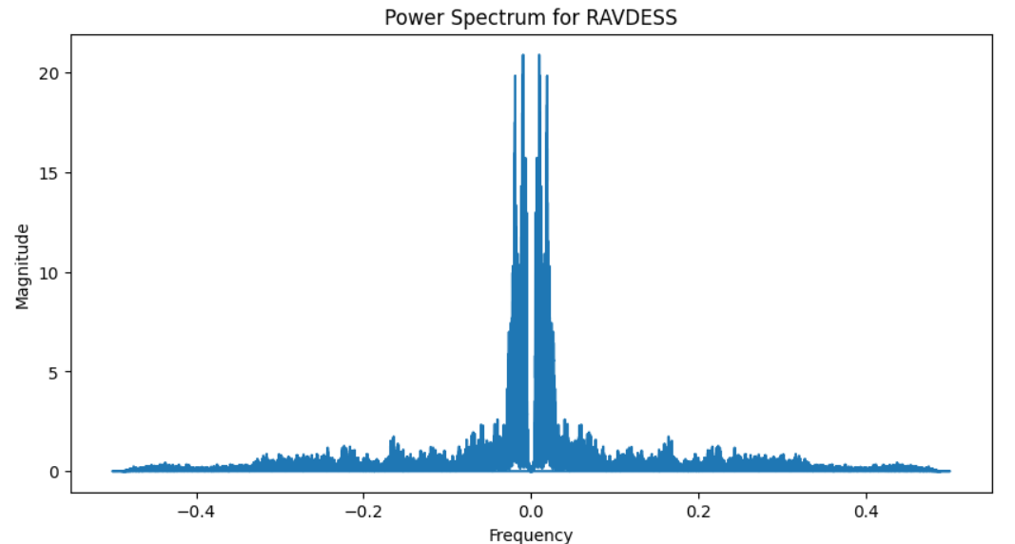
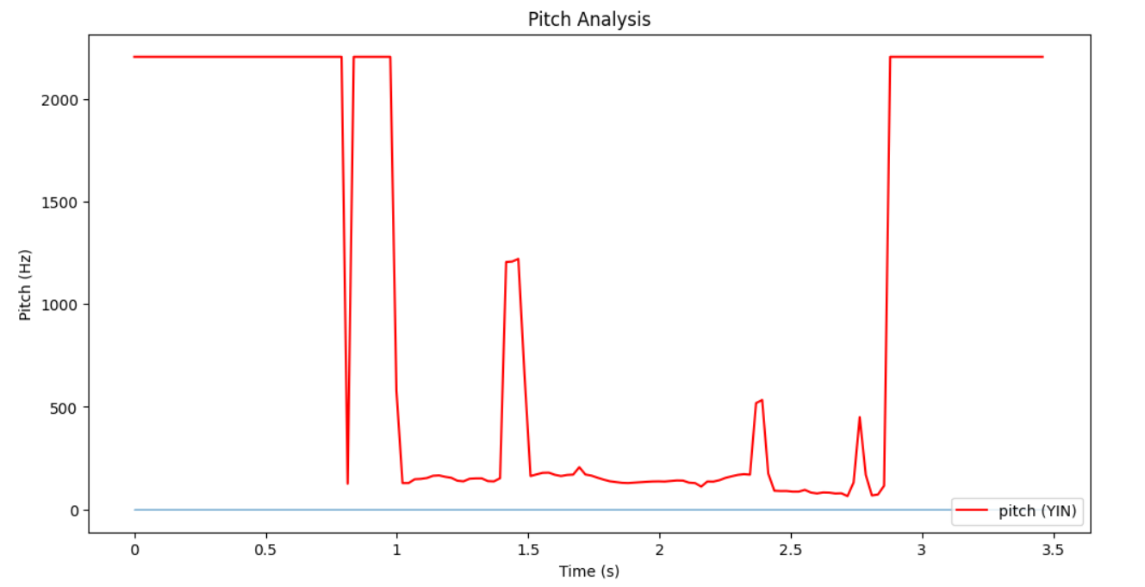
Methodology
Step 1 Exploratory Data Analysis:
Understanding Data
Analyzing Emotions
Audio File Types
Audio Duration
Visualizations
Pitch Analysis
Revealing Patterns
EDA is a critical first step in our methodology, providing a comprehensive understanding of our data and guiding subsequent steps.

Slide 6
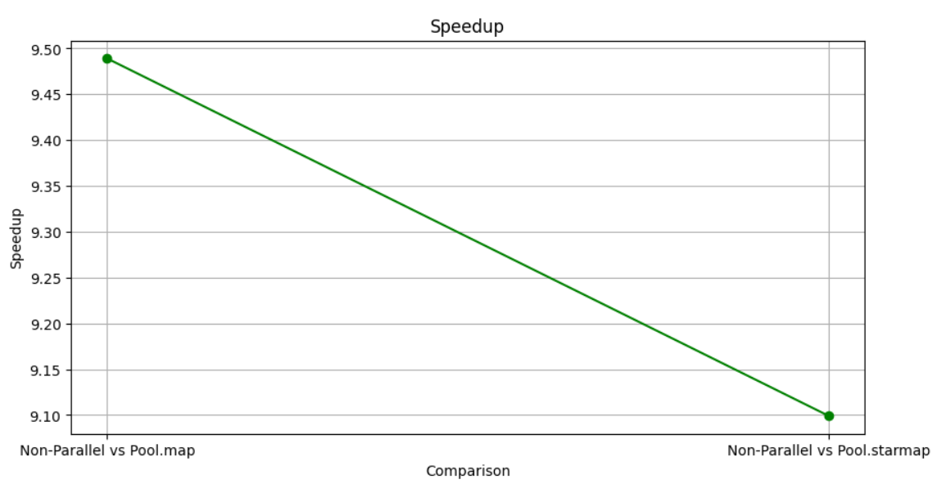
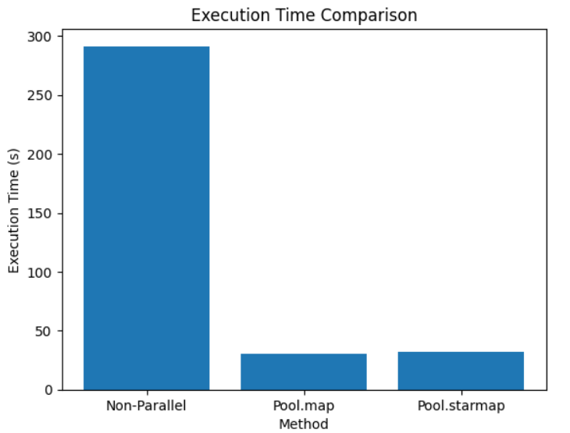
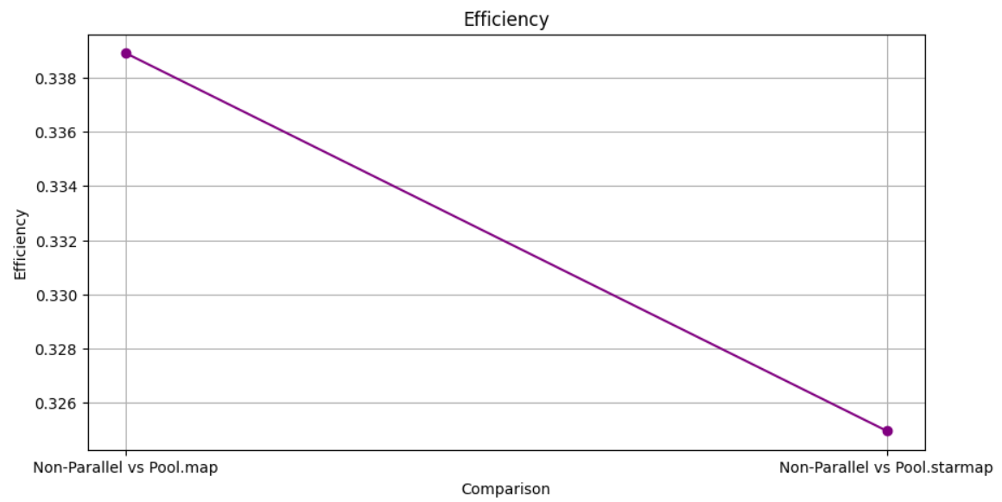
Introducing Parallelism in EDA
We noticed that the calculation of average audio duration task was taking a lot of time as it was going through the entire dataset, hence we introduced parallelism here.

Slide 7
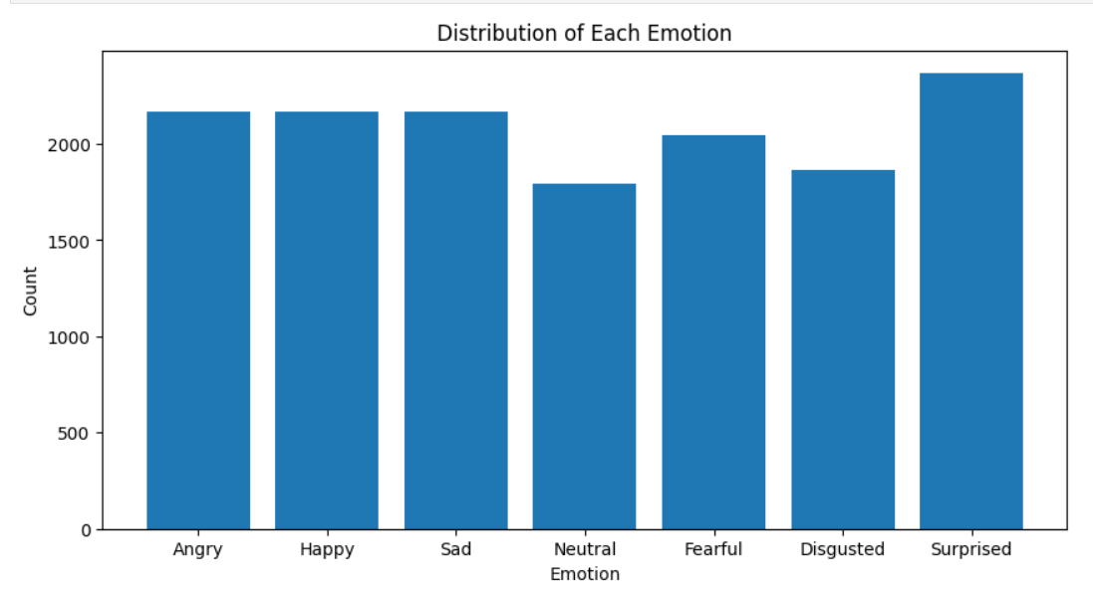
Step 2 Data Preprocessing utilizing Parallel techniques
Data Augmentation
Data Preparation: Data Preprocessing involves preparing the data for the training process.
Removing Bias: A key task is to check and remove bias in the dataset to prevent a model that is biased towards certain classes.
Data Augmentation: To address the under-representation of the ‘surprised’ emotion, we augmented the data for this emotion, ensuring a balanced dataset for a more robust and fair model.
Utilized concurrent.futures and ThreadPoolExecutor to parallelize this task

Slide 8
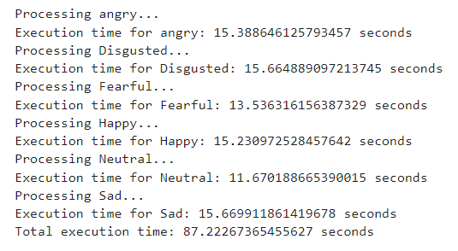
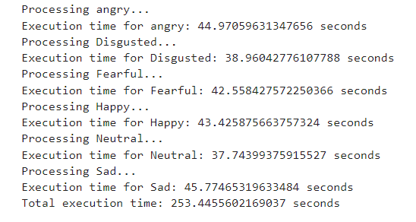
Step2 Continued:
Calculating Mel Spectrogram
Mel Spectrograms: An important task is the calculation of Mel spectrograms, which provide a visual representation of the spectrum of frequencies of sound as they vary with time. They capture the tonal characteristics of an utterance, often carrying emotional content.
Leveraging Multiple CPUs: We leverage multiple CPUs to speed up the calculation of Mel spectrograms, demonstrating the power of parallel computing even in the data pre-processing stage.
The calculation of Mel spectrograms and the use of multiple CPUs for speed enhancement further highlight the importance of data preprocessing in our methodology. It ensures that our model is trained on well-prepared and balanced data, ready for efficient emotion classification.

Slide 9
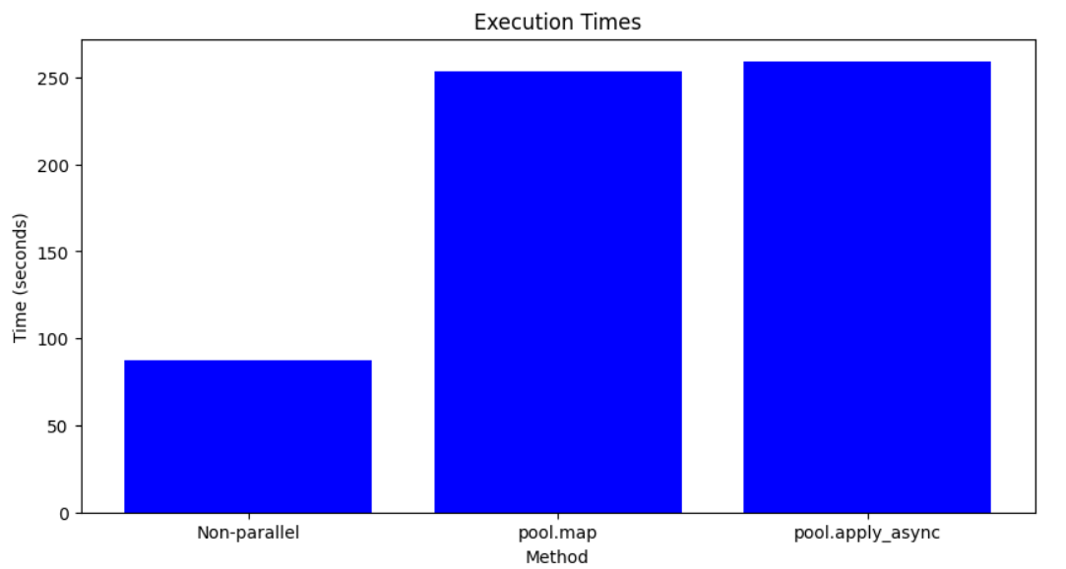
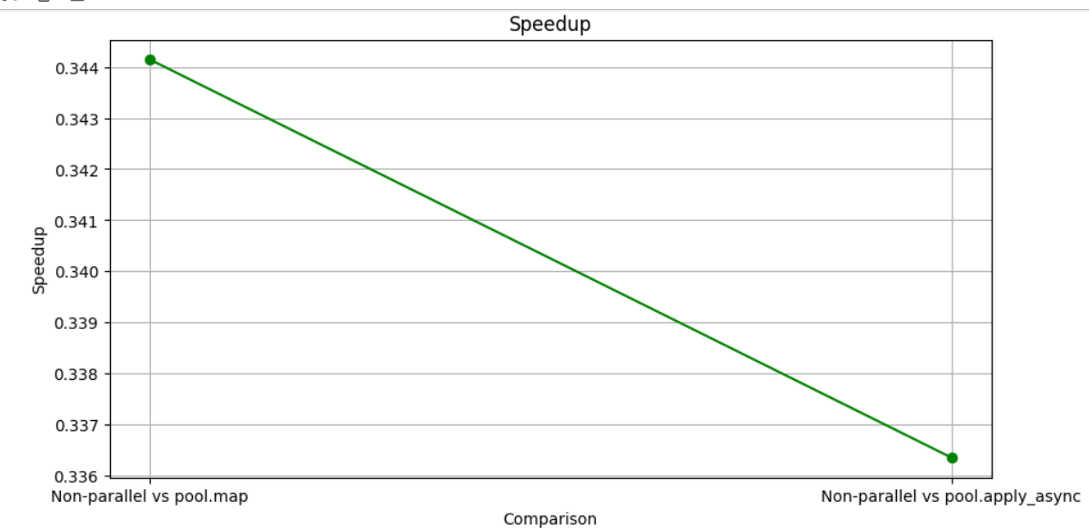
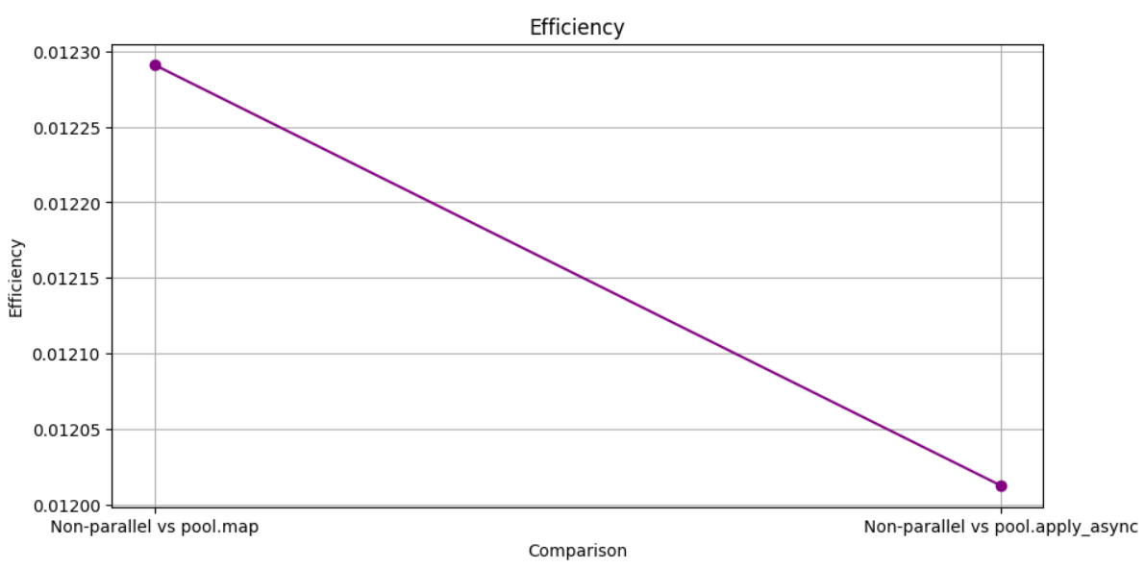

Slide 10
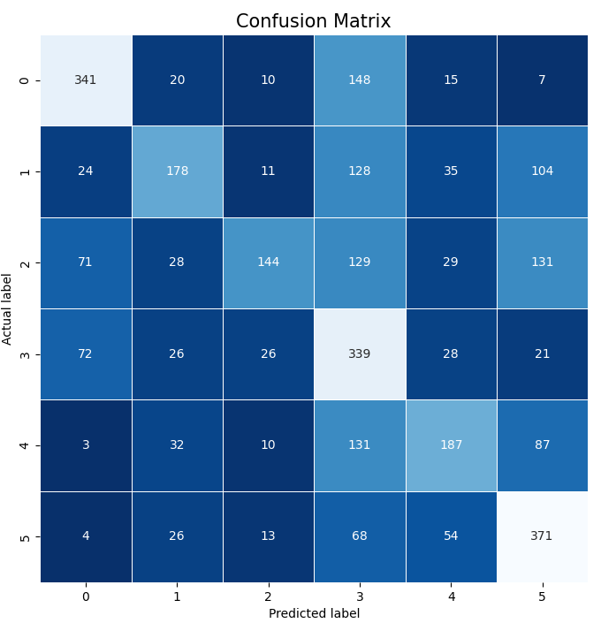
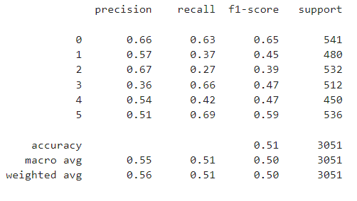
Step3 Model Development:
Model 1 – Custom CNN MODEL
The model architecture consists of a convolutional neural network (CNN) with one convolutional layer, followed by max-pooling, a fully connected layer, and an output layer. The CNN processes input audio spectrograms, and the output layer produces predictions for the emotion classes using the softmax activation function.
The preprocessed data for each emotion is combined and resized. These are then converted into tensors and split into training and testing sets. A Convolutional Neural Network (CNN) model is defined in PyTorch with one convolutional layer and two fully connected layers. The model is trained using the training set, with early stopping implemented to prevent overfitting. After each training epoch, the model is tested on the testing set and the accuracy is calculated. If the accuracy doesn't improve for a certain number of epochs, the training stops early.

Slide 11
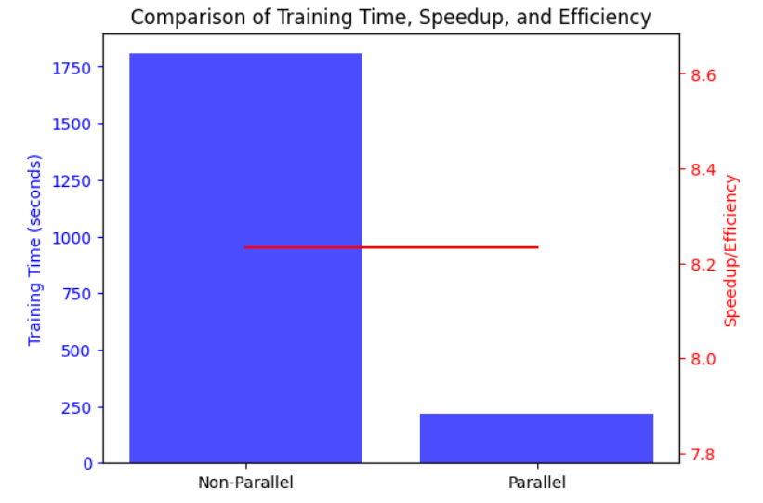
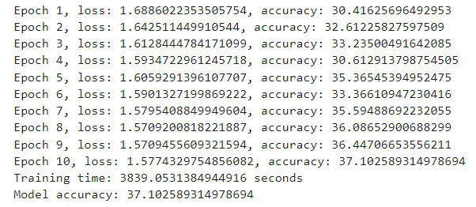
Model 2 – Resnet50
we opted to use the ResNet-50 model, a variant of the ResNet architecture. ResNet-50 is a deep convolutional neural network known for its ability to effectively handle complex visual recognition tasks.
We fine-tuned the last fully connected layer to adapt the model to our specific classification task, resulting in a powerful and effective solution for audio emotion recognition

Slide 12
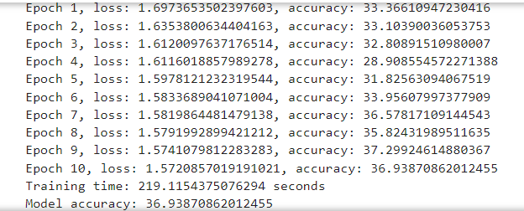
Resnet50 CNN model with parallelism (data parallel) as it took too much time to train

Slide 13
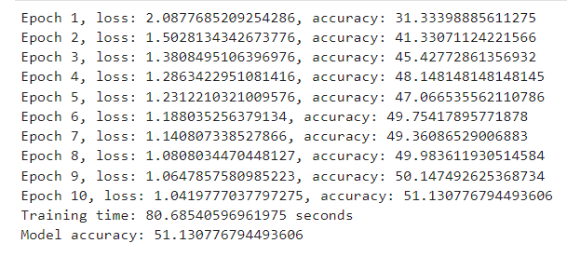
Result and Analysis – Model Evaluation
We chose our custom CNN model as Restnet50 took too more time to train even with parallelization without any improvement in accuracy
Non-Parallel
Parallel

Slide 14
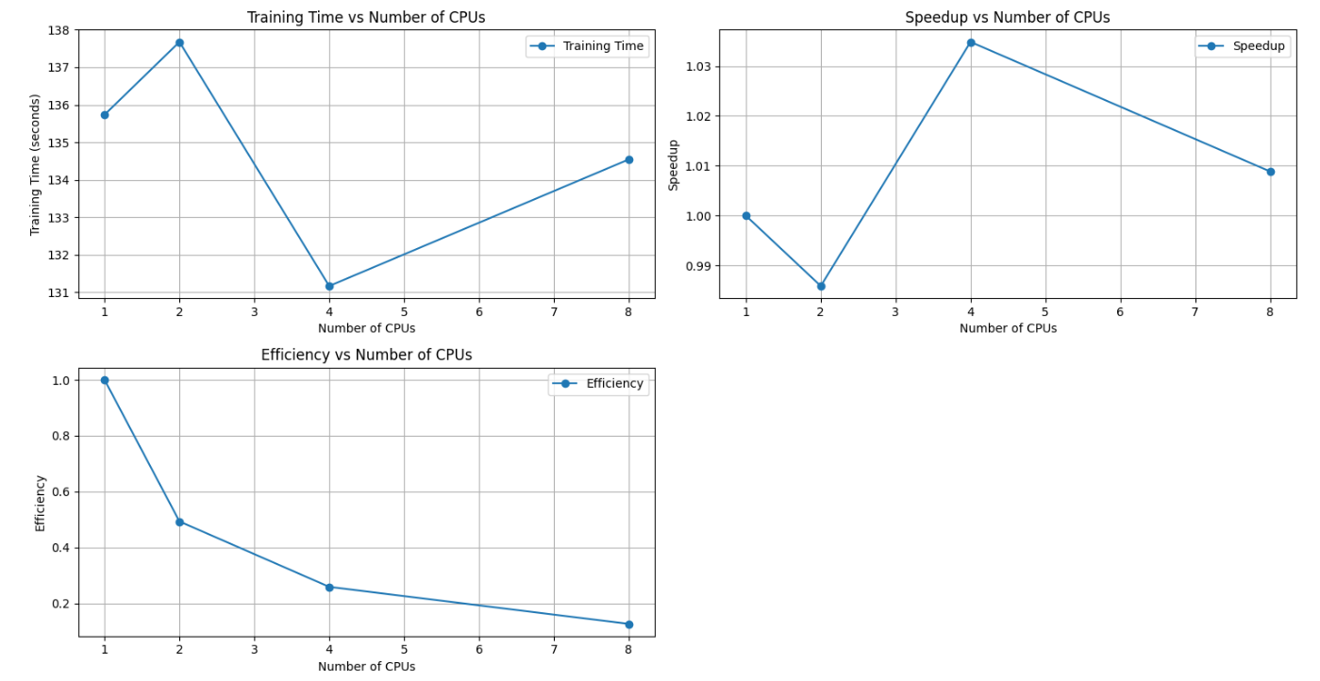
Let's parallelize our selected model and perform Multiprocessing to find the ideal number of CPUs

Slide 15
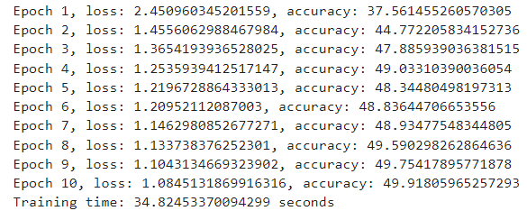
CNN Model utilizing Data Parallel method with 1 GPU

Slide 16
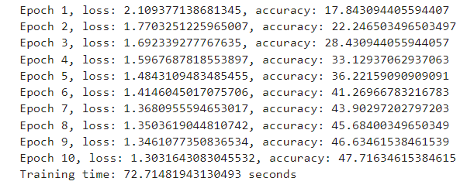
CNN Model utilizing Distributed Data Parallel method with 1 GPU

Slide 17
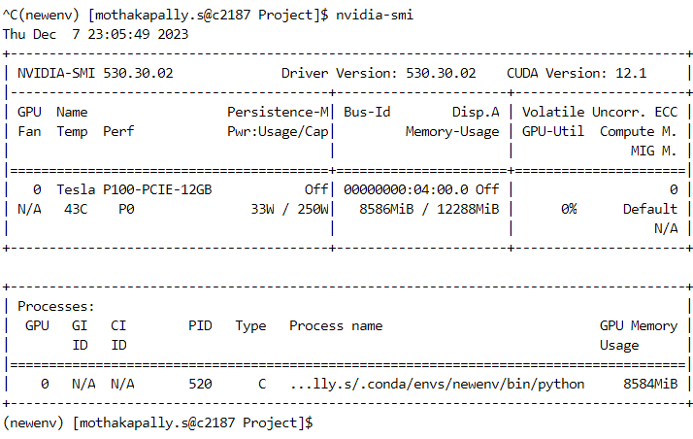
GPU Configuration

Slide 18
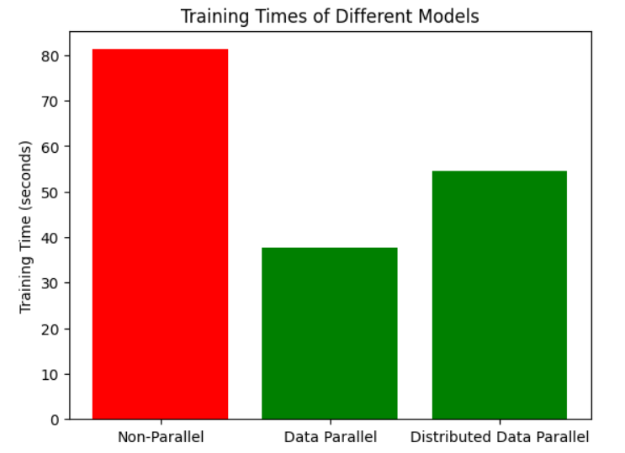
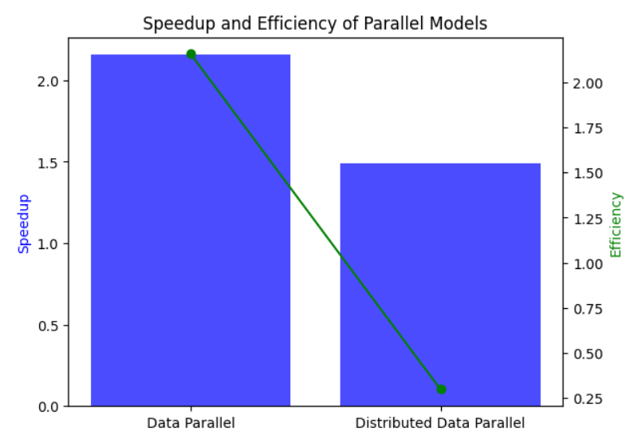
Conclusion: for the Ideal Parallel Method and Number of GPUs Comparing Non parallel vs Parallel methods

Slide 19
Conclusion continued..
The project has demonstrated the transformative impact of parallel computing on the efficiency of deep learning models.
Our exploration of both Data-Parallel and Distributed Data-Parallel (DDP) methods has shown that these techniques can significantly reduce execution time, thereby accelerating the training process. This is a critical advantage in the field of machine learning, where training complex models on large datasets can be computationally intensive and time-consuming.
As observed in the results, Data Parallel (DP) with one GPU and four CPUs exhibited a notable speedup compared to the non-parallel model, leading to enhanced training efficiency. The speedup and efficiency metrics, as depicted in the accompanying graphs, underscore the substantial performance gains achieved through parallel computing strategies, validating our choice of DP for its efficacy in our specific configuration.

Slide 20
References
[1] Audio Emotions Dataset: https://www.kaggle.com/datasets/uldisvalainis/audio-emotions
[2] Exploratory Data Analysis: https://towardsdatascience.com/speech-emotion-recognition-with-convolution-neural-network-1e6bb7130ce3
[3] Calculating Mel Spectrogram: https://towardsdatascience.com/getting-to-know-the-mel-spectrogram-31bca3e2d9d0
[4] Convulated Neural Network Model development: https://github.com/jeffprosise/Deep-Learning/blob/master/Audio%20Classification%20(CNN).ipynb
[5] Pytorch fundamentals: https://pytorch.org/tutorials/beginner/deep_learning_60min_blitz.html
[6] Pytorch for audio classification: https://pytorch.org/tutorials/intermediate/speech_command_classification_with_torchaudio_tutorial.html
[7] Doubts and Clarifications: https://chat.openai.com/

Slide 21
Thank You

