Slide 1

Hand Written Number Recognition GUI using JavaFX and TensorFlow
By,
Sukruth Mothakapally
Shivani Shah

Slide 2
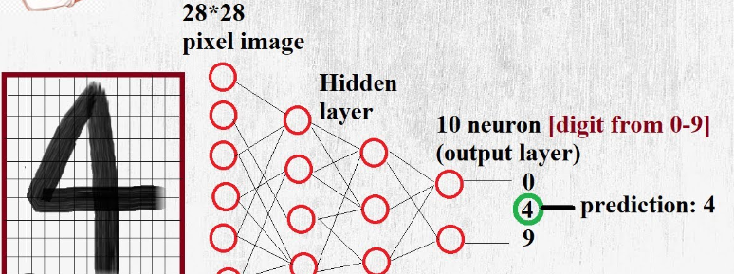
CONTENTS
Testcase Passed
Testcase Failed
JavaFX GUI
Exception Handling
TensorFlow Model
Formatted Image
Class Diagram
Conclusion

Slide 3

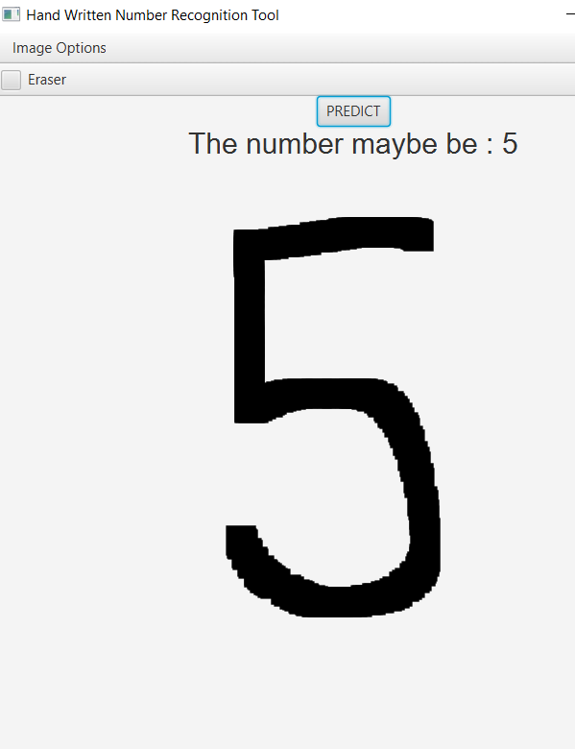
Testcase Passed

Slide 4
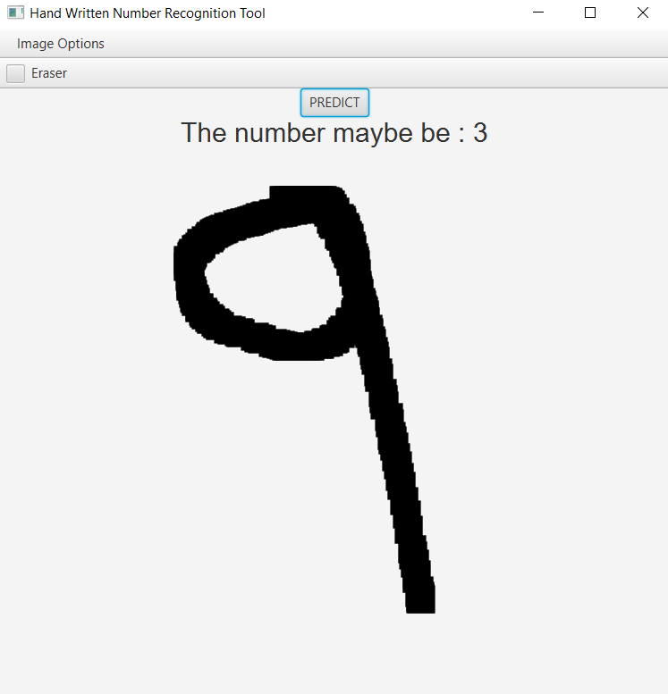
Testcase Failed

Slide 5
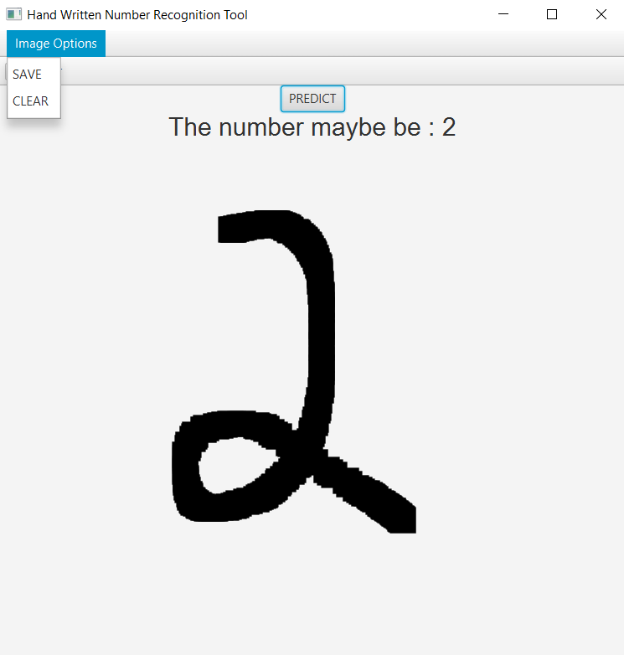
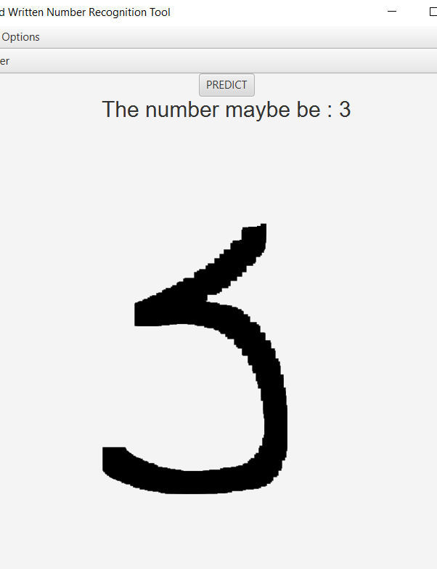
JavaFX GUI

Slide 6
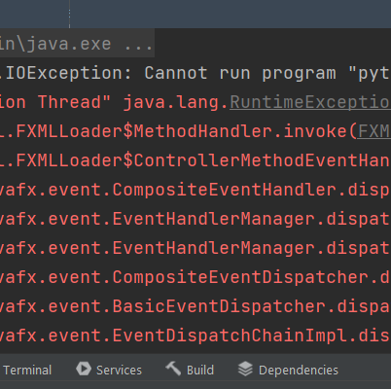
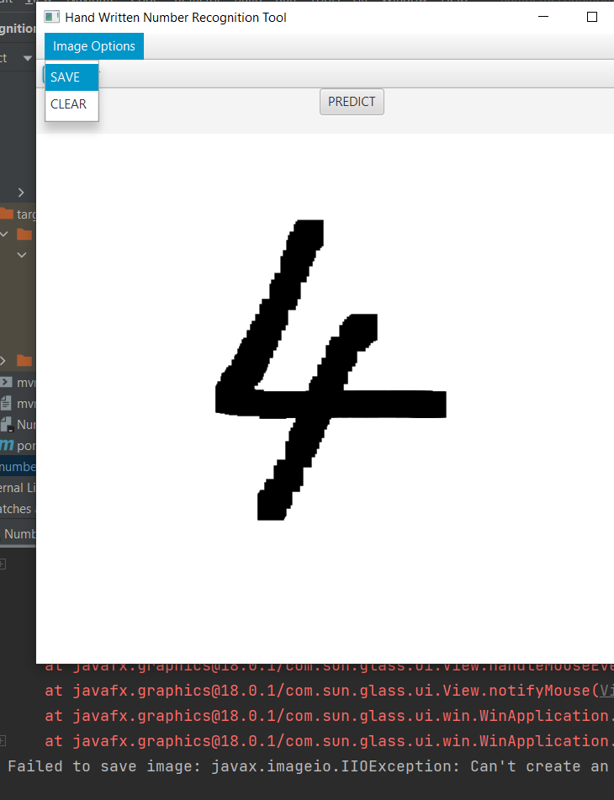
Exception Handling

Slide 7
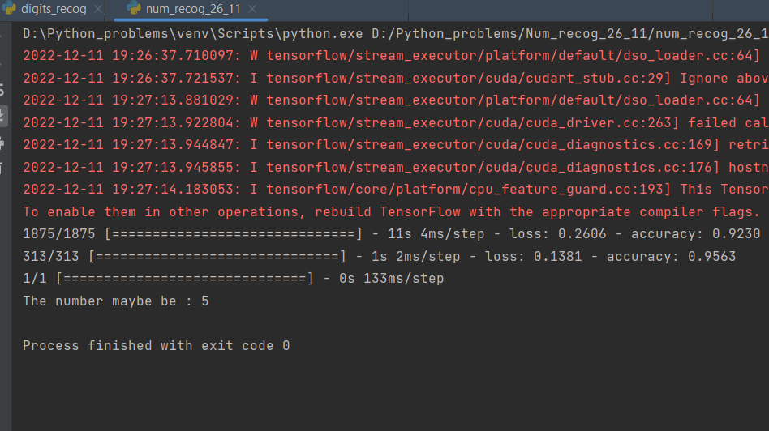
TensorFlow Model

Slide 8

Formatted Image

Slide 9
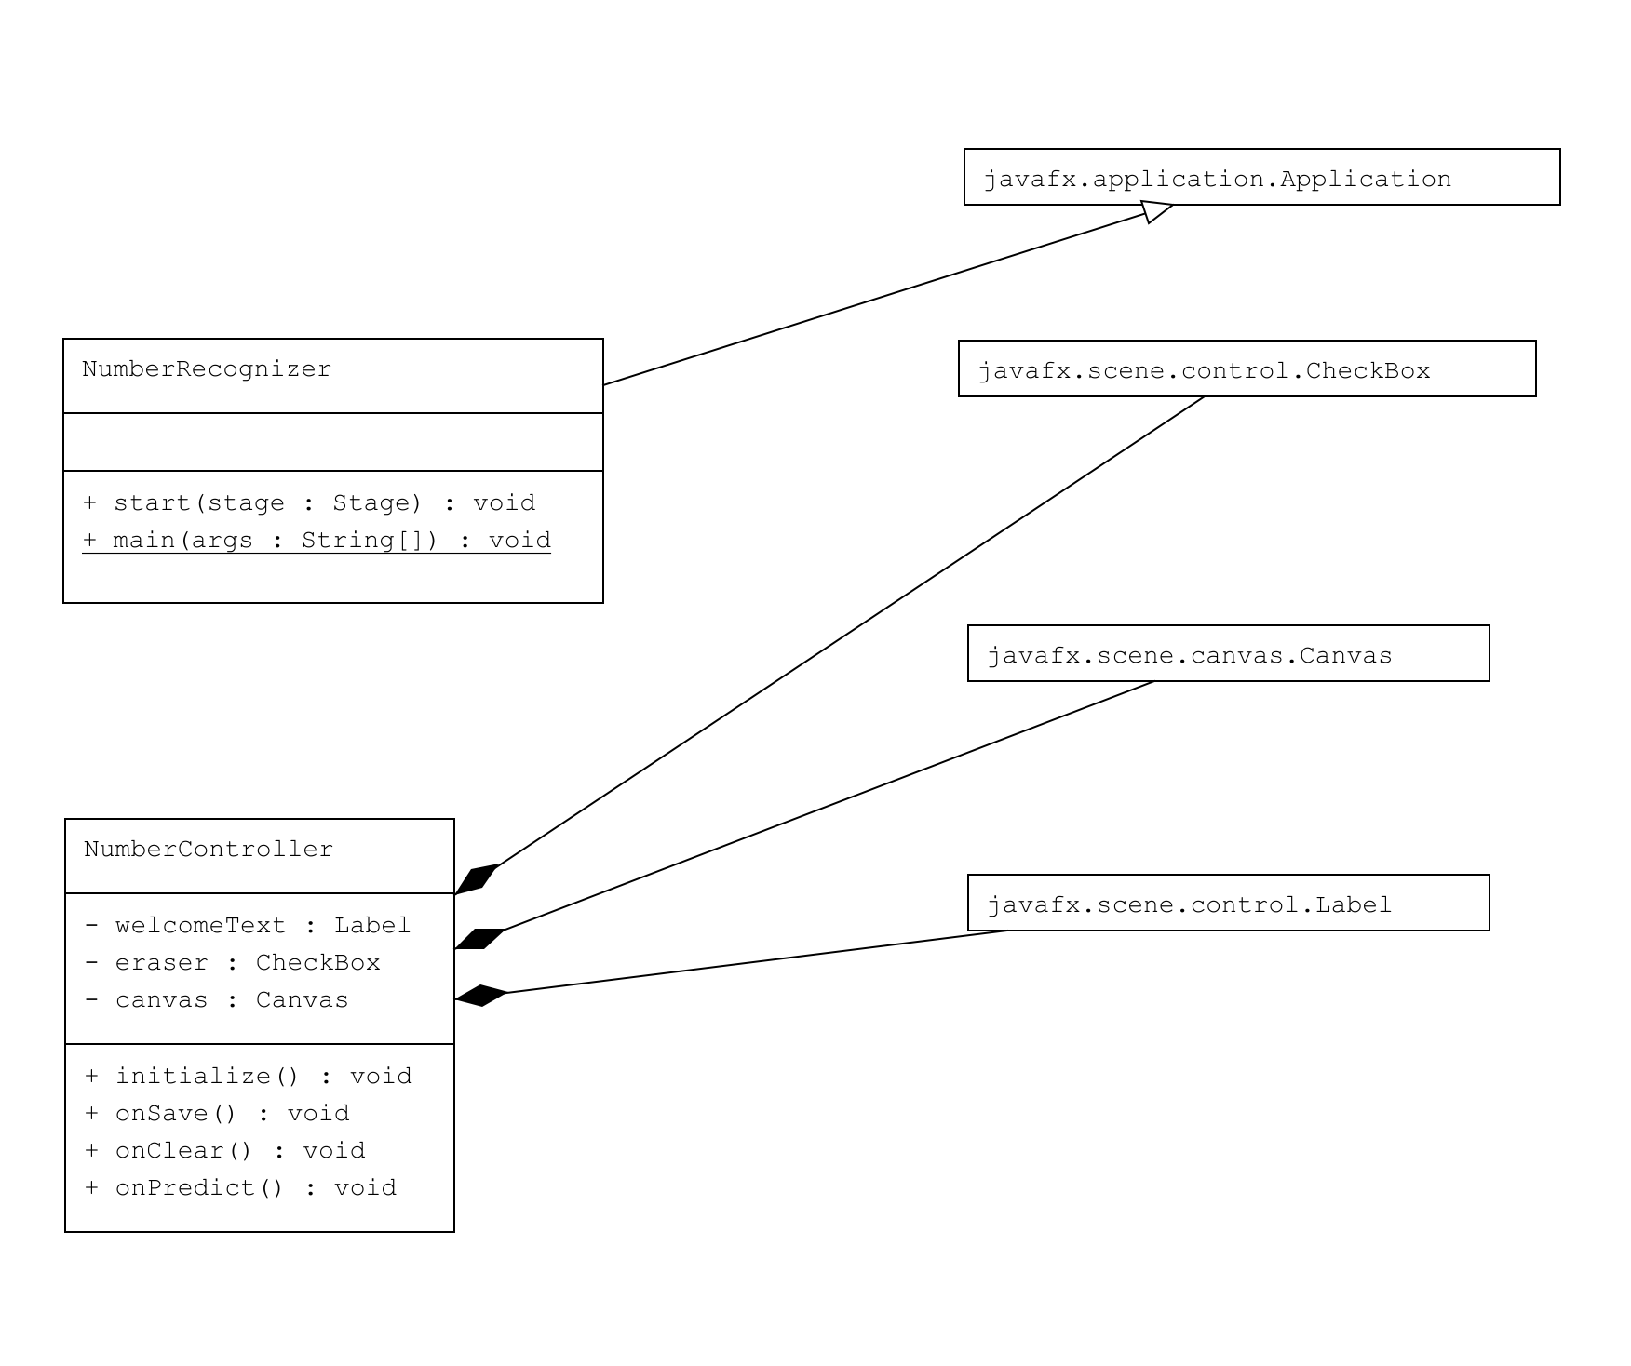
Class Diagram

Slide 10

Conclusion
Successfully created a JavaFX GUI where we can draw a digit , save the digit and display the predicted digit using TensorFlow

Slide 11


