Slide 1
Resource-Aware Scheduling for Dependable Multicore Real-Time Systems
ILLURU SAHITYA (2020H1400247H,ME Embedded)
CHIDARA SINDHUJA(2020H1400251H,ME Embedded)
SUKRUTH S(2020H1400236H,ME Embedded)
Supervisor :Dr. Soumya J

Slide 2
Problem statement
Problem definition: Implementation of proposed algorithm for resource aware scheduling in multicore processing systems and improving the same.
Assumptions (if any): All the processors are homogeneous in nature and the task set is either given by user or auto generated.
Tools used: Python IDEs-PyCharm, Spyder, Python 3.6
Libraries used
Math
Matplot
Random
Scipy
numpy

Slide 3
Description
Inputs: Task set from task.csv or user defined
Output:
A feasible partitioning and scheduling for the given task set for multi core real time systems.
Algorithm proposed:
Partioned EDF with Multiprocessor Stack Resource Policy(MSRP) and bin packing algorithm
Reliability and synchronization aware Task Partioning algorithm(RSA-TPA)
Offset | Deadline | Period | Wcet | Utilization | Number
0 | 0.17 | 0.17 | 0.07 | 0.41 | 0
0 | 0.32 | 0.32 | 0.03 | 0.08 | 1
0 | 0.49 | 0.49 | 0.39 | 0.79 | 2
0 | 0.65 | 0.65 | 0.04 | 0.07 | 3
0 | 0.15 | 0.15 | 0.09 | 0.61 | 4
Parameters | Task 1 | Task 2 | Task 3
Deadline | 30 | 20 | 15
Non-Critical Execution Ti | 2 | 2 | 0
Semaphore1 | 2 | 0 | 2
Semaphore2 | 2 | 2 | 0
Utilization | 0.2 | 0.2 | 0.1
Premption Level | 1 | 2 | 3
Phase | 0 | 1 | 3

Slide 4
Methodology
Start
User prompt
Obtain semaphore and priority values
Input task set
Task Generator
Edf algorithm
Any concern
Calculate ceiling value for resources
Bin packing algorithm
Processor
Preempt and execute new task
Stack resource policy for task
RSA TPA
No
Ceiling> Preemption of tasks
Display outputs
End

Slide 5
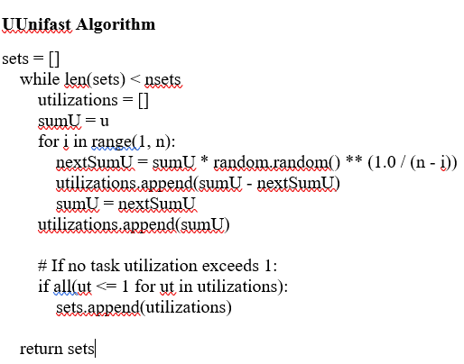
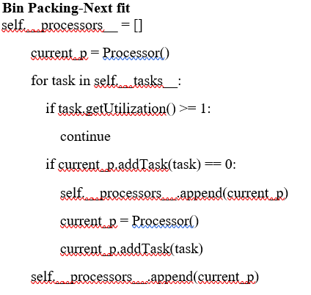
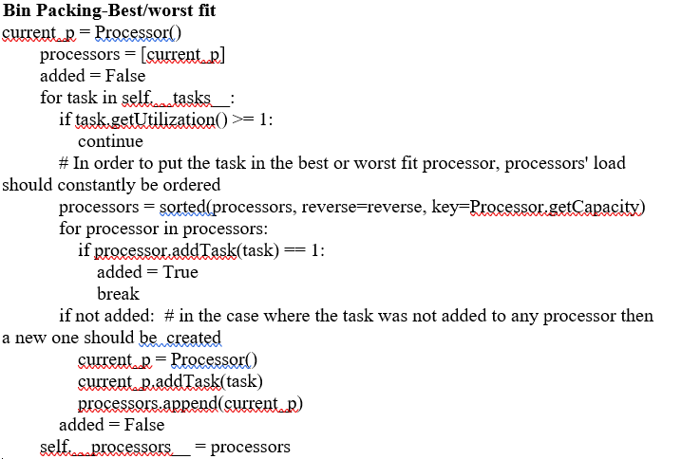
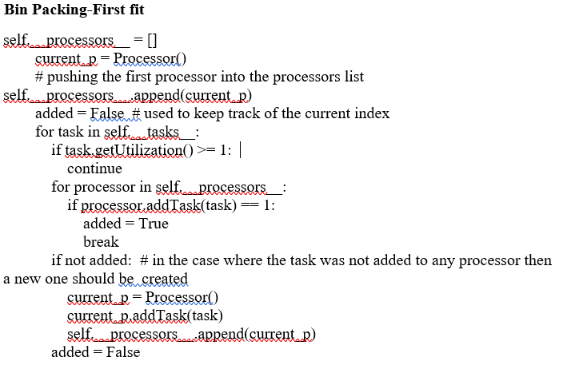
Implementation

Slide 6
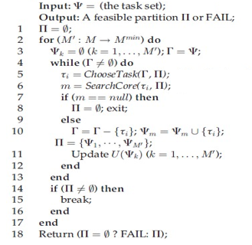
Implementation
RSA-TPA
Stack Resource Policy(SRP)
Finding Preemption Level for the task: πi∝1/Di
Finding all tasks using resources
Find priority ceiling :highest pre-emption level among all tasks using that particular resource
System ceiling ∏s : this is a dynamic parameter that can change every time a resource is accessed or released.
A task can preempt another task if
If it has the highest priority;
if its preemption level is higher than the system ceiling. πi>∏s

Slide 7
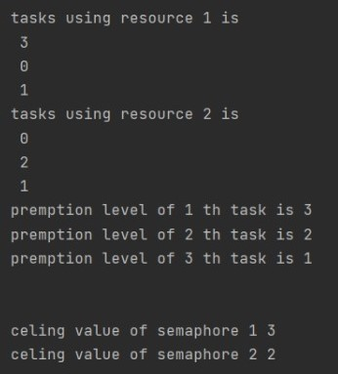
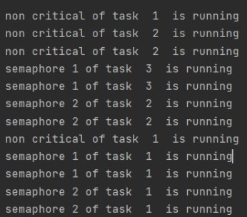
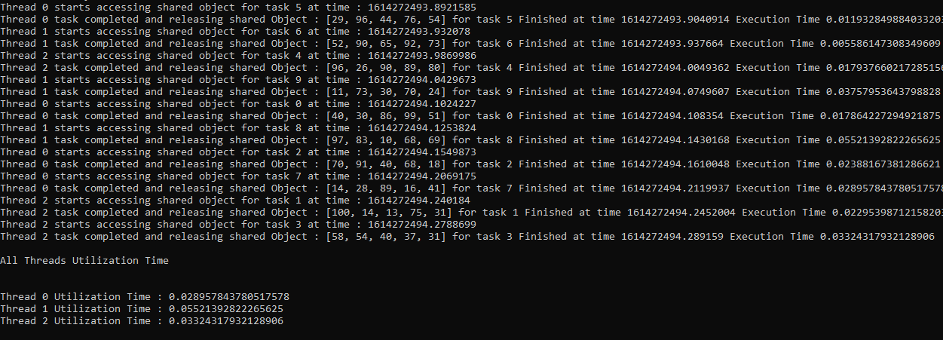
Experimental Results
SRP Output
Task Partitioning Output

Slide 8
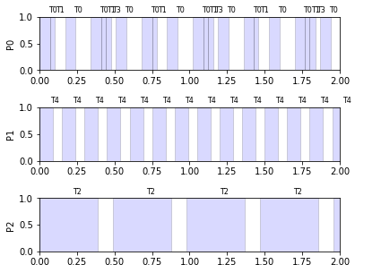
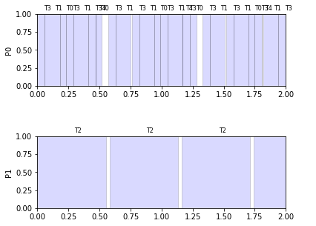
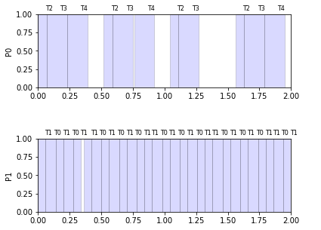
Experimental Results(EDF)
Next fit
Best fit
Worst fit
First fit

Slide 9
References
Han, J. J., Wang, Z., Gong, S., Miao, T., & Yang, L. T. (2019). Resource-Aware Scheduling for Dependable Multicore Real-Time Systems: Utilization Bound and Partitioning Algorithm. IEEE Transactions on Parallel and Distributed Systems,30(12), 2806-2819
J. Ras and A. M. Cheng, “An evaluation of the dynamic and static multiprocessor priority ceiling protocol and the multiprocessor stack resource policy in an smp system,” in Proc. Real-Time Embedded Technol. Appl. Symp., 2009, pp. 13–22.

Slide 10
THANK YOU

