Slide 1
Optimizing User, Group, And Role Management With Access Control And Workflows

Slide 2
Introduction to User, Group, and Role Management
Effective management of users, groups, and roles is critical for securing organizational resources.
Proper access control ensures only authorized individuals can access sensitive data and systems.
Workflow automation simplifies provisioning, de-provisioning, and updating user permissions.
Notes:
Image source: https://www.slidemake.com

Slide 3
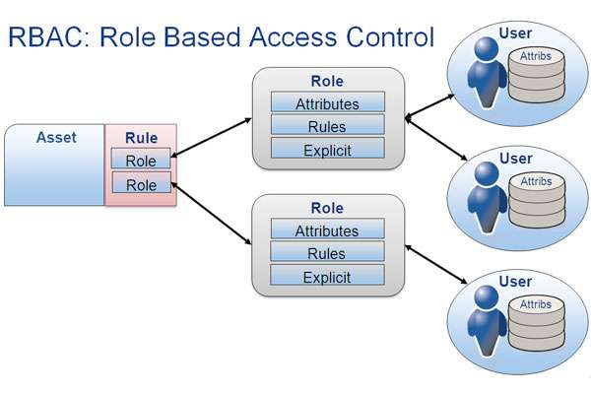
Importance of Access Control in Organizations
Access control enforces security policies by restricting resource access based on roles.
It helps prevent unauthorized data leaks and reduces insider threats.
Implementing robust access control improves compliance with industry regulations and standards.
Notes:
Image source: https://idenhaus.com

Slide 4
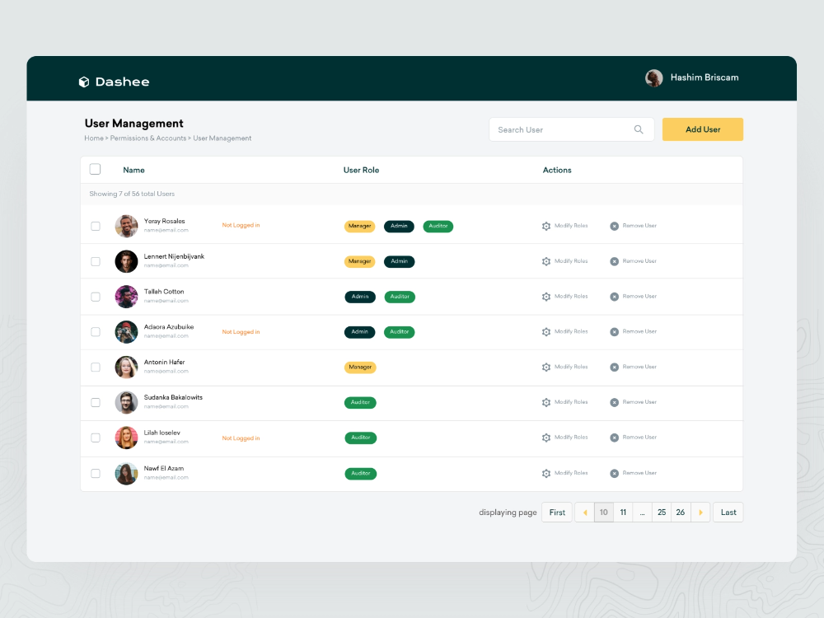
Structuring User Management
User management involves creating, updating, and deleting user accounts within systems.
Assigning unique identifiers helps track user activity and manage permissions effectively.
Regular audits and reviews of user accounts are essential to maintain security and compliance.
Notes:
Image source: https://i.pinimg.com

Slide 5
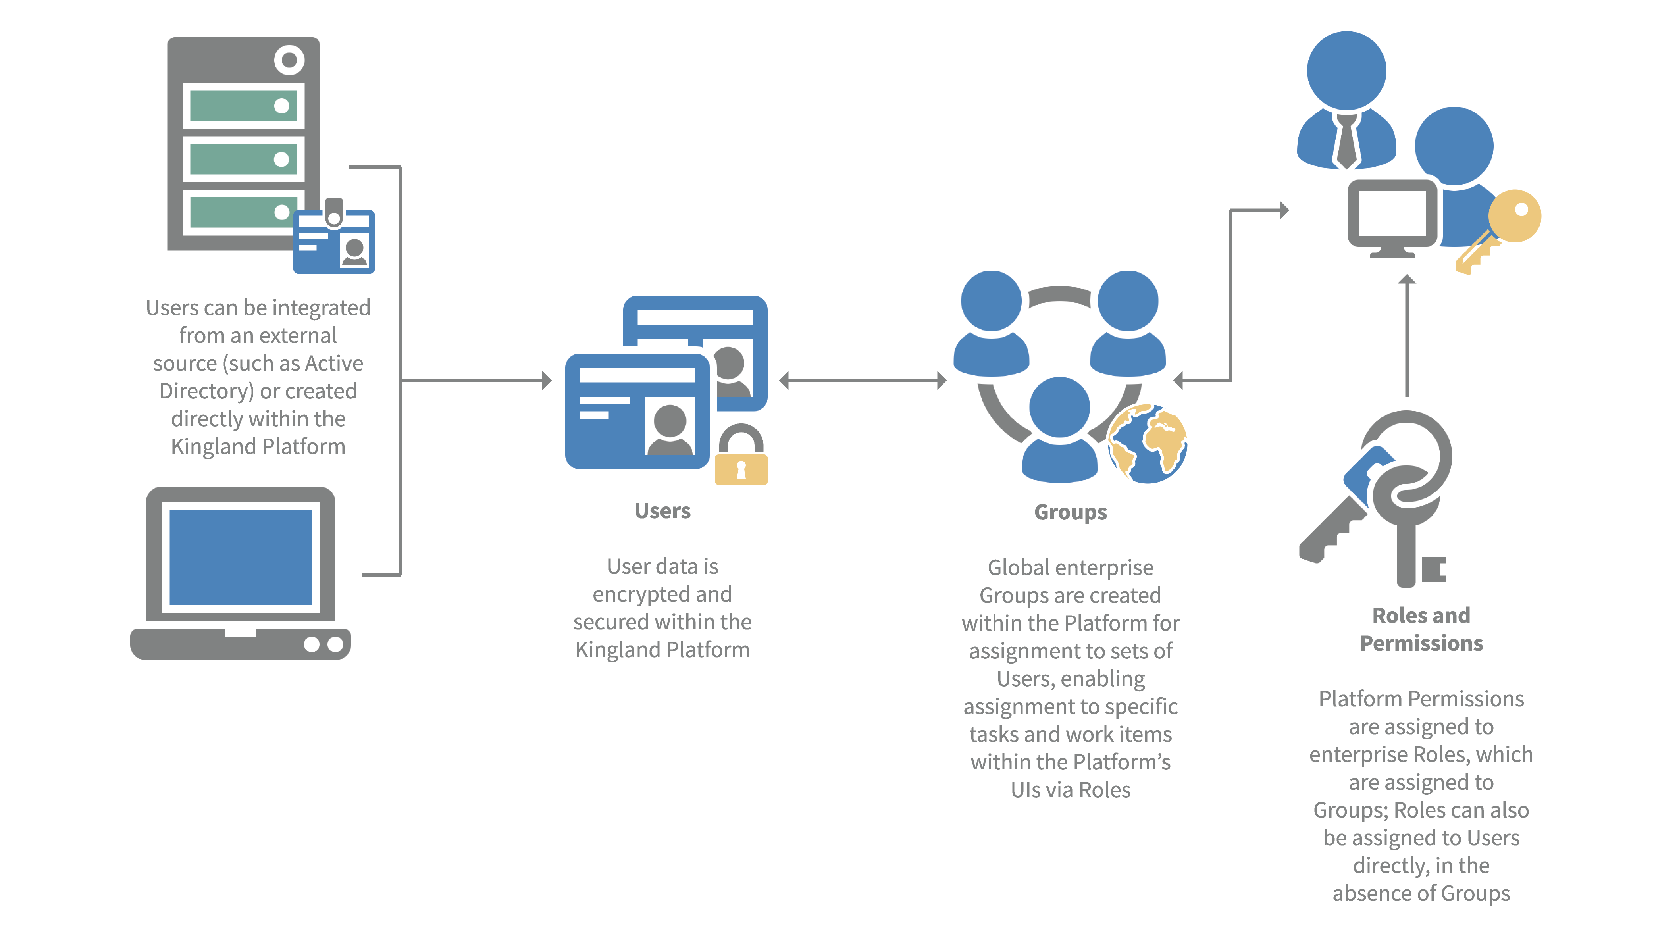
Group Management Strategies
Groups organize users with similar roles or responsibilities for easier permission assignment.
Group policies can streamline access management across multiple users simultaneously.
Dynamic group memberships based on attributes enable flexible and scalable access control.
Notes:
Image source: https://blog.kingland.com

Slide 6
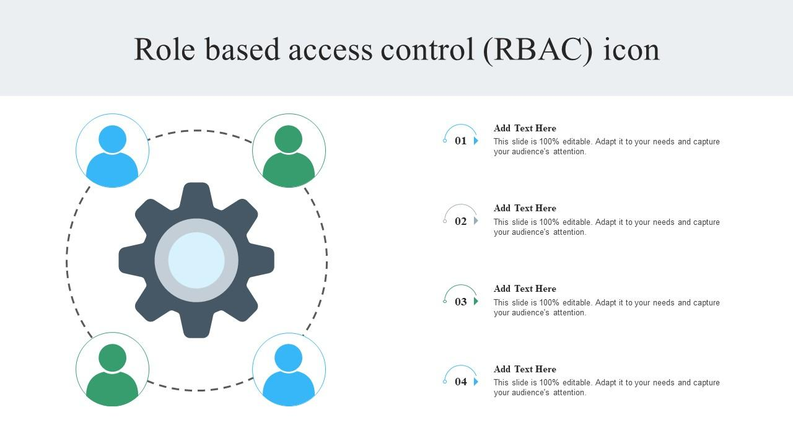
Role-Based Access Control (RBAC) Overview
RBAC assigns permissions to roles, which are then assigned to users or groups.
This model simplifies permission management by reducing the need for individual user permissions.
Proper role design reflects organizational structure and operational needs.
Notes:
Image source: https://www.slideteam.net

Slide 7
Designing Effective Roles and Permissions
Define roles based on job functions, responsibilities, and security requirements.
Limit permissions to the minimum necessary for role fulfillment (principle of least privilege).
Regularly review and update roles to adapt to organizational changes and security threats.
Notes:
Image source: https://www.slidemake.com

Slide 8

Automating Access Workflows
Workflow automation accelerates onboarding, offboarding, and permission updates.
Automated workflows reduce human error and ensure consistency in access provisioning.
Integration with identity management systems enhances efficiency and compliance.
Notes:
Image source: https://www.slidemake.com

Slide 9
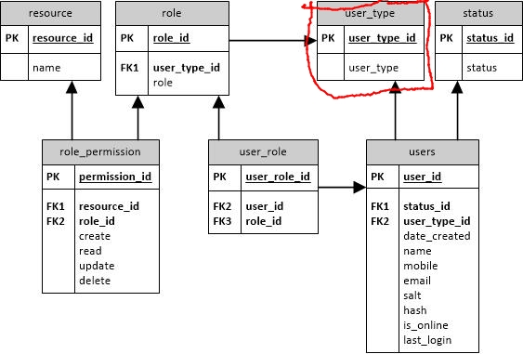
Best Practices for Managing Access and Workflows
Implement multi-factor authentication (MFA) to strengthen access security.
Enforce regular access reviews and audits to detect and revoke unnecessary permissions.
Use policy-driven automation and approval workflows for scalable access management.
Notes:
Image source: https://i.stack.imgur.com

Slide 10
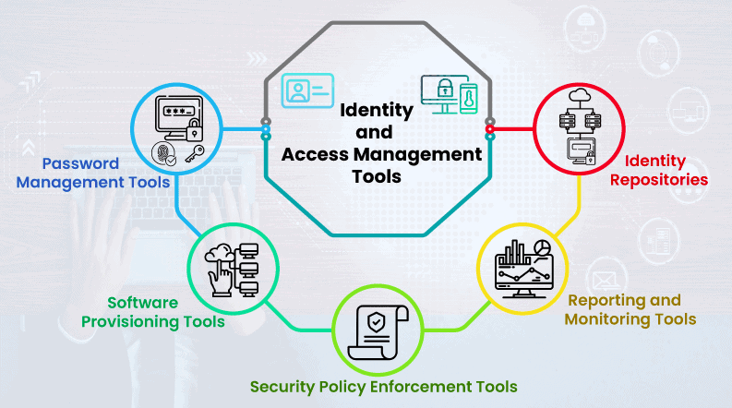
Tools and Technologies for Optimization
Identity and Access Management (IAM) platforms centralize user, group, and role management.
Workflow automation tools streamline approval processes and permission updates.
Monitoring and analytics tools help track access activity and identify security gaps.
Notes:
Image source: https://cdn.infrasos.com

Slide 11
Conclusion and Key Takeaways
Optimizing user, group, and role management enhances security and operational efficiency.
Clear policies, automation, and regular audits are fundamental to effective access control.
Continuous improvement and adaptation to organizational changes ensure ongoing security resilience.
Notes:
Image source: https://blog.kingland.com

