Slide 1
Romans
Enterprise
Represents...

Slide 2

Discord bot in C#

Slide 3
The
Problem:

Slide 4
I was bored in Discord and wanted to create something to satisfy boredom.

Slide 5
The
Solution:

Slide 6
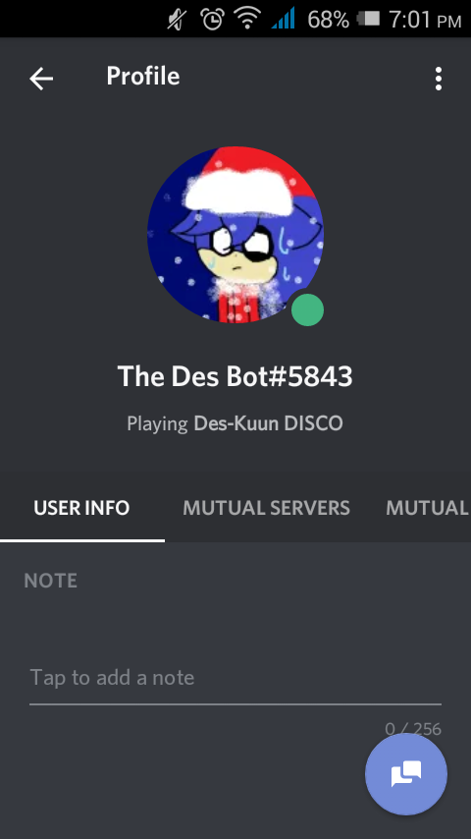
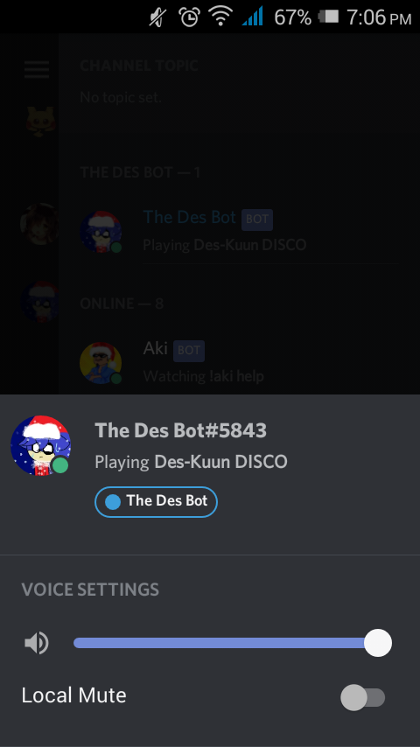
Creating the bot and its
profile

Slide 7
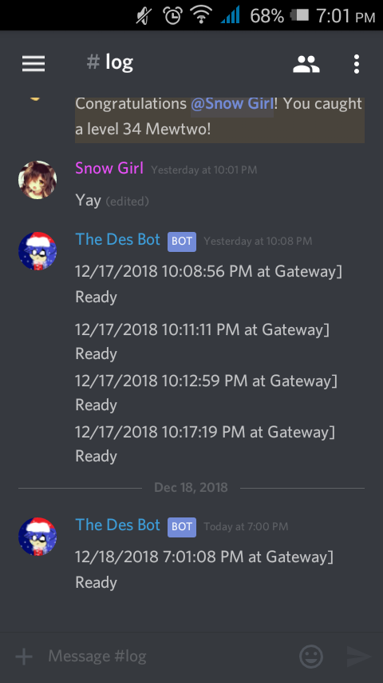
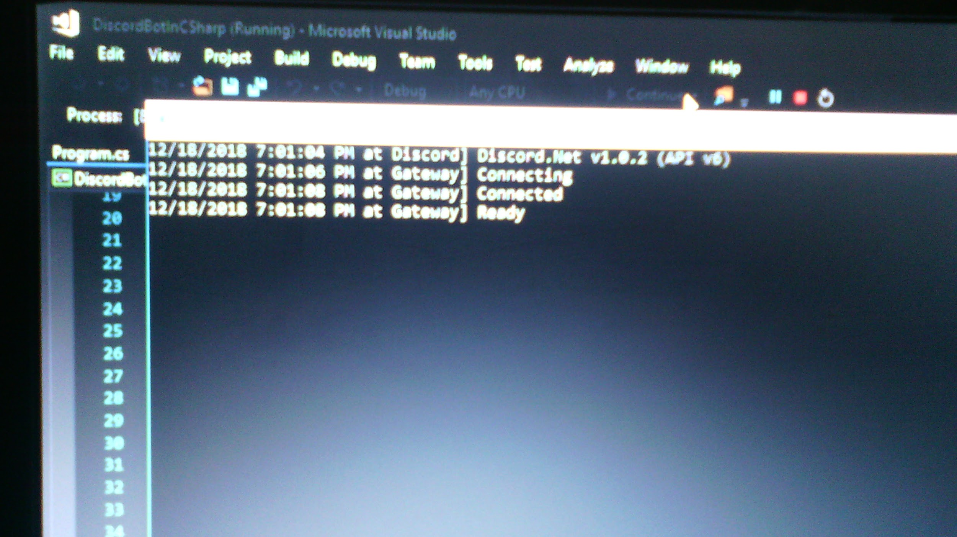
Bringing the bot online

Slide 8
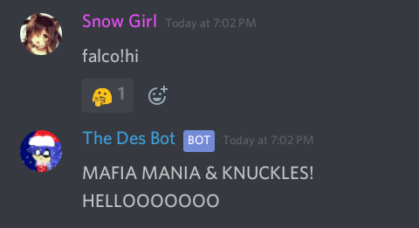
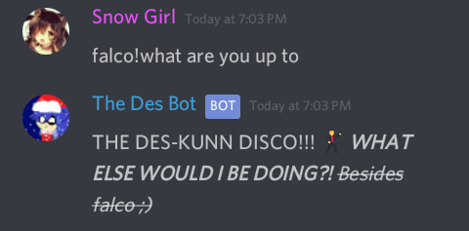
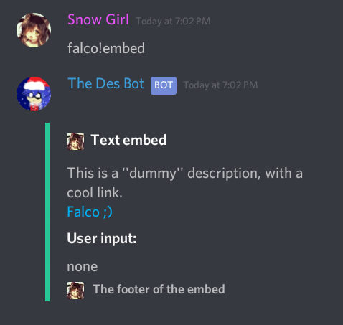
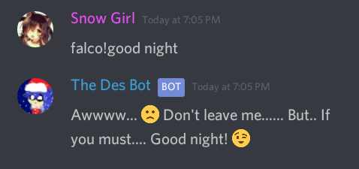
Bot Commands

Slide 9
THANK YOU!

