Slide 1
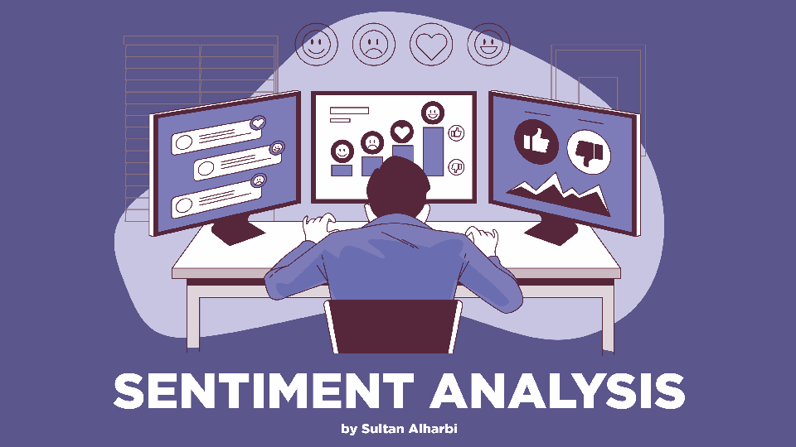

Slide 2

WHAT WE WILL DISSCUSS TODAY:
WHAT IS SENTIMENT ANALYSIS.
SENTIMENT ANALYSIS APPROACHES.
HOW IT WORKS.
SENTIMENT ANALYSIS APPLICATIONS.
CHALLENGES OF SENTIMENT ANALYSIS.
CODE EXAMPLE FOR SENTIMENT ANALYSIS.
REFERENCES USED.

Slide 3

WHAT IS SENTIMENT ANALYSIS ?
Sentiment analysis is a process that uses
NLP , Statistics , Text analysis in order to identify the emotional tone behind a body of text , thus it can classify the emotion behind the text if it was a positive , neutral , negative or it can goes beyond that .
SENTIMENT ANALYSIS APPROACHES:
There are two main approaches for sentiment analysis:
1- Rule-based sentiment analysis.
2- Automated sentiment analysis.

Slide 4

RULE-BASED APPROACH :
Rule-based approaches consist of creating grammatical and logical rules to assign emotions and use lexicons to assign emotions or polarities to words , and each word must have a weight that defines if it was a positive , neutral or negative word .
AN EXAMPLE OF A LEXICON :
WORD | POLARITY | WEIGHT
GREAT | POSITIVE | +2
AWFUL | NEGATIVE | -3
CAR | NEUTRAL | 0

Slide 5
RULE-BASED APPROACH :
EXAMPLE:
IT WAS A GREAT MOVIE .
WORD | POLARITY | WIEGHT
IT | NEUTRAL | 0
WAS | NEUTRAL | 0
A | NEUTRAL | 0
GREAT | POSITIVE | 3
MOVIE | NEUTRAL | 0
0 + 0 + 0 + 3 + 0 = 3 , So it’s a positive text .
WHOLE TEXT WIEGHT > 0 , POSITIVE
WHOLE TEXT WIEGHT < 0 , NEGATIVE
WHOLE TEXT WIEGHT = 0 , NETRAUL

Slide 6

MACHINE LEARNING APPROACH:
In the Machine Learning approach, a ML algorithm is trained to classify sentiment based on both the words and their order.
In Rule-Based SA they don’t consider the sentence as a whole , and most of the time human sentiments are based on the context of the sentence , fortunately the ML approach can solve this problem , but it depends on the training data set and its quality .
ML APPROACH STEPS:
1- Feature extraction .
2- Choosing the model .
3- Training and prediction .

Slide 7

MACHINE LEARNING APPROACH:
Feature Extraction :
It is where we transform the text into numeric vector to be ready for reading by a computer.
And we do that using a process called Vectorization , There are more than one method for vectorization such as Word2Vec , Bag of words ..etc.
Choosing the model:
The most popular algorithms for Sentiment analysis classification :
1- Logistic regression.
2- Linear regression.
3- Naïve bayes.

Slide 8

SENTIMENT ANALYSIS APPLICATIONS :
1- Business Intelligence:
The most common application of SA is in this area , it is used to see the feedback of a product , how sucessful the marketing campaign was , monotoring the reputation of a brand..etc.
2- Election campaigns :
SA can provide substanial value for candidates running for various postions , they can track how voters feel about different issues .
3- Fainancial markets :
There are a huge number of news, articles, blogs and tweets about each public company in the market, and applying SN on thoes articles and combine them to get a single score that can be used for automated trading systems.

Slide 9

CHALLENGES OF SENTIMENT ANALYSIS:
1- Subjectivity :
Texts can be subjective or objective , usually machines struggles with subjectivity , for example “the laptop is great , but no way that justifies the massive price-tag” , the first part of the sentence is positive , but it negated by the second part , thus the overall sentiment of the text is negative.
THE SOLUTION :
Using a large data set with a lots of examples of subjectivity can
help the algorithm to classify the sentiment correctly .

Slide 10
CHALLENGES OF SENTIMENT ANALYSIS:
2- Understanding the context of a text :
Some people uses scarcasm to express their negative sentiment , but the used words can be positive , in example “I’m so glad that your product is working. “ , this sentence can be classified as positve while it’s implying that usually the products are not working.
THE SOLUTION :
The solution to this problem is to preprocess and postprocess the data
To capture the right context.

Slide 11
CHALLENGES OF SENTIMENT ANALYSIS:
3- Speaking about competitors :
Let’s say that we have to competitors , Pizza Hut and Dominos and somone replied on Pizza hut tweet and said “I like Dominos pizza , they have a good service “ , a general model would classify this as a positve sentiment but If our model is working for Pizza hut and somone says that our compititor is good, then that might be a negative sentiment from our prespective.
THE SOLUTION:
The solution is to simply train a custom model for the compititors .

Slide 12

CODE EXAMPLE:
We have used IMDb data set , the data set contains 50,000 rows and 2 columns.
Each row represent a review , and each row has two columns ( Review , Sentiment).
In the code we did a preprocessing on the data .
Applied the vectorization on the data so we can use it on our models .
The used model are Logisitc Regression , RF classifier and Decision tree classifier.
We evaluate the models we used to see which one preformed better
If you were intrested to see the whole code you can check my GitHub repo .

Slide 13
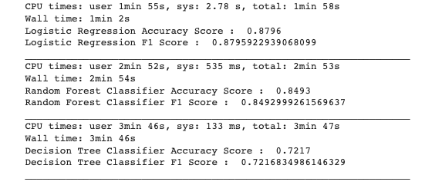
CODE EXAMPLE:
We can notice that the logisitc regression model is the best model in terms of Acuracy score , F1 score and total time.
Decision tree classifier is the worst between the three models in terms of Acuracy score , F1 score and total time.

Slide 14

ANY QUESTIONS ?

Slide 15
REFERENCES:
Techniques and applications for sentiment analysis by Ronen Feldman .
AI Multiple SA challenges and solutions by Begüm Yılmaz .
Thematic comprehensive SA begginers guide .
TechTarget Sentiment analysis .
Lucidya use cases .
This one for the illustrations that I have used in the slides.

Slide 16
I HOPE YOU LEARNED SOMETHING NEW
THANK YOU FOR YOUR TIME
SULTAN ALHARBI

