Slide 2

Scope
Combed
Domestic
Carded
40s’ China
Combed
FOB
Carded
Cotton Yarn
Domestic
Combed
30s’ India
FOB
Combed
TFT model
LSTM Variants, GRU models

Slide 3

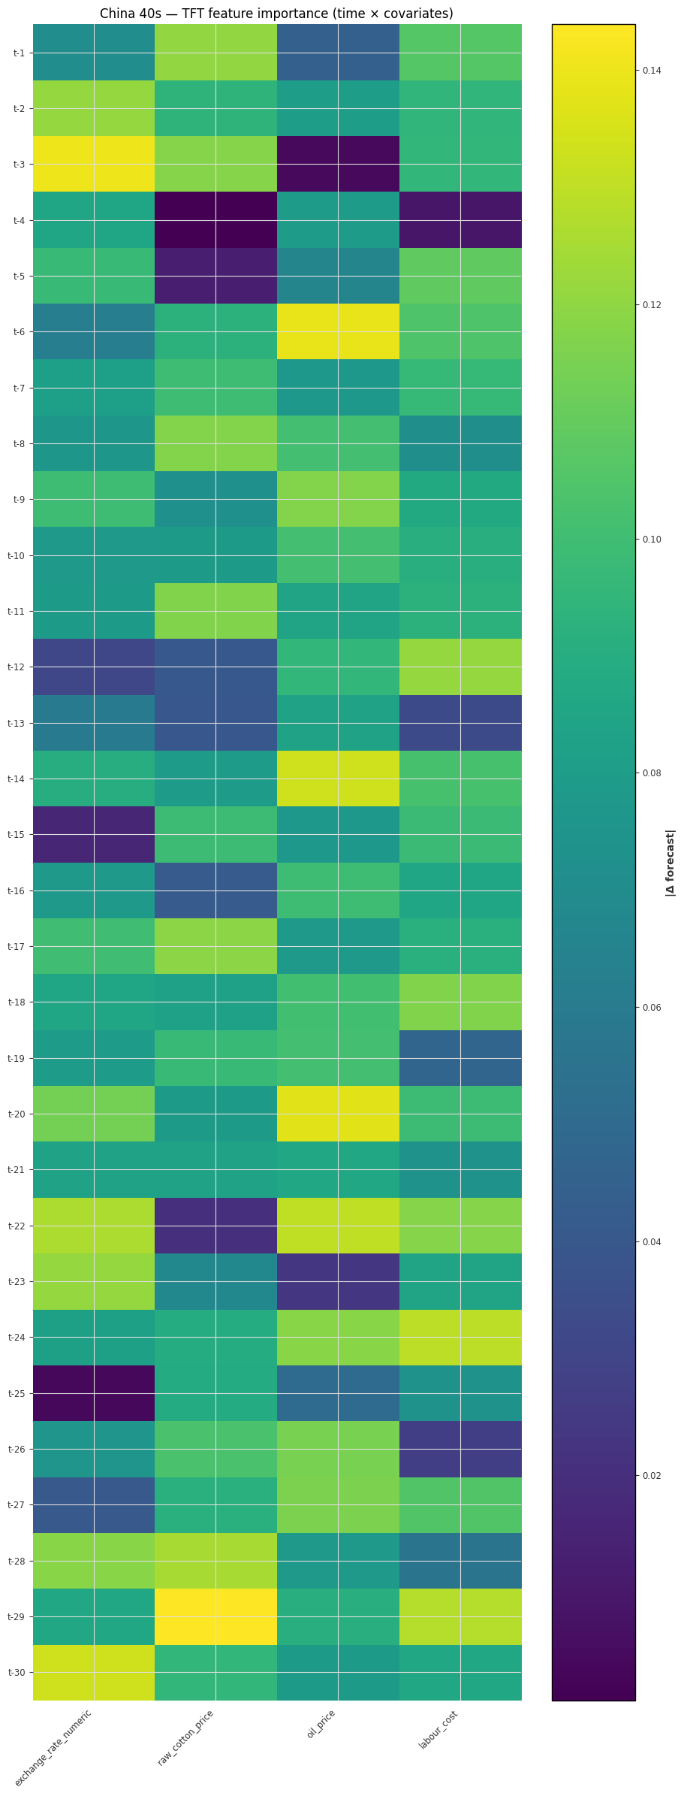
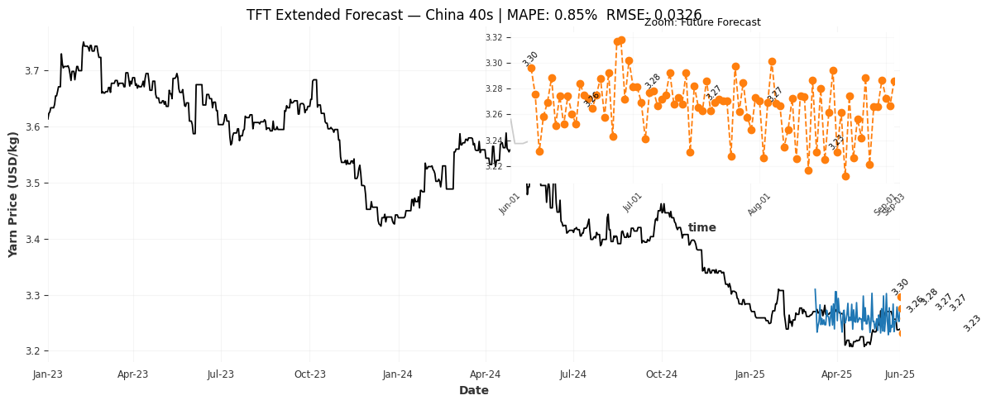
Results
Accuracy
99.15 %
TFT Model – China 40s
Raw cotton price and oil price consistently appear among the most influential drivers.
Exchange rates and labor costs have a more moderate influence.
Exchange Rate
Raw Cotton
Oil Price
Labor Cost

Slide 4
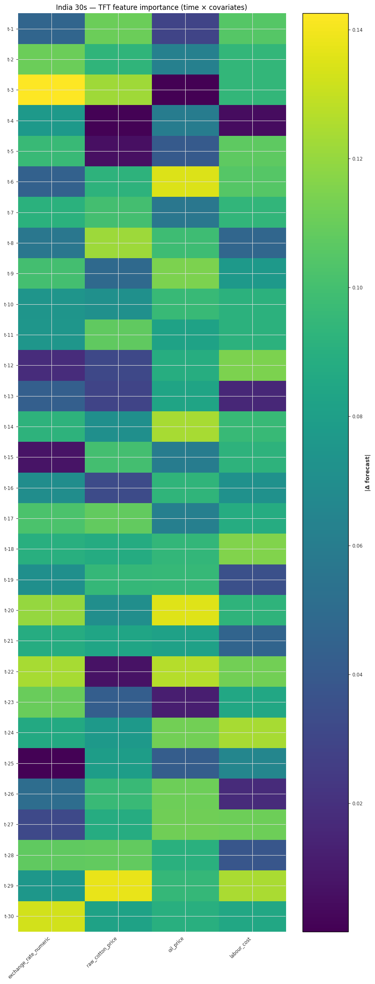
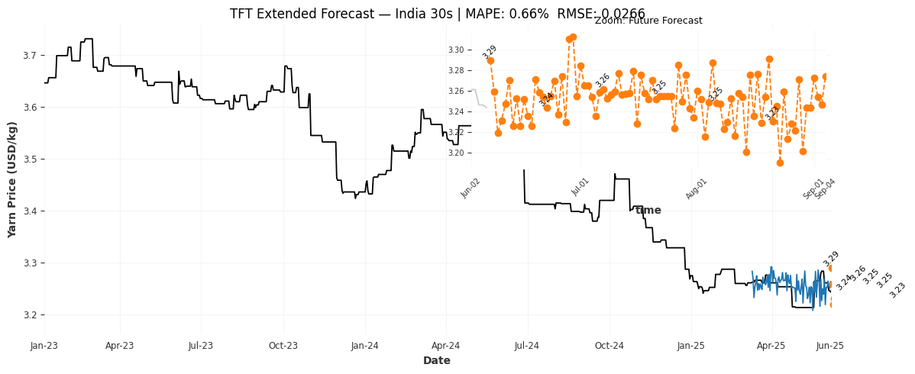
Results
Accuracy
99.34 %
TFT Model – India 30s
Oil price and Labor cost consistently appear among the most influential drivers
Exchange rates and Raw Cotton Prices have a more moderate influence
Exchange Rate
Raw Cotton
Oil Price
Labor Cost

Slide 5
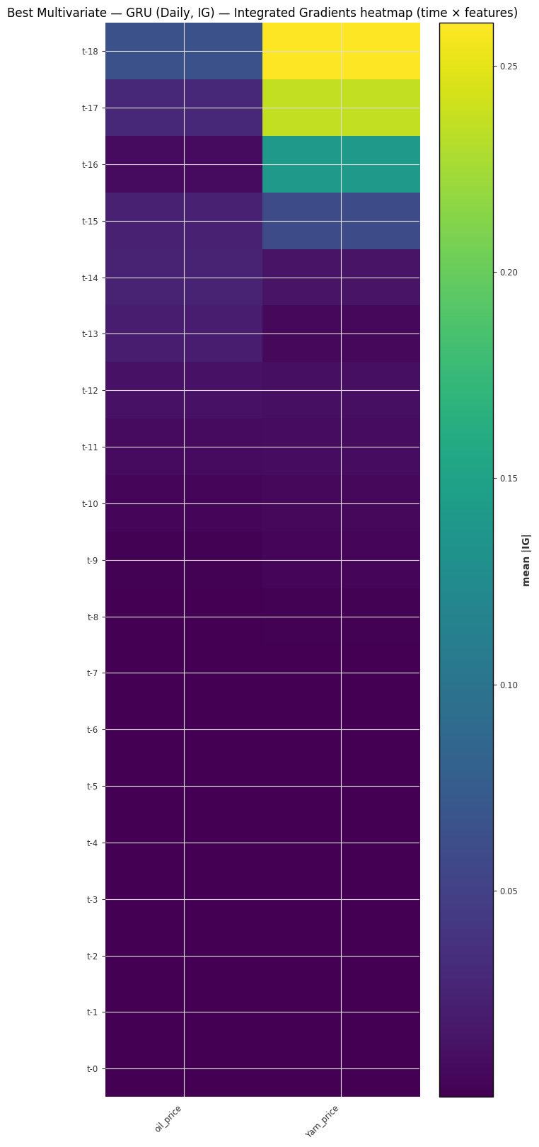
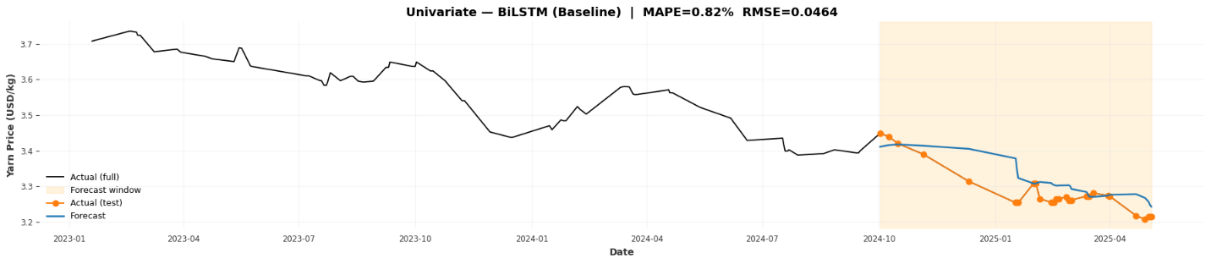
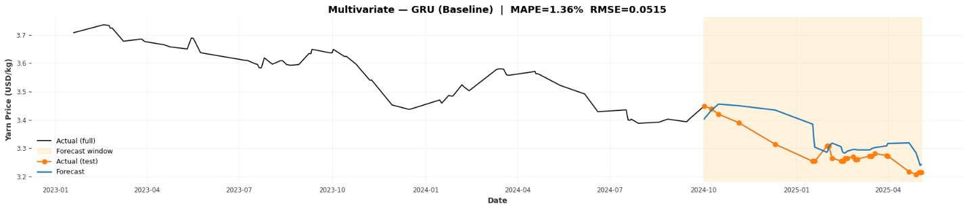
Results
Accuracy
99.18 %
Domestic China 40/1 Combed
Accuracy
98.64 %
Oil Price
Yarn
Price

Slide 6
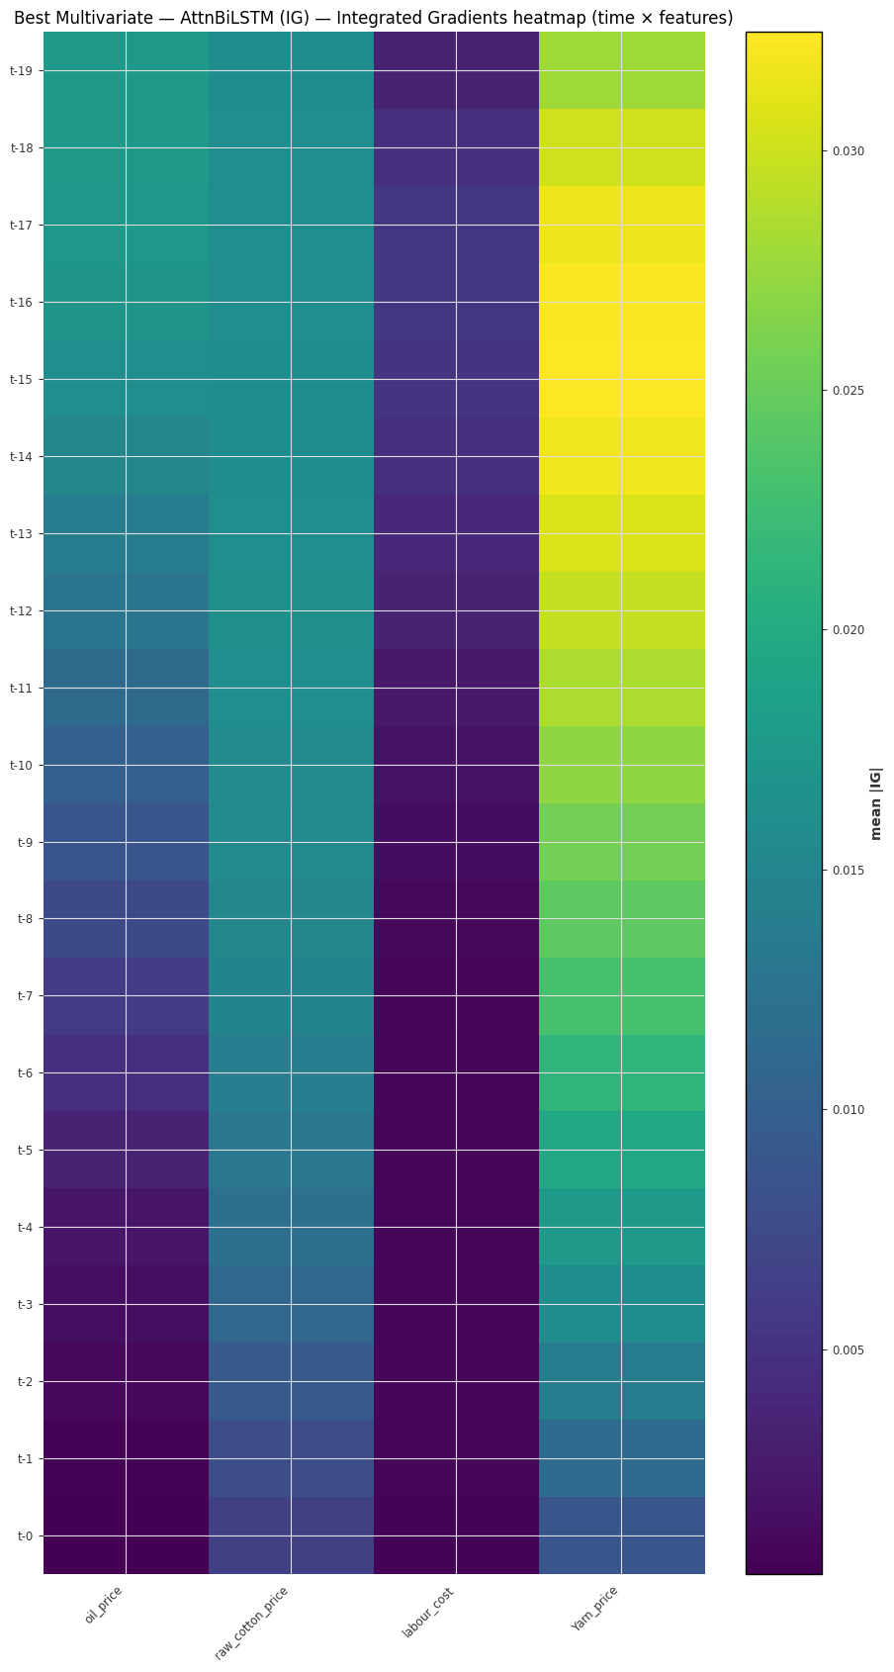
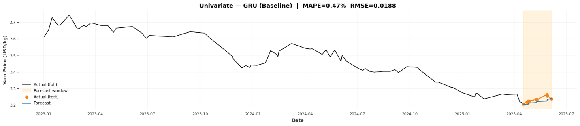
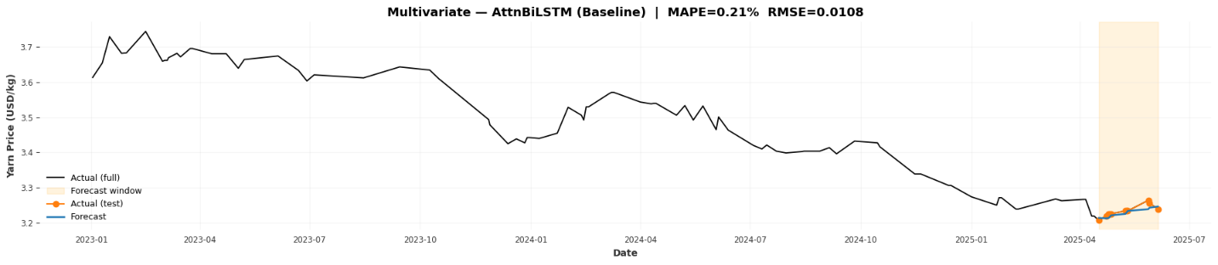
Results
Accuracy
99.53 %
FOB China 40/1 Carded
Accuracy
99.79 %
Oil Price
Raw Corron
Labor
Cost
Yarn
Price

Slide 7
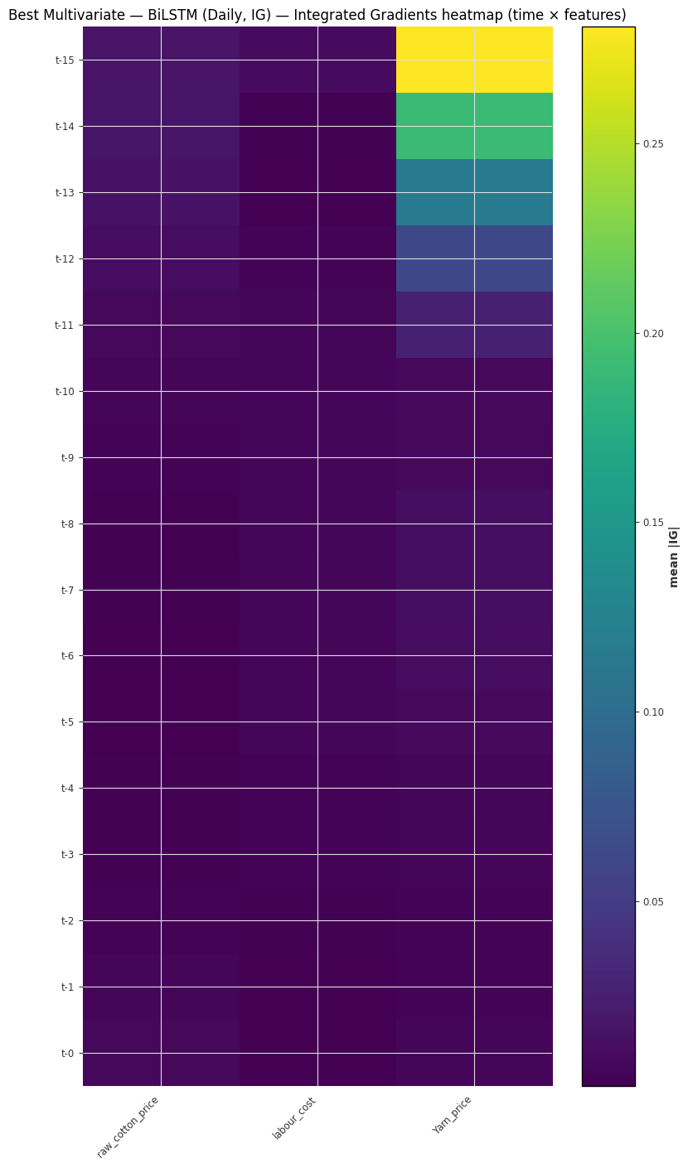
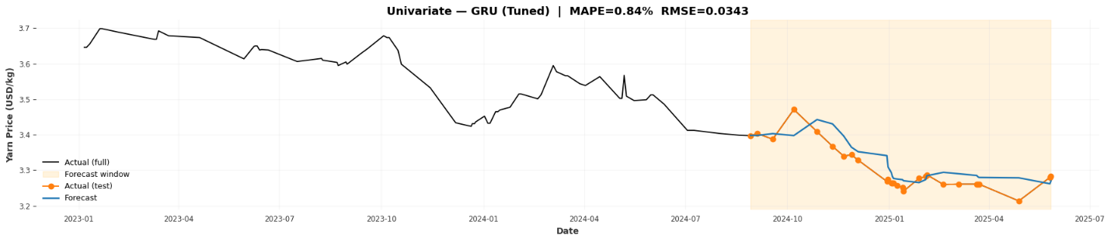
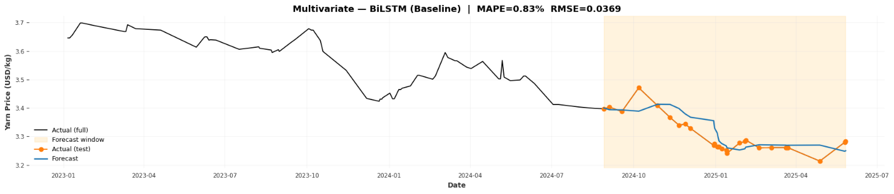
Results
Accuracy
99.16 %
FOB North India 30/1 Combed
Accuracy
99.17 %
Raw Corron
Labor
Cost
Yarn
Price

Slide 8
Results
Market | Yarn Count | Univariate Model | MAPE-Based Accuracy | Multivariate Model | Variables | MAPE-Based Accuracy | Best Model
Domestic China | 40/1 Carded | GRU | 99.10% | GRU | exchange_rate_numeric | 99.35% | Multivariate
Domestic China | 40/1 Combed | BiLSTM | 99.18% | GRU | oil_price | 98.64% | Univariate
Domestic China | 40/2 Carded | GRU | 99.48% | GRU | exchange_rate_numeric | 99.26% | Univariate
FOB China | 40/1 Carded | GRU | 98.68% | GRU | raw_cotton_price | 98.75% | Multivariate
FOB China | 40/1 Combed | BiLSTM | 99.32% | GRU | exchange_rate_numeric | 98.72% | Univariate
FOB China | 40/2 Carded | GRU | 99.53% | AttnBiLSTM | oil_price, raw_cotton_price, labour_cost | 99.79% | Multivariate
FOB North India | 30/1 Combed | GRU | 99.16% | BiLSTM | raw_cotton_price, labour_cost | 99.17% | Multivariate
Domestic North India | 30/1 Combed | GRU | 99.09% | GRU | raw_cotton_price | 98.96% | Univariate
Summary

