Slide 1

Love Recommender
Never worry I’ll find someone like you ohhhhhh.. I wish nothing but a nice partner for you ohhhhhhh…

Slide 2

PROJECT GOAL
Analyzing the descriptions of people available on okcupid website’s dataset and finding out how they like to describe themselves most commonly.
Creating a Recommendation system that asks a user to enter their description and find the most similar descriptions available on the dataset.

Slide 3
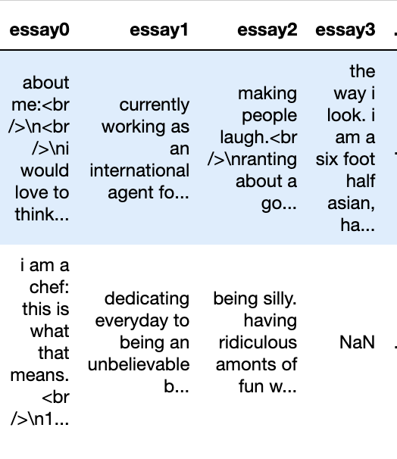
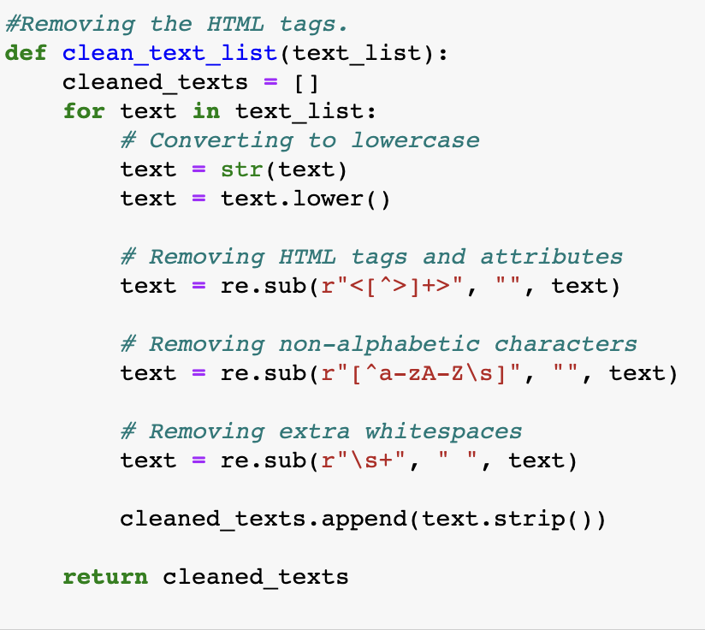
DATA CLEANING
The main part of data cleaning was removing the html tags from the available descriptions in the dataset.
After obtaining the cleaned descriptions, I saved just the descriptions in a .txt file since I was concerned only with text analysis.

Slide 4
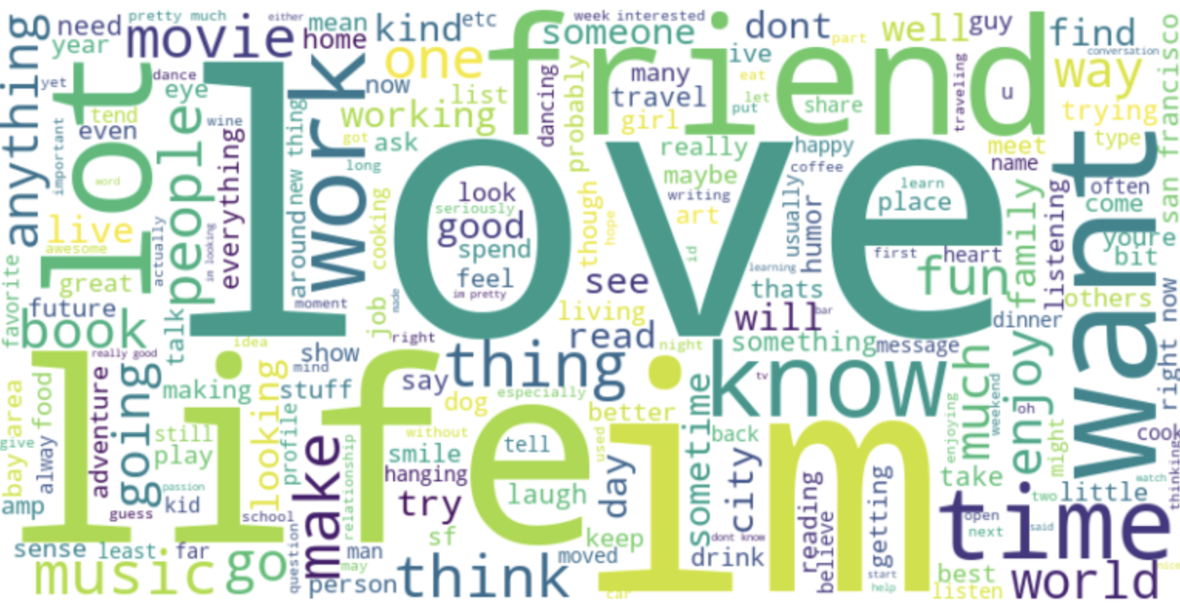
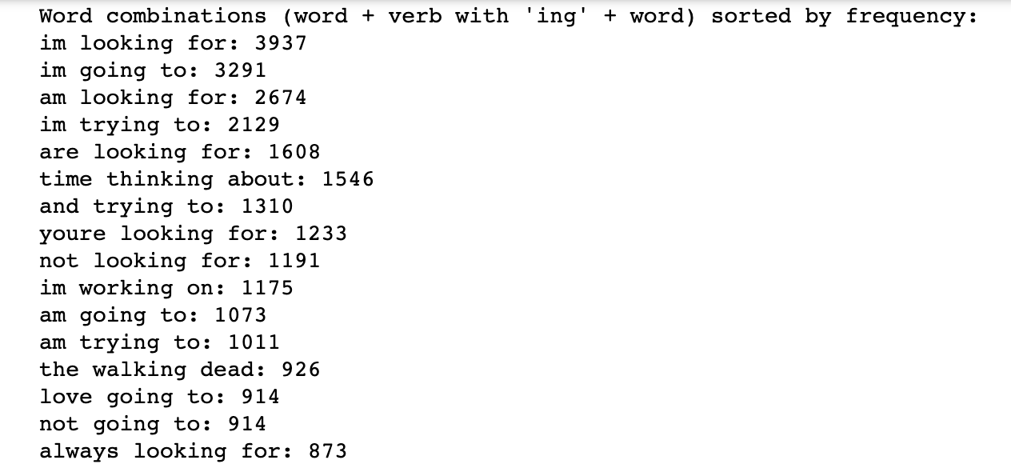
INITIAL ANALYSIS
Firstly, I separated all the descriptions into single words and analyzed the most common words using wordcloud. The most commonly used words were not insightful as they contained lots of common articles.
Secondly, I tried to filter the words by common present-tense action verbs, having a word+ing-verb+ word as a unit and examine the most common form of them. The result were still typical and uninsightful.
Finally, I decided to import and use natural language processing library to gain more insightful data as the library would filter our common articles and extract common but useful data.

Slide 5
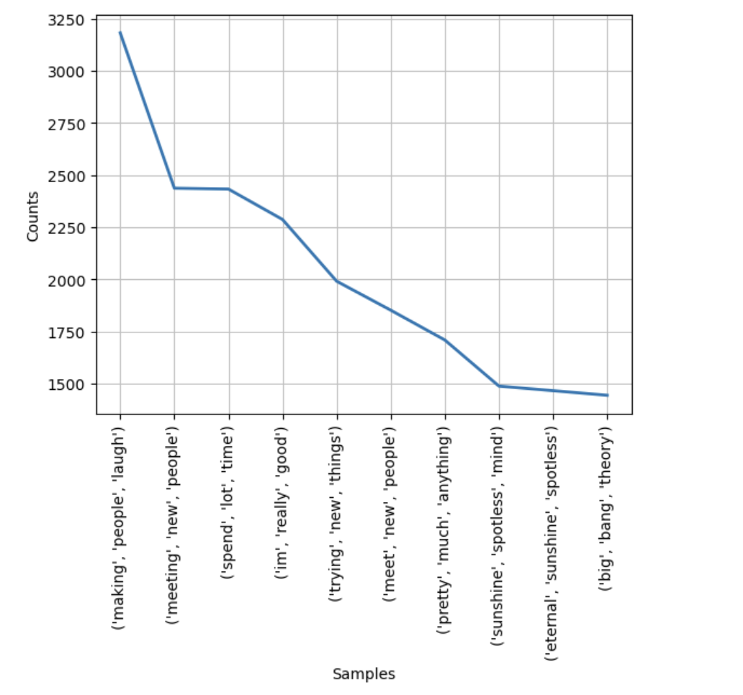
NLTK NGRAMS ANALYSIS
After Importing the nltk library, I use its ngrams feature to properly analyze the descriptions. This method is superior to manual analysis as before since the library filters out commonly used articles to produce contiguous sequence of insightful words.
After performing ngrams test with n=1,2,3,4&5, I found the words with n=3 to be most insightful.
We find that people describe themselves as who like to meet new people, make people laugh, try new things whereas the most common movies and TV shows they like are eternal sunshine of the spotless mind and big bang theory.

Slide 6

Recommendation SYSTEM
For the recommendation system I use the user input i.e. their own description and use TF-IDF vectorizing technique and cosine similarity to compare user’s description to descriptions in the dataset and present the top 5 most common descriptions.
The method works as long there are some common unique words in user’s description and descriptions in the dataset, but further neural network and deep learning analysis would be necessary to refine the recommendations and provide more contextual recommendations.

