Slide 1
What is Prolog?
A logic programming language
“Prolog” stands for “Programming in Logic” (or “Programmation en Logique” in French)
Designed in 1972 by Alain Colmerauer and Robert Kowalski (much later than Lisp)
Used in AI programming, expert systems, and computational linguistics
Functional programming (ala Lisp) is possible, but very cumbersome
A logic program is a finite set of program clauses.
Programs clauses are:
Facts.
Rules.

Slide 2
Prolog Resources
SWI-Prolog
http://www.swi-prolog.org/
Visual Prolog: http://www.visual-prolog.com/
GNU Prolog: http://gnu-prolog.inria.fr/
InterProlog (Java): http://www.declarativa.com/interprolog/
[Linux] Install SWI-Prolog through the package manager:
Open a terminal (Ctrl+Alt+T) and type:
sudo apt-get install swi-prolog
P# (.NET)
http://www.dcs.ed.ac.uk/home/jjc/psharp/psharp-1.1.4/dlpsharp.html

Slide 3
Prolog Resources
Quick start (Linux):
Write a prolog program as a text file with a .pl ending. For example, program.pl.
Open a terminal (Ctrl+Alt+T) and navigate to the directory where you stored your program.
Open SWI-Prolog by invoking swipl.
In SWI-Prolog, type [program] to load the program, i.e. the file name in brackets, but without the ending.
In order to query the loaded program, type goals and watch the output.
Alternatively, you can also load the program by passing its name as a parameter to SWI-Prolog: swipl -s program.pl.
To exit SWI-Prolog, type halt..

Slide 4
Editor: Notepad or Notepad++
Compiler: SWI-Prolog
File Extension: “filename.pl”
Predicate or rules are terminated by “.”
In SWI-Prolog
To load a file in Windows:
consult('c:/Users/balkr/Documents/Prolog/example2.pl').
“ ; “ will give you next solution.

Slide 5
Syntax
Constants
Names: which always begin with a lowercase letter.
likes mary parent predecessor sita gokul pathof
Numbers:
0 -23 3.4585 14092
Variables
Always begin with either an capital letter or an underline character.
X Answer _ _Input

Slide 6
Prolog’s computation
Depth First Search: Pursues a goal till the end
Conditional AND; falsity of any goal prevents satisfaction of further clauses.
Conditional OR; satisfaction of any goal prevents further clauses being evaluated.
Control flow:
Given
g:- a, b, c. (1)
g:- d, e, f; g. (2)
If prolog cannot satisfy (1), control will automatically fall through to (2).
Taking g:- a, b, c.
If a succeeds, prolog will try to satisfy b, succeeding which c will be tried.
For ANDed clauses, control flows forward till the ‘.’, iff the current clause is true.
For ORed clauses, control flows forward till the ‘.’, iff the current clause evaluates to false.

Slide 7
Rules - Logical AND , OR
Rules - Logical AND
dances(Ram) :- happy(Ram), listensToMusic(Ram).
, is used to indicate Logical AND
Equivalent to:
happy(Ram) ∧ listensToMusic(Ram) => dances(Ram)
“Ram dances if he listens to music and he is happy”.
Other example:
father(X,Y) :- parent(X,Y) , male(X).
Rules - Logical OR
dances(Ram) :- happy(Ram);listensToMusic(Ram).
; is used to indicate Logical OR

Slide 8
Program Clauses
A :- B1, … , Bn.
Body
Head
End of clause marker
Rule
The head and the body are nonempty.
The body is the conditional part.
The head is the conclusion.
Fact
The body is empty, and is written as:
A.
“ if ”

Slide 9
Prolog Programming Model
A program is a database of (Horn) clauses that are assumed to be true.
The clauses in a Prolog database are either facts or rules. Each ends with a period.
A fact is a clause without a right-hand side.
rainy(asheville).
A rule has a right-hand side.
snowy(X) :- rainy(X), cold(X).
The token :- is the implication symbol.
The comma (,) indicates “and”.
A query or goal is a clause with an empty left-hand side.
Queries are given to the prolog interpreter to initiate execution of a program.

Slide 10
Facts, rules, and queries
Fact: Hari is a man.
man(hari).
Rule: All men are mortal.
mortal(X) :- man(X).
Query: Is Hari mortal?
mortal(hari).
Queries have the same form as facts.

Slide 11
Interpretations
A :- B₁, … , B_{n}.
Logic
∀X₁,..X_{m} ((B₁∧ … ∧ B_{n}) ⇒ A)
Procedural
To execute A, first execute B₁, then execute B₂,...
Process
A, B₁, … , B_{n} are considered processes.
Shared variables are communication channels

Slide 12
Example 1:A simple Knowledge Base
Facts
Rules has head and body i.e.head := body
e.g. person ( X) => mortal (X)
male(sham).
female(sita).
male(hari).
mortal(X) :- person(X).
person(X) :- female(X).
person(X) :- male(X).
Find Answer:
male(X).
female(X).
mortal(X).
Person(X).

Slide 13
Example 2: A simple Knowledge Base
Find Answer:
orbits(mercury, sun).
planet(P).
satellite(S).
orbits(moon, earth).
orbits(X, mars).
orbits(moon, X).
orbits(X, Y).
Knowledge Base:
orbits(mercury, sun).
orbits(venus, sun).
orbits(earth, sun).
orbits(mars, sun).
orbits(moon, earth).
orbits(phobos, mars).
orbits(deimos, mars).
planet(P) :- orbits(P, sun).
satellite(S) :- orbits(S,P), planet(P).

Slide 14
Example 3: A simple Knowledge Base
Find Answer:
?- pair(X, john, coke).
?- pair(mary, susan, gin).
?- pair(john, mary, gin).
?- pair(john, john, gin).
?- pair(X, Y, gin).
?- pair(bertram, lucinda).
?- pair(bertram, lucinda, vodka).
?- pair(X, Y, Z).
Knowledge Base:
drinks(john, coke).
drinks(ram, coke).
drinks(mary, gin).
drinks(susan, vodka).
drinks(sita, vodka).
drinks(john, gin).
drinks(hari, gin).
pair(X, Y, Z) :- drinks(X, Z), drinks(Y, Z).
pair(X, Y, Z) :- drinks(X, Z), drinks(Y, Z), X \= Y.
This definition forces X and Y to be distinct:
pair(X, Y, Z) :- drinks(X, Z), drinks(Y, Z), X \= Y.

Slide 15
Example 4: Family Tree
Knowledge Base:
male(shyam).
male(ganesh).
male(gopal).
male(ramesh).
male(om).
female(rita).
female(sita).
female(raksha).
father(shyam,ganesh).
father(gopal,sima).
father(gopal,om).
father(shyam,gopal).
father(ganesh,raksha).
father(ramesh,rina).
mother(sita,rina).
mother(sita,rina).
mother(rita,ganesh).
mother(rita,gopal).
mother(rina,sima).
mother(rina,om).
husband(shyam,rita).
husband(ramesh,sita).
husband(gopal,rina).
parent(X,Y) :- father(X,Y).
parent(X,Y) :- mother(X,Y).
grandparent(X,Z) :- parent(X,Y),parent(Y,Z).
ancestor(X,Z) :- parent(X,Y),parent(Y,Z).

Slide 16
Example 4: Family Tree
Depending upon the figure above, define the relation and answer the following question.
Define the relation cousin and show the result.
Define the relation sibling and show the result.
Who is the ancestor of sima?
Find the sibling of gopal.
Who is the descendent of rina?
Define the relation uncle and show the result.
Define the relation mother-in- law and show the result.

Slide 17
Example 4: Family Tree
grandparent(X,Z) :- parent(X,Y), parent(Y,Z).
ancestor(X,Z) :- parent(X,Z).
ancestor(X,Z) :- parent(X,Y), ancestor(Y,Z).
sibling(X,Y) :- mother(M,X), mother(M,Y), father(F,X), father(F,Y), X\=Y.
cousin(X,Y) :- parent(U,X), parent(V,Y), sibling(U,V).

Slide 18
Arithmetic
Operators
X + Y, -X, X-Y, X*Y, X/Y, …
=:= means equal to
=\= means Not equal to
Functions
abs(X), max(X, Y), sin(X), …
Relations
X < Y, X > Y, X =< Y, X =:= Y, X =\= Y, ..
is “Evaluates arithmetic expression”
?- X is 2*3 + 4.
X = 10

Slide 19
Example5: To find maximum number
maxnumber(A,B,Ax) :- Ax is A, A > B.
maxnumber(A,B,Ax) :- Ax is B, A < B.
addnum(X,Y,S):- S is (X+Y).
multnum(X,Y,P):- P is (X*Y).
subnum(X,Y,Z):- Z is X-Y.
maxThreeNumber(A,B,C,Ax) :- Ax is A, A > B, A > C.
maxThreeNumber(A,B,C,Ax) :- Ax is B, A < B, B > C.
maxThreeNumber(A,B,C,Ax) :- Ax is C, A < C, B < C.
add_3_and_double(X,Y) :- Y is (X+3)*2.
plus(A,B,C):- C is A+B.

Slide 20
Example-6: Factorial
factorial(0,1).
factorial(A,B) :-
A > 0,
Ax is A - 1,
factorial(Ax,Bx),
B is A * Bx.
To Find
?- Factorial (3, F).
F = 6
The Factorial of 0 is 1.
Factorial(0,1).
If N > 0, and N1 is N – 1, and the Factorial of N1 is F1, and F is N*F1, then the Sum of N is F.
Factorial(N, F) :- N > 0, N1 is N-1,
Factorial(N1, F1), F is N*F1.

Slide 21
Examples
Example 7: Find G.C.D. of two given numbers.
Example 8: Find the Fibonacci Series up to N term.
Example 9: Find the sum of up to n Natural numbers.
Example 10: Implement the Tower of Hanoi problem.
Example 11: Read two numbers from keyboard and Display the sum.

Slide 22
Examples
To find n^{th} Fibonnaci number
fib(1,1).
fib(2,1).
fib(N,R):- N >= 3,N1 is N-1,N2 is N-2,
fib(N1,R1),fib(N2,R2),R is R1+R2.
To find GCD of given numbers
gcd( X, X, X).
gcd( X, Y, D) :- X<Y, Y1 is Y-X, gcd( X, Y1, D).
gcd( X, Y, D) :- Y<X, gcd( Y, X, D).
Sum of N natural numbers
Sum(0, F) :- F is 0.
Sum(N, F) :- N > 0,
N1 is N-1,
Sum(N1, F1),
F is N + F1.

Slide 23
Examples
Example: to add two numbers.
start:- sum , nl.
sum:- write('X= '),read(X),
write('Y= '),read(Y),
S is X+Y,
write('Sum is '),write(S).
?- start.
X= |: 1.
Y= |: 2.
Sum is 3
yes
Example: TOH
move(1,X,Y,_) :-
write('Move top disk from '),
write(X),
write(' to '),
write(Y),
nl.
move(N,X,Y,Z) :-
N>1,
M is N-1,
move(M,X,Z,Y),
move(1,X,Y,_),
move(M,Z,Y,X).

Slide 24
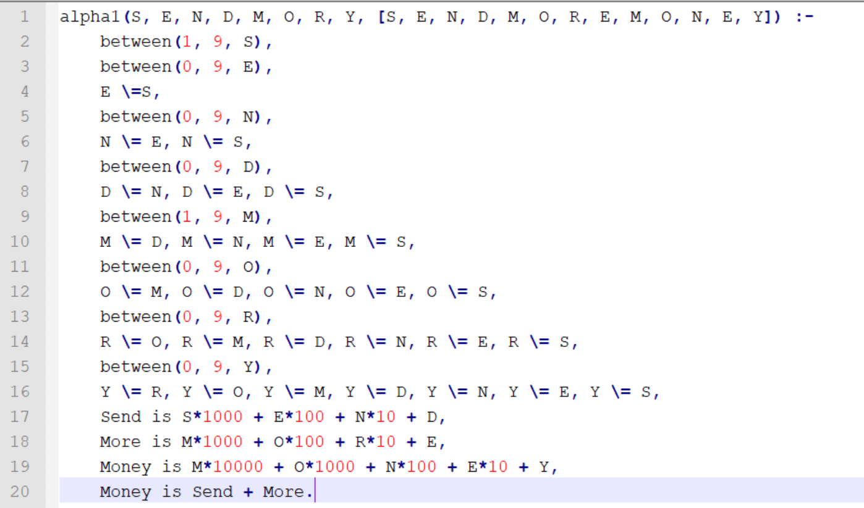

Crypto-Arithmetic problem

