Slide 1
FINETICA powered by DOCULUS AI

Slide 2
DOCUMENT PROCESSING
Build an intelligent document processing system that handles the full lifecycle of invoice management. The tool should enable direct invoice upload or email forwarding, automatically parse invoice data, route it for approval based on SOPs and rulebooks, apply accounting dimensions, integrate with Pantheon ERP, and mark invoices as closed once payment is completed.

Slide 3
INVOICE INGESTION
Direct upload
Email redirection, capturing PDF, XML, or image attachments
Automatically detect and parse:
Supplier name, invoice number, date, amount, currency
Line items, tax rates, PO numbers, payment terms
Validate invoice format and content against standard compliance checks

Slide 4
INTELLIGENT ROUTING & APPROVAL WORKFLOW
Route parsed invoices to the correct person or department based on:
A predefined rulebook (e.g., cost center, vendor, amount thresholds)
A set Standard Operating Procedure (SOP) for approvals
Enable:
Automated approvals based on predefined criteria
Manual approvals via notification to relevant stakeholders
Track all actions in an audit log for accountability

Slide 5
DIMENSION TAGGING & ENRICHMENT
Assign appropriate accounting dimensions (e.g., project, cost center, cost category, worker) :
Manually, if required
AI-powered, based on historical tagging behavior
Rule-based, using fixed logic per vendor/type/category
Ensure all invoices are enriched with complete and correct metadata before it is forwarded to finance for booking and payment

Slide 6
ERP INTEGRATION (PANTHEON)
Sync with Pantheon ERP to:
Recognize booking numbers and financial entry status
Match invoices to ERP data
Add payment information once processed

Slide 7
PAYMENT STATUS & INVOICE CLOSURE
Once payment is completed (automatically or manually recorded):
Update the invoice record with payment details
Mark invoice as closed in the system
Trigger final notification and archive the document

Slide 8
FINAL OUTPUT
Seamless invoice import from uploads or emails
Accurate invoice parsing and data extraction
Smart approval workflows based on rules and SOP
AI-enhanced dimension tagging or manual entry
Real-time Pantheon ERP integration
Automatic status updates and invoice closure

Slide 9
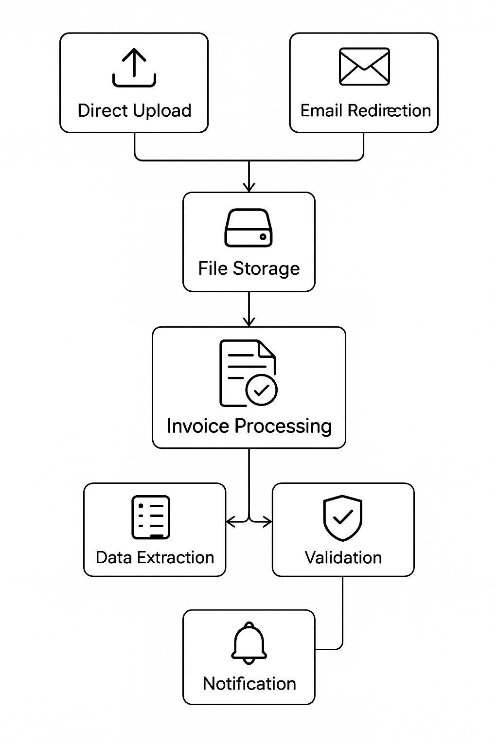

Slide 10
CACH FLOW / BANK
Develop a tool that automates the import and categorization of financial transactions from bank statements, accurately builds real-time cash flow reports, and generates forward-looking forecasts based on historical spending behavior. The tool should support comparative analysis, insights, and customizable configuration for scaling financial control.

Slide 11
DATA IMPORT & PARSING
Import bank statements (multi-format support: CSV, Excel, PDF, API-based feeds) across all our companies
Automatically parse incoming and outgoing payments based on:
Predefined values (e.g., keywords, vendor names, IBANs)
Historical tagging rules
Group and label recurring vs. one-time transactions
Prebuil AI logic

Slide 12
COST RECOGNITION & CLASSIFICATION
Recognize and classify costs based on:
Predefined cost categories (e.g., salaries, rent, maintenance, administration)
Custom parameters like vendor, account, dimensions or GL code
Assign cost centers or business units for granular reporting
Flag unrecognized or new transactions for manual review and training

Slide 13
REAL-TIME CASH FLOW CONSTRUCTION
Dynamically build the cash flow view, including:
Opening balance
Inflows and outflows per day/week/month
Closing cash position
Support multiple bank accounts and currencies
Enable consolidated views

Slide 14
CASH FLOW REPORTS & FORECASTING
Automatically generate:
Cash flow statements and charts
Monthly or weekly cash position summaries
Visual comparisons of actual vs. forecasted flows
Forecast future cash flow based on:
Historical patterns
Seasonality and vendor cycles
Committed spend and recurring revenue
Allow user-defined forecasting rules and manual adjustments

Slide 15
INSIGHTS, ALERTS & COMPARISON
Highlight:
Unusual transactions or cost spikes
Gaps in predicted vs. actual cash flow
Periods of low liquidity or overexposure
Compare:
Forecast vs. actuals across months, accounts, or categories
Current month vs. historical average

Slide 16
FINAL OUTPUT
A tool that automatically parses bank statements across all our companies and locations
Accurate transaction classification and cost recognition
Dynamic cash flow dashboards and visualizations
Forward-looking cash flow forecasts
Cash Flow reports
Customizable engine for rules, categories, and alerts

Slide 17
AUTOMATED INVOICING & PAYMENT RECONCILIATION
Develop a system that automates the invoicing process, integrates contractual data (SOWs/MSAs/PSAs), track Accounts Receivables and ensures full alignment with Pantheon ERP. The system must follow an embedded SOP, handle exceptions, and facilitate consistent communication with clients and internal stakeholders.

Slide 18
DATA EXTRACTION & INTEGRATION 🡪 CONTRACTUAL DATA PARSING
Automatically extract:
Payment options from PSAs, MSAs, and SOWs
Billing rates, budgets, and financial terms from SOWs
Detect and flag inconsistencies or missing data
Enable manual entry for mandatory fields that cannot be extracted
Notes:
MSA: master service agreement (across projects)
PSA: project service agreement
SOW: statement of work

Slide 19
DATA EXTRACTION & INTEGRATION 🡪 DATA MERGING
Merge extracted data with:
First invoice template (to standardize formatting)
Historical invoice exports (manual or from CoreTool)
Map and reconcile any irregularities in billing structures, amounts, or terms

Slide 20
DATA EXTRACTION & INTEGRATION 🡪 ROLE & EXCEPTION SETUP
Define internal and client-side invoice recipients
Set up exception rules, such as:
Custom approval flows
Client-specific payment terms
Rate overrides

Slide 21
INVOICE GENERATION
Generate invoices by:
Combining data from CoreTool exports
Integrating contractual and budget data from parsed documents
Flag and report:
Discrepancies in billing logic
Missing or ambiguous fields

Slide 22
INVOICE REVIEW & DISPATCH WORKFLOW 🡪 PRE-SENDING VALIDATION
Route generated invoice to Finance team for internal confirmation
Conduct automated checks for:
Contractual term mismatches
Budget exceedances
Conflicts with previously issued invoices

Slide 23
INVOICE REVIEW & DISPATCH WORKFLOW 🡪 AUTOMATED DISPATCH
Once approved, automatically send invoices to predefined client contacts
Ensure secure, trackable email delivery or integration with client’s billing portals

Slide 24
SOP-BASED NOTIFICATIONS & COMMUNICATION 🡪 SOP LOGIC ENGINE
Embed a Standard Operating Procedure (SOP) that defines:
Who receives which notifications
Timing for follow-ups
Trigger-based automation for each lifecycle stage
Notes:
SOP: standard operating procedure

Slide 25
SOP-BASED NOTIFICATIONS & COMMUNICATION 🡪 EMAIL NOTIFICATION FLOWS
Trigger automatic communications for:
Invoice issuance
Upcoming due dates
Payment reminders
Escalations and delays

Slide 26
SOP-BASED NOTIFICATIONS & COMMUNICATION 🡪 RESPONSE MANAGEMENT
Capture and store:
Client replies to invoicing emails
Manual updates (e.g., “client promised to pay next week”)
Maintain logs of:
Sent invoices
Communication history
Payment discussions

Slide 27
FORECASTING, REPORTING & ERP RECONCILIATION 🡪 PAYMENT FORECASTING
Predict and update expected payment dates
Refine estimates based on:
Client responses
Historical payment patterns
Custom rules defined in SOP

Slide 28
FORECASTING, REPORTING & ERP RECONCILIATION 🡪 AUTOMATED REPORTING
Generate real-time reports showing:
Outstanding balances
Invoice statuses (sent, paid, overdue)
Response summaries and notes

Slide 29
FORECASTING, REPORTING & ERP RECONCILIATION 🡪 PANTHEON ERP RECONCILIATION
Sync invoices with Pantheon ERP system
Reconcile:
ERP records vs. issued invoices
Expected vs. received payments
Flag discrepancies and trigger review alerts

Slide 30
FINAL OUTPUT
Automated Invoicing Engine
Smart Document Parser (PSA / MSA / SOW)
Embedded SOP Configuration UI
Notification & Reminder Flows
Invoice & Communication Dashboard
ERP Reconciliation Module (Pantheon)

Slide 31
VISUALISATION, DASHBOARD
Develop an AI-powered agent that can analyze historical financial data (revenue and cost), detect discrepancies, support function validation, and interactively converse with users to explain results, highlight anomalies, and assist in financial control tasks. The agent should also generate auto-populated dashboards based on a predefined structure, pulling data from multiple sources each month to ensure consistent, up-to-date visual insights.

Slide 32
INPUT WE CAN GIVE
A large dataset of historical revenue and cost transactions across various business units, projects, and timeframes.
Associated metadata (cost centers, categories, clients, dates, currencies).
Past versions of manual dashboards, where available, for reference.
Optional: Budget data, targets, and actuals for variance analysis.

Slide 33
INPUT WE CAN GIVE
A large dataset of historical revenue and cost transactions across various business units, projects, and timeframes.
Associated metadata (cost centers, categories, clients, dates, currencies).
Past versions of manual dashboards, where available, for reference.
Optional: Budget data, targets, and actuals for variance analysis.

Slide 34
AI CAPABILITIES

Slide 35
CONVERSATIONAL INTERFACE
Respond to questions like:
“Why did our margin drop in Q3?”
“Which client’s costs increased the most last year?”
“Are there any untagged or uncategorized entries in March?”
Provide exploratory, follow-up analysis based on user prompts, if possible, with charts that will back up the answer.

Slide 36
CONTROL FUNCTION - DISCREPANCY DETECTION
Automatically:
Flag missing or outlier values (e.g., sudden drops, unusual spikes)
Identify uncategorized or unlinked financial entries
Compare planned vs. actuals and flag variances

Slide 37
FUNCTIONALITY CHECK
Validate presence and logic of financial control functions like:
Proper tagging (e.g., revenue mapped to projects & portfolios)
Correct period mapping
Notify of missing or incomplete calculations (e.g., missing dimensions, invalid formulas)

Slide 38
DASHBOARD & REPORTS GENERATION + AUTOMATED CALCULATIONS
Automatically generate and update reports using raw revenue and cost data.
Perform automatic calculations of predefined financial parameters (e.g., margins, growth rates, variance).
Provide flexible views segmented by business unit, time period, client, margin level...
Include summary KPIs, trend analysis, drill-down capabilities, and automated alerts for anomalies.
Create a dashboard that is automatically populated each month using data extracted from defined financial sheets, ensuring consistent and real-time reporting across all key metrics.

Slide 39
FINAL OUTPUT
A conversational AI agent accessible via chat or embedded app
A fully functioning, auto-updating dashboard
Regular reports or alerts for discrepancies or missing entries
Backend logic to continuously process and learn from new financial data

