Slide 1
Webpack
module bundler

Slide 2
Links
https://webpack.js.org/guides
https://github.com/SulePostar/webpackDemo

Slide 3
What is Webpack?
Webpack is a module builder
Webpack does not run during your page
Webpack runs during your development

Slide 4
What is Webpack?
Webpack is a tool wherein you use a configuration to explain to the builder how to load specific things
When you run it, it goes into your entry point and walks up and down your program and figures out exactly what it needs, in what order it needs it, and what each piece depends on
It will then create bundles — as few as possible, as optimized as possible, that you include as the scripts in your application.

Slide 5
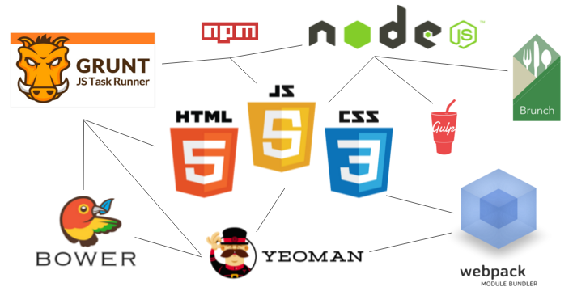
Build Tools

Slide 6
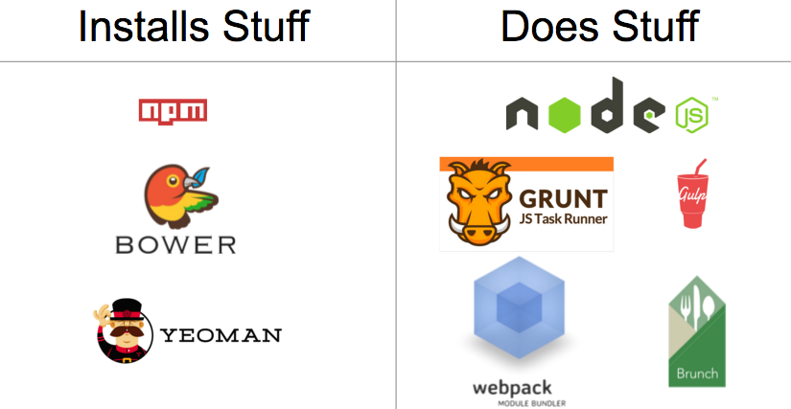
The Core Dichotomy
Build tools do two things:
1. Install things like npm, Bower, Yeoman
2. Do things like Grunt, Gulp, Webpack
Notes:
“Installing” tools like npm, Bower, and Yeoman can install pretty much anything. They can install front-end libraries like Angular.js or React.js. They can install servers for your dev environment. They can install testing libraries. They even help you install other front end build tools.
The “doing” tools like Grunt, Webpack, Require.js, Brunch, and Gulp are much more complicated. The goal of the “doing” tools is to automate all the menial and error prone tasks in web development. The things they do are sometimes called “tasks.”

Slide 7
Automated tasks
Replacing a string of text in a file
Creating folders and moving files into those folders
Running unit tests with a single command
Refreshing browser after saving a file
Combining all JS files into one, and all CSS files into one
Minifying (uglifying) concatenated JS and CSS files
Notes:
npm can install libraries like Angular.js or React.js. It can also install a server to run your app locally for development. It can even install tools to do things like minify your code.
Node, on the other hand, “does” things for you, like run JavaScript files, servers, and so much more.
If you need a place to start learning, start with Node+npm, and stay there for a while. When your project gets large enough, you’ll reach the limits of what Node and npm can automate for you. At that point you can organically incorporate another build tool.

Slide 8
Build is Production Ready
Developers often break JavaScript and CSS into separate files
When moving up application into production, more convenient is to have a fewer files
You can create a “build” of your app: merge all JS and CSS files into one file → use “build tool”

Slide 9
Dichotomy
The lines between “install” and “do” can be blurry
There is no one right combination of tools
Build tools have a steep learning curve, so only learn what’s necessary
All build tools share the same goal: to make you happy by automating a lot of menial tasks
The documentation often is terrible

Slide 10
Webpack
module bundler

Slide 11
Installation
npm install --save-dev webpack
npm install --save-dev webpack-cli
npm install --save-dev webpack-dev-server

Slide 12
Start Project
index.html
src/index.js
<!doctype html>
<html>
<head>
<title>Webpack Demo</title>
</head>
<body>
<script src='./src/index.js'></script>
</body>
</html>
webpackdemo
|-package.json
|-index.html
|-/src
| |-index.js
function component() {
let element = document.createElement('div');
element.innerHTML = 'Hello Webpack!';
return element;
}
document.body.appendChild(component());

