Slide 1
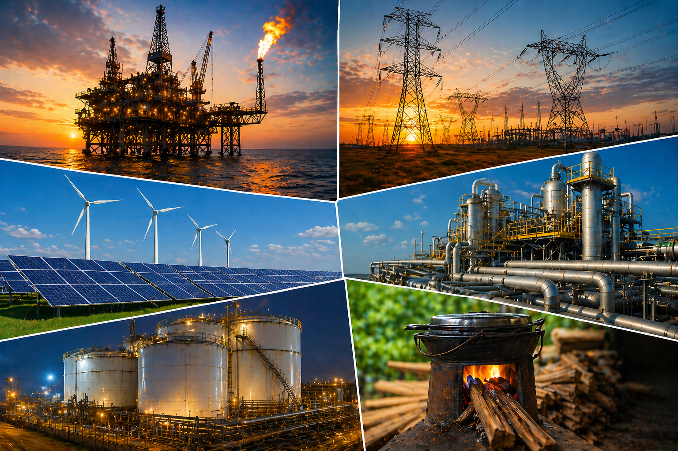
Nigeria's Structural Energy Deficit
A Data-Driven Analysis of Energy Consumption and Economic Growth (2000–2024)
Suleiman Taiwo: Energy Data Analyst
Date: May, 2026

Slide 2
EXECUTIVE SUMMARY
Nigeria’s energy consumption per capita is significantly lower than peer economies
Low energy intensity reflects constraint, not efficiency
Energy growth is diluted by rapid population increase
Nigeria operates at ~13% of expected energy levels
Nigeria’s low energy intensity reflects constraint, not efficiency

Slide 3


The Paradox
Largest Economy
Major Producer
Nigeria is one of Africa's largest economies by GDP, with significant economic potential.
A leading oil & gas producer with vast natural energy resources.
Energy-Poor
Yet energy consumption per capita remains critically low — among the lowest globally.
Why does a resource-rich economy remain energy-poor?

Slide 4
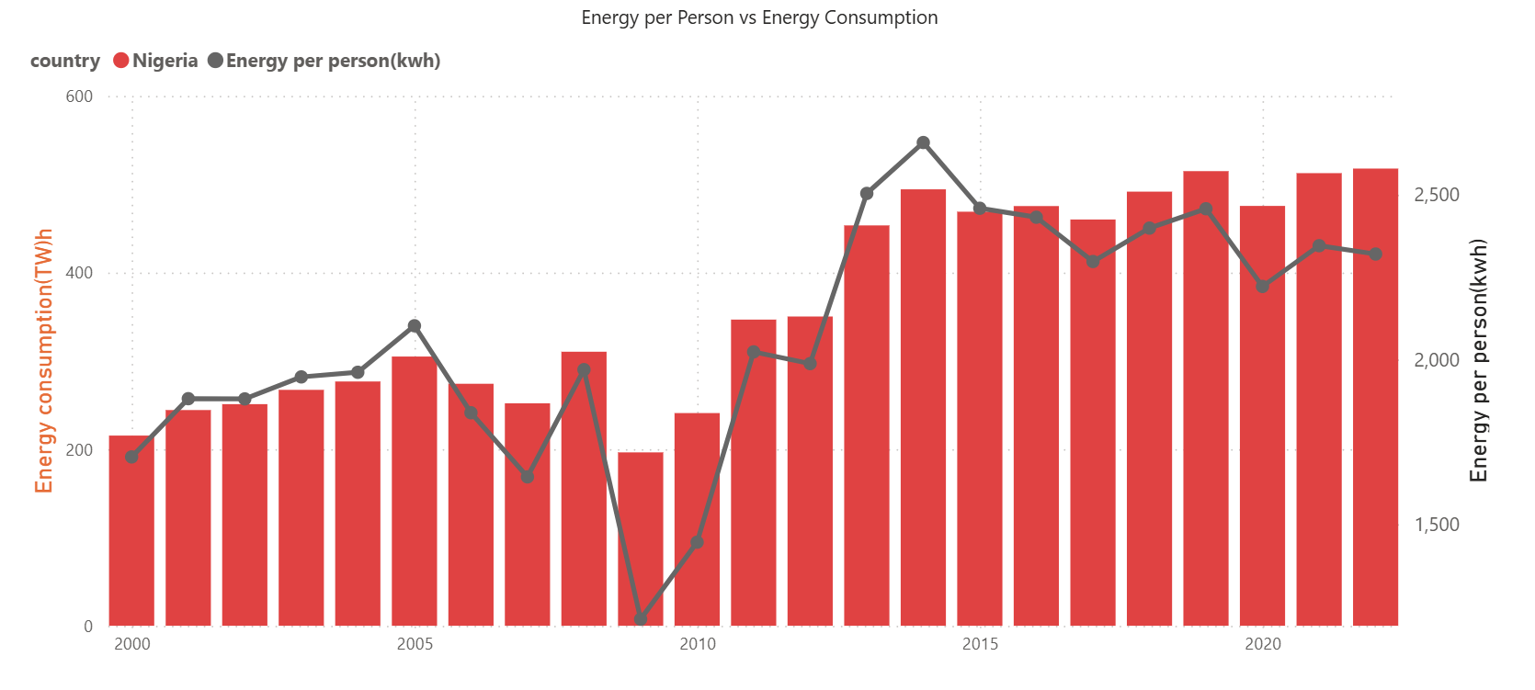

Nigeria Has a Severe Energy Scale Gap
What the Data Shows
Total energy consumption has grown slowly over 24 years — but per capita energy has remained nearly flat, hovering around 2,3000 KWh/person.
Population growth is absorbing all gains. More energy is being produced, but individual Nigerians are not getting more of it.

Slide 5
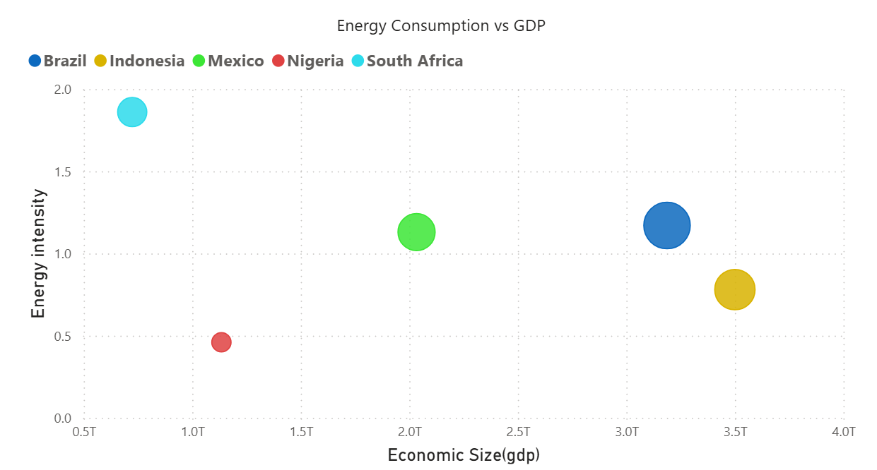

Low Energy Intensity ≠ Efficiency
Reading the Scatter Plot
Nigeria sits in the bottom-left quadrant — low GDP and low energy intensity. This is not a sign of efficiency; it reflects severe energy constraint.
Higher-income peers use significantly more energy per unit of GDP
Energy intensity rises with industrialization — a sign of productive capacity
Nigeria's low intensity signals under-consumption, not optimization
Nigeria is not efficient — it is under powered

Slide 6
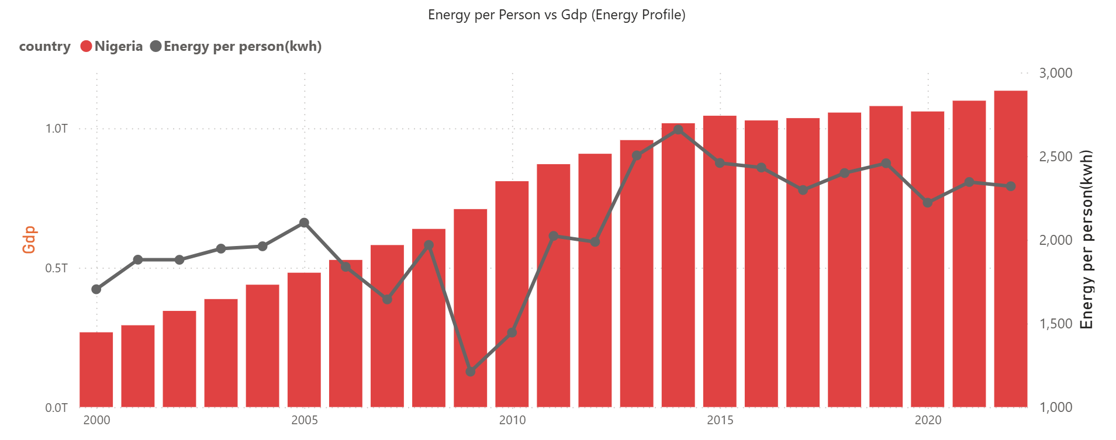
Economic Growth Is Not Translating into Energy Access
Access & development
GDP has grown steadily over time
Energy per capita remains flat
Economic growth is not improving energy availability per person

Slide 7
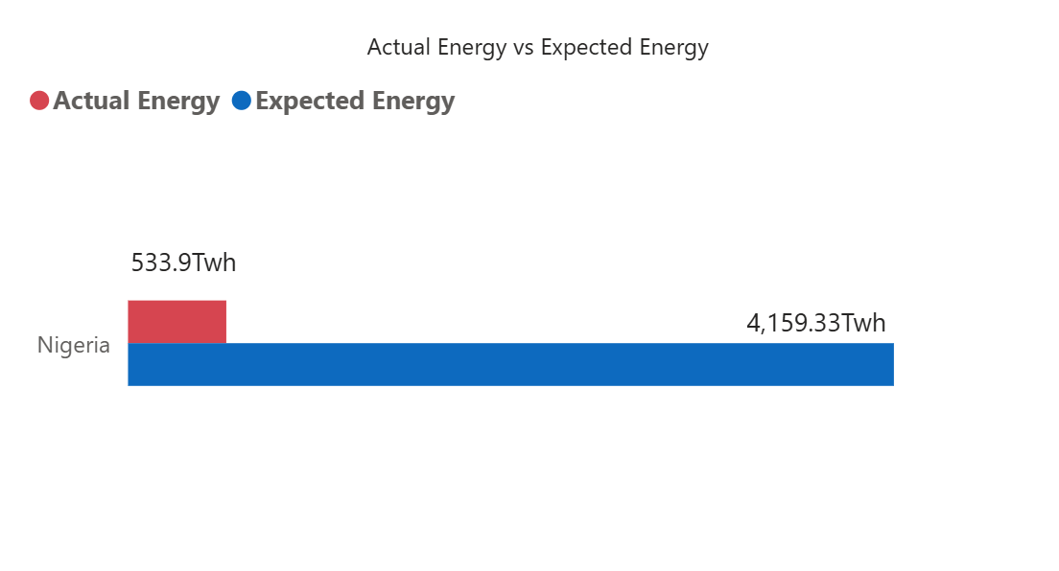
Nigeria Operates Far Below Expected Energy Levels
The 87% Energy Gap
Using peer economies as benchmarks, Nigeria achieves only ~13% of expected energy consumption relative to its economic size.
If Nigeria matched Brazil's energy profile, total consumption would need to be 7–8× higher than today.
13%
87%
Benchmark achievement rate
Unmet energy gap

Slide 8
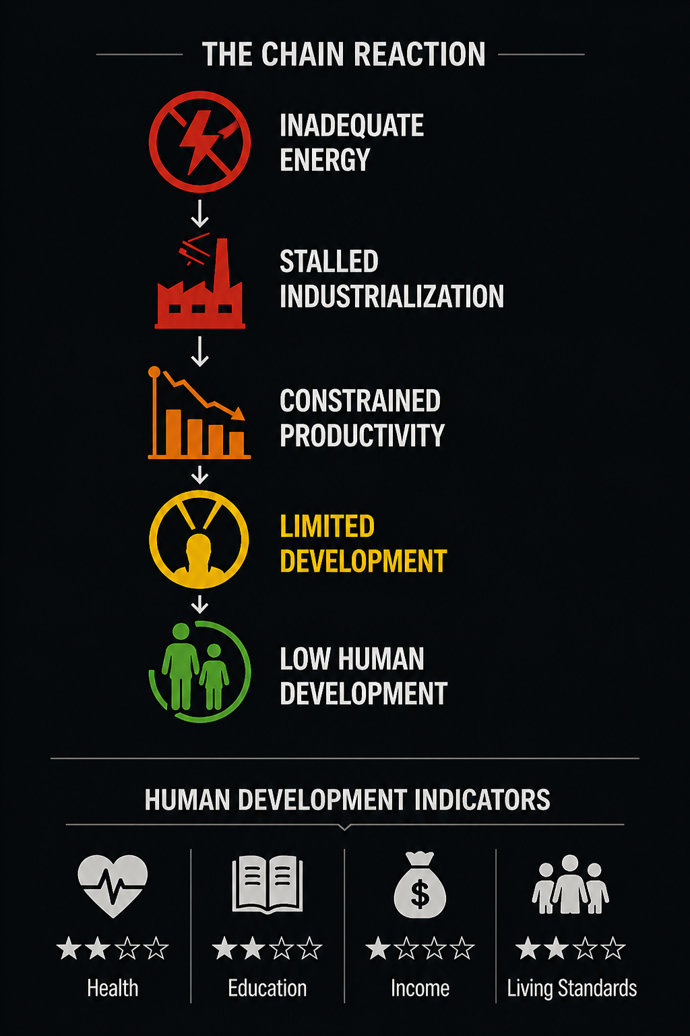



What This Means
Industrialization Stalled
Without adequate energy, manufacturing cannot scale. Industries remain small, informal, or non-existent.
Productivity Constrained
Businesses face chronic outages, raising costs and limiting output across all sectors.
Development Limited
Human development indicators — health, education, income — are tightly coupled to energy access.
Nigeria’s core problem is not inefficiency but structural under consumption of energy

Slide 9

Three Pillars for Closing the Gap
1
2
3
Scale Energy Supply
Align Energy with Population & GDP
Enable Data-Driven Planning
Expand generation capacity and diversify energy sources
Modernize transmission and distribution infrastructure
Reduce technical and commercial losses in the grid
Track energy per capita as a core national KPI
Ensure energy growth consistently outpaces population growth
Set binding targets tied to GDP expansion
Build demand forecasting models for regional planning
Use analytics to prioritize investment decisions
Create transparent energy dashboards for accountability
Closing the energy gap enables industrial growth, higher productivity, and sustainable economic development. Nigeria’s challenge is not optimizing energy usage – it’s scaling energy availability to match her economic ambitions

Slide 10

How the Analysis Was Done
Analytical Pipeline
Data Source
Python
Our World in Data (2000–2024)
Countries Compared
PostgreSQL
Nigeria
Brazil
South Africa
Indonesia
Mexico
Power Bi
Git and GitHub
A reproducible, end-to-end pipeline ensuring data integrity from raw source to final insight.

Slide 11
Contact
📧 Email
Suleyimantaiwo@gmail.com
🔗 LinkedIn
https://www.linkedin.com/in/suleimantaiwo/
💻 GitHub
https://github.com/SuleimanTaiwo/Nigeria-Electricity-System-Analysis.git
🌍 Portfolio Website
https://suleyimantaiwo.wixsite.com/portfolio

