Slide 1
Interview Questions

Slide 2
1. What is the difference between dictionaries and JSON?
Dict is python datatype, a collection of indexed but unordered keys and values.
JSON is a syntax for storing and exchanging data.
Python has a built-in package called json, which can be used to work with JSON data.
For example-Parse JSON - Convert from JSON to Python
import json
# some JSON:
x = '{ "name":"John", "age":30, "city":"New York"}'
# parse x:
y = json.loads(x)
# the result is a Python dictionary:
print(y["age"]

Slide 3
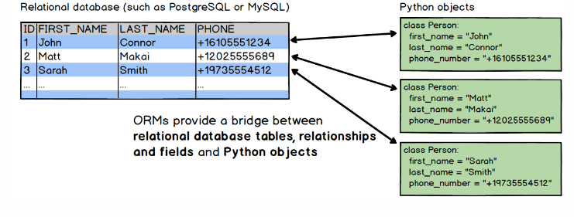
.
What ORMs have you used in Python? ORMs (object relational mapping) map data models (usually in an app) to database tables and simplifies database transactions.
Object-relational Mappers (ORMs)
An object-relational mapper (ORM) is a code library that automates the transfer of data stored in relational databases tables into objects that are more commonly used in application code.

Slide 4
How do any() and all() work? Any takes a sequence and returns true if any element in the sequence is true. All returns true only if all elements in the sequence are true.
For example- any()
a = [False, False, False]
b = [True, False, False]
c = [True, True, True]
print( any(a) )-false
print( any(b) )-true
print( any(c) )-true
print( all(a) )-false
print( all(b) )-false
print( all(c) )-false
Are dictionaries or lists faster for lookups?
Looking up a value in a list takes O(n) time because the whole list needs to be iterated through until the value is found.
Looking up a key in a dictionary takes O(1) time because it’s a hash table.
This can make a huge time difference if there are a lot of values so dictionaries are generally recommended for speed. But they do have other limitations like needing unique keys.

Slide 5
What is the difference between a module and a package?
A module is a file (or collection of files) that can be imported together.
import sklearn
So packages are modules, but not all modules are packages.
from sklearn import cross_validation.
So packages are modules, but not all modules are packages.
How to increment and decrement an integer in Python?
Increments and decrements can be done with +- and -= .
value = 5value += 1 print(value) #=> 6value -= 1 value -= 1 print(value) #=> 4

Slide 6
How to return the binary of an integer?
Use the bin() function.
bin(5) #=> '0b101‘
How to remove duplicate elements from a list?
This can be done by converting the list to a set then back to a list.
a = [1,1,1,2,3] a = list(set(a)) print(a) #=> [1, 2, 3]
How to check if a value exists in a list?
Use in.
'a' in ['a','b','c'] #=> True
'a' in [1,2,3] #=> False

Slide 7
What is the difference between append and extend? append adds a value to a list extend adds values in another list to a list.
a = [1,2,3] b = [1,2,3]
a.append(6) print(a) o/p#=> [1, 2, 3, 6]
b.extend([4,5]) print(b) o/p#=> [1, 2, 3, 4, 5]
How to take the absolute value of an integer?
abs(2) #=> 2
abs(-2) #=> 2

Slide 8
How to combine two lists into a list of tuples?
using zip() method to merge the two list elements and then typecasting into tuple.
def merge(list1, list2):
merged_list = tuple(zip(list1, list2))
return merged_list
# Driver code
list1 = [1, 2, 3]
list2 = ['a', 'b', 'c']
print(merge(list1, list2))
Output-((1, 'a'), (2, 'b'), (3, 'c')
How can you sort a dictionary by key, alphabetically?
You can’t “sort” a dictionary because dictionaries don’t have order but you can return a sorted list of tuples which has the keys and values that are in the dictionary.
For example
d = {'c':3, 'd':4, 'b':2, 'a':1}
sorted(d.items()) #=> [('a', 1), ('b', 2), ('c', 3), ('d', 4)]

Slide 9
How can you remove all whitespace from a string? Python String strip() function will remove leading and trailing whitespaces.
s = ' Hello World From Pankaj \t\n\r\tHi There '
>>> s.strip()
Output-'Hello World From Pankaj \t\n\r\tHi There‘
Why would you use enumerate() when iterating on a sequence?
It is gives us a set of tuples of (index, item) until all items are looped over. Enumerate provides us a way to count by coupling a sequence of objects with the index of each item in a much more readable way.
L = ['apples', 'bananas', 'oranges']
for idx, val in enumerate(L):
print("index is %d and value is %s" % (idx, val))
Output
The code above will have this output:
index is 0 and value is apples
index is 1 and value is bananas
index is 2 and value is oranges

Slide 10
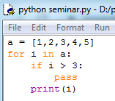

What is the difference between pass, continue and break?
continu
Pass means do nothing. We typically use it because Python doesn’t allow creating a class, function or if-statement without code inside it.
Continue- continues to the next element and halts execution for the current element. So print(i) is never reached for values where i < 3.
a = [1,2,3,4,5]
for i in a:
if i < 3:
continue
print(i)
Output-#=> 1,2,3,4,5

Slide 11
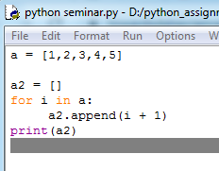

Breaks the loop and the sequence is not longer iterated over. So elements from 3 onward are not printed.
for i in a: if i == 3: break print(i) output-#=> 1 #=> 2
Convert the following for loop into a list comprehension.
This for loop Output

Slide 12
Give an example of the ternary operator The ternary operator is a one-line if/else statement. The syntax looks like a if condition else b. x = 5 y = 10'greater' if x > 6 else 'less' #=> 'less'‘ greater' if y > 6 else 'less' #=> 'greater'
Check if a string only contains numbers.
You can use isnumeric()
'123a‘ . isnumeric() #=> False
'123'.isnumeric() #=> True
Check if a string only contains letters.
You can use isalpha()
'123a'.isalpha() #=> False
'a'.isalpha() #=> True

Slide 13
Check if a string only contains numbers and letters. You can use isalnum().
'123abc...'.isalnum() #=> False
'123abc'.isalnum() #=> True
Return a list of keys from a dictionary.
This can be done by passing the dictionary to python’s list() constructor, list().
d = {'id':7, 'name':'Shiba', 'color':'brown', 'speed':'very slow'}
list(d) Output#=> ['id', 'name', 'color', 'speed']
How do you upper and lowercase a string?
You can use the upper() and lower() string methods.
small_word = 'potatocake' big_word = 'FISHCAKE‘
small_word.upper() #=> 'POTATOCAKE‘
big_word.lower() #=> 'fishcake'

Slide 14
What is the difference between remove, del and pop? remove() remove the first matching value.
li = ['a','b','c','d']l
i.remove('b') #=> ['a', 'c', 'd']
del removes an element by index.
li = ['a','b','c','d']
del li[0] #=> ['b', 'c', 'd']
pop() removes an element by index and returns that element.
li = ['a','b','c','d']
li.pop(2) #=> 'c'li #=> ['a', 'b', 'd']

Slide 15
Give an example of dictionary comprehension. Dict Comprehension to remove selected key-value pairs from a dictionary and create a new dictionary.
# Python code to demonstrate dictionary
# comprehension
# Lists to represent keys and values
keys = ['a','b','c','d','e']
values = [1,2,3,4,5]
# but this line shows dict comprehension here
myDict = { k:v for (k,v) in zip(keys, values)}
# We can use below too
# myDict = dict(zip(keys, values))
print (myDict)
Output-{'a': 1, 'b': 2, 'c': 3, 'd': 4, 'e': 5}

Slide 16
How is exception handling performed in Python?
To use exception handling in Python, you first need to have a catch-all except clause. The words "try" and "except" are Python keywords and are used to catch exceptions. try-except [exception-name] (see above for examples) blocks The code within the try clause will be executed statement by statement. If an exception occurs, the rest of the try block will be skipped and the except clause will be executed.
Python provides 3 words to handle exceptions, try, except and finally.
The syntax looks like this.
try: # try to do this except: # if try block fails then do this finally: # always do this
In the simplistic example below, the try block fails because we cannot add integers with strings. The except block sets val = 10 and then the finally block prints complete.
try: val = 1 + 'A' except: val = 10 finally: print('complete') print(val) #=> complete #=> 10

