Slide 1
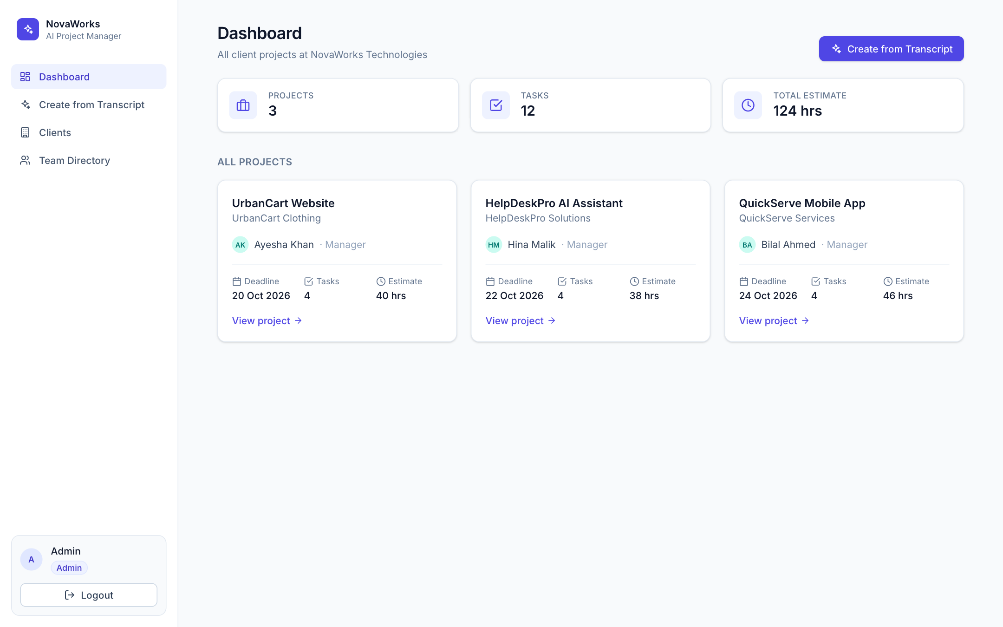
NovaWorks AI Project Manager
From a meeting transcript to assigned projects and tasks in about 20 seconds
Team Dual Byte
Muhammad Ali · Malik Muhammad Suleman Saleh
infinity-hackathon.vercel.app
Notes:
Hi, we are team Dual Byte. Our project is an AI project manager for NovaWorks Technologies: the admin pastes a meeting transcript and the app creates the projects, tasks, owners, deadlines and estimates automatically, then shows each person only their own work. It is live at infinity-hackathon.vercel.app.

Slide 2
Meetings decide the plan, then someone retypes it by hand
1
Slow
Every project, task, owner, deadline and estimate is entered manually after the meeting.
12
tasks, each with an owner, deadline and estimate, from one 60-minute meeting
2
Error-prone
Decisions change mid-meeting, so it is easy to save the first value instead of the final one.
4
decisions changed during the meeting: deadline 18 → 20 Oct, 17 → 19 Oct, 8 → 10 h, Zain → Maryam
3
Scope creep
Rejected features and non-employees are mentioned too, and can sneak into the plan.
5
rejected features that must not become tasks, plus a client contact (Kamran) who is not an employee
4
No focus
Managers and developers need to see their own work, and nobody else's.
Notes:
The challenge: after a planning meeting, someone has to turn the discussion into projects and tasks. In the supplied meeting that is 12 tasks. It is also tricky: 4 decisions change during the meeting, 5 features are rejected, and a client contact called Kamran is mentioned who is not an employee. A careless plan gets all of these wrong.

Slide 3
Our solution: paste the meeting, get the plan
1
2
3
4
5
Paste
Extract
Validate
Save
View
Admin pastes the meeting transcript, or loads the supplied one.
AI reads it with the team directory and returns projects and tasks as JSON.
Server checks people, roles, dates and hours before anything is saved.
One transaction saves all projects, tasks and clients, or nothing at all.
Admin, managers and agents each see only the work they are allowed to see.
Admin: ~20 seconds instead of retyping a whole meeting. Everyone else: a focused view of their own work.
Notes:
Our flow has five steps. The admin pastes the meeting. The AI extracts projects and tasks using our team directory. Our server validates everything. Then it saves everything in one database transaction, or nothing if something is wrong. Finally every user sees only their own work.

Slide 4
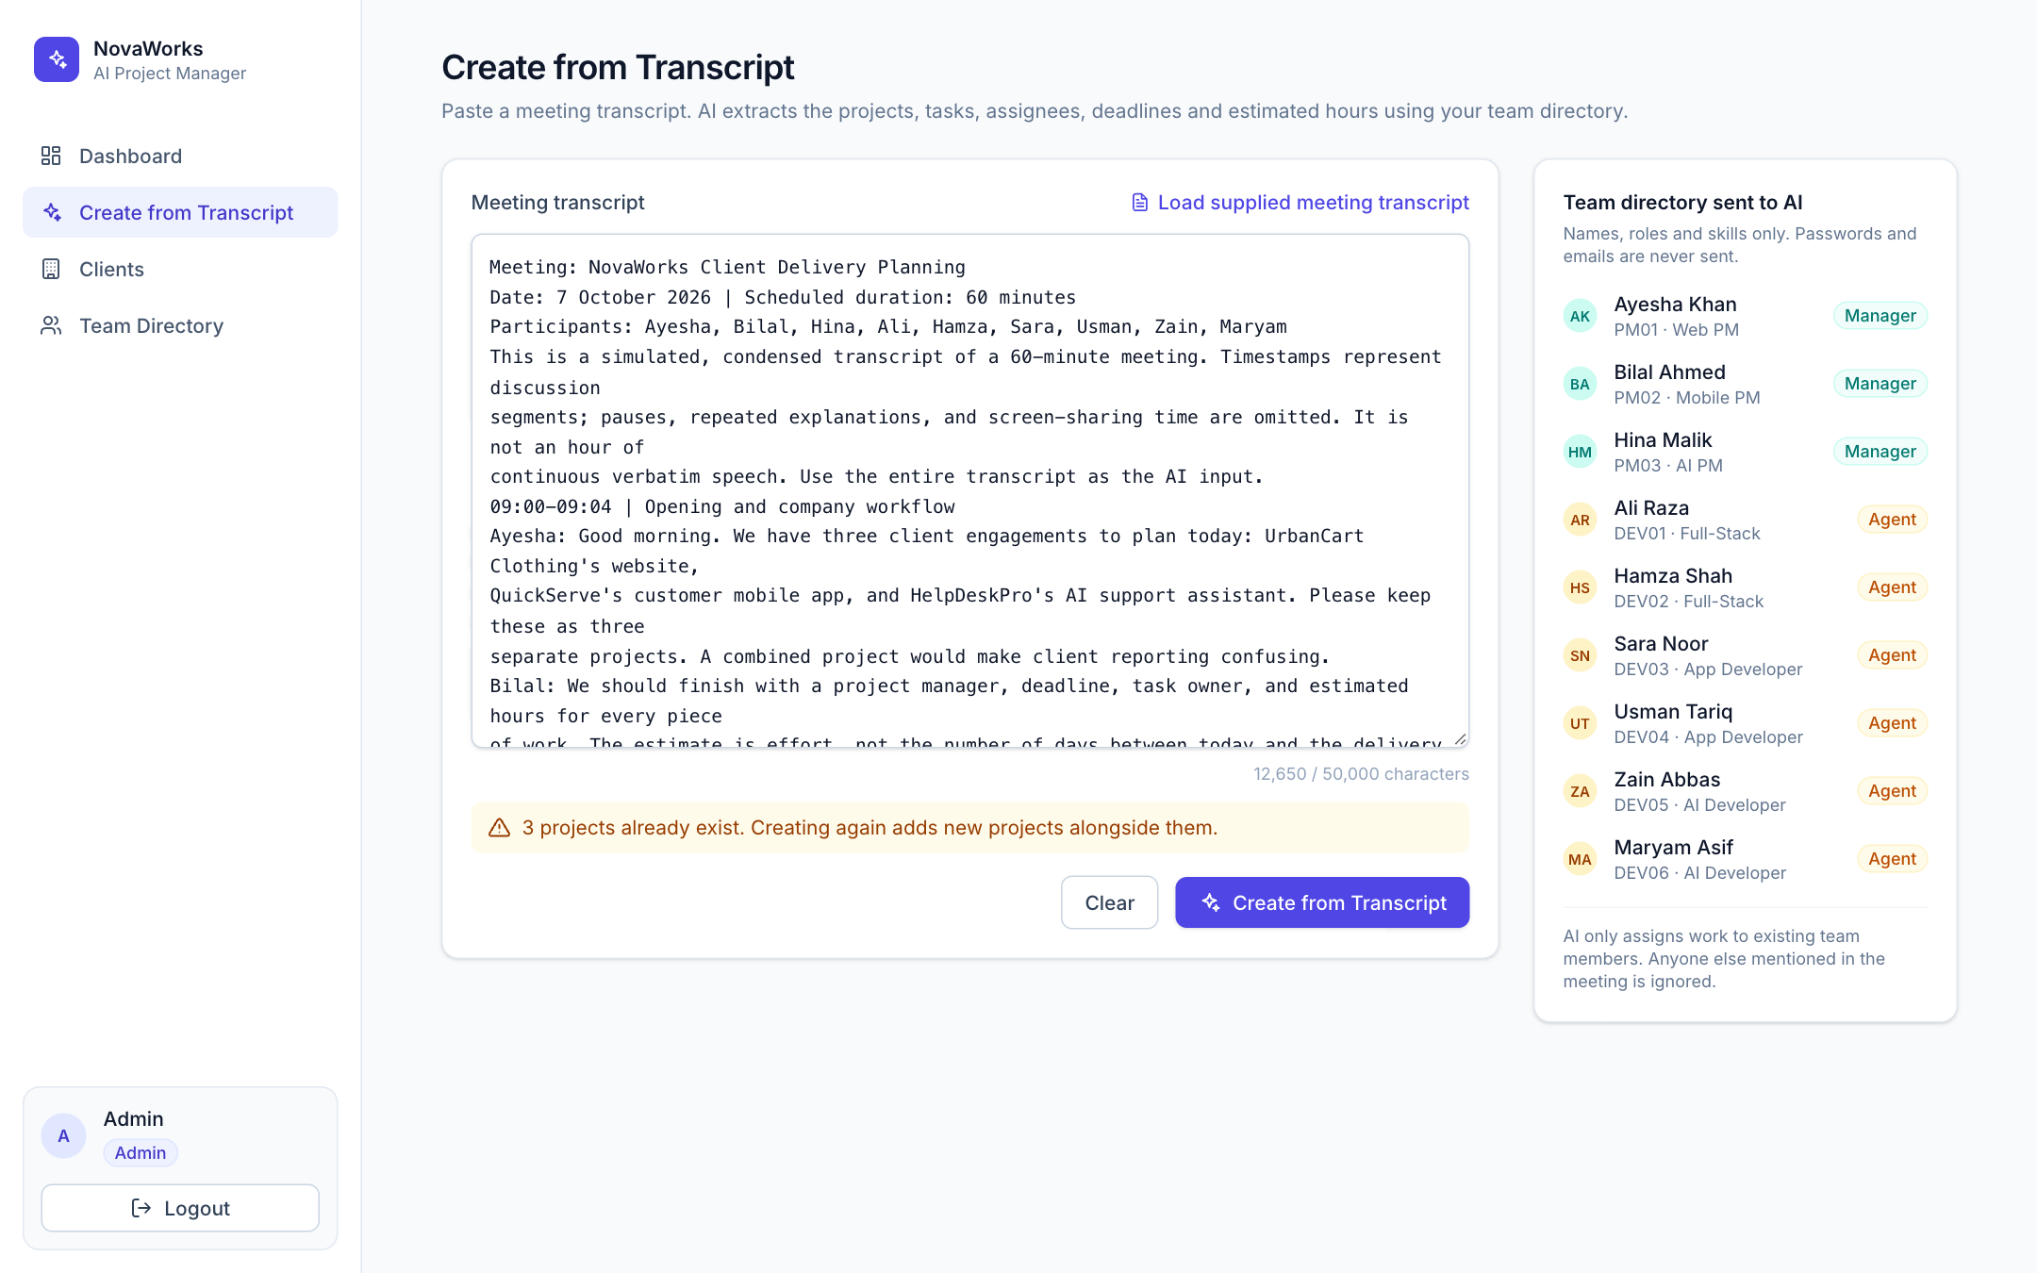
One click turns a meeting into a plan
1
Paste or load
Any transcript, up to 50,000 characters. The supplied meeting loads with one click.
2
Directory, not secrets
The AI gets names, roles and skills only. Emails and passwords are never sent.
3
Safe to click
The button locks while processing (10–25 s), so no accidental duplicates.
Notes:
This is the Create from Transcript page. The admin pastes the meeting or loads the supplied one. On the right you see exactly what we send to the AI: names, roles and skills, never emails or passwords. While it runs, the button is locked so you cannot create duplicates by clicking twice.

Slide 5
Where AI is used: the AI extracts, our code verifies
AI: Groq · GPT-OSS 120B
Our code guarantees
Reads the whole transcript plus the team directory
Keeps only final decisions; the recap wins
Skips rejected, excluded and future features
Never invents people: unknown values become null
Returns strict JSON at temperature 0
Shape check of the AI output (zod)
Manager must be a MANAGER, owner an AGENT
Hours > 0, valid dates, task deadline ≤ project deadline
All-or-nothing database transaction
Rate-limit retry and fallback model (GPT-OSS 20B)
Every run logged for audit
Primary openai/gpt-oss-120b · fallback openai/gpt-oss-20b · temperature 0 · JSON mode · 10–25 s per meeting
Notes:
AI is used in one place: turning the transcript into structured JSON. We use Groq with the GPT-OSS 120B model at temperature 0. The prompt tells it to use only final decisions, skip rejected features, and never invent people. But we never trust the AI blindly: our code checks the shape, the roles, the dates and the hours, and saves in one transaction. If Groq is rate-limited we wait and retry, and fall back to a second model.

Slide 6
12 out of 12 tasks correct, including every trap
12/12
tasks match the organizer answer key, with both AI models
✓ UrbanCart deadline 20 Oct, not 18
✓ Integration task due 19 Oct, not 17
✓ QuickServe integration 10 h, not 8
✓ Testing owned by Maryam, not Zain
✓ Kamran (client contact) gets nothing
✓ No payment, maps, inventory or email tasks
Notes:
Accuracy: on the supplied transcript, all 12 tasks match the organizer answer key, and both of our models get 12 out of 12. That includes every trap: the moved deadlines, the revised estimate, the changed owner, Kamran, and the rejected features. Totals are 40, 46 and 38 hours, exactly as expected.

Slide 7
Change the meeting, and the plan changes with it
Supplied transcript
Changed transcript
Mobile integration and testing · Usman
Mobile integration and testing · Usman
10 h due 22 Oct 2026
12 h due 23 Oct 2026
QuickServe total: 46 h
QuickServe total: 48 h
11
other tasks unchanged
~22 s
on the live site
0
hardcoded answers
Notes:
To prove this is real AI conversion and not a fixed answer, we ran the organizers' changed-input test: change the QuickServe integration estimate to 12 hours and the deadline to 23 October. Only that task changes, the QuickServe total becomes 48 hours, and the other 11 tasks stay the same. On the live site this took about 22 seconds.

Slide 8
Everyone sees only their own work
Admin
Manager · Ayesha
Agent · Ali
All projects and clients
Create from Transcript
Edit and rename clients
Everyone's work in the team directory
Only the projects she manages
All tasks inside them
Edit her clients' contact details
Team members' work in her projects only
Only his own tasks (3 of 12)
Project name and manager for context
Client contacts, without internal notes
Other projects: 403 Access denied
Enforced in the database queries, not just hidden in the UI. The user comes from a signed httpOnly cookie, never from the request; opening another person's project or client returns 403.
Notes:
Access control is enforced on the server. The admin sees everything. Ayesha, a manager, sees only UrbanCart. Ali, an agent, sees only his three tasks; Hamza sees his two tasks across two projects. The current user always comes from a signed cookie, and the filters run inside the database queries, so even typing another project's URL returns 403.

Slide 9
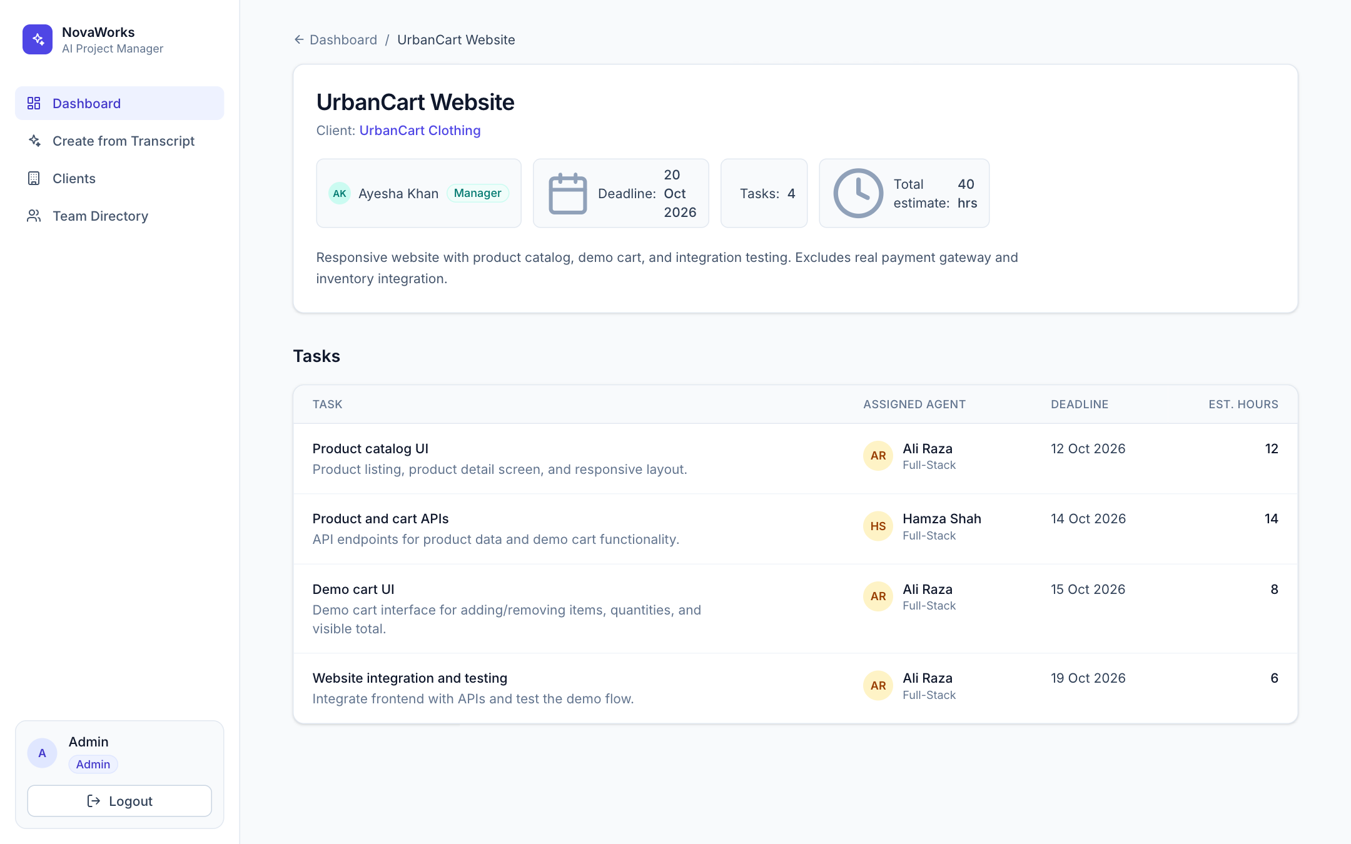
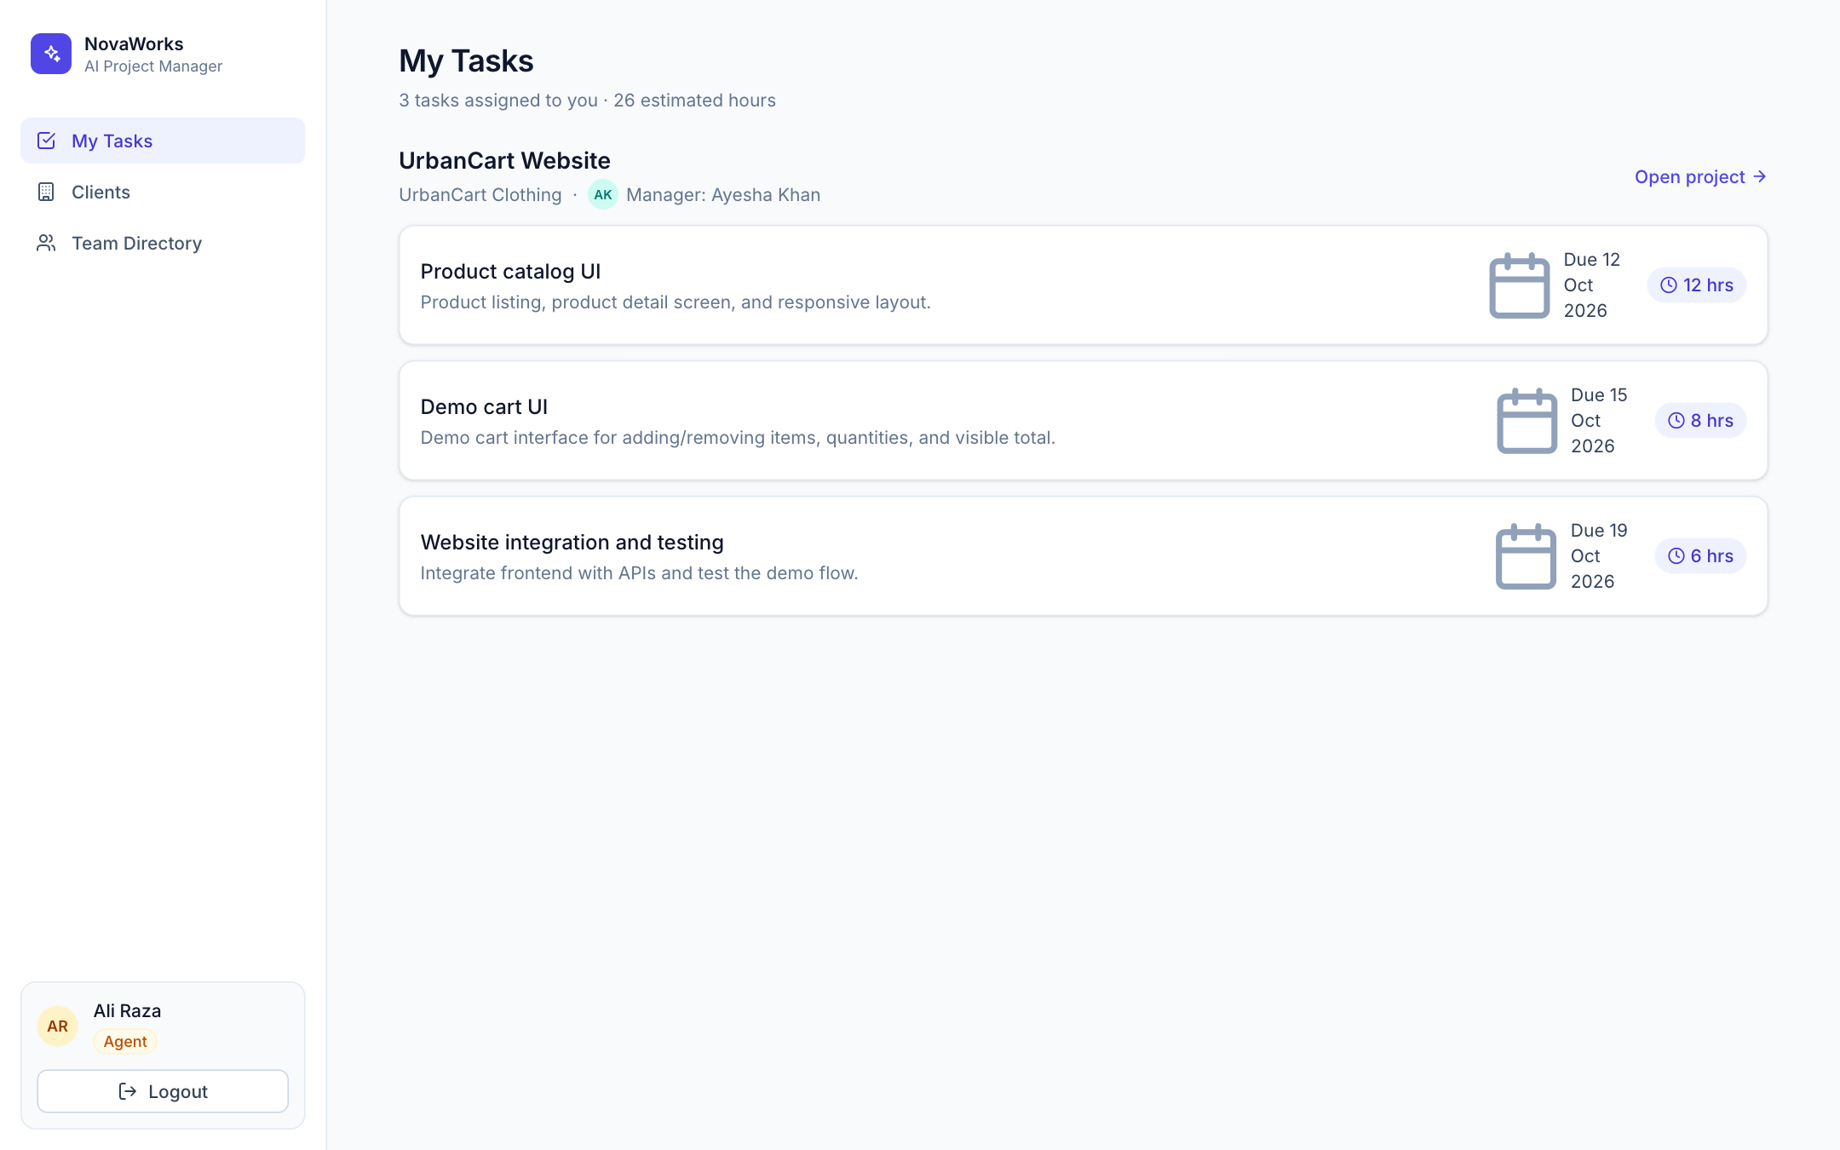
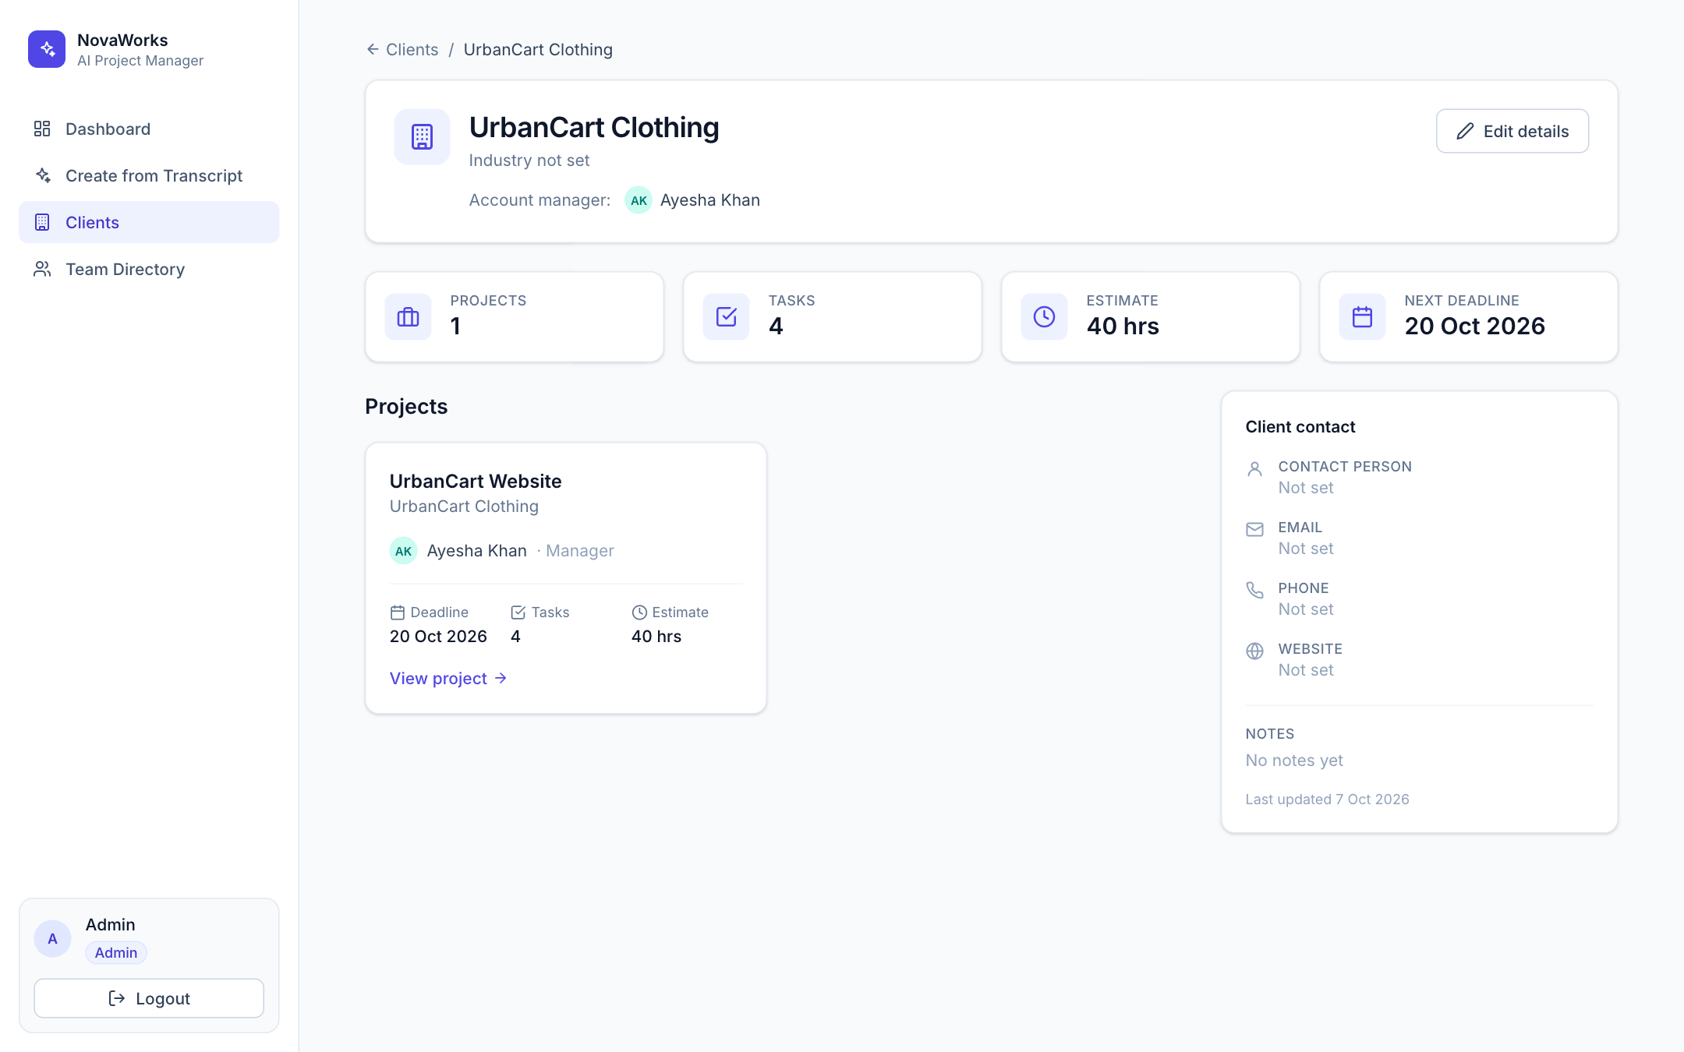
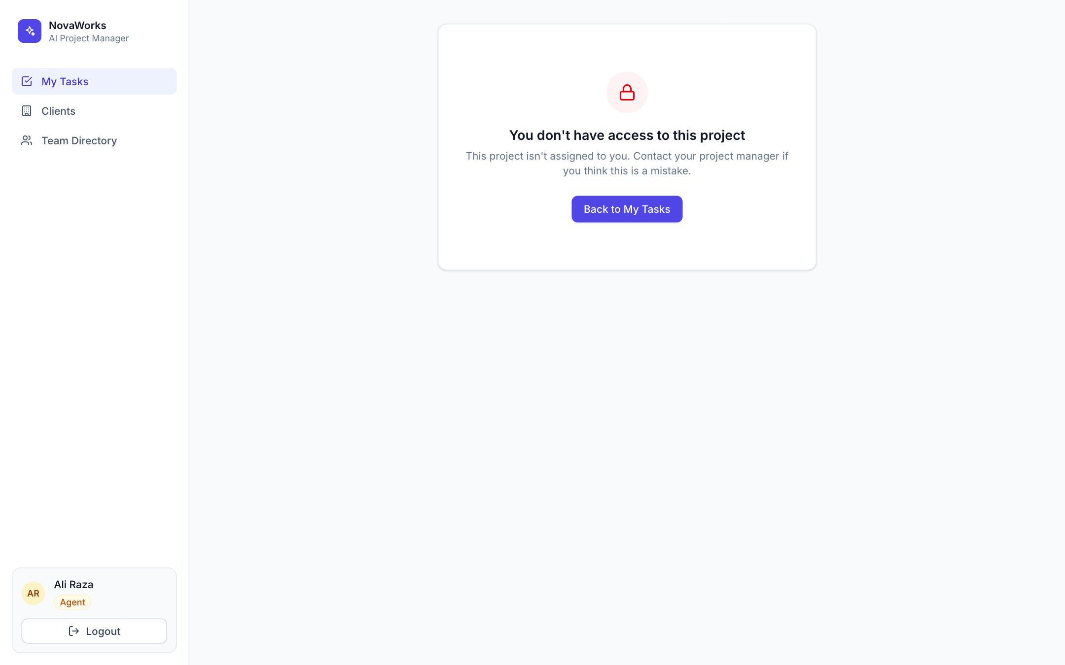
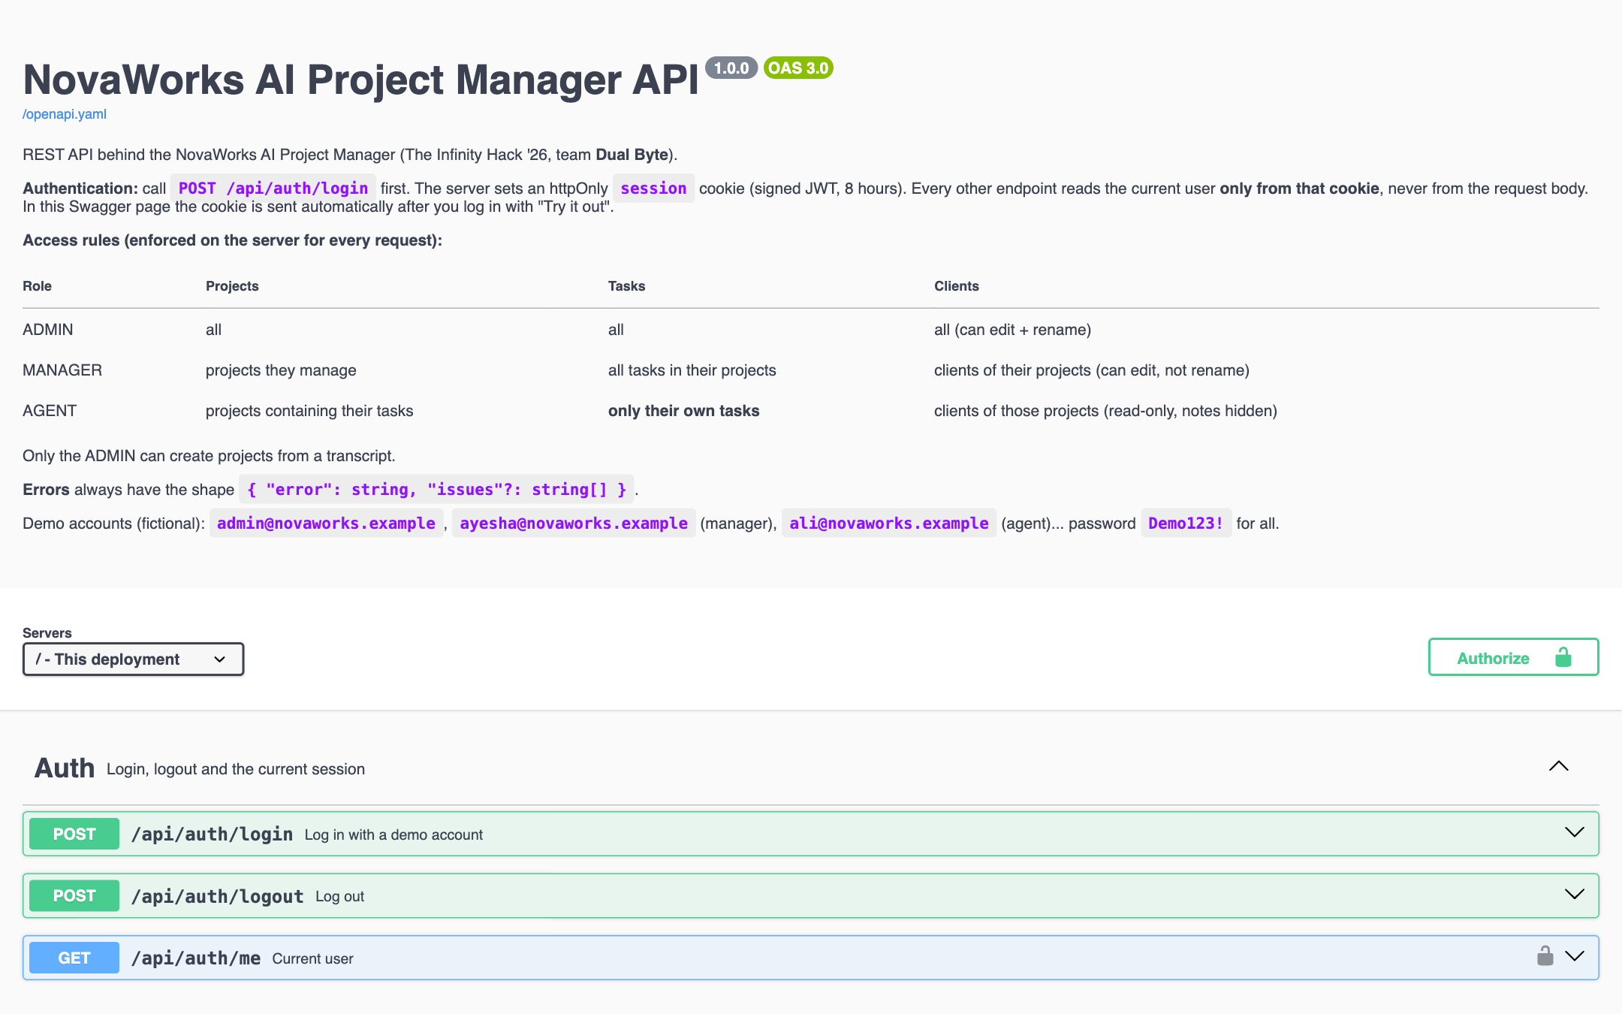
What we built: a complete CRM, not just a demo
Admin dashboard
Project detail and tasks
Agent: My Tasks
Clients (CRM) with contacts
403: access denied
Swagger API docs
Notes:
Beyond the minimum screens we built a full CRM: the admin dashboard, project detail with tasks, the agent's My Tasks, a Clients section with contact details and notes, a team directory with each person's work, clear access-denied screens, and interactive Swagger API documentation.

Slide 10
Built to scale: a modular monolith
Browser: React pages
Login, dashboard, projects, tasks, clients, team
Stack
Next.js 16 · React 19 · TypeScript
Tailwind CSS 4
Prisma 6 · PostgreSQL (Aiven)
Groq GPT-OSS 120B / 20B
JWT httpOnly cookie · bcrypt
zod validation
Vercel hosting
OpenAPI · Swagger UI
API routes
Thin: parse request, call service, return JSON
AI provider
Groq, swappable
Services + access policies
Business logic; role filters in one place
Repositories (Prisma)
The only layer that talks to the database
PostgreSQL on Aiven
Users, clients, projects, tasks, transcript runs
Notes:
Architecture: one Next.js app and one database, but split into layers and modules. Routes are thin, business logic lives in services, all access rules live in policy files, and only repositories talk to the database. The AI sits behind an interface, so Groq can be swapped. To scale we would add a job queue for AI calls, multi-company support and caching, without rewriting.

Slide 11
System architecture
Vercel · one Next.js 16 app
Groq AI
GPT-OSS 120B / 20B
Admin
Manager
Pages (server-checked session)
Agent
API routes · withHandler()
Browser
React UI
JSON mode
HTTPS
Services + access policies
+ cookie
PostgreSQL
Aiven
Repositories (Prisma)
SQL · SSL
Notes:
System architecture. Users use the React UI in the browser. Everything runs in one Next.js app on Vercel: pages, API routes, services with access policies, and Prisma repositories. The app talks to two external services: the Groq AI for transcript extraction, and the Aiven PostgreSQL database. Secrets stay on the server; the browser only holds a signed session cookie.

Slide 12
Flowchart: transcript to tasks
No: wait, retry, fallback 20B
Admin submits
transcript
Load team directory
(no passwords)
Groq · GPT-OSS 120B
JSON output
Valid JSON?
Yes
Each role sees
its own work
201 Created
3 projects · 12 tasks
One DB transaction
clients · projects · tasks
Rules OK?
Yes
No
400 + issues list
nothing saved
Checks: manager is a MANAGER · owner is an AGENT · hours > 0 · task date ≤ project date
Notes:
The core flow. The admin submits the transcript. We load the team directory without passwords and send both to Groq, asking for JSON. If the JSON is invalid or Groq is rate-limited, we wait, retry and fall back to the 20B model. Then our business rules run: roles, hours and dates. If anything fails, the admin gets a list of issues and nothing is saved. Otherwise one database transaction saves the clients, projects and tasks, and each role sees its own work.

Slide 13
Flowchart: every API request
Session valid?
In user's scope?
Request
+ cookie
Yes
Role filter in
DB query
Yes
200 JSON
only allowed data
No
No
Admin: all
401
Please log in
403
Access denied
Manager: managerId = me
Agent: assigneeId = me
Notes:
Every API request follows this path. First the signed session cookie is checked; without it you get 401. The user and role come only from that cookie. Then the role filter is applied inside the database query: admin sees everything, a manager only projects they manage, an agent only tasks assigned to them. If the requested project or client is outside that scope, the answer is 403. Otherwise only the allowed data is returned.

Slide 14
Data model
User
Project
Client
id: ADMIN · PM01 · DEV01
email (unique)
passwordHash
role
skills[]
manages 1:n
name · clientName
managerId → User
clientId → Client
deadline
transcriptRunId
has 1:n
name (unique)
industry
contact name / email
phone · website
notes
contains 1:n
created 1:n
Task
TranscriptRun
assigned 1:n
projectId → Project
assigneeId → User
deadline
estimatedHours
transcript · aiOutput
model · status
issues[]
Notes:
The data model has five tables. A user manages projects and is assigned tasks. Each project belongs to a client and contains tasks. Every transcript conversion is stored as a TranscriptRun, which links to the projects it created, so we have an audit log of what the AI produced.

Slide 15
Why it matters, and what we would build next
Why it is useful
Next, with more time
A whole meeting becomes a plan in about 20 seconds
Plans follow the final decisions, not the first draft
Bad AI output never reaches the database
Each person gets a focused view of their own work
Client contacts and projects live in one place
Review and edit the AI draft before saving
Task status and deadline reminders
Upload meeting audio: speech-to-text, same pipeline
Slack, Google Meet and Jira integrations
Multi-company SaaS with per-company AI usage
Everything we showed works today on the live site; the right column is our roadmap.
Notes:
Why it is useful: the admin saves the time of retyping a meeting, the plan follows the final decisions, invalid AI output is never saved, and everyone gets a focused view. With more time we would add a review step before saving, task status and reminders, audio upload with speech-to-text, and integrations with Slack, Google Meet and Jira.

Slide 16
Thank you. Let's see it live
Live app
infinity-hackathon.vercel.app
API docs
infinity-hackathon.vercel.app/api-docs
Source
github.com/Suleman-Saleh/InfinityHackathon
Demo login
admin@novaworks.example · Demo123!
Team Dual Byte · Muhammad Ali · Malik Muhammad Suleman Saleh
Notes:
LIVE DEMO SCRIPT (about 4 minutes). Before judging: run npm run db:reset so the dashboard starts empty.
1. Log in as admin@novaworks.example / Demo123!. Show the empty dashboard: no signup needed, accounts are seeded.
2. Create from Transcript → Load supplied meeting transcript → Create. Point out the locked button and the team directory panel.
3. Success: 3 projects, 12 tasks. Open UrbanCart: client UrbanCart Clothing, manager Ayesha, deadline 20 Oct, integration due 19 Oct.
4. Log out, log in as ayesha@: only UrbanCart. Open Clients: only UrbanCart Clothing.
5. Log in as ali@: My Tasks shows his 3 tasks (26 h). Paste a QuickServe project URL: 'You don't have access' (403).
6. Log in as hamza@: 2 tasks across UrbanCart and QuickServe.
7. Refresh: data persists.
8. Optional: changed transcript (QuickServe integration 12 h, 23 Oct) → only that task changes. Optional: /api-docs.

