Slide 1
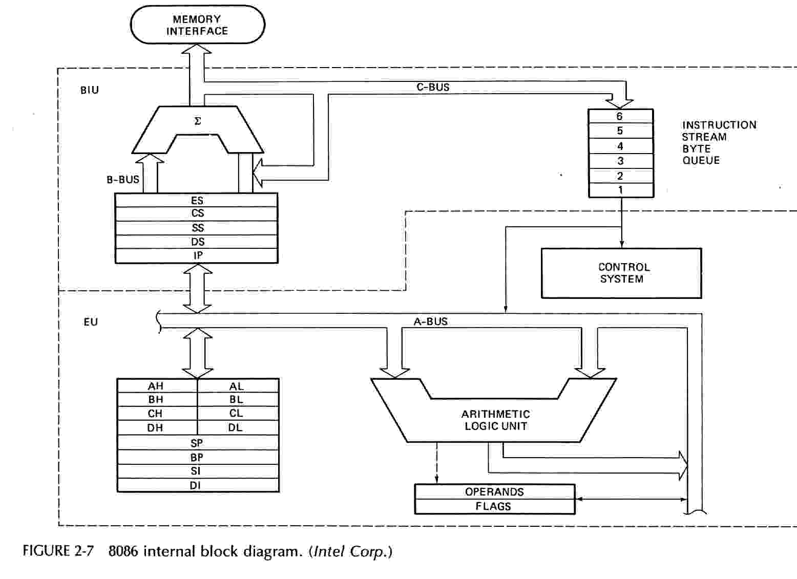
Block diagram of 8086

Slide 2
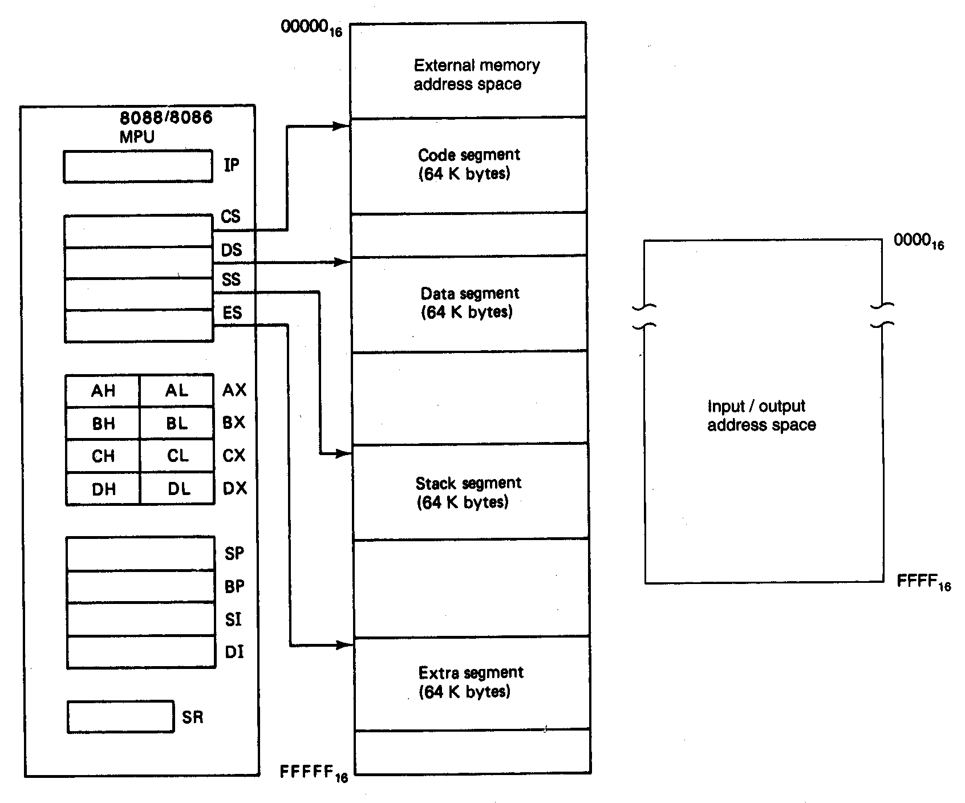
Software Model of the 8086 Microprocessors

Slide 3
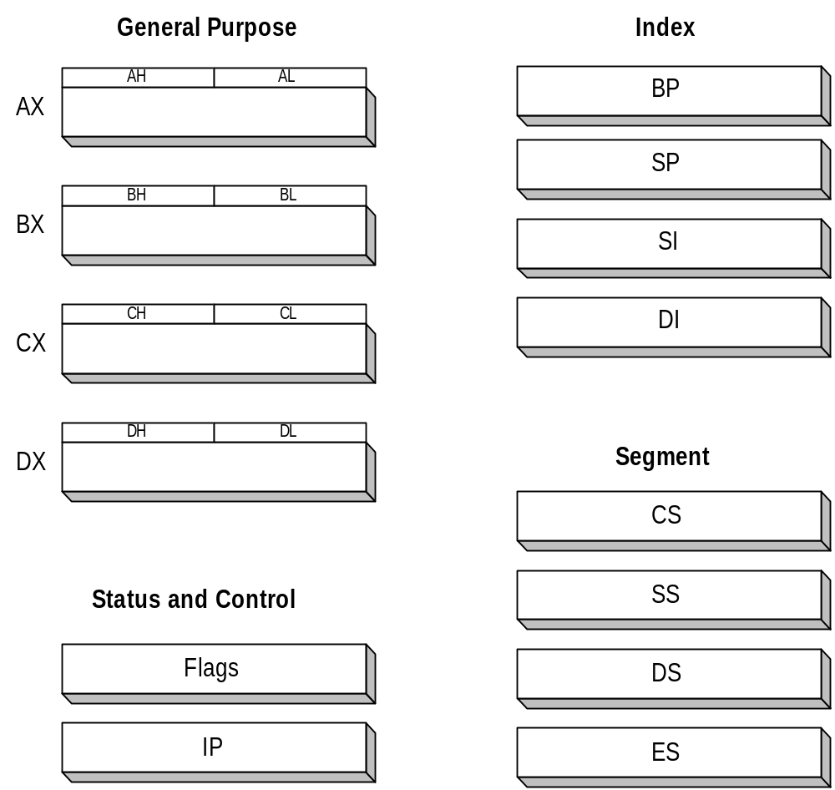
8086 Registers

Slide 4
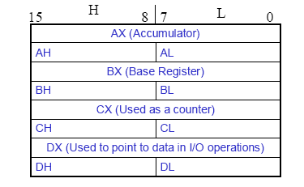
General Purpose Registers
        AX - the Accumulator
        BX - the Base Register
        CX - the Count Register
        DX - the Data Register
Normally used for storing temporary results
Each of the registers is 16 bits wide (AX, BX, CX, DX)
Can be accessed as either 16 or 8 bits AX, AH, AL

Slide 5
General Purpose Registers
AX
  Accumulator Register
  Preferred register to use in arithmetic, logic and data transfer instructions because it generates the shortest Machine Language Code
  Must be used in multiplication and division operations
  Must also be used in I/O operations
BX
  Base Register
  Also serves as an address register

Slide 6
General Purpose Registers
CX
  Count register
  Used as a loop counter
  Used in shift and rotate operations
DX
  Data register
  Used in multiplication and division
  Also used in I/O operations

Slide 7
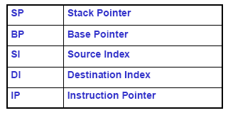
Pointer and Index Registers
All 16 bits wide, L/H bytes are not accessible
Used as memory pointers
  Example: MOV AH, [SI]
    Move the byte stored in memory location whose address is contained in register SI to register AH
IP is not under direct control of the programmer

Slide 8
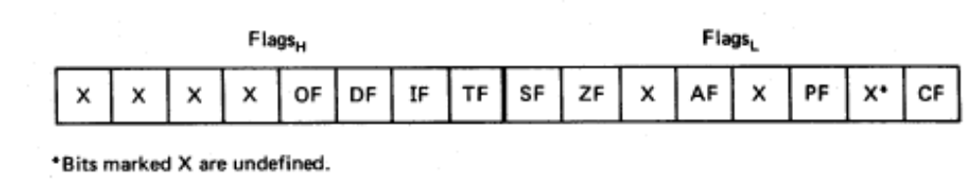
Flag Register
Overflow
Carry
Direction
Parity
Interrupt enable
Auxiliary Carry
Trap
Zero
6 are status flags
3 are control flag
Sign

Slide 9
8086 Programmer’s Model
ES
Extra Segment
_{BIU registers}
_{(20 bit adder)}
CS
Code Segment
SS
Stack Segment
DS
Data Segment
IP
Instruction Pointer
_{EU registers}
AX
AH
AL
Accumulator
BX
BH
BL
Base Register
CX
CH
CL
Count Register
DX
DH
DL
Data Register
SP
Stack Pointer
BP
Base Pointer
SI
Source Index Register
DI
Destination Index Register
FLAGS

Slide 10
The Stack
The stack is used for temporary storage of information such as data or addresses.
When a CALL is executed, the 8086 automatically PUSHes the current value of CS and IP onto the stack.
Other registers can also be pushed
Before return from the subroutine, POP instructions can be used to pop values back from the stack into the corresponding registers.

Slide 11
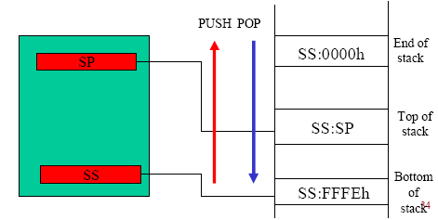
The Stack

Slide 12
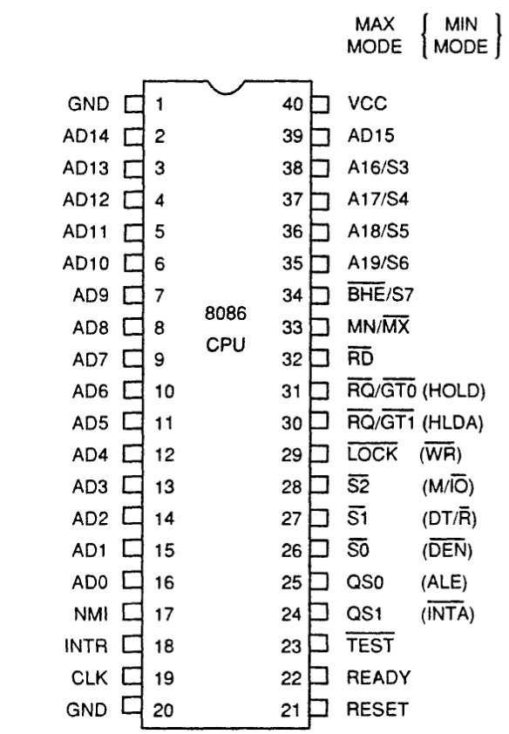
INTEL 8086 - Pin Diagram

Slide 13
INTEL 8086 - Pin Details
Power Supply
5V ± 10%
Ground
Reset
Registers, seg regs, flags
CS: FFFFH, IP: 0000H
If high for minimum 4 clks
Clock
Duty cycle: 33%

Slide 14
INTEL 8086 - Pin Details
Address/Data Bus:
Contains address bits A₁₅-A₀ when ALE is 1 & data bits D₁₅ – D₀ when ALE is 0.
Address Latch Enable:
When high, multiplexed address/data bus contains address information.

Slide 15
INTEL 8086 - Pin Details
INTERRUPT
Non - maskable interrupt
Interrupt acknowledge
Interrupt request

Slide 16
INTEL 8086 - Pin Details
Direct Memory Access
Hold
Hold acknowledge

Slide 17
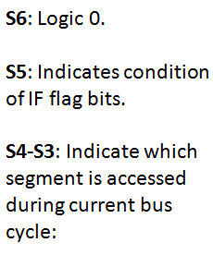
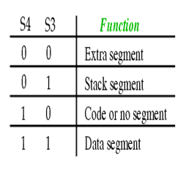
INTEL 8086 - Pin Details
Address/Status Bus
Address bits A₁₉ – A₁₆ & Status bits S₆ – S₃

Slide 18
INTEL 8086 - Pin Details
BHE#, A₀:
0,0: Whole word (16-bits)
0,1: High byte to/from odd address
1,0: Low byte to/from even address
1,1: No selection
Bus High Enable/S7
Enables most significant data bits D₁₅ – D₈ during read or write operation.
S₇: Always 1.

Slide 19
INTEL 8086 - Pin Details
Min/Max mode
Minimum Mode: +5V
Maximum Mode: 0V
Minimum Mode Pins
Maximum Mode Pins

Slide 20
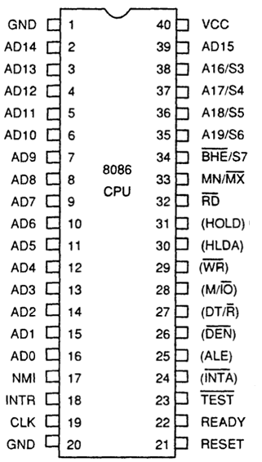
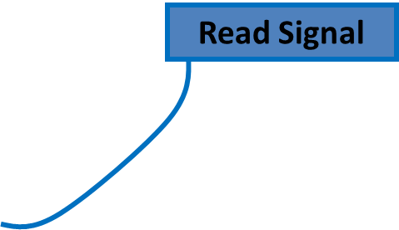




Minimum Mode- Pin Details

Slide 21
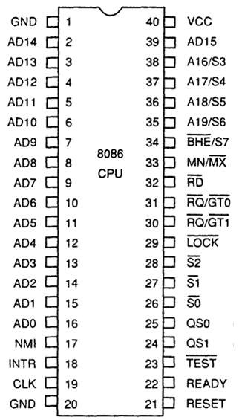
Maximum Mode - Pin Details
S2 S1 S0
000: INTA
001: read I/O port
010: write I/O port
011: halt
100: code access
101: read memory
110: write memory
111: none -passive
Status Signal
Inputs to 8288 to generate eliminated signals due to max mode.

Slide 22
Maximum Mode - Pin Details
Lock Output
Used to lock peripherals off the system
Activated by using the LOCK: prefix on any instruction
DMA Request/Grant
Lock Output

Slide 23
Maximum Mode - Pin Details
QS1 QS0
00: Queue is idle
01: First byte of opcode
10: Queue is empty
11: Subsequent byte of opcode
Queue Status
Used by numeric coprocessor (8087)

