Slide 1

Design Pattern
Name: Suleyman
Surname: Dadashov
Student number: 20180808004

Slide 2
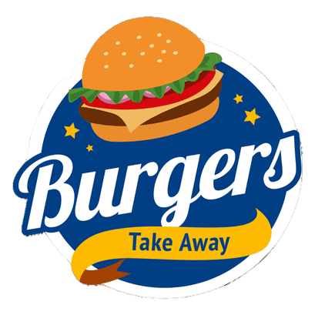
My project is to design a system for the DadaDonald mall restaurant. To use Design Pattern for the problems that may arise in this system.

Slide 3

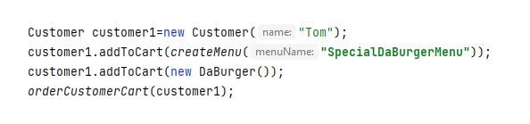
When a customer approaches the restaurant safe, a Customer class is created with their name. Then the customer's requests are added to his cart. He/She can also remove it from the cart if he/she wants.
Adding products to the cart is done with the addToCart() method. If a menu is to be added to the cart, first that menu is created with createMenu(“Menu Name”). This method returns the menu that can be added to the cart.
Factory Pattern is used while creating this menu.

Slide 4

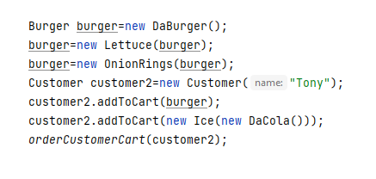
The customer can request a burger with extra meatball or lettuce , or add a drink to his cart with ice. We do this using the Decorator Pattern.

Slide 5

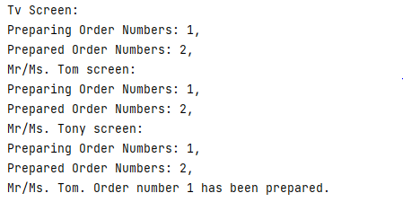
When creating a customer, each customer is given a screen like a phone. The number of the orders that are ready and prepared is written on this screen. The same articles appear on restaurant television. When the order is ready, the restaurant TV announces that the order is ready, along with the customer's name. Here, too, we use the Observer Pattern to send information to the screens.

Slide 6

This restaurant has a safe class (DadaSafe). In this class, the orders placed so far are kept together with their times and we can get how much earnings information from this class until now. Singleton Pattern was used because a single instance is needed in this structure.

Slide 7

The Happy End

