Slide 1
Tennis Court Booking App Progress
Full-stack web development with Django and React
Suleyman Eminov
12/12/2024
Notes:
Hook: “Imagine you want to reserve a tennis court for the weekend, but every time you call the club, the line is busy. Frustrating, right? That’s the problem I aimed to solve with my project.”
My project is the development of a Tennis Court Booking Web Application that enables clients to book courts remotely, while also giving tennis clubs an efficient tool to manage their court schedules. This project combines modern web development technologies to address a real-world issue.

Slide 2
Completed so far
JWT authentication (rest_framework_simplejwt)
Registration, login, logout, access token, refresh token, token lifetime
User groups (user, manager, coach)
User permissions (add_club, change_club, view_club)
Django Test user authentication
RegisterClubForm (register club to db)
View clubs

Slide 3
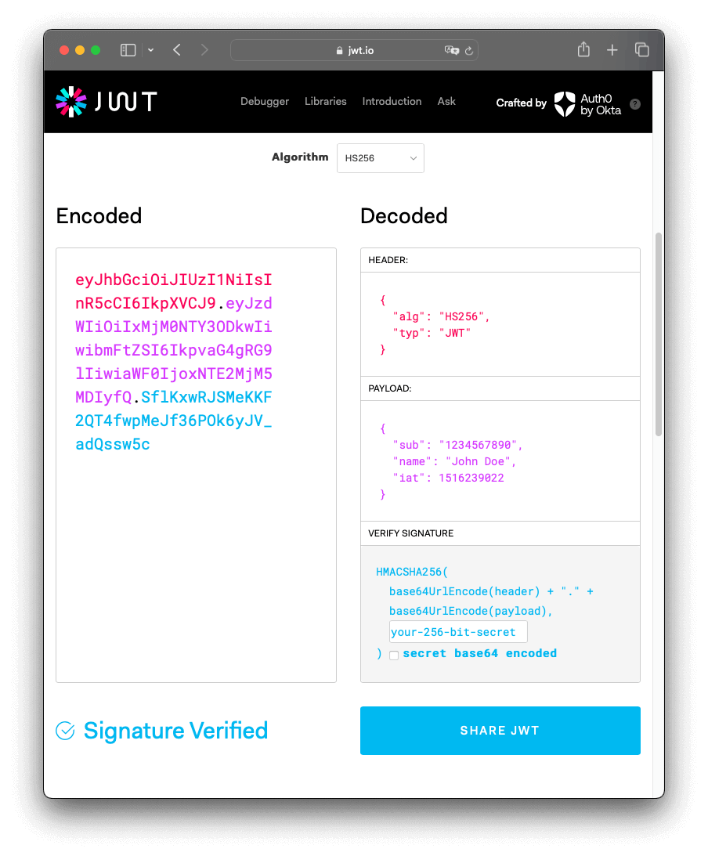
JWT Authentication
JWT is JSON Object which is used to transfer information over the web securely.
JWT Web token – [header].[payload].[signature]

Slide 4
Challenges overcame
User permissions and groups implementation
Refresh token (after timeout, refresh token didn’t work)
Solution: react interceptor

Slide 5
Current challenges
Logout bug - after clicking the logout button, the user doesn’t logout right away. Only after clicking the register or login button does it log out.
Db real-time access learning
Handle concurrent booking
Handle double bookings
What things I don’t realize I don’t know?

Slide 6
Next steps
Manager view to manage court availability
User view to see available time slots for courts and book via a booking form.
MVP by February
Booking
Manager view to push available time slots
User view to see available time slots
User form to book available time slots

