Slide 1
Tennis Court Booking Web Application
Full-stack web development with Django and React
Notes:
Hook: “Imagine you want to reserve a tennis court for the weekend, but every time you call the club, the line is busy. Frustrating, right? That’s the problem I aimed to solve with my project.”
My project is the development of a Tennis Court Booking Web Application that enables clients to book courts remotely, while also giving tennis clubs an efficient tool to manage their court schedules. This project combines modern web development technologies to address a real-world issue.

Slide 2


Web Applications
Static
Dynamic
Client
Server
GET / HTTP/1.1
Host: example.com
HTTP/1.1 200 OK
Content-Type: text/html

Slide 3
Workflow diagram
user logs in
user selects location/facility
user searches for available courts
user selects a coach
user selects a court and time
Payment information
Reservation is confirmed
Reservations should be addable to user’s calendars (in future)

Slide 4
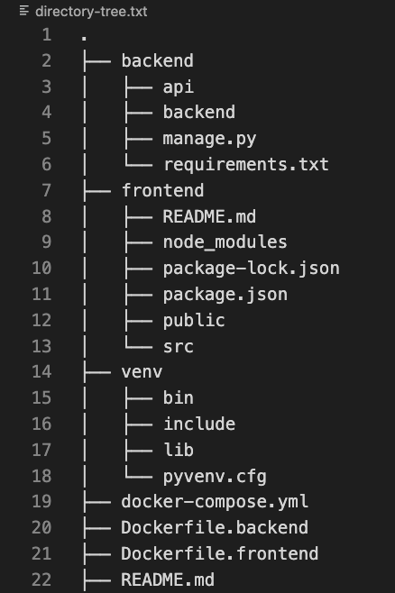
System Architecture

Slide 5
Docker
Platform for containerization
Package your application with dependencies
Resolves the “it works on my computer” problem ☺
Consistency across environments

Slide 6
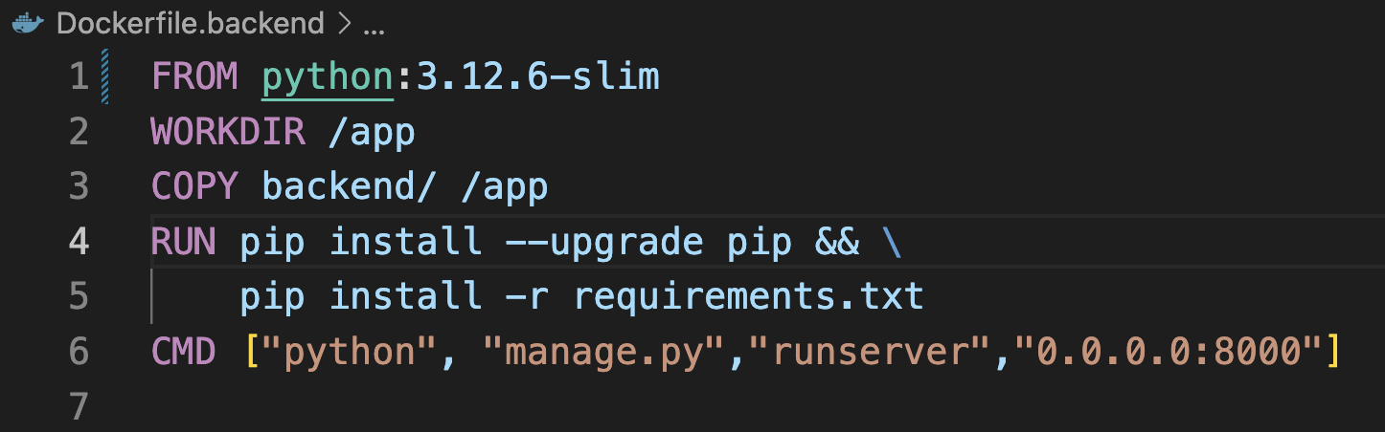
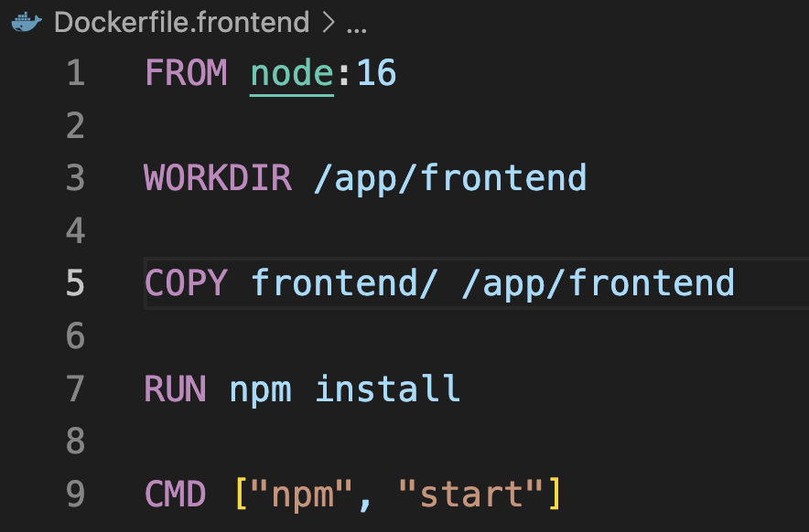

Slide 7
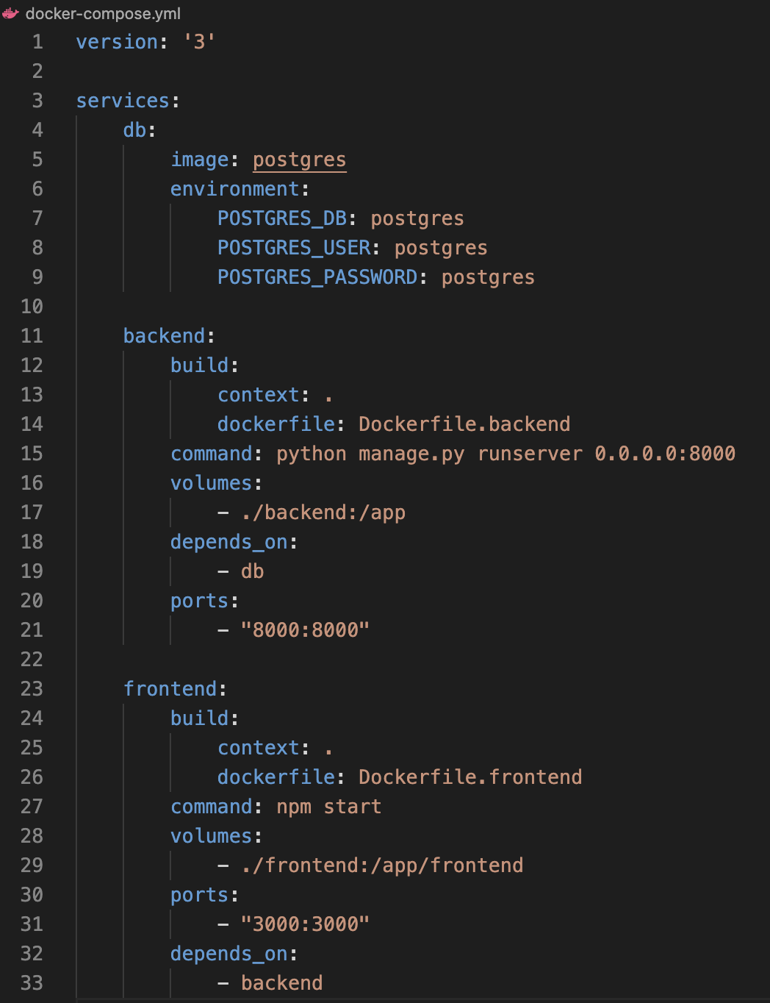

Slide 8
Django and Django REST Framework (API)

Slide 9
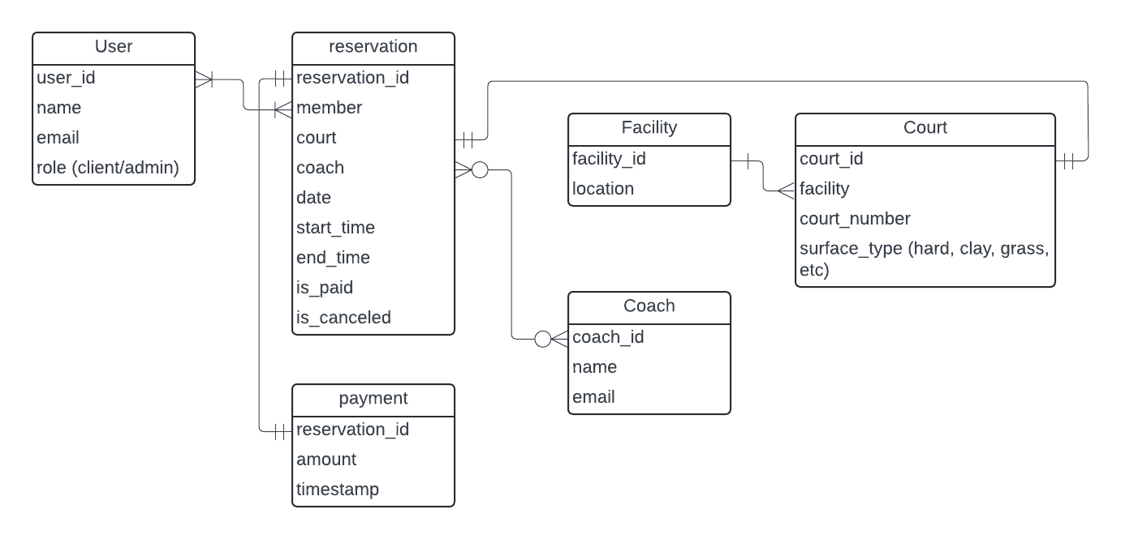
DB ERD diagram

Slide 10
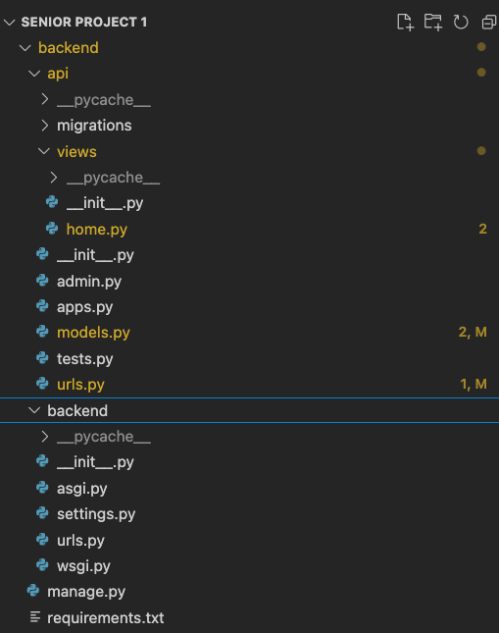
Django
Models
Views
Urls

Slide 11
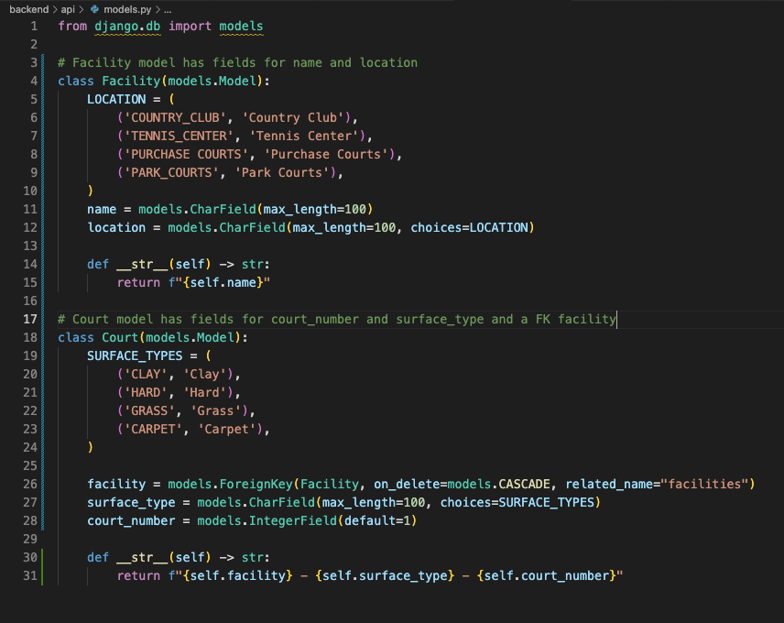
Django Models

Slide 12
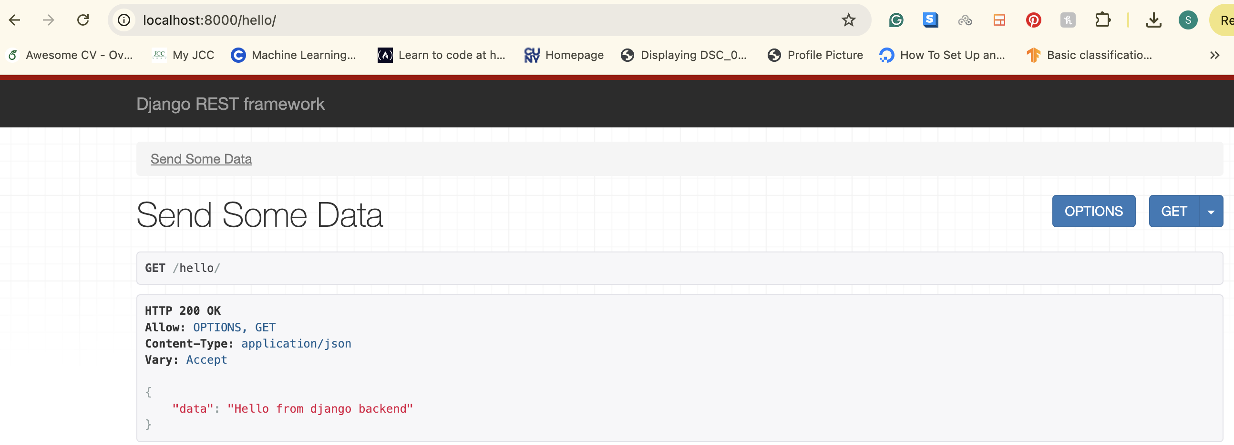
Django REST Framework (API)
Backend API
endpoints can be called from frontend
Sends JSON to frontend

Slide 13
React
Dynamic UI: Responsive
Component-Based Architecture

Slide 14
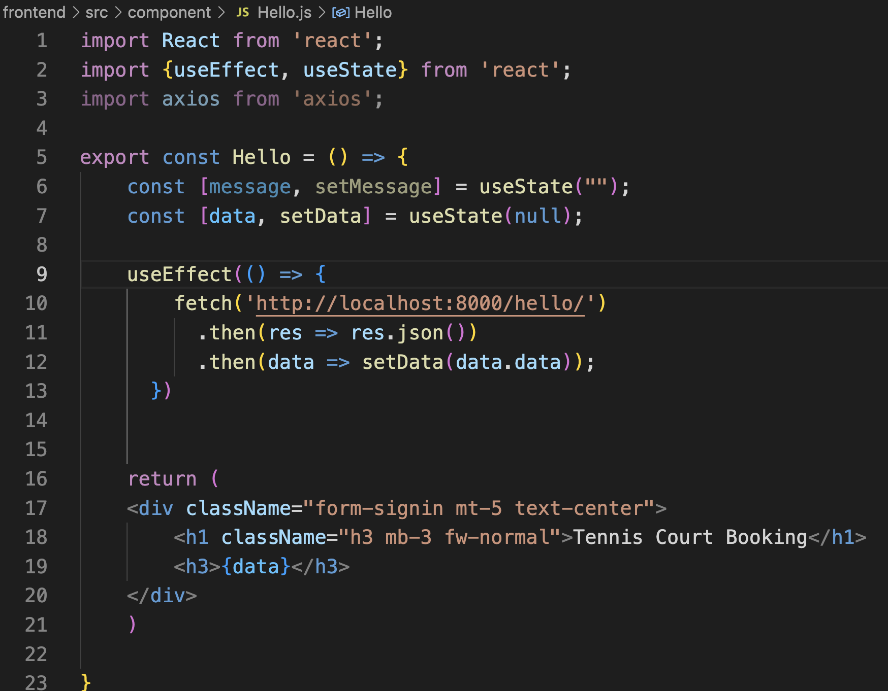
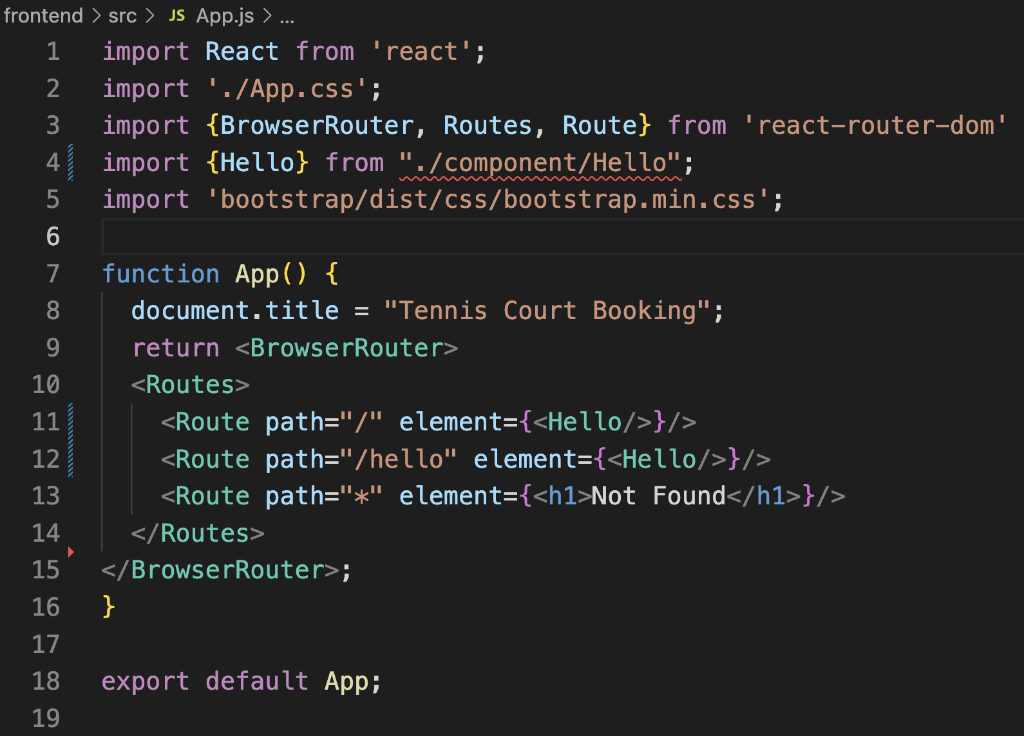

Slide 15
