Slide 1
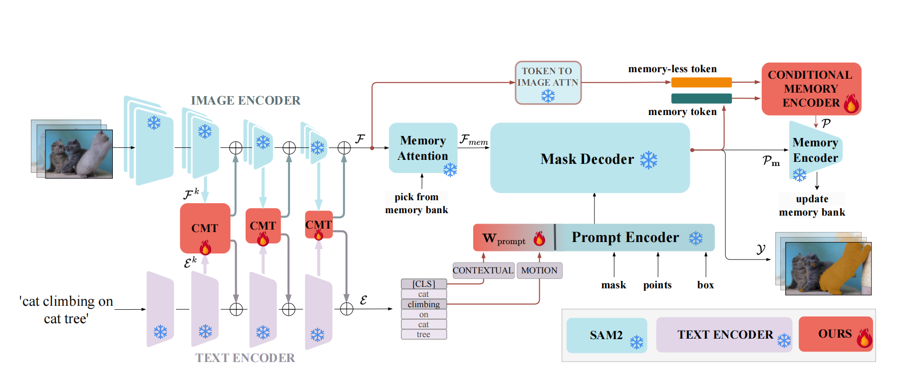

Slide 2

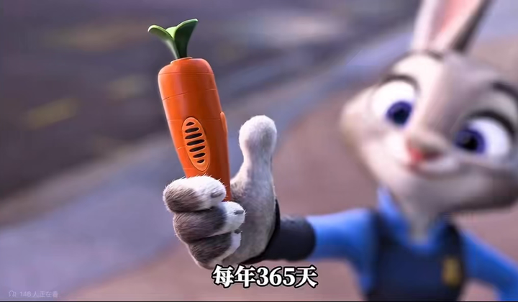



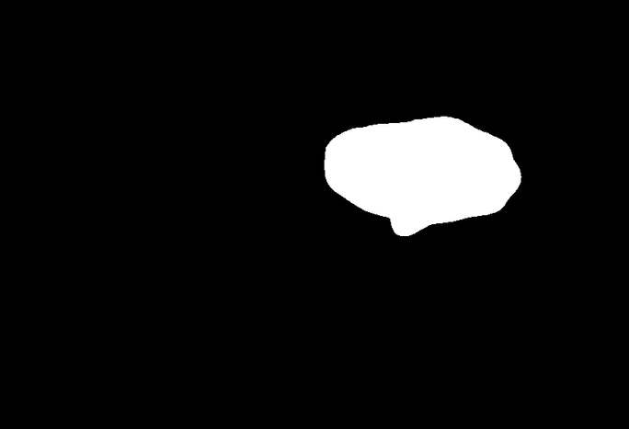




























Video Frame
Prompt Block
$${VF}_{1}$$
Hiera-B
$P_{1}$: the carrot
$P_{1}$: the red eyes
Encoder
$${VF}_{2}$$
$$×3$$
$${VF}_{3}$$
$P_{2}$: the rabbit
$P_{2}$: ones with anger
IMAGE ENCODER
CLIP-B
$${TF}_{1}$$
$P_{3}$: hand held
Stacking Encoders
$${TF}_{2}$$
$$×3$$
Stacking Encoders
$${TF}_{3}$$
Image Encoder
Prompt Encoder
PROMPT ENCODER
$${VF}_{1}$$
CMT 1
$${TF}_{1}$$
read state
Memory Attention
$${VF}_{2}$$
CMT 2
$${TF}_{2}$$
Memory Bank
$${VF}_{3}$$
CMT 3
$${TF}_{3}$$
write state
Mask Decoder
external explicit state store
CMT Module
TVA
VTA
HSA
$$P_{1}$$
$$P_{2}$$
T2V
V2T
Hiera-Select
Attention Score
Visual Embeddings
Cross Modal Temporal Module
Text Embeddings
(a) SAM2 Architecture
(b) P-MASk Encoder Blocks
Raw Image Information
Memory-FREE
IMG-tokens
Correcting Tracking Bias
Patch2Attn
CONDITIONAL MEMORY ENCODE
Memory Attention
Memory Embedding Block
Mask Decoder
Memory-Aware
IMG-tokens
$$P_{conditional}$$
M-Bank
$$P_{memory}$$
Mask Encoder
CONTEXTUAL
$$W_{prompt}$$
Prompt Encoder
get results
memory update
$$P_{1}$$
$$P_{2}$$
rabbit
carrot
mask
point
box
New-Load
M-Bank
MOTION
SAM2 Original Format
$$P_{3}$$
held
Results
(c) P-MASk MemoryTracking and Mask Generation

Slide 3
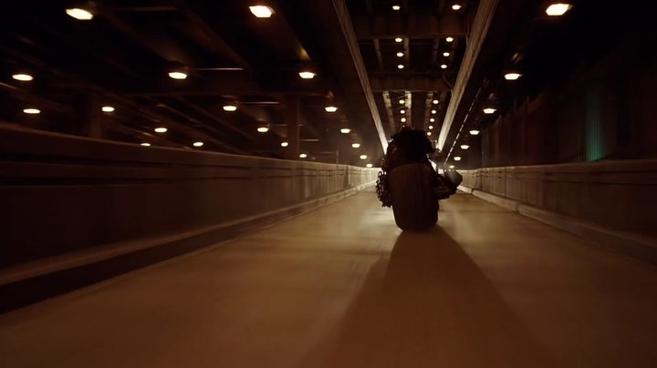
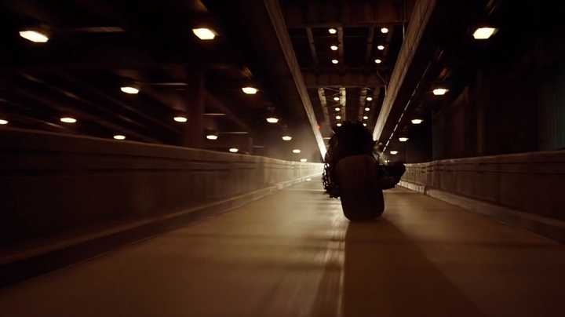

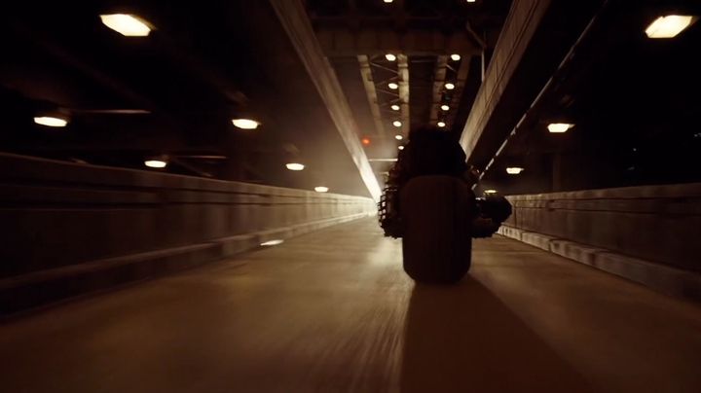
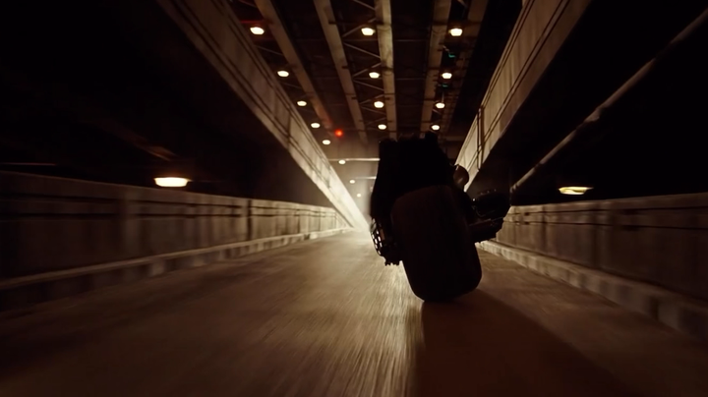

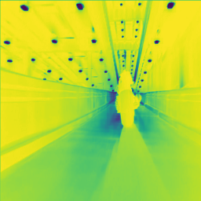
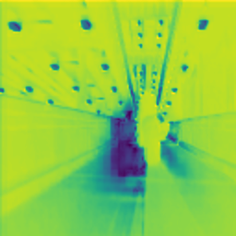
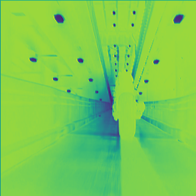
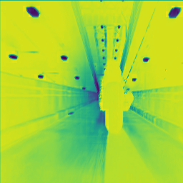





prompt input
P: one with the red eyes
Frame t
Frame t-1
Video Patch
Window
Hiera-B
Image Encoder
CLIP-B
Prompt Encoder
$$×3$$
$$×3$$
Frame t-2
Frame t-3
$$×{Patch}_{w}$$
T = x
$$F_{P}$$
positional
embedding
DOWN PROJECTION
HSA
Residual connection
Residual connection
T=4
P
Residual connection
VTA
TVA
Patches Division
$F_{k[n]}$ Size: ${TP}^{2}$
HSA1
HSA2
UP PROJECTION
query
key, value
Patch Size P Scaling
with Feature ROS
Multimodal embedding
Pixel to all tokens
(a) Hierarchical Selective Attention (HSA)
(b) P-MASk CMT Module

