Slide 1
Infosys Crowd Count People Counting Using Video Analytics
Presented By:
Nishanth H S
Priya Pushpam S
Ammana Pyare
Sanketh Singh
Cherkuri Likitha Rani
Sulfa Saji

Slide 2
MILESTONE1
Zone Detection System using OpenCV

Slide 3
Problem Statement
Monitoring crowded environments such as public spaces, events, or restricted areas is a challenging task when done manually, as it often leads to inaccuracies and inefficiencies. One of the major issues in crowd analysis systems is the lack of clearly defined regions of interest, which makes it difficult to track, analyze, and control crowd movement effectively. Without predefined zones, systems cannot accurately identify where people are located or detect overcrowding in specific areas. Therefore, there is a need for an interactive and flexible solution that allows users to define custom monitoring zones dynamically on live video feeds. This enables structured analysis, improves accuracy, and forms a foundation for advanced features like automated crowd detection, counting, and alert generation in future developments.

Slide 4
System Workflow
Start webcam
Load existing zones (if any)
Draw zones using mouse
Display zones with labels
Save zones to file
Modify/delete zones dynamically

Slide 5
Technologies Used
Python
OpenCV (cv2) → Video processing
JSON → Data storage
Random module → Unique zone colors

Slide 6
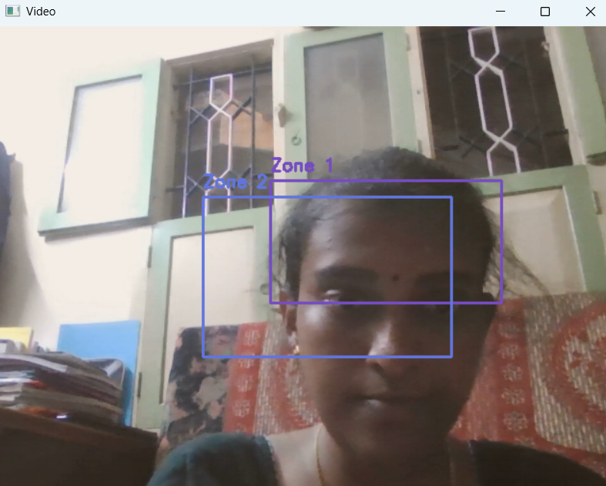
Output

Slide 7
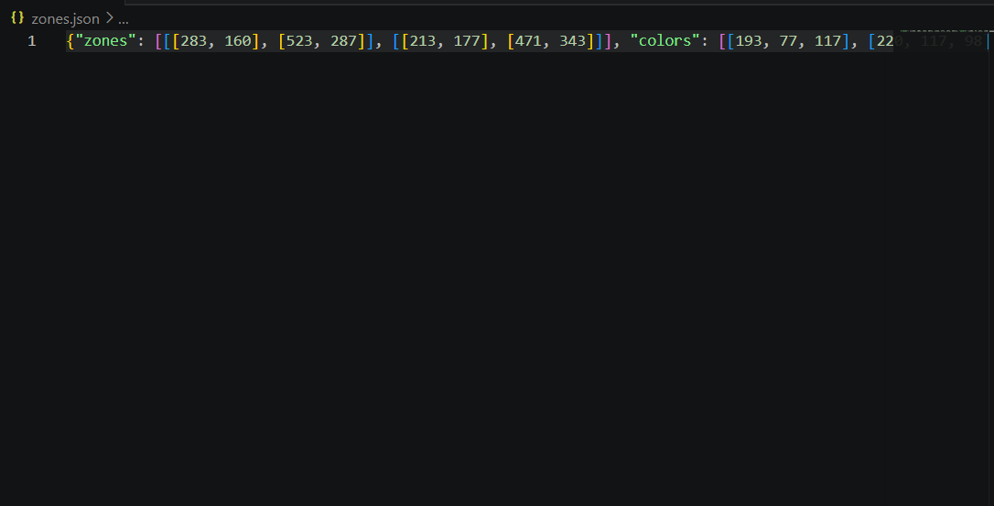
zones.json file:

Slide 8
Milestone-2
Advanced Zone Management & Monitoring Tool

Slide 9
System Workflow
Load saved zones
Start webcam feed
Draw zones using mouse
Display zone details
Log zone creation
Manage zones using keyboard controls

Slide 10
Technologies Used
Python
OpenCV (cv2) → Video processing
JSON → Zone storage
Datetime → Timestamp logging
Time module → Screenshot naming

Slide 11
User Controls
Key | Function
Mouse | Draw zone
d | Delete last zone
r | Reset all zones
p | Capture screenshot
f | Toggle fullscreen
q | Quit

Slide 12
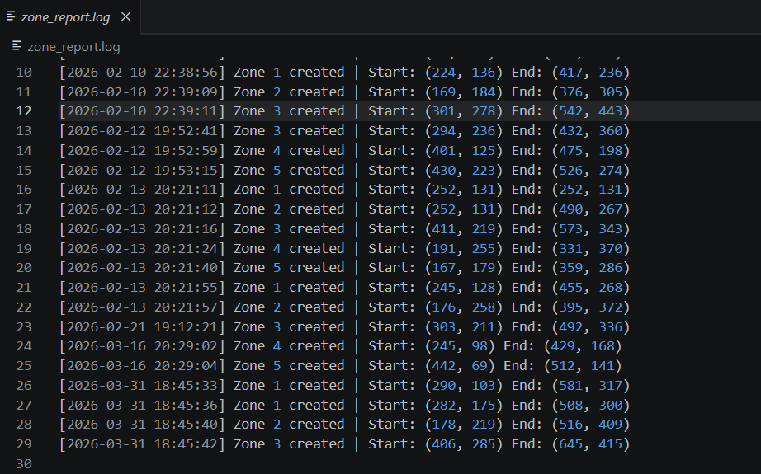
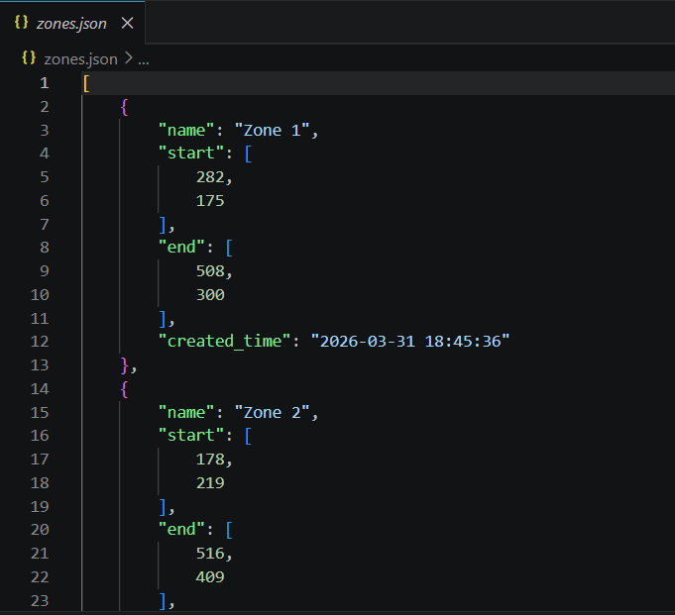
Output

Slide 13
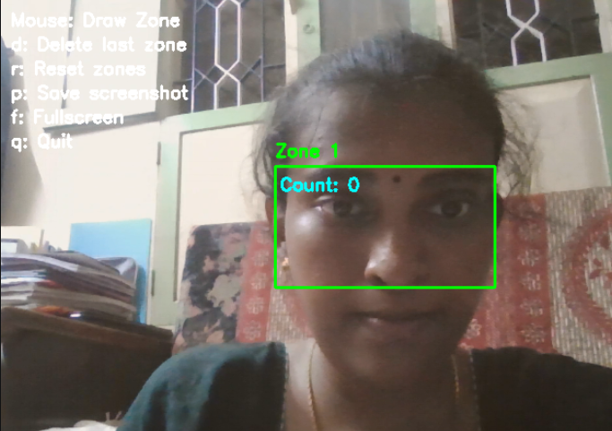

Slide 14
MILESTONE-3
simulation-based crowd tracking system

Slide 15
System Workflow
Initialize virtual persons
Assign unique IDs
Move persons randomly
Detect crossing of boundary line
Update entry/exit counts
Store data in CSV

Slide 16
Technologies Used
Python
OpenCV → Visualization
NumPy → Frame creation
CSV → Data logging
Random module → Movement simulation

Slide 17
Key Features
✔ Real-time simulation ✔ Unique person identification ✔ Entry & exit detection ✔ Zone-based counting ✔ Data logging to CSV ✔ Visual tracking with IDs

Slide 18
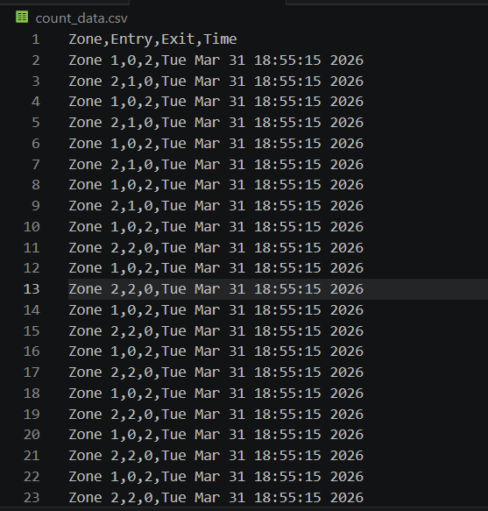
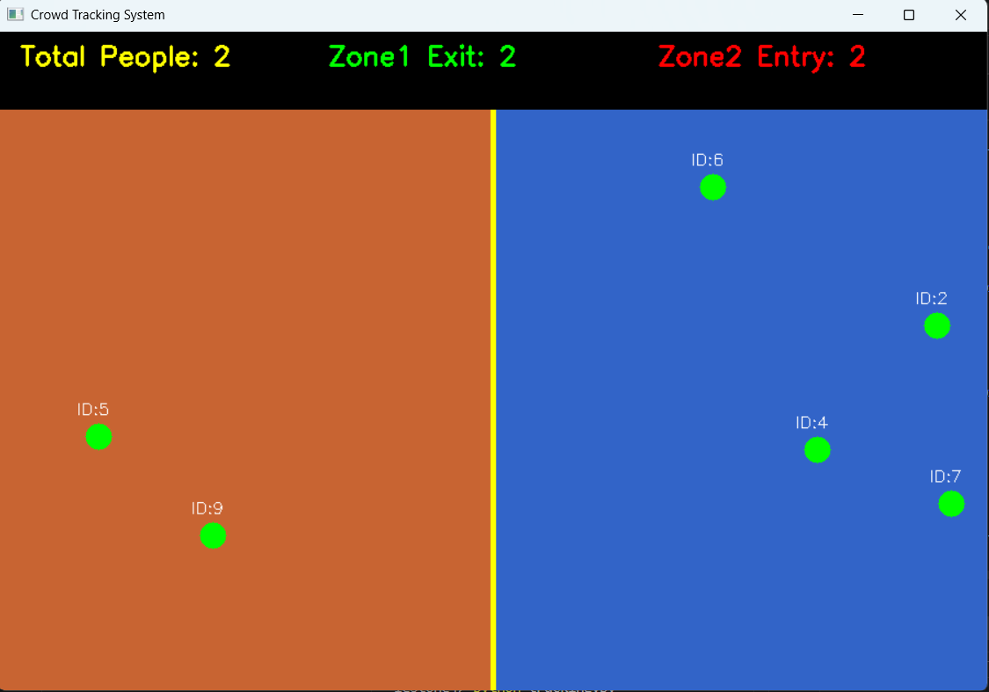
Output

Slide 19
MILESTONE-4

Slide 20
TASKS:
Task 1 – Store Crowd Data
Task 2 – Display Live Crowd Statistics
Task 3 – Create Overcrowding Alert
Task 4 – Show Alert on Screen
Task 5 – Save Alert Screenshot
Task 6 – Generate Crowd Report
Task 7 – Create Simple Graphs
Task 8 – Build Monitoring Interface
Task 9 – Add System Logs
Task 10 – Final System Testing

Slide 21
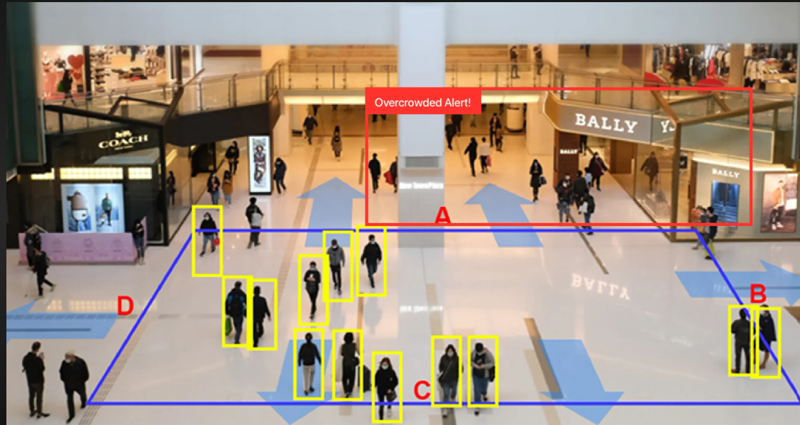
Overcrowding alert

Slide 22
Technologies Used:
Technology | Purpose
Python | Core programming language
OpenCV (cv2) | Video frame generation and visualization
NumPy | Frame creation and array operations
CSV | Data storage for crowd activity
Pandas | Data analysis and report generation
Matplotlib | Graph generation
Logging Module | System event tracking
Datetime | Timestamp generation
Random Module | Simulated people movement

Slide 23
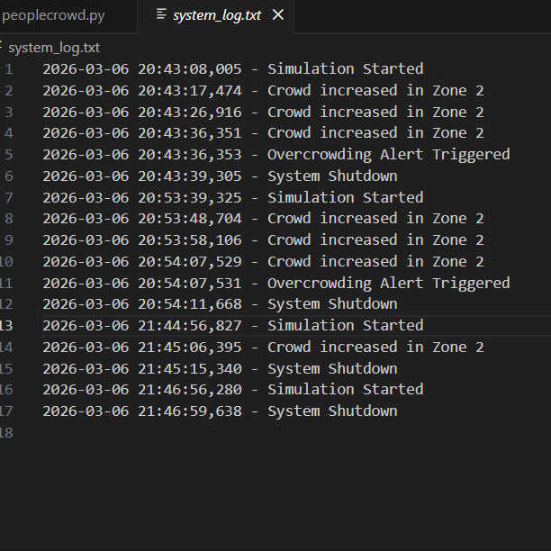
Output screenshots:
System_log.txt file:

Slide 24
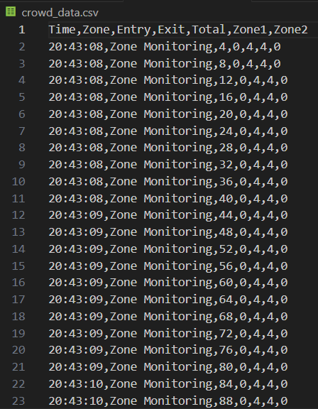
Crowd_data.csv file:

Slide 25
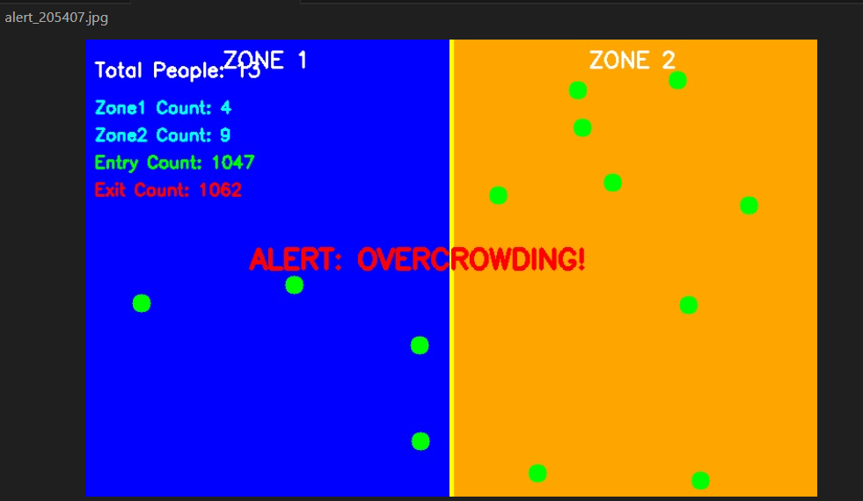
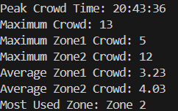
Alert Screenshot:

Slide 26
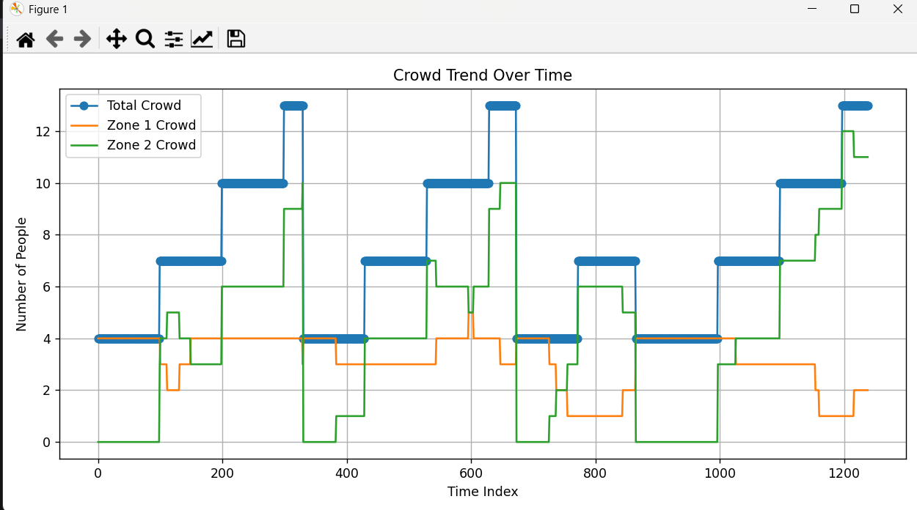
Graph Represemtation:

Slide 27
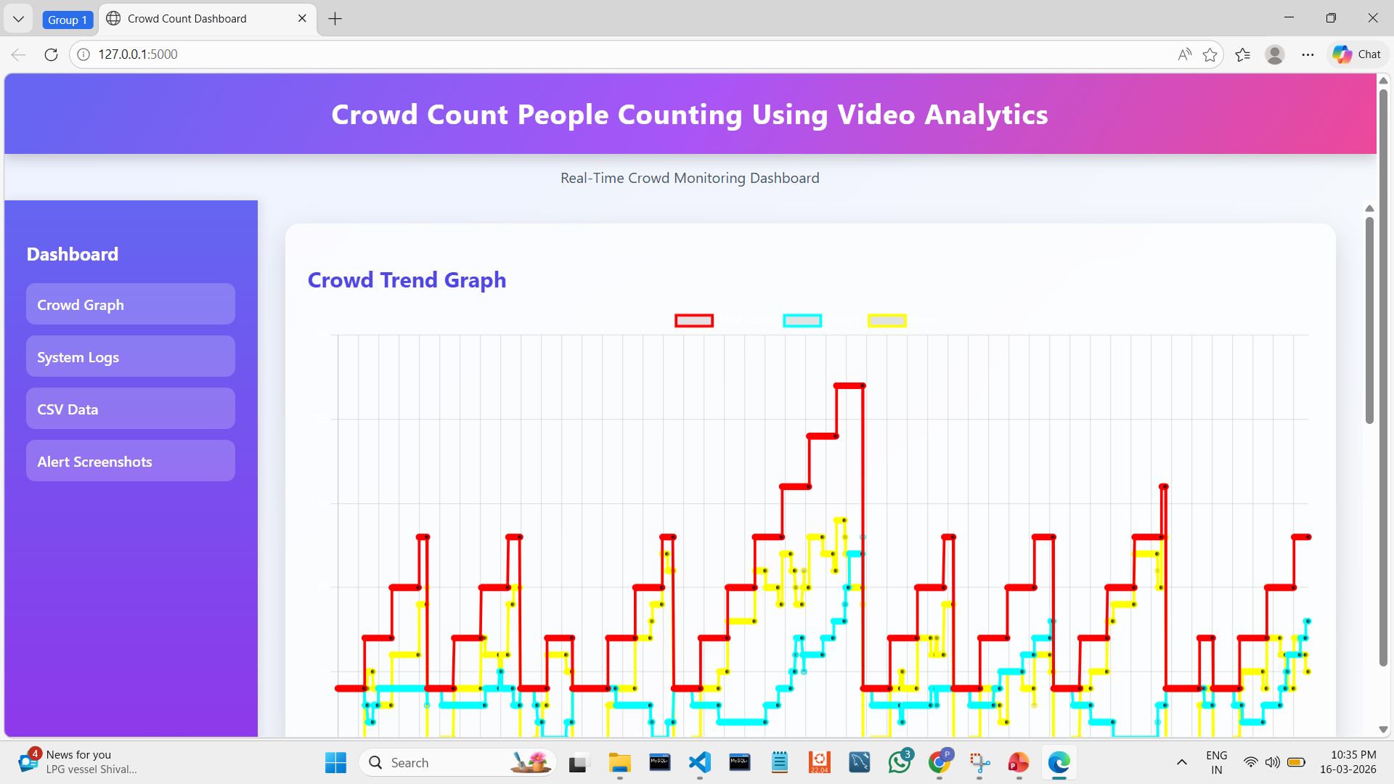
Dashboard

Slide 28
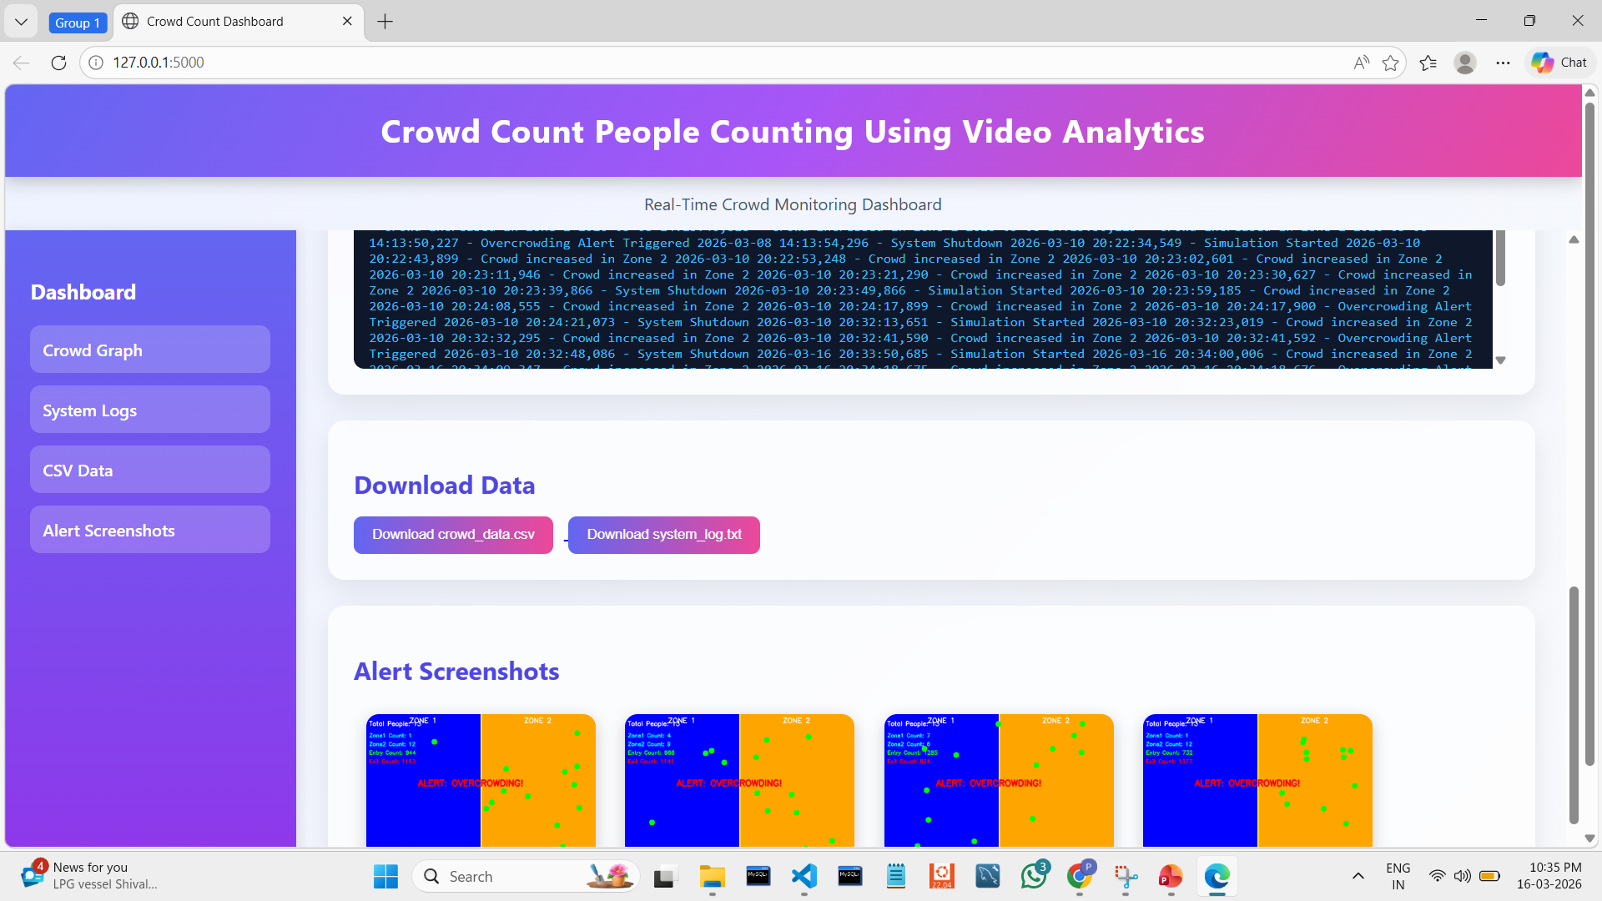

Slide 29
FUTURE IMPLEMENTATIONS
Advanced Tracking Algorithms
Use DeepSORT or BoT-SORT for improved tracking accuracy
Combines motion + appearance features
Reduces ID switching in dense crowds
Multi-Camera Integration
Supports monitoring from multiple cameras
Covers large areas like malls, airports, events
Reduces blind spots and improves coverage
Cloud-Based Monitoring
Enables remote access to crowd data
Supports real-time monitoring from anywhere
Provides centralized control and analytics

Slide 30
Low-Light Detection Enhancement
Improves detection in poor lighting conditions
Uses advanced deep learning models
Ensures consistent performance day and night
Behavior & Anomaly Detection
Detects unusual crowd activities
Identifies sudden gatherings or panic movement
Provides early warnings (not just reactive alerts)
IoT & Smart City Integration
Connects with smart city infrastructure
Triggers automatic alerts and responses
Enhances scalability and real-world deployment

Slide 31
Conclusion
The CrowdCount system demonstrates the effective use of AI and computer vision for real-time people counting and crowd monitoring. By combining YOLOv8 detection, ByteTrack tracking, and zone-based logic, it provides accurate analytics, live monitoring, and automated alerts. The system is scalable and suitable for real-world applications, highlighting its potential for improving crowd management and safety.

Slide 32
THANK YOU…

