Slide 1
Special Course in Software Engineering ‘24
MINI-PROJECT PRESENTATION
Dream what you want to dream; go where you want to go; be what you want to be, because you have only one life and one chance to do all the things you want to do.
GROUP NO.17

Slide 2
1
Group Introduction
目录
2
Dataset
CONTENT
3
Analysis
4
Interesting Results

Slide 3
1
Group Introduction

Slide 4
Group members and their contribution
Member Name | Contribution to the Mini-project
Youmei Gong | Data Inspection
Shulin Cao | Data Analysis
Xiaoting Sha | Data Analysis
Jing Xu | Integration

Slide 5
2
Dataset

Slide 6
Dataset introduction
Dataset name: heart_attack_prediction_dataset.csv
Brief description:
This CSV file contains relevant information about the risk of heart disease in patients.
Each row represents a patient's record, and each column represents a specific feature or attribute.
Variable Name | Type | Mean | Median | Mode | Kurtosis | Skewness
Patient ID | Nominal | NA | NA | NA | NA | NA
Age | Ratio | 53.71 | 54.0 | 90 | -1.21 | 0.03
Sex | Nominal | NA | NA | NA | NA | NA
Cholesterol | Ratio | 259.88 | 259.0 | 235 | -1.18 | -0.001
Blood Pressure | Nominal | NA | NA | NA | NA | NA
Heart Rate | Ratio | 75.02 | 75.0 | 94 | -1.21 | -0.003
Diabetes | Ratio | 0.65 | 1.0 | 1 | -1.59 | -0.64
Family History | Ratio | 0.49 | 0.0 | 0 | -2.00 | 0.03
Smoking | Ratio | 0.90 | 1.0 | 1 | 4.81 | -2.61
Obesity | Ratio | 0.50 | 1.0 | 1 | -2.00 | -0.006
Alcohol Consumption | Ratio | 0.60 | 1.0 | 1 | -1.84 | -0.40

Slide 7
Variable Name | Type | Mean | Median | Mode | Kurtosis | Skewness
Exercise Hours Per Week | Ratio | 10.01 | 10.07 | 0.0244 | -1.20 | -0.02
Diet | Nominal | NA | NA | NA | NA | NA
Previous Heart Problems | Ratio | 0.50 | 0.0 | 0 | -2.00 | 0.02
Medication Use | Ratio | 0.50 | 0.0 | 0 | -2.00 | 0.01
Stress Level | Ratio | 5.47 | 5.0 | 2 | -1.23 | 0.01
Sedentary Hours Per Day | Ratio | 5.99 | 5.93 | 0.0126 | -1.19 | 0.02
Income | Ratio | 158263.18 | 157866.0 | 225278 | -1.18 | 0.02
BMI | Ratio | 28.89 | 28.77 | 18.00 | -1.19 | 0.04
Triglycerides | Ratio | 417.68 | 417.0 | 799 | -1.20 | -0.002
Physical Activity Days Per Week | Ratio | 3.49 | 3.0 | 3 | -1.23 | 0.02
Sleep Hours Per Day | Ratio | 7.02 | 7.0 | 10 | -1.23 | 0.00
Country | Nominal | NA | NA | NA | NA | NA
Continent | Nominal | NA | NA | NA | NA | NA
Hemisphere | Nominal | NA | NA | NA | NA | NA

Slide 8
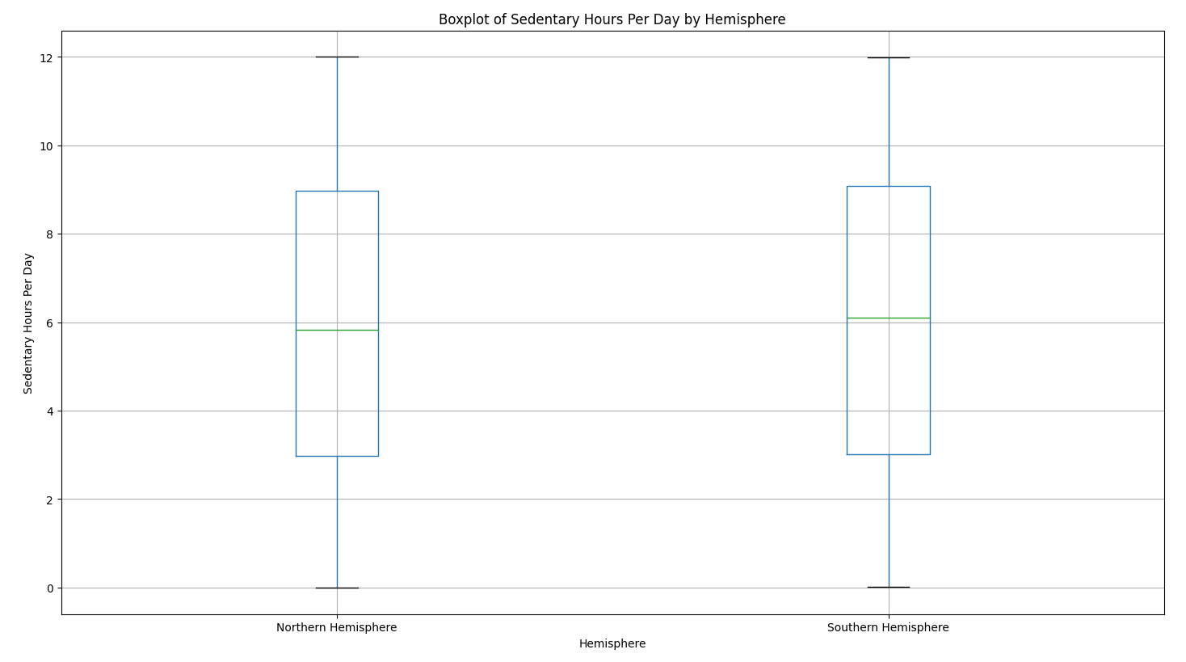
Box map of sedentary time in northern and southern hemispheres

Slide 9
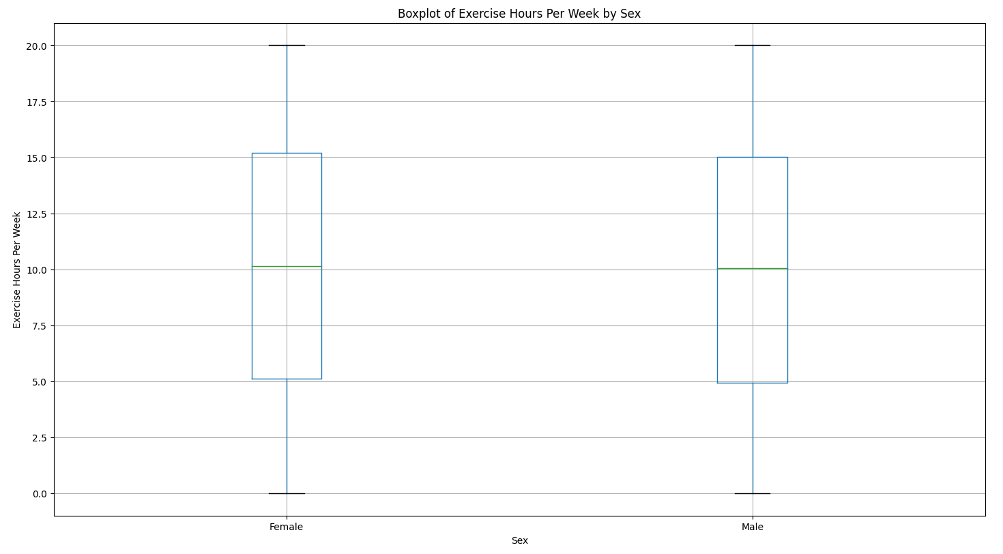
Chart of weekly working hours for male and female patients

Slide 10
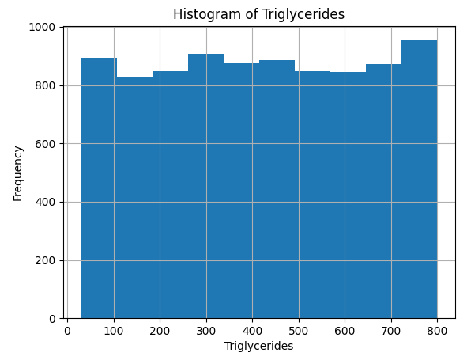
Patient's triglyceride level bar chart

Slide 11
3
Analysis

Slide 12
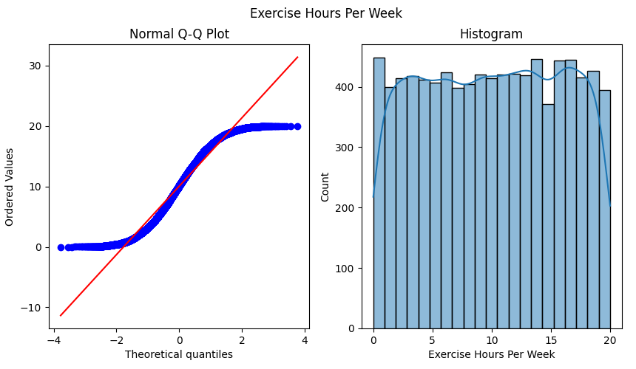
ANOVA

Slide 13
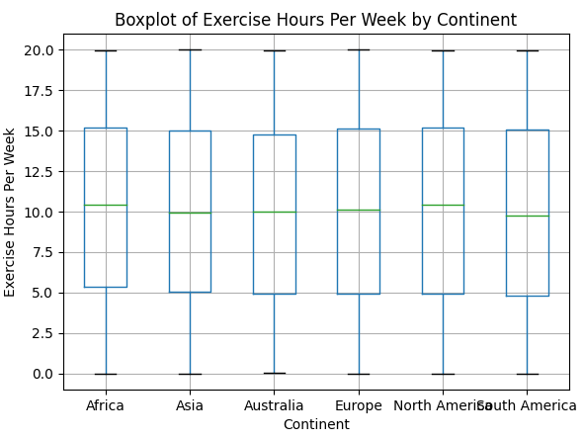
ANOVA

Slide 14
ANOVA
Exercise Hours Per Week & Continent
Interval Variable: Exercise Hours Per Week
Categorical Variable: Continent
H0: There is no significant difference in the mean exercise hours per week across the different continents.
Ha: There is a significant difference in the mean exercise hours per week across the different continents.
Test Result：
F-statistic: 0.4671581513198155, p-value: 0.8009830763168034

Slide 15
ANOVA
In this analysis, we used ANOVA to test whether there were significant differences in Exercise Hours Per Week across continents. Our findings are as follows:
The -F statistic is 0.467, which represents the ratio of between-group variation to within-group variation. A low F-score usually means that the groups differ less, or that the groups have similar means.
The -p-value is 0.800, which is well above the commonly used significance level (e.g., 0.05 or 0.01). This indicates that we do not have enough evidence to reject the null hypothesis.
This result may imply that while culture and lifestyle may influence exercise behavior, exercise habits are not significantly different across continents in the sample we analyzed. This provides a basis for further research, which could consider the effect of other variables (such as age, gender, financial status, etc.) on the number of hours of exercise to more fully understand the determinants of exercise behavior.

Slide 16
Chi-square Test
Smoking & Country
Categorical Variable (Ordinal): 'Smoking'
Categorical variable (Nominal): 'Country'
H0: There is no statistically significant association between 'Country' and 'Smoking'
Ha: There is a statistically significant association between 'Country' and 'Smoking'

Slide 17
Chi-square Test
Test Result：
Chi-square statistic: 12.731375719752, p-value: 0.8520341769210303
We selected two nominal variables (Country and Smoking) and conducted a chi square test.
The null hypothesis of chi square test is that two categorical variables are independent of each other, meaning their probability distributions are not affected by each other. If the p-value is greater than 0.05, we cannot reject the null hypothesis and assume that these two variables are independent. In this test, the p-value is 0.8520341769210303, which is greater than 0.05, so we cannot reject the null hypothesis and assume that the variables Country and Smoking are independent.

Slide 18
Linear Regression
BMI & Stress Level
Interval Variable (Ratio): 'BMI'
Interval variable (Ratio): 'Stress Level'
H0: There is no significant linear relationship between BMI and Stress Level.
Ha: There is significant linear relationship between BMI and Stress Level.
Test Result：
Slope: -0.001470926296407546,
Intercept: 5.512199344277715,
R-squared: 1.0565407099802685e-05, p-value: 0.7609491085926147,
Std Err: 0.004834690305750544

Slide 19
Linear Regression
Based on the given results, we can conduct the following analysis:
1. Slope: -0.001470926296407546
Due to the slope being very close to 0, this indicates that there is almost no linear relationship between BMI and Stress Level.
2. Intercept: 5.512199344277715
When BMI is 0, the predicted Stress Level is approximately 5.512. However, since BMI is usually not zero, this value may not have much significance in practical applications.

Slide 20
4
Interesting Results

Slide 21
Interesting Hypothesis
t-test or Mann-Whitney U Test
Stress Level & Sex
interval variable: Stress Level nominal variable: Sex
H0: There is no significant difference in the median level of stress between males and females.
Ha: There is a significant difference in the median level of stress between males and females.

Slide 22
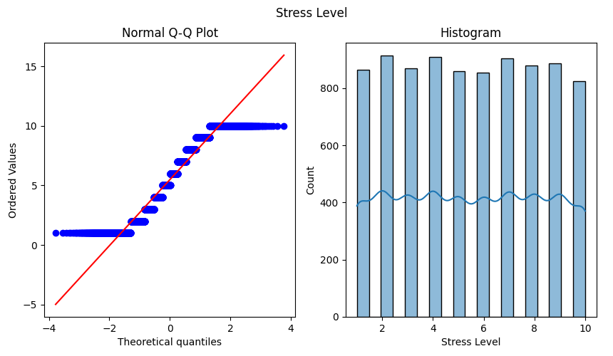
t-test or Mann-Whitney U Test

Slide 23
t-test or Mann-Whitney U Test
In this dataset:
The interval variable "Stress Level" is a continuous variable that can be measured.
The nominal variable "Sex" is a categorical variable.
The Mann-Whitney U statistic is 7881661.5, and the p value is 0.020354987218882833. Since the P-value is less than the commonly used significance level of 0.05, we can reject the null hypothesis that there is no significant difference in the median between the two groups. Therefore, based on the results of the Mann-Whitney U test, we can assume that "Stress Level" differs significantly between different categories of "Sex".
This means that there may be differences in median stress levels between men and women. However, the Mann-Whitney U test only provides information about the difference in the median, not about the difference in other statistics, such as the mean or variance.

Slide 24
End
THANK YOU VERY MUCH FOR SCANNING
Dream what you want to dream; go where you want to go; be what you want to be, because you have only one life and one chance to do all the things you want to do.
GROUP NO.17

