Slide 1
SOAP
Jason Sullenger
15 May 2019
WEB-420 RESTful APIs

Slide 2
WHAT IS SOAP
SOAP - Simple Object Access Protocol
Has pre-defined rules and isn’t as flexible as REST
It’s a message protocol that allows distributed elements of an application to communicate
Transports data for web services
Mainly use HTTP transfer protocols
Can also use SMTP, TCP, and UDP

Slide 3
WHAT IS SOAP - XML
SOAP uses XML
Extensible Markup Language
XML was created to store and transport data
Similar to HTML and easy to read
Consists of information wrapped in tags
Doesn’t “DO” anything

Slide 4
WHAT IS SOAP – MESSAGE STRUCTURE
Envelope - required element
“Sets the beginning and end of the message” (Tutorialspoint.com, "SOAP - Message Structure")
Header - optional element
“Contains attributes used for processing the message” (Tutorialspoint.com, "SOAP - Message Structure")
Body - required element
The data of the message being sent is included here
Fault - optional element
Information for error handling that may occur is included in this element

Slide 5
ENVELOPES
<Envelope></Envelope> - Required Element
Declares the start and end of the message
An envelope must contain a body element
“The SOAP envelope solves the problem of knowing when you are done receiving a message and are ready to process it. The SOAP envelope is therefore basically a packaging mechanism” (Tutorialspoint.com, "SOAP - Envelope")
“XML envelopes can contain data that supplements the data within the XML documents” (Ohlinger, Sharkey, & Cai, 2017)
“XML envelopes can be used to combine multiple XML documents into a single, valid XML instance message” (Ohlinger, Sharkey, & Cai, 2017)

Slide 6
HEADERS
<Header></Header> - Optional Element
“The header will contain recipient, subject line, date, and other information” (Myer, 2016)
All attributes used for processing the message
“The header is encoded as the first immediate child element of the SOAP envelope” (Tutorialspoint.com, "SOAP - Header")
Header Attributes
Actor attribute
MustUnderstand attribute - regulates if processing the element is required or not

Slide 7
FAULTS
<Fault></Fault> - Optional Element
Contains information for errors that may occur (errors, error codes, and status information)
<Faultcode> Required Element
The code used for identifying the error
<Faultstring> Required Element
A brief explanation of the error
<Faultactor> Optional Element
Information about what triggered the error

Slide 8
FAULT CODES
Must be included in the faultcode element
VersionMismatch – “The SOAP node processing the request encountered a version mismatch. The namespace identifier of the SOAP envelope determines version compatibility” (Jewell & Chappell, 2002)
MustUnderstand – “The SOAP processor was not able to recognize the element or was not capable of processing it” (Jewell & Chappell, 2002)
Client – “The content generated by the client is incorrect or malformed” (Jewell & Chappell, 2002)
The same error will occur if the data is resent.
Server – “The content sent by the client is perfectly acceptable, but the SOAP processor is unable to process it for some reason, such as an unavailable service” (Jewell & Chappell, 2002)
Sending the same data could result in success

Slide 9
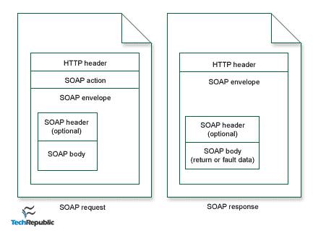
SOAP API – DATA FLOW
“Client wraps a method call in SOAP/XML” (Moore, 2001)
Posted over HTTP to the server
Any type of data being sent to the server
HTTP request/response model
A “listener” is used by the server to process SOAP requests
“This is server code at the specified URL for parsing the XML request, making the procedure call, and wrapping the result in XML to send as the response” (Moore, 2001)
SOAP uses the standard HTTP request/response model.
("Figure A", 2001)

Slide 10
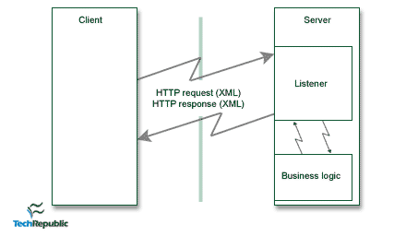
SOAP API – DATA FLOW
“The XML request is parsed to read the method name and parameters passed and delegated for processing” (Moore, 2001)
“Parsing - to analyze (a string of characters) in order to associate groups of characters with the syntactic units of the underlying grammar” (Parse, n.d.)
“The XML response is then sent back to the client, containing the return value—or fault data—of the method call” (Moore, 2001)
XML request and response formats a similar
“The client may parse the response XML to make use of the return value” (Moore, 2001)
Data flow of a SOAP call
("Figure B", 2001)

Slide 11
WORKS CITED
Jewell, T., & Chappell, D. A. (2002, March). Error Handling with SOAP Faults. Retrieved from https://www.oreilly.com/library/view/java-web-services/0596002696/ch04s02.html
Moore, B. (2001, April 2). An introduction to the Simple Object Access Protocol (SOAP). Retrieved from https://www.techrepublic.com/article/an-introduction-to-the-simple-object-access-protocol-soap/
Myer, T. (2016, February 02). A Really, Really, Really Good Introduction to XML. Retrieved from https://www.sitepoint.com/really-good-introduction-xml/
Ohlinger, M., Sharkey, K., & Cai, S. (2017, June 07). XML Message Envelopes. Retrieved from
https://docs.microsoft.com/en-us/biztalk/core/xml-message-envelopes
Parse. (n.d.) In Oxford Living Dictionary. Retrieved from https://en.oxforddictionaries.com/definition/parse
Tutorialspoint.com. (n.d.). SOAP - Header. Retrieved from https://www.tutorialspoint.com/soap/soap_header.htm
Tutorialspoint.com. (n.d.). SOAP - Message Structure. Retrieved from https://www.tutorialspoint.com/soap/soap_message_structure.htm
Tutorialspoint.com. (n.d.). SOAP - Envelope. Retrieved from https://www.tutorialspoint.com/soap/soap_envelope.htm

