Slide 1
REST Representational State Transfer
Jason Sullenger
04 May 2019
WEB-420 RESTFul APIs

Slide 2
The relationship between HTTP messages and REST
Data exchanges between server and client are done via HTTP messages
Types of HTTP messages
“Requests- sent by the client to trigger an action on the server” ("HTTP Messages", 2019)
“Responses- the answer from the server” ("HTTP Messages", 2019)

Slide 3
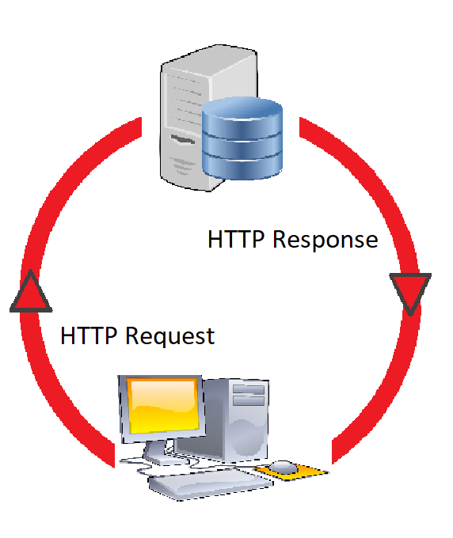
Requests from the client – responses from the server

Slide 4
The ROLE of rest in modern web apps
Utilizing resources using common HTTP verbs
GET, POST, PUT, PATCH, and DELETE
Maintaining stateless communication
Every request includes all necessary information
Error Codes
Supplying a code and message to the user

Slide 5
The key features of REST
It’s Stateless
This means that every time we refer to it, it will be necessary to remind it our data, whether it is our user credentials or any other information
It’s easily scalable
Scalability is maximized as data isn’t held up in memory
Less data stored = less reliance on more powerful servers
Support JSON and XML
“REST API’s satisfy the expectations of those who use the JSON language as much as it satisfies those that rely on XML” ("Find out the 5 key features of the REST API", 2016)
Multiple languages keep more developers from feeling ignored

Slide 6
The Key features of rest continued
REST is more simple than SOAP
Soap- Simple Object Access Protocol
An alternative protocol- not an architecture
The simplicity of REST is advantageous on multiple levels:
Has access to more powerful services
More convenient
Simpler Interaction

Slide 7
The Key features of REST concluded
Documentation
Changes made to REST APIs should be included in the documentation
Allows for easier access for developers
Can be difficult but tools are available to assist with this process
Error Messages
Provides lists of possible error messages
These error messages are made even more helpful when they can provide additional information about which error you have encountered.

Slide 8
HTTP verbs
POST
The POST verb is most-often utilized to **create** new resources.
In particular, it's used to create subordinate resources.
GET
The HTTP GET method is used to **read** (or retrieve) a representation of a resource.
DELETE
Used to **delete** a resource identified by a URI.
(Fredrich)

Slide 9
HTTP verbs continued
PUT
Most-often utilized for **update** capabilities, PUT-ing to a known resource URI with the request body containing the newly-updated representation of the original resource
PATCH
Used for **modify** capabilities.
The PATCH request only needs to contain the changes to the resource, not the complete resource
(Fredrich)

Slide 10
Stateless client/server protocol
Client-Server architecture keeps resources separate
“The client is responsible for requesting and displaying the data while the server is taking care of data storage and application logic.” (Luecke, 2018)
“One advantage is that both sides can be developed separately as long as the agreed-upon request format is followed” (Luecke, 2018)
Stateless client-server communication
Every client request includes all the information necessary for the server to process your request
“This further reduces server complexity since no global state (other than a possibly shared database) is necessary and improves scalability since any request can be processed by any server.” (Luecke, 2018)

Slide 11
Works Cited
Find out the 5 key features of the REST API. (2016, October 19). Retrieved from https://bbvaopen4u.com/en/actualidad/find-out-5-key-features-rest-api
Fredrich, T. (n.d.). Using HTTP Methods for RESTful Services. Retrieved from https://www.restapitutorial.com/lessons/httpmethods.html
HTTP Messages. (2019, March 18). Retrieved from https://developer.mozilla.org/en-US/docs/Web/HTTP/Messages
Luecke, D. (2018, November 18). Design patterns for modern web APIs. Retrieved from https://blog.feathersjs.com/design-patterns-for-modern-web-apis- 1f046635215

