Slide 1
OAuth – Open Authorization
Jason Sullenger
23 June 2019
WEB-420 RESTful APIs

Slide 2
What is OAuth
OAuth is an open-standard authorization protocol
Websites can be accessed with credentials from a single service provider
“… your password, phone, digital certificate, biometric identity, two-factor authentication (2FA) or multi-factor authentication (MFA) SSO solution to log onto one place.” (Grimes, 2017)
Does not handle authentication
A framework that dictates how servers and services can share a resource without compromising a user’s credentials
“A secure, third-party, user-agent, delegated authorization” (Grimes, 2017)

Slide 3
How does OAuth work
OAuth can be seen when you visit a website and are offered the ability to log in with another website’s logon. (e.g., Google and Facebook)
There are three parties involved of OAuth
The OAuth Love Triangle
User – the owner of the secure resource, requesting an action
Consumer – the app the would like to access the resource on behalf of the user
Service Provider – the controller of a secure resource
OAuth allows the consumer to access a user’s resource through the service provider

Slide 4
How does OAuth work
Access is granted without the user sharing their credentials to the consumer
The user can review the access that has been granted through the Service Provider
Access can be revoked to a specific consumer without affecting other consumers that have previously received a token
There are different permission levels
Consumers can be restricted to read only
Consumer can also be given permission to post and make changes to the resource

Slide 5
The History of OAuth
1.0 vs 2.0
1.0 based off of Flickr’s authorization API and Google AuthSub
1.0 was released in 2010
Complicated crypto requirements
2.0 Completely new protocol
Released in 2012
faster/easier to implement 2.0 is incompatible with 1.0 and 1.1

Slide 6
The History of OAuth, continued
Changes from 1.0 to 2.0
Consumer is now Client
User is Resource owner
Service provider is Resource server
“Two-legged” and “Three-legged became grant types (Client credentials and Authorization code)
“OAuth 1 also does not explicitly separate the roles of resource server and authorization server.” (OAuth)

Slide 7
The popularity of OAuth
Strong security with easy usability
Overcomes the risk of “password antipattern”
Password antipattern would be bad practices with passwords
Providing your credentials to a third party app
“In case the token gets compromised, the access rights associated with the token can be revoked” (Biehl, 2018)
No longer need to give their password to third parties

Slide 8
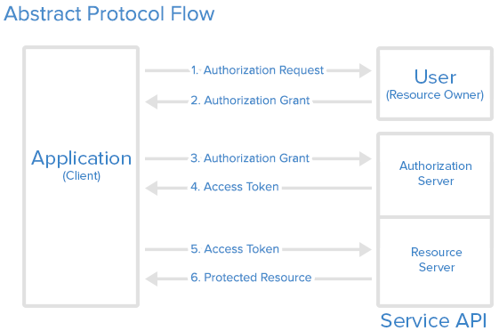
End-to-end data flow
Application requests authorization to access the users resource
If approved, the application receives an authorization grant
Application requests access token from API
Authorization grant and authentication of the applications identity are presented
API issues an access token to the application if the following conditions are met:
Application identity is authenticated
There is a valid authorization grant

Slide 9
End-to-end data flow, continued
Authorization is now complete
The application requests the resource from the resource server
Access token is presented for authentication
The resource is served to the application if the token is valid
**Data flow can change between the different grant types**
(Anicas, 2014)

Slide 10
Works Cited
Anicas, M. (2014, July 21). Abstract Protocal Flow [End-to-End data flow of OAuth]. Retrieved from https://www.digitalocean.com/community/tutorial s/an- introduction-to-oauth-2
Biehl, M. (2018, August 13). Why is OAuth so popular? Retrieved from https://www.quora.com/Why-is-OAuth-so-popular
Grimes, R. A. (2017, August 16). What is OAuth? How the open authorization framework works. Retrieved from https://www.csoonline.com/article/3216404/what- is- oauth-how-the-open-authorization-framework- works.html
OAuth. (n.d.). Differences Between OAuth 1 and 2. Retrieved from https://www.oauth.com/oauth2-servers/differences- between-oauth-1-2/

